Slide 1
Heterogeneous Parellel Programming
Background and OpenCL Overview
Greg Stitt
Professor
Department of Electrical and Computer Engineering
University of Florida

Slide 2
Heterogeneous Parallel Programming
Multiple languages/frameworks
  Complicated APIs, platform models, memory hierarchies
  Overwhelming to learn initially
Important to understand basic idea first
  Then, map that idea on to specific constructs and models of a given framework
Basic Idea:
  Given a data structure and algorithm to compute
  Identify parallelization strategy for computation
  Define kernels (i.e., functions) that correspond to the parallel operations
    A kernel will usually access a small portion of the data and produce a small portion of the output
  Create threads (i.e., kernel instances) to execute kernels according to parallelization strategy
Heterogeneous parallel programming usually uses numerous threads that collectively produce all outputs with as much parallelism as possible
  By contrast, traditional software uses a single thread to produce all outputs
2

Slide 3
Heterogeneous Parallel Programming
Multiple languages/frameworks
  Complicated APIs, platform models, memory hierarchies
  Overwhelming to learn initially
Important to understand basic idea first
  Then, map that idea on to specific constructs and models of a given framework
Basic Idea:
  Given a data structure and algorithm to compute
  Identify parallelization strategy for computation
  Define kernels (i.e., functions) that correspond to the parallel operations
    A kernel will usually access a small portion of the data and produce a small portion of the output
  Create threads (i.e., kernel instances) to execute kernels according to parallelization strategy
Heterogeneous parallel programming usually uses numerous threads that collectively produce all outputs with as much parallelism as possible
  By contrast, traditional software uses a single thread to produce all outputs
3

Slide 4
Heterogeneous Parallel Programming
Programming goal: divide computation on data structure across parallel threads
Original Code
1) Determine Parallelization Strategy:
2) Define kernel
for (int i=0; i < N; i++) {
c[i] = a[i] + b[i];
}
a[0]
b[0]
a[1]
b[1]
a[2]
b[2]
a[N-1]
b[N-1]
kernel(int i) {
c[i] = a[i] + b[i];
}
+
+
+
. . . . . . . .
+
c[0]
c[1]
c[2]
c[N-1]
3) Create threads
Thread 0
Thread 1
Thread 2
Thread N-1
4) Framework schedules threads onto processing elements
PE 0
PE 1
PE 2
. . . . . . . .
PE N-1
4

Slide 5
Heterogeneous Parallel Programming
What if parallelization strategy creates more threads than processing elements?
  e.g., vector add of 1 million element array has potentially 1 million threads
  No architecture has millions of processing elements
Solution: time multiplex threads across shared processing elements
  Threads usually switch when one thread is waiting for memory, helps hide long memory latencies
When thread counts reaches architecture maximum, each thread generates multiple outputs
  Note: fewer threads can provide more performance if scheduling overhead is significant
Thread 8
Thread 9
Thread 10
Thread 11
Time
Thread 4
Thread 5
Thread 6
Thread 7
Thread 0
Thread 1
Thread 2
Thread 3
PE 0
PE 1
PE 2
PE 3
5

Slide 6
Heterogeneous Parallel Programming
Why is this hard?
Creating a functional implementation is often straightforward
Creating an optimized implementation is often very difficult
  Code might theoretically achieve portability across platforms
  However, code is rarely performance-portable
Code must be optimized different for different architectures
  Different architectures have different number and type of resources
  Threads must often be grouped strategically
  Memory transfer is often programmer’s responsibility, hierarchy can be complex
  Thread synchronization between requires fundamental understanding of parallel-programming challenges
Ultimately, developer might require knowledge of each architecture
6

Slide 7
OpenCL
Problem: different vendors required different programming solutions
  Nvidia used CUDA
  Intel used OpenMP, MPI, Pthreads, many others
  FPGAs use VHDL and Verilog
Khronos group formed to come up with standard
  Goal: unify programming for heterogeneous and/or multi-core architectures
  Includes many industrial members to cover all needs
OpenCL was the resulting language/framework
  Supported by wide range of device types and vendors
  Widely “battle tested” on real-life applications
7

Slide 8
OpenCL
Basic Idea:
  Define kernels in separate language from “host” code
  Provide API to create threads, communicate with kernels, synchronize
Parallelization strategy: perform all adds in parallel
  If not sufficient processing elements, framework will automatically schedule multiple work-items onto same processing elements
Sequential Code
Corresponding Kernel
for (int i=0; i < N; i++) {
c[i] = a[i] + b[i];
}
__kernel void mul(__global const float *a,
__global const float *b,
__global float *c) {
int i = get_global_id(0);
c[i] = a[i] + b[i];
}
Execute entire loop by
creating N threads
(i.e. work-items)
8

Slide 9
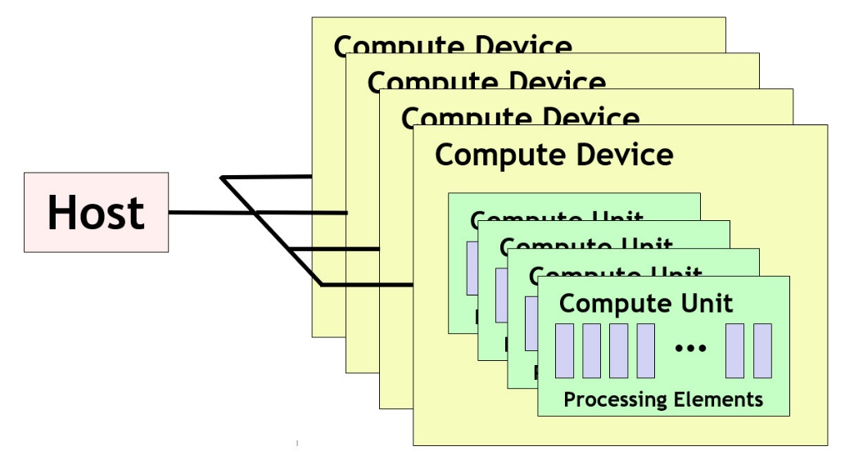
OpenCL Platform Model
Platform model defines the topology of compute resources
A single host which controls multiple compute devices
  e.g., CPUs, GPUs, FPGAs, etc.
Each compute device consists of one or more compute units
  e.g., cores in CPUs, streamlining multiprocessors (SMs) in GPUs
Each compute unit consists of multiple processing elements
  Fundamental compute resources that execute work items (i.e., threads)
  e.g., cores or streaming processors in a GPU
Note that this platform model does not usually have an obvious mapping onto FPGA accelerators
  We will see how FPGAs work later
9

Slide 10
OpenCL Execution Model
Host uses OpenCL API to manage and interface with compute devices
  CPUs, GPUs, FPGAs
API for host code has bindings for multiple languages (C, C++, Python)
Work submitted to processing elements in the form of kernels
  Written in an extension of C99, called OpenCL C
  C++ for OpenCL, a C++17-based language, can also be used
After submission, kernels execute in parallel with host
Execution organized across work-items
  Work-item: fundamental item of execution (CUDA threads)
    Conceptually similar to thread
    Each work-item represents an instance of a kernel
    Executed on a processing element
10

Slide 11
OpenCL Work-Items
Host program specifies the number of work-items for a kernel
  Generally equal to the number of parallel tasks/threads that can be executed in parallel
Number of work-times specified by “NDRange”
  N-dimensional data structure representing all threads
    N chosen by programmer based on characteristics of data
  Purpose: provides kernels with thread information to determine data to access
e.g., vector add would create work-item for each element of input array
  Corresponds to a 1D NDRange
    vector<float> a, b;
    ….
    NDRange range(a.size()); // creates 1D range with one work-item for each element of vector
11

Slide 12
OpenCL NDRange
What is the purpose of the NDRange?
A kernel instance (i.e., work-item) needs to know its index within the NDRange:
  Index determines inputs to read and outputs to write
  get_global_id(0) returns the kernel’s index (0 requests id within first dimension)
Sequential Code
for (int i=0; i < N; i++) {
c[i] = a[i] + b[i];
}
i = get_global_id(0)
// i == 2
c[2] = a[2] + b[2]
i = get_global_id(0)
// i == 0
c[0] = a[0] + b[0]
i = get_global_id(0)
// i == 1
c[1] = a[1] + b[1]
………
Corresponding Kernel
__kernel void mul(__global const float *a,
__global const float *b,
__global float *c) {
int i = get_global_id(0);
c[i] = a[i] + b[i];
}
Work-Item 0
Work-Item 1
Work-Item 2
12

Slide 13
OpenCL NDRange
NDRange can be N dimensional
  OpenCL implementations required to support 3 dimensions
  Multiple dimensions can be useful when data structure being processed has multiple dimensions
  e.g., assign a work-item to each pixel in an image
  Note: multiple-dimensional NDRange is for convenience
    N dimensions can always be handled with 1D range via appropriate indexing computations
    Host Code
    get_global_size(0) == 5
    Returns # work-items in the 0 (first) dimension
    NDRange range2D(5, 8);
    get_global_size(1) == 8
    Returns # work-items in the 1 (second) dimension
13

Slide 14
OpenCL 2D Range Example
Simple 2D example
  Take two inputs with same dimensions (assume to be grayscale)
  Average the values of each pixel across iamges, output new averaged image
  Parallelization strategy: create work-item for each pixel
Note: kernel inputs are not multi-dimensional (no pointers to pointers)
  Serialized when buffered for OpenCL device
  Must calculate index in 1D buffer
Kernel Code
Host Code
__kernel void img_avg(__global const float *in0,
__global const float *in1,
__global float *out) {
int x = get_global_id(0); // Specifies index in x dimension
int y = get_global_id(1); // Specifies index in y dimension
int index = y * get_global_size(0) + x;
c[index] = (a[index] + b[index]) / 2;
}
    NDRange range2D(rows, cols);
14

Slide 15
OpenCL Work Groups
Developer will often partition NDRange into “work-groups”
  Each work-group will execute on a single compute-unit (but single unit can execute multiple groups)
  Nvidia Streaming Multiprocessor (compute unit) has 64-128 CUDA cores (processing elements)
  Intel core (compute unit) has vector instructions with 8-12 slots (processing elements)
    Compute unit definition may vary across implementations
If developer doesn’t specify work-groups, runtime will choose them automatically
  NDRange global(10); // 10 total work-items
  NDRange local(2); // 2 work-items per work group (10/2 = 5 total work groups)
  queue.enqueueNDRangeKernel(kernel, NullRange, global, local); // Creates the NDRange with groups
Global Size = 10 (entire NDRange)
WG 0
WG 1
WG 2
WG 3
WG 4
Local Size = 2
15

Slide 16
OpenCL Work Groups
Why use work-groups?
  Work-items within a group can share local resources (if provided by architecture)
  Work-items within a group can be synchronized
  Might align with application behavior (e.g., window operations)
Significant optimization potential
  Choose appropriate work-group size based on processing elements in compute unit
    Unfortunately, # of processing elements not always known
  Leverage spatial locality when multiple work-items work on overlapping data
  Useful parameter for tuning code for particular architecture
Can be synchronized
Cannot be synchronized
WG 0
WG 1
WG 2
WG 3
WG 4
16

Slide 17
OpenCL Work Groups
Global IDs:
0
1
2
3
4
5
6
7
8
9
Local IDs:
0
1
0
1
0
1
0
1
0
1
get_global_size(0) == 10
get_local_size(0) == 2
Total number of work groups = get_global_size(0) / get_local_size(0) = 5
  Assumes global size is multiple of local size (required by some OpenCL versions)
get_global_id(0) returns value between 0 and 9 (every work-item has unique global ID)
get_local_id(0) returns value between 0 and 1
  Multiple work-items have same local id
Note that work-groups must have same # of dimensions as global NDRange
  1D Range requires 1D work groups, 2D Range requires 2D work groups, etc.
17

Slide 18
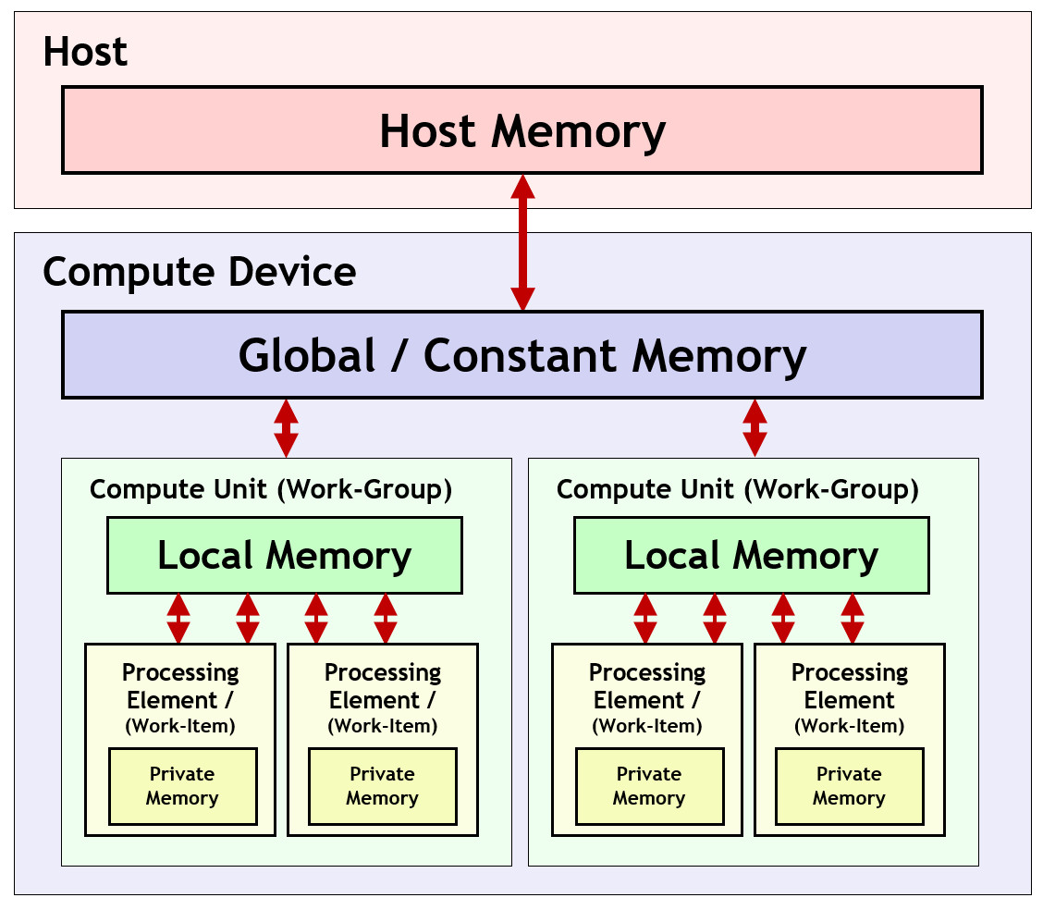
OpenCL Memory Model
Memory model defines memory hierarchy used by kernels
  Supporting hardware assumed to implement this hierarchy
Host memory
  Available only to the host CPU
  e.g., CPU RAM
Global/Constant memory
  Available to all compute units in a compute device
  e.g., GPU external RAM
Local memory
  Available to all processing elements in a compute unit
  e.g., small memory shared between cores
Private memory
  Available to a single processing element
  e.g., registers for a single core
All memory transfers must be explicit!
18

Slide 19
OpenCL Execution Sequence
  Complete sequence for executing an OpenCL program:
                Query for available OpenCL platforms and devices
                Create a context for one or more OpenCL devices in a platform
                Create and build programs for OpenCL devices in the context
                Select kernels to execute from the programs
                Create memory objects for kernels to operate on
                Create command queues to execute commands on an OpenCL device
                Enqueue data transfer commands into the memory objects, if needed
                Enqueue kernels into the command queue for execution
                Enqueue commands to transfer data back to the host, if needed
19

Slide 20
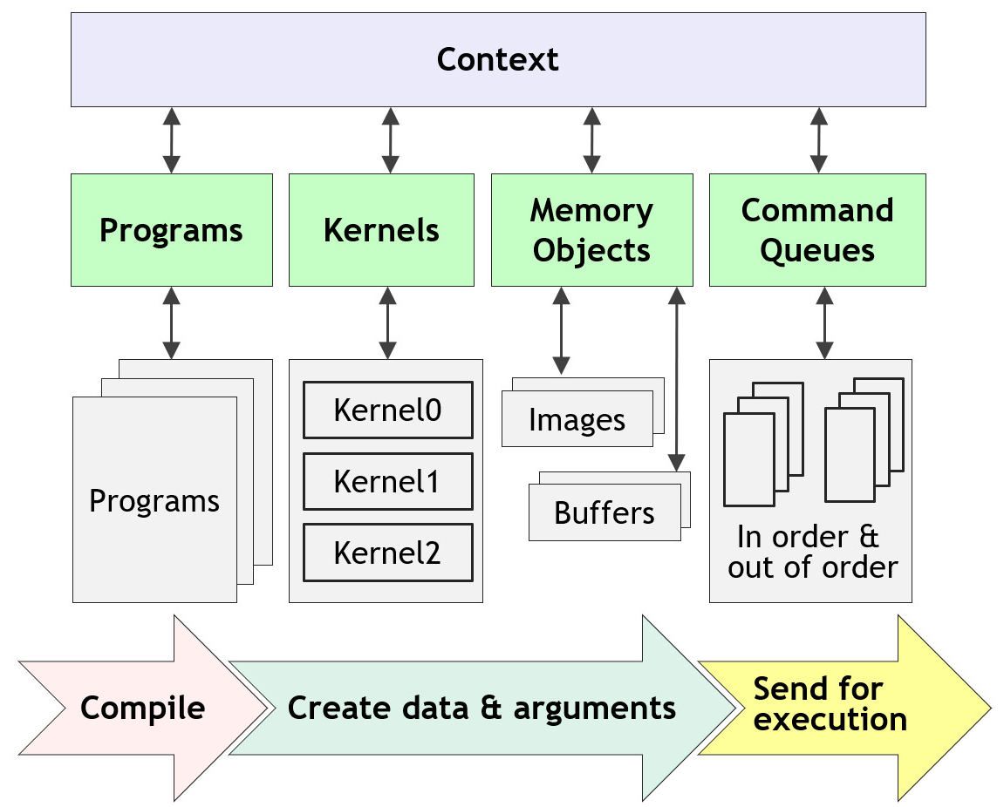
OpenCL Context
A “context” ties together the programs, kernels, memory objects, and command queues
20

Slide 21
OpenCL Host Code
Query for available platform and device (using C++ bindings):
// Get the default platform
cl::Platform default_platform = all_platforms[0];
std::cout << "Using platform: " <<default_platform.getInfo<CL_PLATFORM_NAME>() << "\n";
// Print out available devices on that platform
std::vector<cl::Device> all_devices;
default_platform.getDevices(CL_DEVICE_TYPE_ALL, &all_devices);
if (all_devices.size() == 0) {
std::cout << " No devices found.\n"; exit(1);
}
cl::Device default_device = all_devices[0];
std::cout << "Using device: " << default_device.getInfo<CL_DEVICE_NAME>() << "\n";
21
Example from https://ulhpc-tutorials.readthedocs.io/en/latest/gpu/opencl/

Slide 22
OpenCL Host Code
Create an OpenCL “context”:
  Encapsulates command queues, memory, kernels, etc. (basically combines everything)
cl::Context context({default_device});
Define code objects (sources for kernels):
cl::Program::Sources sources;
22
Example from https://ulhpc-tutorials.readthedocs.io/en/latest/gpu/opencl/

Slide 23
OpenCL Host Code
Allocate memory on device:
// Create normal C/C++ arrays (_h suffix specifies this is host memory)
const int SIZE = 10;
int A_h[] = { 0, 1, 2, 3, 4, 5, 6, 7, 8, 9 };
int B_h[] = { 10, 9, 8, 7, 6, 5, 4, 3, 2, 1 };
int C_h[] = { 0, 0, 0, 0, 0, 0, 0, 0, 0, 0 };
// Create buffers on the device for each array
cl::Buffer A_d(context, CL_MEM_READ_ONLY, sizeof(int) * SIZE);
cl::Buffer B_d(context, CL_MEM_READ_ONLY, sizeof(int) * SIZE);
cl::Buffer C_d(context, CL_MEM_WRITE_ONLY, sizeof(int) * SIZE);
Create “Queue”
  Object for issuing commands to devices from host
cl::CommandQueue queue(context, default_device);
23
Example from https://ulhpc-tutorials.readthedocs.io/en/latest/gpu/opencl/

Slide 24
OpenCL Host Code
Transfer input arrays to device buffers:
// Create normal C/C++ arrays (_h suffix specifies this is host memory)
queue.enqueueWriteBuffer(A_d, CL_TRUE, 0, sizeof(int) * SIZE, A_h);
queue.enqueueWriteBuffer(B_d, CL_TRUE, 0, sizeof(int) * SIZE, B_h);
Build the OpenCL kernel
  Uses run-time compilation (other methods exist)
// String representing kernel code (can also be specified in different file)
std::string kernel_code =
" void kernel simple_add(global const int* A, global const int* B, global int* C) { "
" C[get_global_id(0)] = A[get_global_id(0)] + B[get_global_id(0)]; "
" }
cl::Program::Sources sources;
sources.push_back({ kernel_code.c_str(), kernel_code.length() }); // Add kernel code to list of sources
cl::Program program(context, sources); // Create the OpenCL program
// Compile the program
if (program.build({ default_device }) != CL_SUCCESS) {
std::cout << " Error building: " << program.getBuildInfo<CL_PROGRAM_BUILD_LOG>(default_device) << "\n"; exit(1);
}
24
Example from https://ulhpc-tutorials.readthedocs.io/en/latest/gpu/opencl/

Slide 25
OpenCL Host Code
Start execution of the kernel
cl::make_kernel<cl::Buffer, cl::Buffer, cl::Buffer> simple_add(cl::Kernel(program, "simple_add"));
// Create the ND Range (1D in this case) using SIZE total work-items
cl::NDRange global(SIZE);
// Start the kernel by specifying the queue to use, the NDRange (global), and the buffers for the parameters
// Then, wait for completion
simple_add(cl::EnqueueArgs(queue, global), A_d, B_d, C_d).wait();
Read the results back from the device
// Reads the device buffer (C_d) into host array (C_h)
queue.enqueueReadBuffer(C_d, CL_TRUE, 0, sizeof(int) * SIZE, C_h);
Done!
  See https://github.com/ULHPC/tutorials/blob/devel/gpu/opencl/code/exercise1.cpp for complete code
25
Example from https://ulhpc-tutorials.readthedocs.io/en/latest/gpu/opencl/

Slide 26
OpenCL Additional Topics
Use of local and private memory
  Requires explicit transfers in kernel code
Synchronization of work-items in a work-group
  As kernel code gets more complex, some work-items need to wait until other work-items complete
    Example:
      16 work items do a vector-multiply and store the result in local memory
      1 of those work items accumulates the products (after all 16 finish the multiply)
Pipes
  Enabling “deep” parallelism across kernels
  Very important for FPGAs
Numerous optimization strategies
26
Example from https://ulhpc-tutorials.readthedocs.io/en/latest/gpu/opencl/

