Slide 1
C++ Crash Course for SYCL
Greg Stitt
Professor
Department of Electrical and Computer Engineering
University of Florida

Slide 2
C++ Namespaces
Motivation: different code likely to use same names for common operations
  e.g., get_next(), min(), sort(), etc.
  Compiler reports error:
    “error: redefinition of ‘int f(int)’”
#include <some_library> // defines int f(int)
// Naming “Collision”:
// Two definitions of f()
int f(int a) {
return a + 1;
}
int main() {
f(5); // Which function should be called???
}
2

Slide 3
C++ Namespaces
Horrible solution: rename all conflicting code
  Infeasible in general, could be conflicts between multiple 3rd-party code sources
Huge problem in RTL languages
  If you integrate two code bases there are likely already modules called register, mux, alu, memory, etc.
  Leads to verbose names like register_w_en_and_async_reset, register_stitt, register_intel
#include <some_library> // defines int f(int)
int f_local(int a) {
return a + 1;
}
int main() {
f_local(5);
f(10);
}
3

Slide 4
C++ Namespaces
Ideal solution: allow different pieces of code to have their own “namespace”
  Names can be reused in different namespaces
  To specify a namespace, use the namespace resolution operator (::)
Main Code
some_library Code
namespace some_library {
int f(int a) {
  return a * 10;
  }
}
#include <some_library>
int f(int a) {
return a + 1;
}
int main() {
some_library::f(5); // Namespace resolution
f(10); // calls local f()
}
4

Slide 5
C++ Namespaces
Standard C++ library provided in “std” namespace
#include <iostream>
#include <some_library>
int f(int a) {
return a + 1;
}
int main() {
std::cout << some_library::f(5) << std::endl;
std::cout << f(10) << std::endl;
}
5

Slide 6
C++ Namespaces
Explicitly stating the namespace for every function can be good
  But, can also be incredibly annoying
  If a file mostly uses one namespace, you can assign a default namespace
#include <iostream>
#include <some_library>
using namespace std; // Specify a default namespace
int f(int a) {
return a + 1;
}
int main() {
// std:: no longer needed here
cout << some_library::f(5) << endl;
cout << f(10) << endl;
}
6

Slide 7
C++ Const References
C++ by default passes parameters by value
  Creates a copy of the data being passed to a function
What if parameter is a huge object?
  We probably don’t want to copy the entire object
void f(int a) {
a = 10;
}
int main() {
int x = 5;
f(x); // x is copied into a parameter
cout << x << endl; // Prints 5
}
7

Slide 8
C++ Const References
Example of huge object getting copied:
In this example, the entire 10-element vector is copied
  Imagine if x has 1 million elements
using namespace std;
void f(vector<int> a) {
...
}
int main() {
vector<int> x {0, 1, 2, 3, 4, 5, 6, 7, 8, 9};
f(x); // VERY SLOW: copies entire vector
}
8

Slide 9
C++ Const References
References can be used to avoid copying data
  A reference is basically an alias to the assigned variable
void f(int &a) { // a is now a reference to the passed variable
a = 10; // reference assignments change original variable
}
int main() {
int x = 5;
f(x); // x is passed by reference to a
cout << x << endl; // Prints 10 (instead of 5)
}
9

Slide 10
C++ Const References
When using large parameter types, pass by reference
  Parameter passing time is identical for all objects (and is constant)
using namespace std;
void f(vector<int> &a) {
...
}
int main() {
// Initialize a vector with 10 elements.
vector<int> x {0, 1, 2, 3, 4, 5, 6, 7, 8, 9};
f(x); // FAST: only passes reference
}
10

Slide 11
C++ Const References
References have risk of side effects
  Function f() might accidentally change vector
  Ideally, the compiler could report an error when this happens
For read-only objects, use const references
using namespace std;
void f(const vector<int> &a) {
...
a[5] = 10; // Compiler reports an error
...
}
int main() {
vector<int> x {0, 1, 2, 3, 4, 5, 6, 7, 8, 9};
f(x); // Compiler guarantees x doesn’t change inside f()
}
11

Slide 12
C++ Templates
Motivation: annoying to create functions/classes for different types
  e.g.
#include <iostream>
using namespace std;
long my_min(long a, long b) {
return (a < b) ? a : b;
}
int main() {
long a = 5, b = 10;
float c = 5.4, d = 5.6;
cout << my_min(a,b) << endl;
cout << my_min(c,d) << endl;
}
Output:
5
5 (wrong)
12

Slide 13
C++ Templates
Could be fixed with function overloading:
  Multiple function definitions with different “signature”
#include <iostream>
using namespace std;
long my_min(long a, long b) {
return (a < b) ? a : b;
}
float my_min(float a, float b) {
return (a < b) ? a : b;
}
int main() {
long a = 5, b = 10;
float c = 5.4, d = 5.6;
cout << my_min(a,b) << endl;
cout << my_min(c,d) << endl;
}
This duplication gets tedious
Output:
5
5.4
13

Slide 14
C++ Templates
Solution: use a function “template”
#include <iostream>
using namespace std;
// Specifies template, from which compiler will generate
// version for any specified type
template <typename T>
T my_min(T a, T b) {
return (a < b) ? a : b;
}
int main() {
long a = 5, b = 10;
float c = 5.4, d = 5.6;
cout << my_min(a,b) << endl;
cout << my_min(c,d) << endl;
}
Compiler automatically creates
a long and float version of my_min()
14

Slide 15
C++ Templates
Solution: use a function template (alternative)
#include <iostream>
using namespace std;
template <typename T>
T my_min(T a, T b) {
return (a < b) ? a : b;
}
int main() {
long a = 5, b = 10;
float c = 5.4, d = 5.6;
cout << my_min<long>(a,b) << endl;
cout << my_min<float>(c,d) << endl;
}
Code explicitly tells compiler what type to use
15

Slide 16
C++ Templates
Templates can also be used with classes
template <typename T>
class Buffer {
private:
T* data;
public:
Buffer() {…}
void push(const T&) {…}
T* pop() {…return data;}
};
int main() {
Buffer<int> a;
Buffer<float> b;
Buffer<vector<int> > c;
}
16

Slide 17
C++ Standard Template Library
C++ provides the Standard Template Library (STL)
  Common set of data structures templates, in addition to common algorithms
Example classes:
  array: a wrapper around C-style arrays that enables use of other STL functions
  vector: can be indexed like an array, storage is contiguous, can change size dynamically
  list: doubly linked list, more efficient insertion/deletion than vector/array, can’t access with index
  map: stores key:value pairs, similar to dictionary in Python
  set: container that stores unique elements
Example functions:
  sort, partial_sort, is_sorted
  find, find_if
  copy, copy_if
  replace, replace_if
  swap, merge
17

Slide 18
C++ Lambdas
In traditional C/C++, functions are explicitly defined before being used:
  Referred to as “named” functions
#include <iostream>
using namespace std;
// Explicitly defined “named” function
bool is_tall(const Person &p) {
return p.height >= 6;
}
int find_first_tall_person(const vector<Person> &people) {
for (int i=0; i < people.size(); i++) {
if (is_tall(people[i])) break;
}
...
}
18

Slide 19
C++ Lambdas
Using STL find_if, previous code can be simplified a little:
#include <iostream>
#include <vector>
using namespace std;
bool is_tall(const Person &p) {
return p.height >= 6;
}
int find_first_tall_person(const vector<Person> &people) {
// Can replace previous loop with find_if
vector<Person>::const_iterator it = find_if(people.begin(), people.end(),
is_tall);
...
}
19

Slide 20
C++ Lambdas
What if code uses many small functions only in one place?
  Explicitly defining “named” functions can be inconvenient
Solution: lambdas are unnamed functions that can be defined anywhere
#include <iostream>
#include <vector>
using namespace std;
int find_first_tall_person(const vector<Person> &people) {
// Lambdas allow functions to be defined where they are needed
vector<Person>::const_iterator it = find_if(
people.begin(),
people.end(),
[](const Person& p) {return p.height >= 6;});
...
}
20

Slide 21
C++ Lambdas
Lambdas aren’t necessary, but can be very convenient
Often reserved for specialized, one-time use functions
  e.g., writing small function in a large program
  Readability can improve if used appropriately
// Find short person
vector<Person>::const_iterator it = find_if(
people.begin(),people.end(),
[](const Person& p) {return p.height < 5;});
// Find medium person
vector<Person>::const_iterator it = find_if(
people.begin(),people.end(),
[=](const Person& p) {return p.height >= 5 &&
p.height < 6;});
21

Slide 22
C++ Lambdas
Lambda syntax
  [capture clause] (parameters) -> return-type {body}
Capture clause/list
  Defines how to “capture” variables outside of lambda scope
Parameters
  Identical to parameter list in traditional named functions
-> return-type
  Specifies explicit return type
  Optional if nothing returned, or if you want compiler to infer type
Body
  Normal function body
22

Slide 23
C++ Lambda Capture Lists
Capture clause/list specifies two things:
  Capture type
    By copy
      Captured variables are copied (similar to pass by value)
    By reference
      Captured variables are assigned references that are used in lambda body
  Which external variables to capture
    Default capture
      [] Capture no external variables
      [=] Captures all external variables by value
      [&] Captures all external variables by reference
    Explicit capture
      [var1, &var2] captures only var1 (by value) and var2 (by reference)
23

Slide 24
C++ Functors
Function objects (i.e., functors)
  Definition: any type that overloads () operator
  Alternatively, class that be made to act as function
Simple example:
class Add {
public:
int operator() (int x, int y) {
return x + y;
}
};
int main() {
Add a;
int x = a(5, 10);
cout << x << endl;
}
24

Slide 25
C++ Functors
Why would you ever do this? (never needed, but can be convenient)
Advantages:
  Classes preserve state that can be used in function call
  Can be used as template parameters (because they are a type)
  Can enable arbitrary number of parameters for code expecting unary function parameter
    https://www.geeksforgeeks.org/functors-in-cpp/
class Add : public Functor {
public:
int operator() (int x, int y) {
return x + y;
}
};
int main() {
// Can now create data structures of functions
vector<Functor*> functions;
}
class Mult: public Functor {
public:
int operator() (int x, int y) {
return x * y;
}
};
25

Slide 26
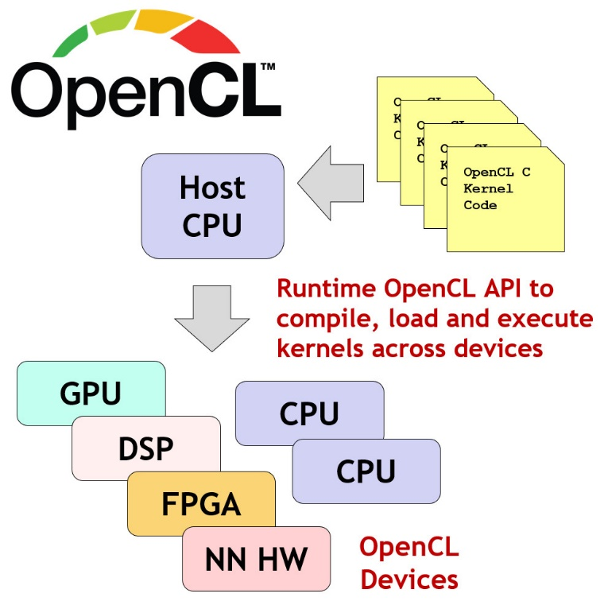
OpenCL
A cross-platform programming framework for heterogeneous parallel computing
Abstracts lower-level hardware functions
  Allows the same code to be used across different devices and vendors
  Gives the ability to utilize different accelerators without use of vendor-specific languages
Provides models for memory and execution
  Abstracts memory operations and code execution
26

Slide 27
C++ Standard Template Library
What are “templates”?
Abstracts lower-level hardware functions
  Allows the same code to be used across different devices and vendors
  Gives the ability to utilize different accelerators without use of vendor-specific languages
Provides models for memory and execution
  Abstracts memory operations and code execution
27

Slide 28
Heterogeneous Parallel Programming
Multiple languages/frameworks
  Complicated APIs, platform models, memory hierarchies
  Overwhelming to learn initially
Important to understand basic idea first
  Then, map that idea on to specific constructs and models of a given framework
Basic Idea:
  Given a data structure and algorithm to compute
  Identify parallelization strategy for computation
  Define kernels (i.e., functions) that correspond to the parallel operations
    A kernel will usually access a small portion of the data and produce a small portion of the output
  Create threads (i.e., kernel instances) to execute kernels according to parallelization strategy
Heterogeneous parallel programming usually uses numerous threads that collectively produce all outputs with as much parallelism as possible
  By contrast, traditional software uses a single thread to produce all outputs
28

Slide 29
https://www.reddit.com/r/OpenCL/comments/6avflu/opencl_cl_device_max_compute_units/
https://www.nersc.gov/assets/pubs_presos/MattsonTutorialSC14.pdf
https://stackoverflow.com/questions/25237145/opencl-clenqueuendrangekernel-how-to-set-work-group-size-correctly#:~:text=Viewed%208k%20times%202%20In%20OpenCL%2C%20if%20I,where%20localSize%20is%20the%20local%20work%20group%20size.
https://stackoverflow.com/questions/18217512/do-global-work-size-and-local-work-size-have-any-effect-on-application-logic
https://github.com/KhronosGroup/OpenCL-Guide/blob/main/chapters/opencl_programming_model.md
http://thebeardsage.com/opencl-kernel-space/#:~:text=The%20index%20space%20supported%20by,are%20conceptually%20similar%20to%20threads.

Slide 30
Heterogeneous Parallel Programming
Multiple languages/frameworks
  Complicated APIs, platform models, memory hierarchies
  Overwhelming to learn initially
Important to understand basic idea first
  Then, map that idea on to specific constructs and models of a given framework
Basic Idea:
  Given a data structure and algorithm to compute
  Identify parallelization strategy for computation
  Define kernels (i.e., functions) that correspond to the parallel operations
    A kernel will usually access a small portion of the data and produce a small portion of the output
  Create threads (i.e., kernel instances) to execute kernels according to parallelization strategy
Heterogeneous parallel programming usually uses numerous threads that collectively produce all outputs with as much parallelism as possible
  By contrast, traditional software uses a single thread to produce all outputs
30

Slide 31
Heterogeneous Parallel Programming
Programming goal: divide computation on data structure across parallel threads
Original Code
1) Determine Parallelization Strategy:
2) Define kernel
for (int i=0; i < N; i++) {
c[i] = a[i] + b[i];
}
a[0]
b[0]
a[1]
b[1]
a[2]
b[2]
a[N-1]
b[N-1]
kernel(int i) {
c[i] = a[i] + b[i];
}
+
+
+
. . . . . . . .
+
c[0]
c[1]
c[2]
c[N-1]
3) Create threads
Thread 0
Thread 1
Thread 2
Thread N-1
4) Framework schedules threads onto processing elements
PE 0
PE 1
PE 2
. . . . . . . .
PE N-1
31

Slide 32
Heterogeneous Parallel Programming
What if parallelization strategy creates more threads than processing elements?
  e.g., vector add of 1 million element array has potentially 1 million threads
  No architecture has millions of processing elements
Solution: time multiplex threads across shared processing elements
  Threads usually switch when one thread is waiting for memory, helps hide long memory latencies
When thread counts reaches architecture maximum, each thread generates multiple outputs
  Note: fewer threads can provide more performance if scheduling overhead is significant
Thread 8
Thread 9
Thread 10
Thread 11
Time
Thread 4
Thread 5
Thread 6
Thread 7
Thread 0
Thread 1
Thread 2
Thread 3
PE 0
PE 1
PE 2
PE 3
32

Slide 33
Heterogeneous Parallel Programming
Why is this hard?
Creating a functional implementation is often straightforward
Creating an optimized implementation is often very difficult
  Code might theoretically achieve portability across platforms
  However, code is rarely performance-portable
Code must be optimized different for different architectures
  Different architectures have different number and type of resources
  Threads must often be grouped strategically
  Memory transfer is often programmer’s responsibility, hierarchy can be complex
  Thread synchronization between requires fundamental understanding of parallel-programming challenges
Ultimately, developer might require knowledge of each architecture
33

Slide 34
OpenCL
Problem: different vendors required different programming solutions
  Nvidia used CUDA
  Intel used OpenMP, MPI, Pthreads, many others
  FPGAs use VHDL and Verilog
Khronos group formed to come up with standard
  Goal: unify programming for heterogeneous and/or multi-core architectures
  Includes many industrial members to cover all needs
OpenCL was the resulting language/framework
  Supported by wide range of device types and vendors
  Widely “battle tested” on real-life applications
34

Slide 35
OpenCL
Basic Idea:
  Define kernels in separate language from “host” code
  Provide API to create threads, communicate with kernels, synchronize
Parallelization strategy: perform all adds in parallel
  If not sufficient processing elements, framework will automatically schedule multiple work-items onto same processing elements
Sequential Code
Corresponding Kernel
for (int i=0; i < N; i++) {
c[i] = a[i] + b[i];
}
__kernel void mul(__global const float *a,
__global const float *b,
__global float *c) {
int i = get_global_id(0);
c[i] = a[i] + b[i];
}
Execute entire loop by
creating N threads
(i.e. work-items)
35

Slide 36
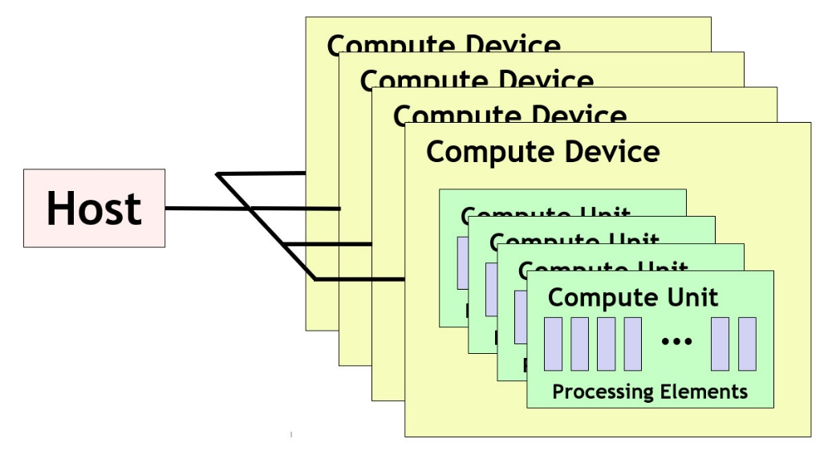
OpenCL Platform Model
Platform model defines the topology of compute resources
A single host which controls multiple compute devices
  e.g., CPUs, GPUs, FPGAs, etc.
Each compute device consists of one or more compute units
  e.g., cores in CPUs, streamlining multiprocessors (SMs) in GPUs
Each compute unit consists of multiple processing elements
  Fundamental compute resources that execute work items (i.e., threads)
  e.g., cores or streaming processors in a GPU
Note that this platform model does not usually have an obvious mapping onto FPGA accelerators
  We will see how FPGAs work later
36

Slide 37
OpenCL Execution Model
Host uses OpenCL API to manage and interface with compute devices
  CPUs, GPUs, FPGAs
API for host code has bindings for multiple languages (C, C++, Python)
Work submitted to processing elements in the form of kernels
  Written in an extension of C99, called OpenCL C
  C++ for OpenCL, a C++17-based language, can also be used
After submission, kernels execute in parallel with host
Execution organized across work-items
  Work-item: fundamental item of execution (CUDA threads)
    Conceptually similar to thread
    Each work-item represents an instance of a kernel
    Executed on a processing element
37

Slide 38
OpenCL Work-Items
Host program specifies the number of work-items for a kernel
  Generally equal to the number of parallel tasks/threads that can be executed in parallel
Number of work-times specified by “NDRange”
  N-dimensional data structure representing all threads
    N chosen by programmer based on characteristics of data
  Purpose: provides kernels with thread information to determine data to access
e.g., vector add would create work-item for each element of input array
  Corresponds to a 1D NDRange
    vector<float> a, b;
    ….
    NDRange range(a.size()); // creates 1D range with one work-item for each element of vector
38

Slide 39
OpenCL NDRange
What is the purpose of the NDRange?
A kernel instance (i.e., work-item) needs to know its index within the NDRange:
  Index determines inputs to read and outputs to write
  get_global_id(0) returns the kernel’s index (0 requests id within first dimension)
Sequential Code
for (int i=0; i < N; i++) {
c[i] = a[i] + b[i];
}
i = get_global_id(0)
// i == 2
c[2] = a[2] + b[2]
i = get_global_id(0)
// i == 0
c[0] = a[0] + b[0]
i = get_global_id(0)
// i == 1
c[1] = a[1] + b[1]
………
Corresponding Kernel
__kernel void mul(__global const float *a,
__global const float *b,
__global float *c) {
int i = get_global_id(0);
c[i] = a[i] + b[i];
}
Work-Item 0
Work-Item 1
Work-Item 2
39

Slide 40
OpenCL NDRange
NDRange can be N dimensional
  OpenCL implementations required to support 3 dimensions
  Multiple dimensions can be useful when data structure being processed has multiple dimensions
  e.g., assign a work-item to each pixel in an image
  Note: multiple-dimensional NDRange is for convenience
    N dimensions can always be handled with 1D range via appropriate indexing computations
    Host Code
    get_global_size(0) == 5
    Returns # work-items in the 0 (first) dimension
    NDRange range2D(5, 8);
    get_global_size(1) == 8
    Returns # work-items in the 1 (second) dimension
40

Slide 41
OpenCL 2D Range Example
Simple 2D example
  Take two inputs with same dimensions (assume to be grayscale)
  Average the values of each pixel across iamges, output new averaged image
  Parallelization strategy: create work-item for each pixel
Note: kernel inputs are not multi-dimensional (no pointers to pointers)
  Serialized when buffered for OpenCL device
  Must calculate index in 1D buffer
Kernel Code
Host Code
__kernel void img_avg(__global const float *in0,
__global const float *in1,
__global float *out) {
int x = get_global_id(0); // Specifies index in x dimension
int y = get_global_id(1); // Specifies index in y dimension
int index = y * get_global_size(0) + x;
c[index] = (a[index] + b[index]) / 2;
}
    NDRange range2D(rows, cols);
41

Slide 42
OpenCL Work Groups
Developer will often partition NDRange into “work-groups”
  Each work-group will execute on a single compute-unit (but single unit can execute multiple groups)
  Nvidia Streaming Multiprocessor (compute unit) has 64-128 CUDA cores (processing elements)
  Intel core (compute unit) has vector instructions with 8-12 slots (processing elements)
    Compute unit definition may vary across implementations
If developer doesn’t specify work-groups, runtime will choose them automatically
  NDRange global(10); // 10 total work-items
  NDRange local(2); // 2 work-items per work group (10/2 = 5 total work groups)
  queue.enqueueNDRangeKernel(kernel, NullRange, global, local); // Creates the NDRange with groups
Global Size = 10 (entire NDRange)
WG 0
WG 1
WG 2
WG 3
WG 4
Local Size = 2
42

Slide 43
OpenCL Work Groups
Why use work-groups?
  Work-items within a group can share local resources (if provided by architecture)
  Work-items within a group can be synchronized
  Might align with application behavior (e.g., window operations)
Significant optimization potential
  Choose appropriate work-group size based on processing elements in compute unit
    Unfortunately, # of processing elements not always known
  Leverage spatial locality when multiple work-items work on overlapping data
  Useful parameter for tuning code for particular architecture
Can be synchronized
Cannot be synchronized
WG 0
WG 1
WG 2
WG 3
WG 4
43

Slide 44
OpenCL Work Groups
Global IDs:
0
1
2
3
4
5
6
7
8
9
Local IDs:
0
1
0
1
0
1
0
1
0
1
get_global_size(0) == 10
get_local_size(0) == 2
Total number of work groups = get_global_size(0) / get_local_size(0) = 5
  Assumes global size is multiple of local size (required by some OpenCL versions)
get_global_id(0) returns value between 0 and 9 (every work-item has unique global ID)
get_local_id(0) returns value between 0 and 1
  Multiple work-items have same local id
Note that work-groups must have same # of dimensions as global NDRange
  1D Range requires 1D work groups, 2D Range requires 2D work groups, etc.
44

Slide 45
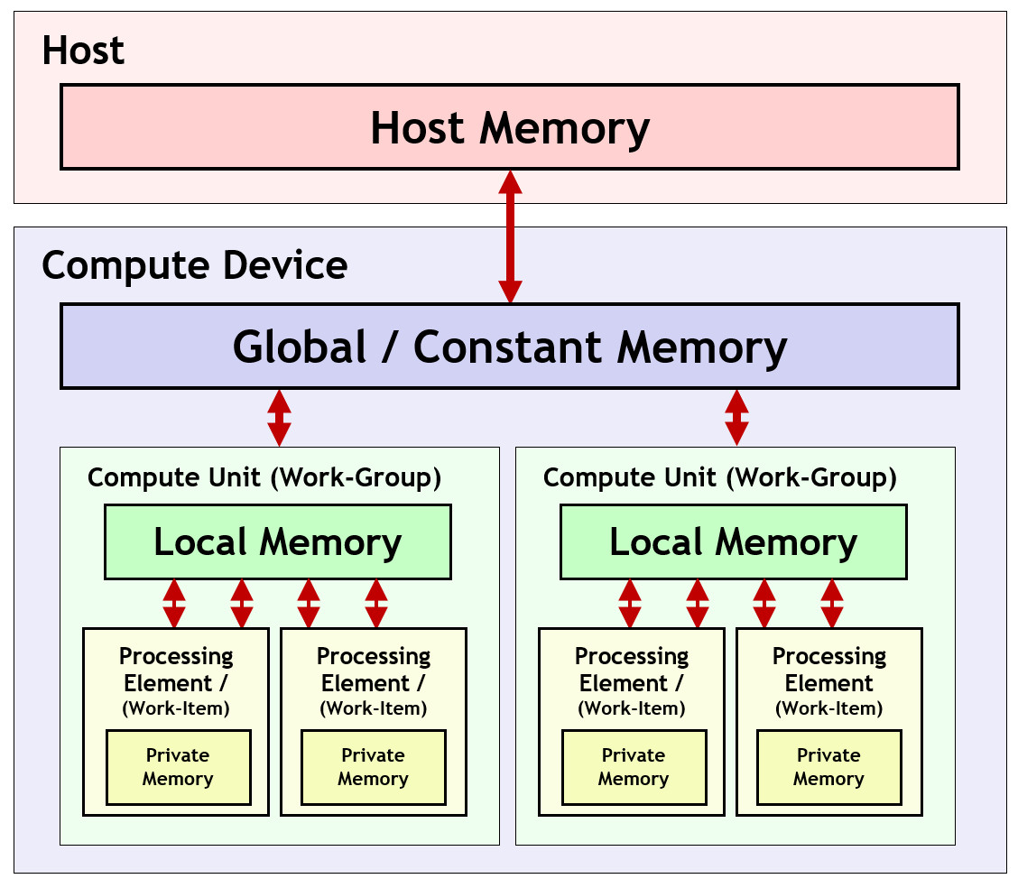
OpenCL Memory Model
Memory model defines memory hierarchy used by kernels
  Supporting hardware assumed to implement this hierarchy
Host memory
  Available only to the host CPU
  e.g., CPU RAM
Global/Constant memory
  Available to all compute units in a compute device
  e.g., GPU external RAM
Local memory
  Available to all processing elements in a compute unit
  e.g., small memory shared between cores
Private memory
  Available to a single processing element
  e.g., registers for a single core
All memory transfers must be explicit!
45

Slide 46
OpenCL Execution Sequence
  Complete sequence for executing an OpenCL program:
                Query for available OpenCL platforms and devices
                Create a context for one or more OpenCL devices in a platform
                Create and build programs for OpenCL devices in the context
                Select kernels to execute from the programs
                Create memory objects for kernels to operate on
                Create command queues to execute commands on an OpenCL device
                Enqueue data transfer commands into the memory objects, if needed
                Enqueue kernels into the command queue for execution
                Enqueue commands to transfer data back to the host, if needed
46

Slide 47
OpenCL Host Code
Query for available platform and device (using C++ bindings):
// Get the default platform
cl::Platform default_platform = all_platforms[0];
std::cout << "Using platform: " <<default_platform.getInfo<CL_PLATFORM_NAME>() << "\n";
// Print out available devices on that platform
std::vector<cl::Device> all_devices;
default_platform.getDevices(CL_DEVICE_TYPE_ALL, &all_devices);
if (all_devices.size() == 0) {
std::cout << " No devices found.\n"; exit(1);
}
cl::Device default_device = all_devices[0];
std::cout << "Using device: " << default_device.getInfo<CL_DEVICE_NAME>() << "\n";
47
Example from https://ulhpc-tutorials.readthedocs.io/en/latest/gpu/opencl/

Slide 48
OpenCL Host Code
Create an OpenCL “context”:
  Encapsulates command queues, memory, kernels, etc. (basically combines everything)
cl::Context context({default_device});
Define code objects (sources for kernels):
cl::Program::Sources sources;
48
Example from https://ulhpc-tutorials.readthedocs.io/en/latest/gpu/opencl/

Slide 49
OpenCL Host Code
Allocate memory on device:
// Create normal C/C++ arrays (_h suffix specifies this is host memory)
const int SIZE = 10;
int A_h[] = { 0, 1, 2, 3, 4, 5, 6, 7, 8, 9 };
int B_h[] = { 10, 9, 8, 7, 6, 5, 4, 3, 2, 1 };
int C_h[] = { 0, 0, 0, 0, 0, 0, 0, 0, 0, 0 };
// Create buffers on the device for each array
cl::Buffer A_d(context, CL_MEM_READ_ONLY, sizeof(int) * SIZE);
cl::Buffer B_d(context, CL_MEM_READ_ONLY, sizeof(int) * SIZE);
cl::Buffer C_d(context, CL_MEM_WRITE_ONLY, sizeof(int) * SIZE);
Create “Queue”
  Object for issuing commands to devices from host
cl::CommandQueue queue(context, default_device);
49
Example from https://ulhpc-tutorials.readthedocs.io/en/latest/gpu/opencl/

Slide 50
OpenCL Host Code
Transfer input arrays to device buffers:
// Create normal C/C++ arrays (_h suffix specifies this is host memory)
queue.enqueueWriteBuffer(A_d, CL_TRUE, 0, sizeof(int) * SIZE, A_h);
queue.enqueueWriteBuffer(B_d, CL_TRUE, 0, sizeof(int) * SIZE, B_h);
Build the OpenCL kernel
  Uses run-time compilation (other methods exist)
// String representing kernel code (can also be specified in different file)
std::string kernel_code =
" void kernel simple_add(global const int* A, global const int* B, global int* C) { "
" C[get_global_id(0)] = A[get_global_id(0)] + B[get_global_id(0)]; "
" }
cl::Program::Sources sources;
sources.push_back({ kernel_code.c_str(), kernel_code.length() }); // Add kernel code to list of sources
cl::Program program(context, sources); // Create the OpenCL program
// Compile the program
if (program.build({ default_device }) != CL_SUCCESS) {
std::cout << " Error building: " << program.getBuildInfo<CL_PROGRAM_BUILD_LOG>(default_device) << "\n"; exit(1);
}
50
Example from https://ulhpc-tutorials.readthedocs.io/en/latest/gpu/opencl/

Slide 51
OpenCL Host Code
Start execution of the kernel
cl::make_kernel<cl::Buffer, cl::Buffer, cl::Buffer> simple_add(cl::Kernel(program, "simple_add"));
// Create the ND Range (1D in this case) using SIZE total work-items
cl::NDRange global(SIZE);
// Start the kernel by specifying the queue to use, the NDRange (global), and the buffers for the parameters
// Then, wait for completion
simple_add(cl::EnqueueArgs(queue, global), A_d, B_d, C_d).wait();
Read the results back from the device
// Reads the device buffer (C_d) into host array (C_h)
queue.enqueueReadBuffer(C_d, CL_TRUE, 0, sizeof(int) * SIZE, C_h);
Done!
  See https://github.com/ULHPC/tutorials/blob/devel/gpu/opencl/code/exercise1.cpp for complete code
51
Example from https://ulhpc-tutorials.readthedocs.io/en/latest/gpu/opencl/

Slide 52
OpenCL Additional Topics
Use of local and private memory
  Requires explicit transfers in kernel code
Synchronization of work-items in a work-group
  As kernel code gets more complex, some work-items need to wait until other work-items complete
    Example:
      16 work items do a vector-multiply and store the result in local memory
      1 of those work items accumulates the products (after all 16 finish the multiply)
Pipes
  Enabling “deep” parallelism across kernels
  Very important for FPGAs
Numerous optimization strategies
52
Example from https://ulhpc-tutorials.readthedocs.io/en/latest/gpu/opencl/

Slide 53
SYCL
An abstraction layer that builds upon OpenCL
  Utilizes the same memory and execution models
Higher-level than OpenCL but has seamless integration with OpenCL and C++ libraries
Able to be used on a wider range of platforms
  Can target other APIs besides OpenCL
Single source code
  Code does not need to be separated between host and device code

Slide 54
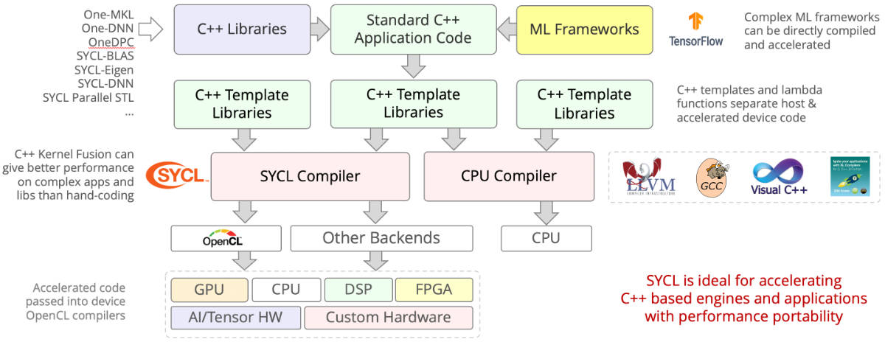
SYCL Flowchart

Slide 55
Basic SYCL Program
In any SYCL program, the host must:
  Choose an accelerator device
    Device is chosen with the ”device selector” class
    Accelerator support is determined by the compiler
      Intel’s DPC++ compiler natively supports Intel GPUs via OpenCL
      Intel FPGAs are supported through their SYCL extension
    Default selectors will choose the most capable device at runtime
      gpu_selector, cpu_selector, accelerator_selector, fpga_selector
    Alternatively, we can extend the device selector class for custom selection criteria
  Tell the device what to do
  Transfer data between host and device

Slide 56
Basic SYCL Program
Host chooses from available accelerator devices using ‘device_selector’ class
FPGA
Host
GPU
AI

Slide 57
Basic SYCL Program
Host sends instructions to and receives feedback
from device using ‘queue’ class
Queue
Host
Kernel instructions
GPU
Device feedback

Slide 58
Basic SYCL Program
References to host memory are contained in the ‘buffer’ class
Memory referenced by buffers is written/read using ‘accessor’ class
Queue
Host
GPU
Host
GPU
Buffer
Accessor
Data
Data
Data
Data
Data
Memory
Data
Memory

Slide 59
Device Selection
Default selector chooses most capable device at runtime
Device selector classes exist to choose from specific class of device
  gpu_selector
  cpu_selector
  accelerator_selector
  fpga_selector exists via intel extension
  Useful for quick development, but typically want specific device for a task
Custom selectors created by extending device_selector base class
virtual int operator()(const device &dev) const {
/* Device selection logic */
}

Slide 60
Custom Device Selection
operator() is key to device selection
  Runs on each available device
  Returns an integer score for each device
    Device which returns highest score is selected
    Devices which return negative scores will never be selected
User is free to define any logic for scoring
  Allows for arbitrarily complex device selection logic
  In simple cases, selecting based on device name or vendor is sufficient

Slide 61
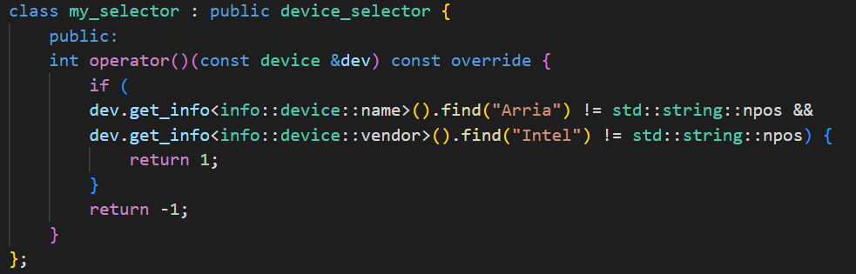
Custom Device Selection Example
Source: Data Parallel C++, James Reinders et al. pg. 46

Slide 62
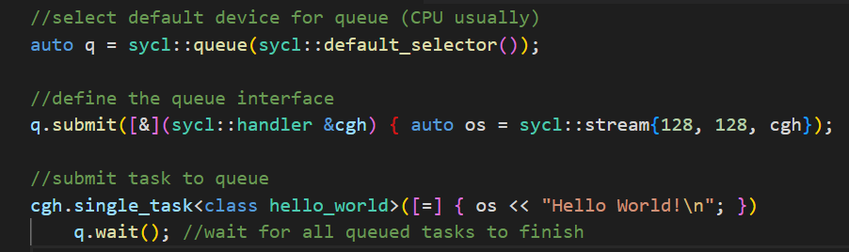
Queues
Abstractions used for submitting work to a device
  Bound to a single device upon creation
  Device is selected via device_selector class
  Can allow selector to select from a class of devices or write custom selector
Tasks submitted to queue are offloaded to device when conditions are met
  Host continues execution of the program after submission to the queue
Task execution can be in-order or out-of-order
  Out-of-order by default, execution order determined by runtime
  Can be instantiated with the in-order property for implicit dependency specification

Slide 63
Buffers
Data abstractions of a certain C++ type
  Can be scalar data types, vectors, or other user-defined class/structure
    Must not require the use of copy constructors for copying
Represent data objects, not memory addresses
  Cannot be accessed like C++ arrays
  Accessors must be used to read from and write to buffers
A single buffer may be distributed across multiple locations
  Between discrete memory locations and devices
An empty buffer may be created by specifying a range for size
  Data must later be initialized before the buffer can be read from
Existing host data may be used to initialize a new buffer
  Accomplished by invoking a constructor that takes a pointer to an existing host allocation
May also be created from existing cl_mem objects if using OpenCL compatibility

Slide 64
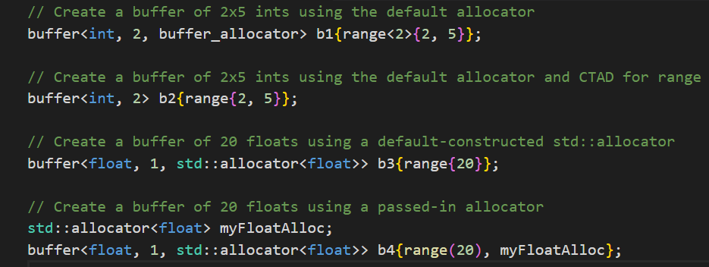
Buffers Examples

Slide 65
Accessors
The only way in which to read from or write to buffers
Can be instantiated with read, write, or read_write access modes
  Accessors are read_write by default
Using appropriate access modes is important
  Provides implicit information used to help the runtime manage memory
    For example: read mode tells the runtime that it does not need to copy memory back to the host, as the device has not changed it.
  Appropriate use of access modes will help the runtime optimize kernel scheduling and data migration

Slide 66
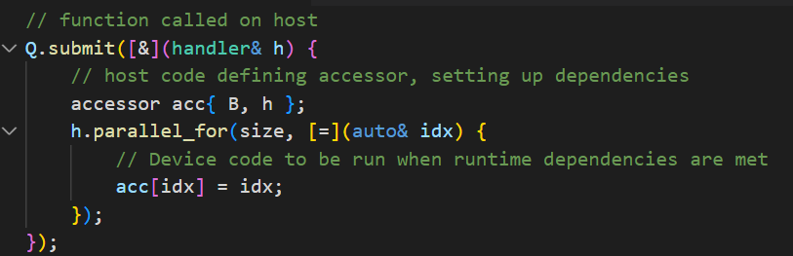
Accessors Example
Source: Data Parallel C++, James Reinders et al. pg. 27

Slide 67
Example
vector_addition.cpp
  https://github.com/BenjaminMFindley/Reconfig-2-SYCL-DPCPP/blob/main/Examples/vector_addition/vector_addition.cpp

Slide 68
Data Management
Running heterogeneous computing systems efficiently requires careful handling of data
  Data must be available for accelerator execution as promptly as possible as any idle time is wasted
There are two methods for managing data in DPC++
  Unified Shared Memory (USM)
  Buffers
Device code requires data as input and may output its own data
Devices may have their own distinct memory which cannot be accessed by the host
  Proper data management deals with the safe and efficient storage and movement of data between memory pools
Remote Accesses are accesses to data in another device’s memory
  Very slow
Local Accesses are accesses to data in directly-attached memory
  Much faster than remote accesses
  It is desirable for a device to utilize local memory for computation
    May require manual movement of data between memory pools to ensure data is in local scope

Slide 69
Dependency
Dependencies between tasks may be implicit or explicit
Explicit dependency refers to dependency between computations
  Most relevant to code utilizing USM for data management
  Dependencies specified using events
Implicit dependency refers to dependency between data accesses
  Relevant to code utilizing buffers for data management
  Dependencies specified through accessors

Slide 70
Implicit vs Explicit Memory Management
Memory Management can be either implicit or explicit
  Explicitly copied within the program itself
  Implicitly copied by the runtime
Implicit Memory Management
  Handled automatically by the runtime
  Simple and safe
  Often at the cost of potential performance
Explicit Memory Management
  Defined manually by the programmer
  May be optimized for better performance
    For example: transfer data while device is busy with execution
  Time consuming and error prone
  Should be reserved for the most performance-critical areas

Slide 71
Data Dependency (Implicit)
Different tasks may depend on one another’s data
Data dependency exists in one of three forms
  Read-after-write: Task B must wait for Task A to read before it can write
  Write-after-read: Task B must wait for Task A to write before it can read
  Write-after-write: Task B must wait for Task A to write before it can write
These relationships are specified implicitly via
  Accessor access modes
  Task ordering
    If two accessors exist for the same data, whichever task is submitted first will be executed first
    An implicit dependency is created based on the types of access

Slide 72
Computational Dependency (Explicit)
A queue’s submit() function returns an event
Event objects can be captured and referenced for other purposes
  wait()
  depends_on()
depends_on() is a handler function used to specify dependency
  Specifies events on which the current operation depends
  Takes an event or vector of events as parameters
  Will wait until all specified events have finished before continuing execution

Slide 73
Universal Shared Memory (USM)
Pointer-based memory management system, similar to C/C++ malloc() or new
Defines a unified virtual memory space shared between host and devices
  A pointer is valid both on the host and any devices, so no translation is necessary
Defines three types of allocation
  Device
    Explicit, accomplished via memcpy() function as part of the queue and handler classes
    Located on device-attached memory
    Only accessible via device. Data must be copied explicitly to move between host and device
  Host
    Implicit
    Accessible via both host and device
    Data accessed on host memory by devices does not transfer into local device memory
      Sent via bus such as PCI-E
  Shared
    Implicit
    Accessible via both host and device
    Can migrate between host and device, allowing for faster execution on device. Occurs automatically via runtime
  All allocations are performed by the host

Slide 74
Example
vector_addition_usm.cpp
  https://github.com/BenjaminMFindley/Reconfig-2-SYCL-DPCPP/blob/main/Examples/vector_addition/vector_addition_usm.cpp

Slide 75
Example
vector_addition_with_timing.cpp
  https://github.com/BenjaminMFindley/Reconfig-2-SYCL-DPCPP/blob/main/Examples/vector_addition/vector_addition_with_timing.cpp

