Slide 1
Physical Design and STA
Nicholas Poindexter
ECE Department
University of Florida

Slide 2
Introduction
RTL code is translated into a physical implementation using a primitive library dependent on the application
Physical limitations associated with these primitives constrain the performance of circuit clock frequencies, power consumption, reliability, and other circuit metrics.
Understanding these physical limitations help designers create better circuits

Slide 3
Why is this important?
Gives good background on how your circuits are implemented
  What’s the max frequency your circuit can operate at?
  Why does it take so much time to compile my design?
Interviewers LOVE to ask about Static Timing Anlaysis

Slide 4
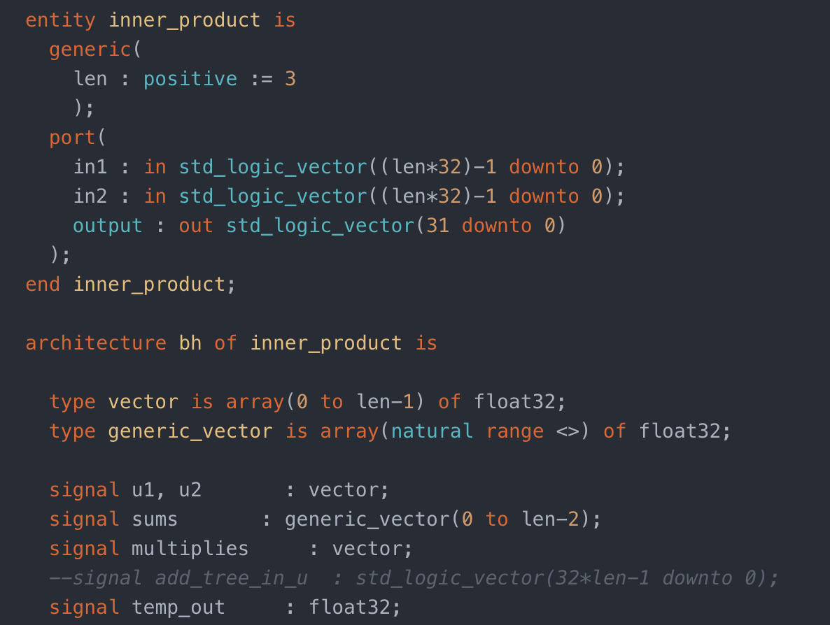
RTL to Physical Translation
Synthesis maps RTL to physical primitives
  Design Compiler: ASIC (Application Specific Integrated Circuits) maps to gates and flipflops
  Quartus: FPGA maps to combinational logic blocks, LABs, DSP
Creates a Synthesized Netlist

Slide 5
Synthesis Netlist to Physical Netlist Translation
Synthesized Netlist is then mapped to physical locations
  ASIC: Highly variable placement and routing (fine grained architecture)
  FPGA: Less variability placement and routing (course grained architecture)
  Creates a placed and routed netlist which is ready to be implemented
    ASIC: Mask Design
    FPGA: Bitstream Generation

Slide 6
Circuit Metrics
After synthesis, during place and route, the tool attempts to meet several different circuit constraints:
  Static Timing Constraints
    Setup Time
    Hold Time
    Clock Skew Effects
  Signal and Circuit Quality Constraints
    Maximum Capacitance
    Slow Slope & Clock Slow Slope
    Parasitic Signal Interference
    Noise
  Reliability Constraints
    Clock Switching Hotpots
  Power Constraints
  Constraints must be met for ALL paths making it very computationally expensive

Slide 7
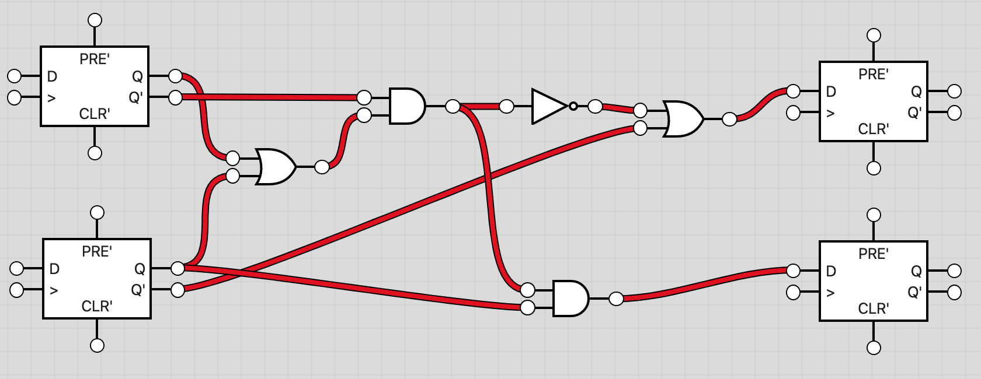
Static Timing Analysis
Given the below circuit, what constraints need to be considered?

Slide 8
Static Timing Analysis
Let’s examine the internals of a flip flop
During a rising edge, D is able to race through to Q for a split second
What happens if the second mux isn’t open long enough for the data pass through?
What happens if the data moves too fast through the muxs?

Slide 9
Setup & Hold Time
Setup Time: The interval before the clock edge where the input data pin must have a stable logic level
Hold Time: The interval after the clock edge where the input data pin must have a stable logic level
In order to have a functioning circuit we must meet both setup time and hold time for all paths

Slide 10
Circuit Delays
Real circuits are subject to delays
Two main types of delays:
  Contamination Delays
    Time it takes for a device to change its output state based on a changing input signal
    Dependent on device type, size, operating voltage, temperature
  RC Delays
    Time it takes for a signal to travel on a wire
    Dependent on length of path

Slide 11
Original Example
Which path will be most likely to have a setup violation? Hold violation?
  Assume all RC delays are equal
Which path will constrain the clock frequency?

Slide 12
Fixing Setup/Hold Violations
Cause the least amount of change to the circuit
Fixing Setup Violations
  Move gates or devices closer to each other
  Reduce Clock Frequency
  Simplify Logic to reduce number of devices
  Add/Remove Buffers
  Change Device Sizes
Fix Hold Violations
  Add/Remove Buffers
  Add Layers of Logic
  Change Device Sizes
  Change operating temperature

Slide 13
Clock Skew
Up to this point assuming everything is on the same clock
  RC delay
  Contamination delay of clock buffers
What if there is added delay between the rising clock edges?
  Introduces more complicated analysis of Setup/Hold

Slide 14
More Advanced STA Techniques
Clock pushing and clock pulling
  Using clock skew to our advantage
Fan-Out Mitigation
  Devices run slower when they have more devices on its output node
  Register duplication
Latency Insensitive Design
  Allows for “infinite” number of pipeline stages
Power-Centric Changelist

Slide 15
FPGA STA
Contamination Delays and RC delays are significantly larger on FPGA
  CLB vs. Gate
  Interconnect vs. Wire
FPGAs are notorious for having lower clock frequencies and higher power consumption for this exact reason
Improving clock frequencies or timing violations becomes significantly harder on FPGAs
  HyperFlex Mapping
  Manual Placement and Routing
  Extensive Repiplining

Slide 16
Questions/Complaints
Thank you (all 4 of you who are probably here since it’s the day before spring break) for listening to my TED talk
Let me know if you have any questions!

