Slide 1
PANDORA: A Parallelizing Approximation-Discovery Framework
Greg Stitt
Assoc. Professor of ECE
University of Florida
*This material is based upon work supported by the National Science Foundation under Grant Nos. CNS-1149285, CNS-1718033, and CCF-1909244.
UF ECE Big Ideas Seminar

Slide 2
Introduction
New technologies enabled by faster computers
  Historically, faster computers result primarily from smaller transistors
Scary time for computing
  Extra transistors providing fewer benefits
    Moore’s Law slowing down, Dennard scaling has ended
    Increasingly problematic leakage power
    Increase in dark silicon
  Reaching physical limits
How to improve performance and energy without more and/or faster transistors?
  Current trend is towards heterogeneous accelerators (GPUs, FPGAs)
  Helps, but these accelerators suffer from same issues
What else can be done?

Slide 3
Approximate Computing
Crazy idea: what if we eliminate the assumption that application output has to be “correct?”
  Instead focus on good-enough output
  How much can performance/energy be improved?
Approximate computing
  Emerging area
  Attractive tradeoffs between performance/energy and error
  Potential solution to transistor bottlenecks

Slide 4
Approximate Computing
Open questions
  When is approximation safe?
  How much approximation can be tolerated?
  How to create approximations?
Mainstream applications already approximate
  Just not thought of that way
  Examples:
    Any application using real numbers
    Simulation of continuous processes (e.g. scientific computing)
    Machine learning

Slide 5
PANDORA
Parallelizing sequential code a longtime compiler goal
Can approximation unlock more parallelism?
  Yes, previous work transforms existing code to violate dependencies
  Provides attractive tradeoffs between error and performance
Transforming existing code provides limited improvements
  Effective approximation can require different algorithms and/or functions
  Problem: manually creating approximations is difficult
PANDORA automatically discovers parallelizing approximations
  Independent of original code
  Independent of language
  Independent of architecture
  Supports multiple optimization goals and constraints

Slide 6
PANDORA Overview
Original Function
Samples
Approximations
1) Replace function with samples
2) Discover more efficient functions that nearly coincide with samples
Idea: infinite number of functions that nearly coincide with samples
  Goal: discover one that is more parallel or efficient than original
Primary research challenge: how to discover efficient functions that coincide with samples?

Slide 7
Symbolic Regression
Definition: search space of all mathematical expressions to discover function that bests fits data
  i.e. find function that minimizes error
PANDORA: perform symbolic regression with additional constraints and optimization goals
  e.g. maximize performance for error constraint
  e.g. minimize energy for error constraint
  e.g. minimize error for performance constraint
Genetic programming commonly used for symbolic regression
  Evolve tree consisting of mathematical primitives
  See papers for details

Slide 8
Results: Recurrence Relations
Ideal goal: replace loop-carried dependencies with independent iterations
  Evaluated with recurrence relations
Parallelism limited by I/O bandwidth
Performance increases considerably with more approximation
Closed-form solution provides single approximation

Slide 9
Results: Synthetic Loops w/ Dependencies
Generated synthetic loops
  Loop-carried dependencies
  Non-associative operations
Range of tradeoffs between speedup and error
  2x to 80x speedup

Slide 10
Results: FPGA Parallelism
Speedup between 1x and 10x at 5% error
ln had speedup of 757x at 18% error
Some errors likely prohibitive
  But, illustrate tradeoffs between performance and error

Slide 11
Conclusions
Parallelizing sequential code a longtime compiler goal
  Parallelism can be significantly increased via approximation
  Discovering approximations is difficult manually
PANDORA automatically discovers parallelizing approximations
  Language independent
  Supports different optimization goals and constraints
Remaining Challenges:
  Symbolic regression algorithms are often limited to toy problems
    Infinite solution space
  Can’t guarantee maximum error
  Resulting approximations are often hard to understand

Slide 12
APPENDIX

Slide 13
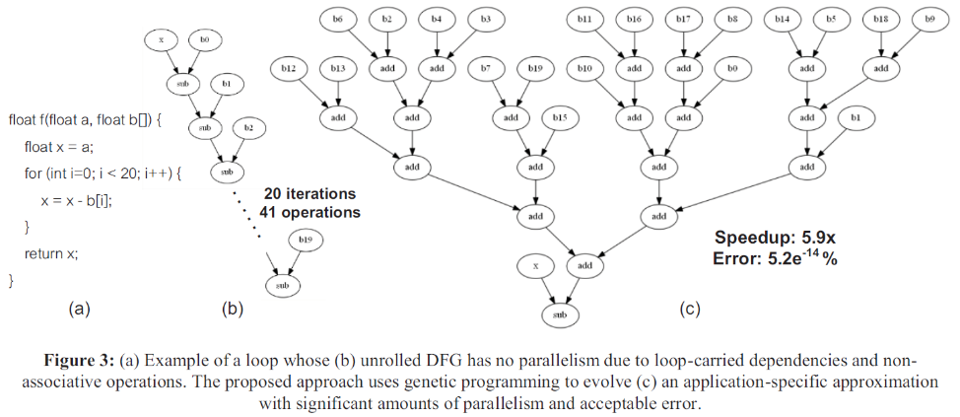
Approximation Example

Slide 14
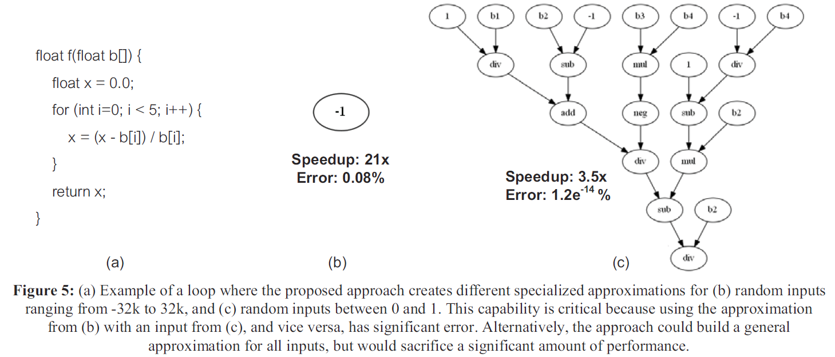
Approximation Example

Slide 15
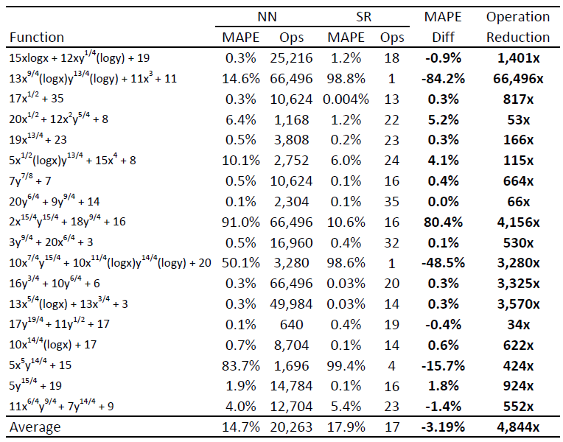
Approximation Examples
Symbolic regression vs. neural nets

Slide 16
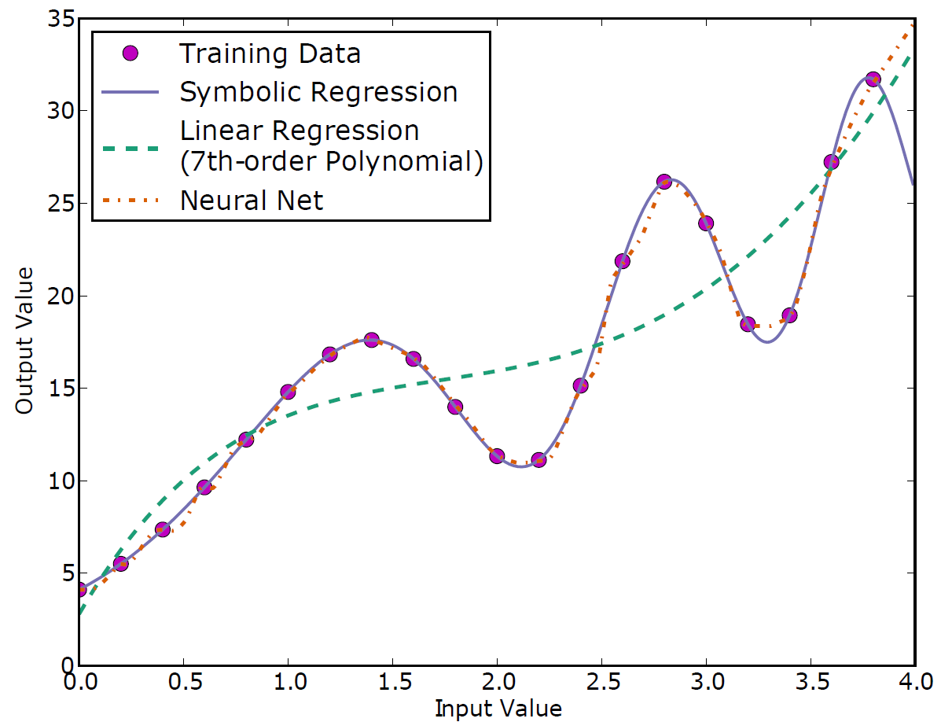
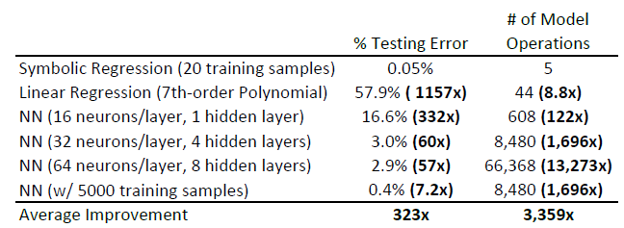
Symbolic Regression
Given set of points, find mathematical equation that best fits the points
Symbolic regression discovers the equation:
5.802(sin(x²)+x) + 4.12

Slide 17
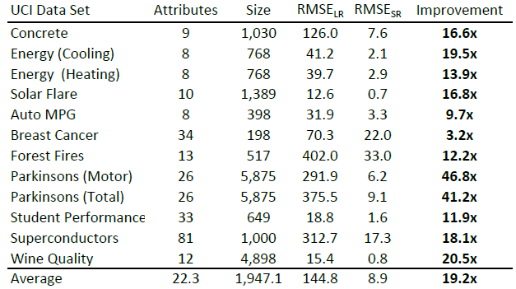
Symbolic Regression
Symbolic regression vs. linear regression

Slide 18
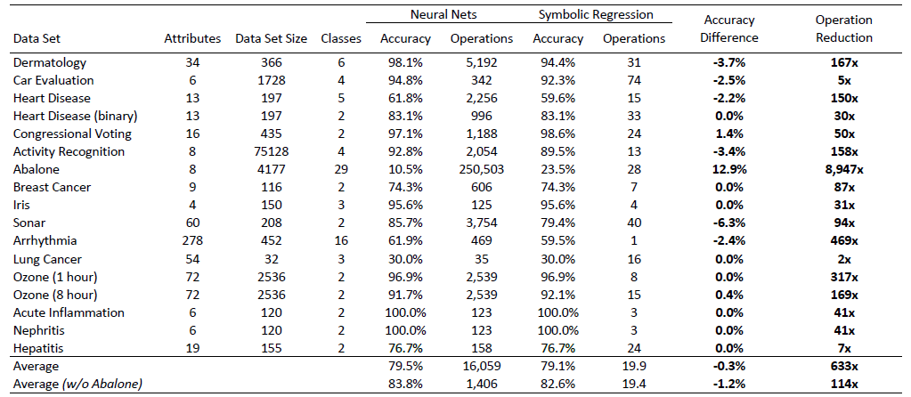
Symbolic Regression
Classification: symbolic regression vs. neural nets

