Slide 1
FPGA Design Opportunities
@ L3Harris Space and Airborne Systems (SAS)
Spring, 2020
Dean Morrison | Sr. Manager, Electrical Engineering

Slide 2






Who is this guy?
Then ...
Graduated UF ECE in 2006 ...
The “Year of the Gators”
Course interests ...
  Digital Design
  Digital Computer Architecture
  Reconfigurable Computing
... Now
FPGA Designer
Group Leader
Systems Engineer
FPGA Engineering Manager
L3Harris
Space & Airborne Systems
Communication Systems
Integrated Mission Systems
Aviation Systems
Electrical Engineering
FPGA
Directorate
FPGA Processing
FPGA Signals
FPGA Spectrum
FPGA Resilience
Over 300 FPGA designers

Slide 3







What’s L3Harris?
 | $56.5B
 | $31.7B (defense only)
 | $31.6B
 | $27.5B
 | $23.2B (defense only)
 | $16.0B (estimate)
The Motley Fool - Biggest Defense Companies in the Stock Market

Slide 4

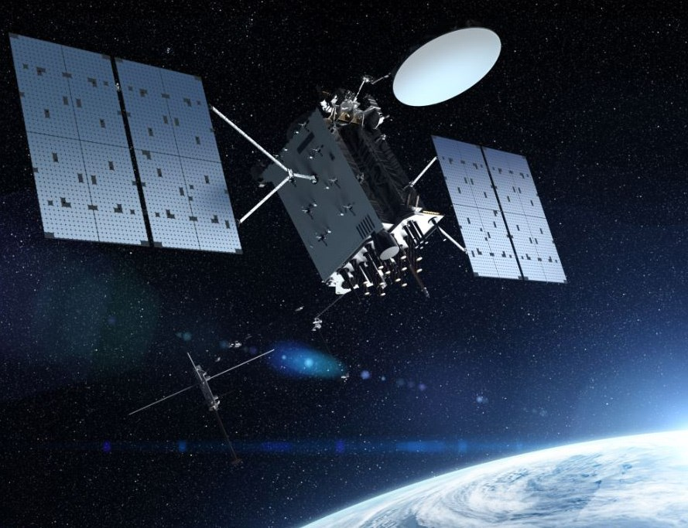
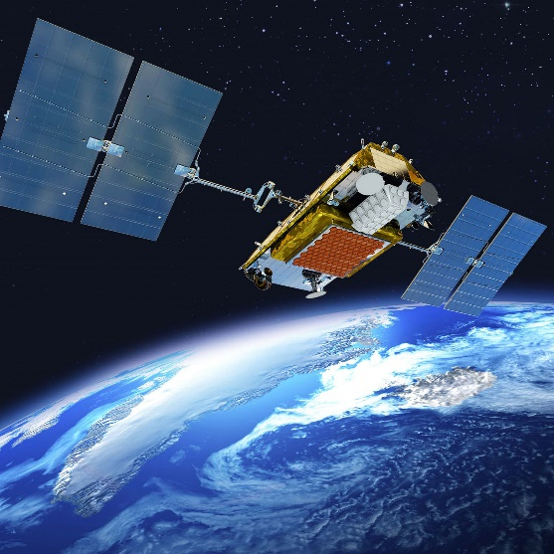

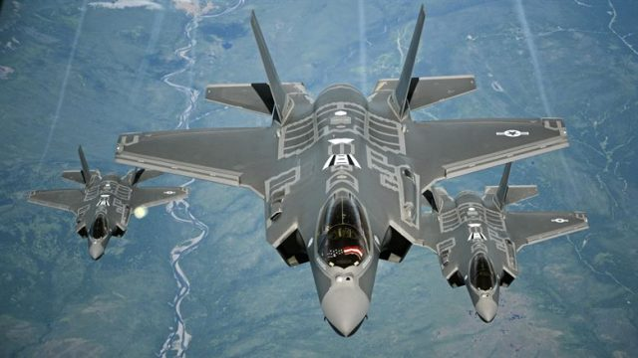
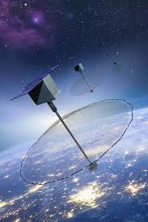

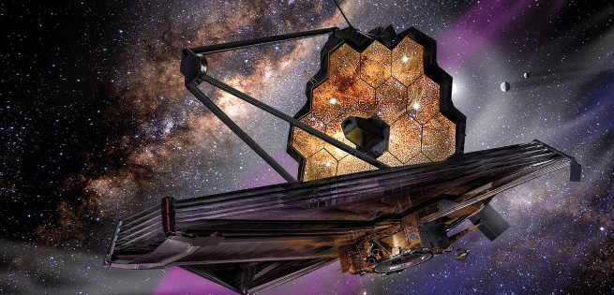
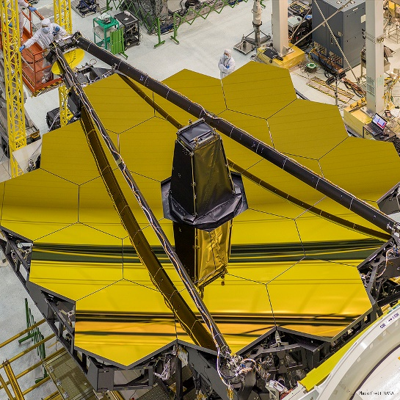

What do we do? [Space and Airborne Systems]
Customers
Government
Commercial
Missions
Protecting national security
Exploring the universe
Providing insights for better business decisions
Solutions
Reconfigurable multi-mission electronics
On-board processing
Applications for ISR, communications, secure networks, electronics warfare, ...
Platforms
Microelectronics
Sensors/Instruments
Payloads
Satellites
Constellations

Slide 5

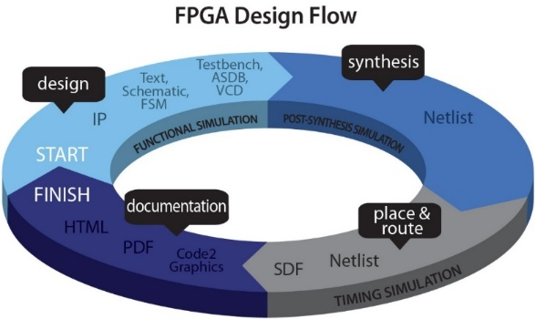
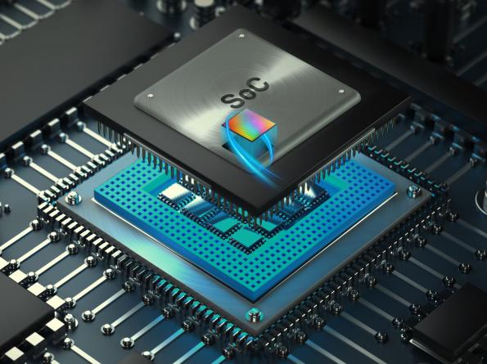
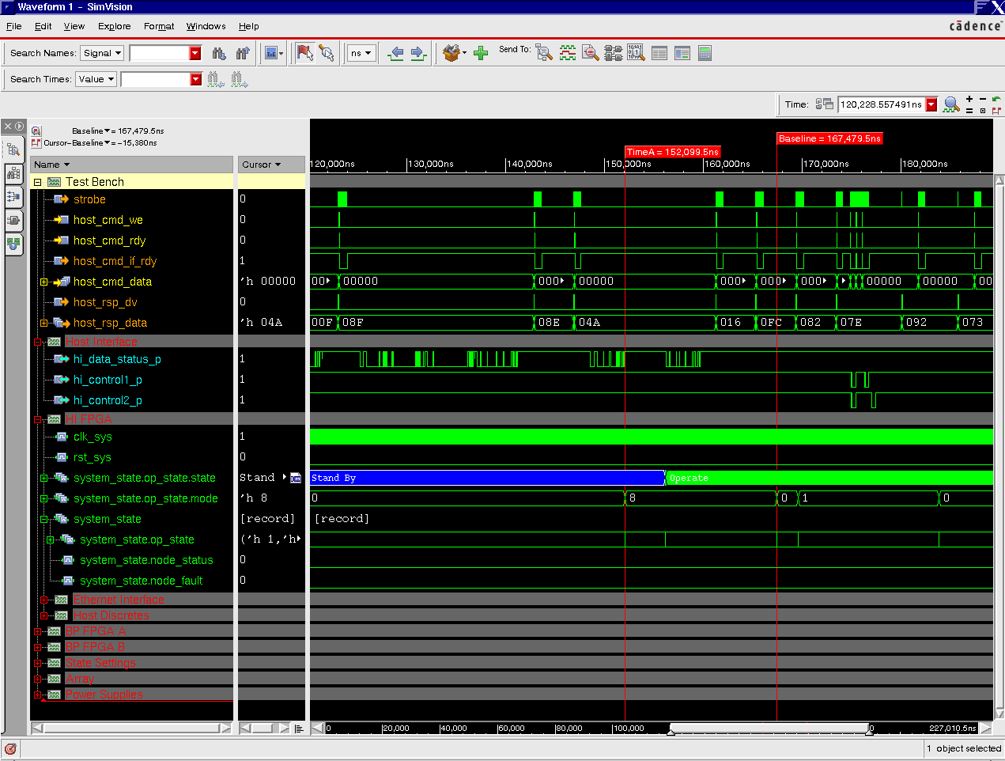
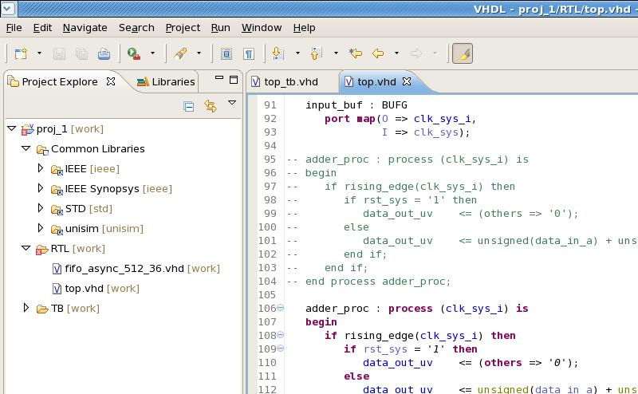

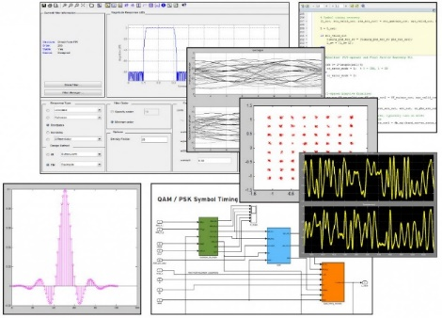
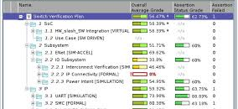

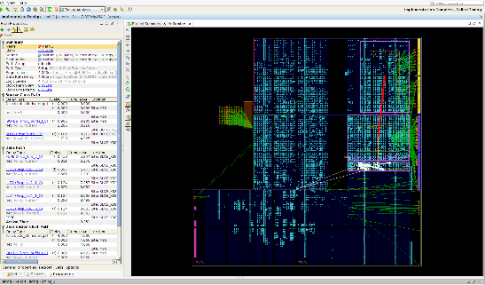
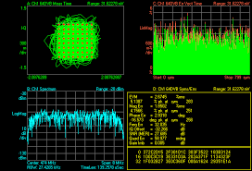
What do we do? [FPGA Discipline]
FPGA Applications
Specialized Digital Signal Processing
Secure networking
Sensor, Payload, and Satellite control
Communication MODEMs
Fault-tolerant designs, SEU mitigations
FPGA Design
Architecture
HDL & model-based design entry
Functional simulation & modeling
Synthesis & PAR
Integration & test
Field support
FPGA Technology
Radiation tolerant
High-density devices
Giga-transfer interfaces
SoCs

Slide 6
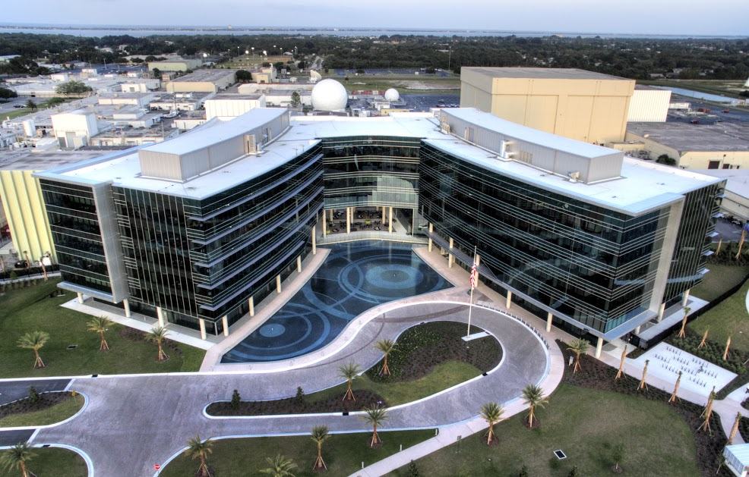
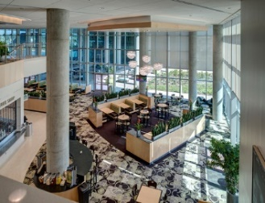
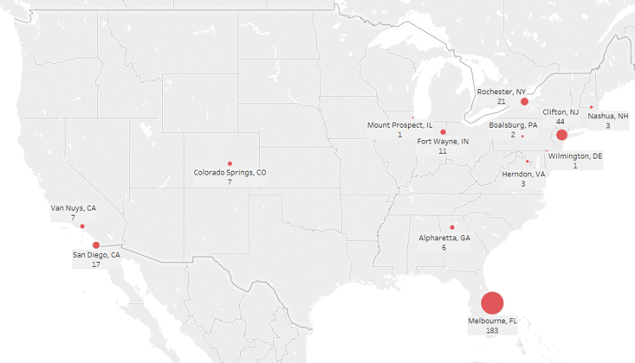
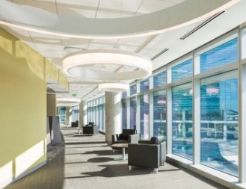
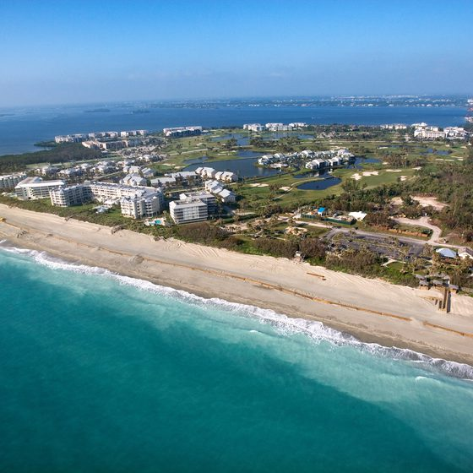
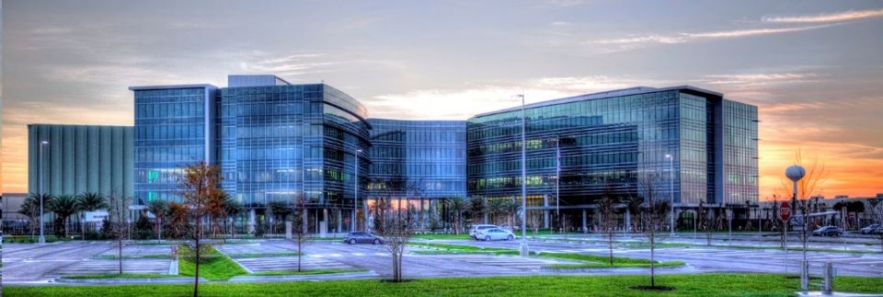
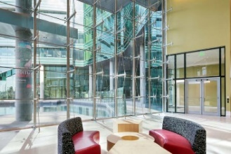
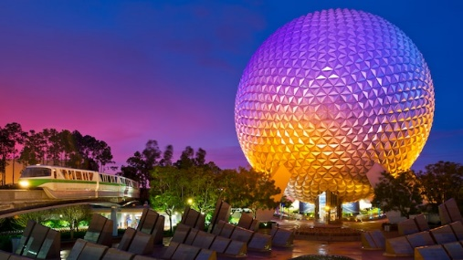
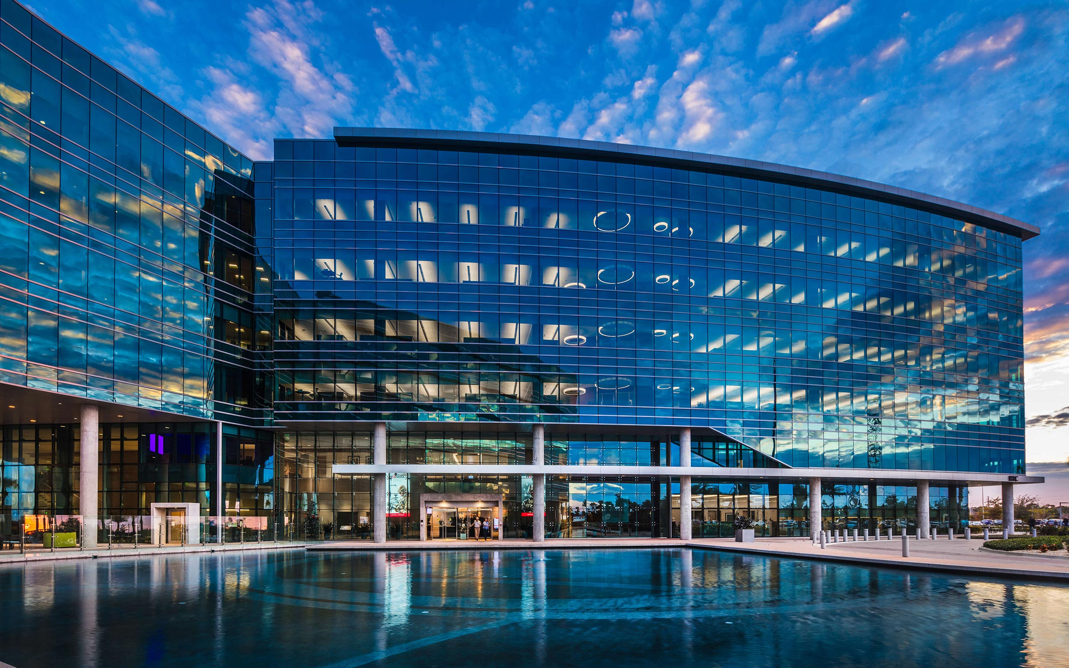

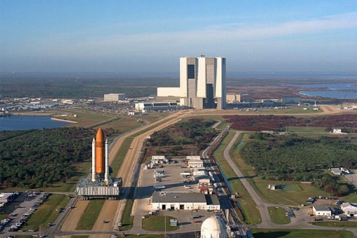
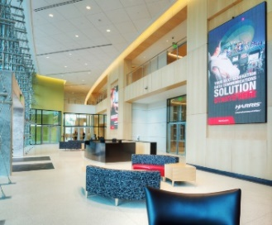
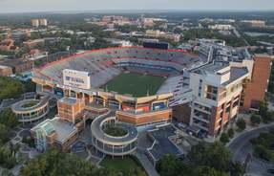
Locations and facilities
Locations
(L3)Harris Technology Center
FPGA design @ multiple sites
SAS headquarters: Palm Bay, FL
  Florida’s Space Coast ...
... 1 hour from Orlando
... 1 hour from KSC
... 3 hours from Gainesville

Slide 7
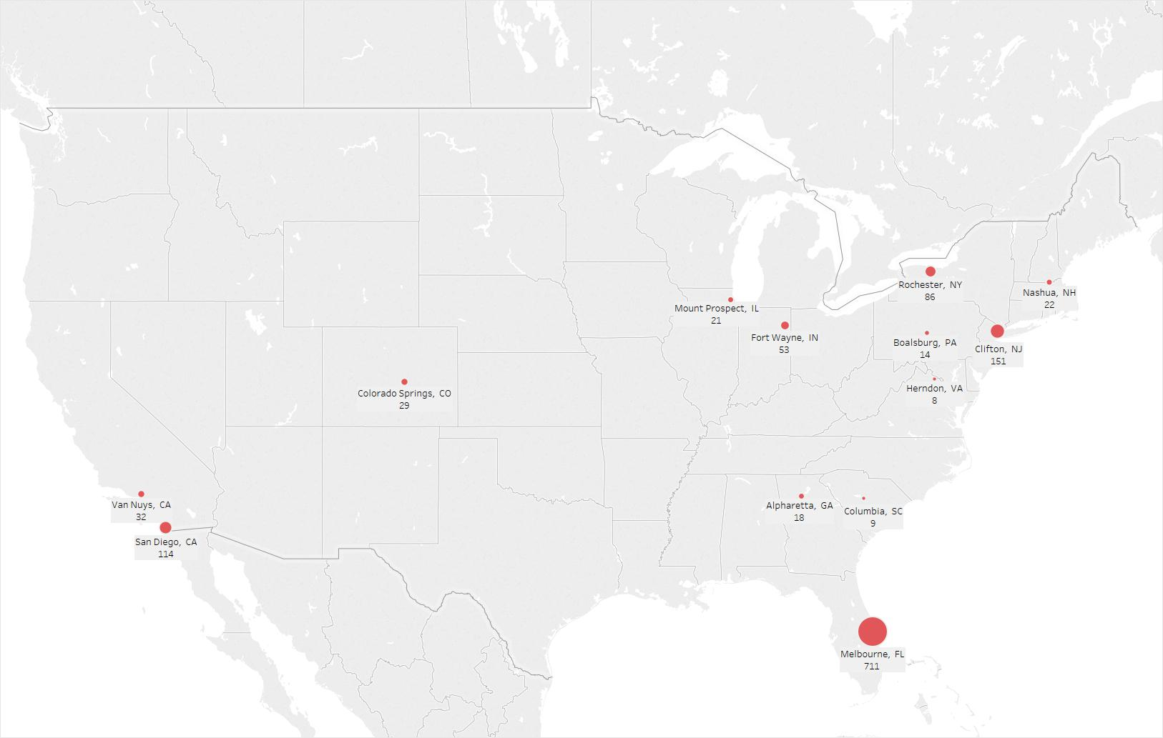
Many more locations ...

Slide 8
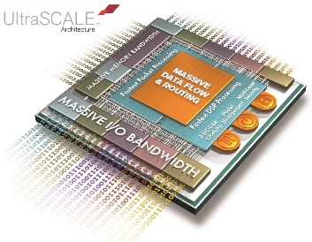
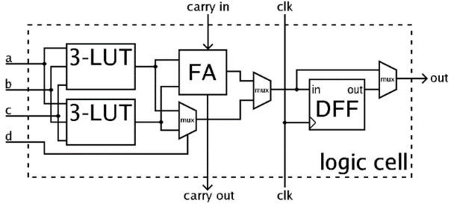
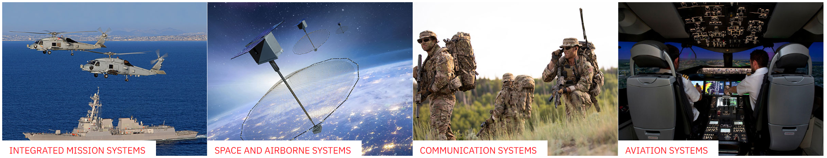
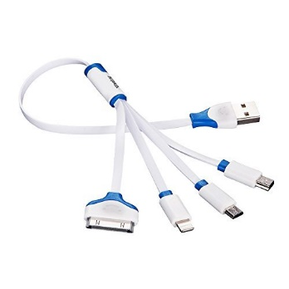

Who we’re looking for ...
FPGA/VHDL designers ...
Design Engineers interested in contributing to systems that make a difference ...
... Not just a more efficient USB-C macro or the next iDevice touch sensor
Ability to obtain a security clearance

Slide 9


Come see us
What | When | Where | Who
L3Harris ECE Info Night | Wednesday 1/22 @ 7pm | Larsen 234 | Dean, Travis, Trey
UF Career Showcase | Wednesday 9/25 9am – 3pm | O’Connell Center | Travis McConnaughey Trey Staton
L3Harris Info Night | Wednesday 2/5 4:30pm – 6:30pm | New Career Connection Center, Exploration Room | Anyone

Slide 10
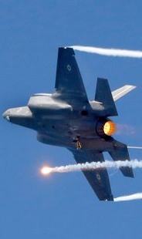
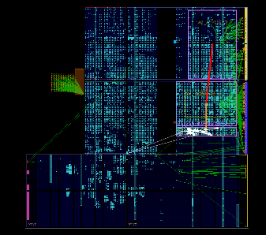
Questions?
Space and Airborne Systems (SAS)
(L3)Harris Technology Center
FPGA Discipline
Palm Bay, FL

Slide 11
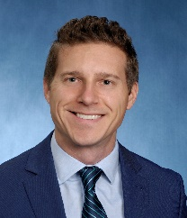
Interested?
Contact:
Dean Morrison
Dean.Morrison@L3Harris.com
[Please include a current copy of your resume]

