Slide 1
Carry Lookahead Adder
David Wilson, Greg Stitt
ECE Department
University of Florida

Slide 2
Introduction
There are many ways to implement a digital function, but each approach may have different tradeoffs
As a digital designer, you need to consider these tradeoffs when meeting design requirements
As an example, we’ll look into different adder architectures
  Read Section 5.4 for more details

Slide 3
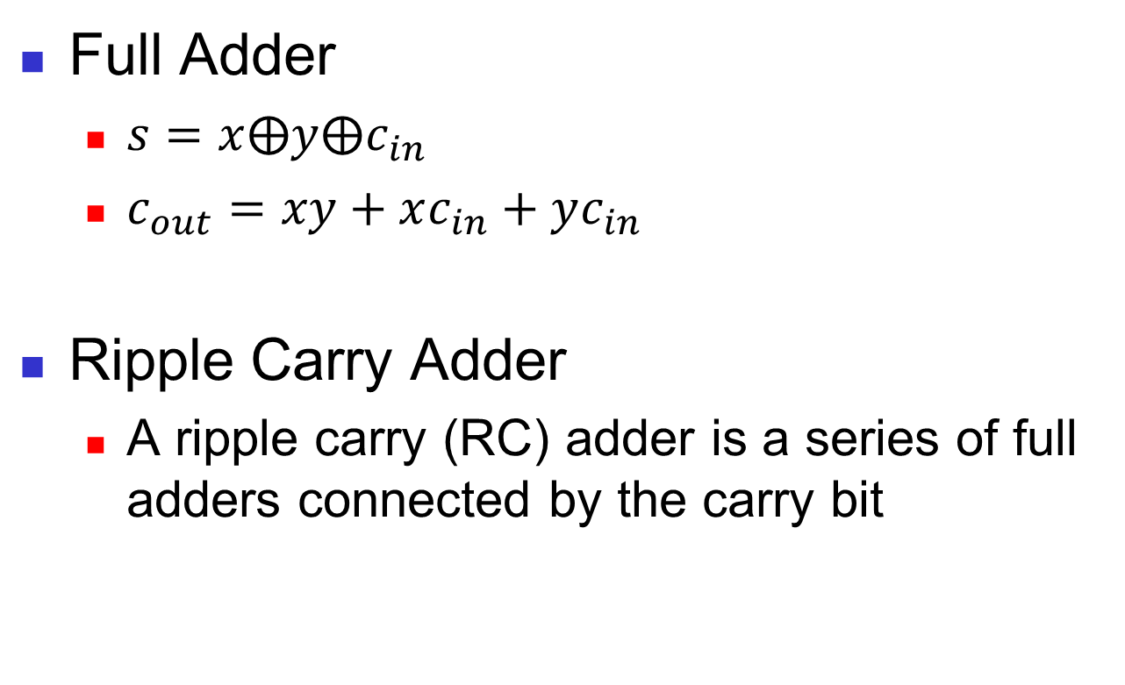
Ripple Carry Adder
Full Adder
  $s=x⨁y⨁c_{in}$
  $c_{out}=xy+xc_{in}+yc_{in}$
Ripple Carry Adder
  A ripple carry (RC) adder is a series of full adders connected by the carry bit

Slide 4
Advantage: Area Impact
The ripple carry adder’s area grows linearly with bit width
Each additional bit adds another full adder and its associated gates

Slide 5
Disadvantage: Delay Impact
The ripple carry adder’s delay also grows linearly with bit width
Each full adder must wait for the previous full adder to produce outputs
  Lower performance with bit width!

Slide 6
Delay Problem
Ideally, we want an adder that has constant delay for any width
Can we remove the dependence on the previous stage to avoid cascaded delays?

Slide 7
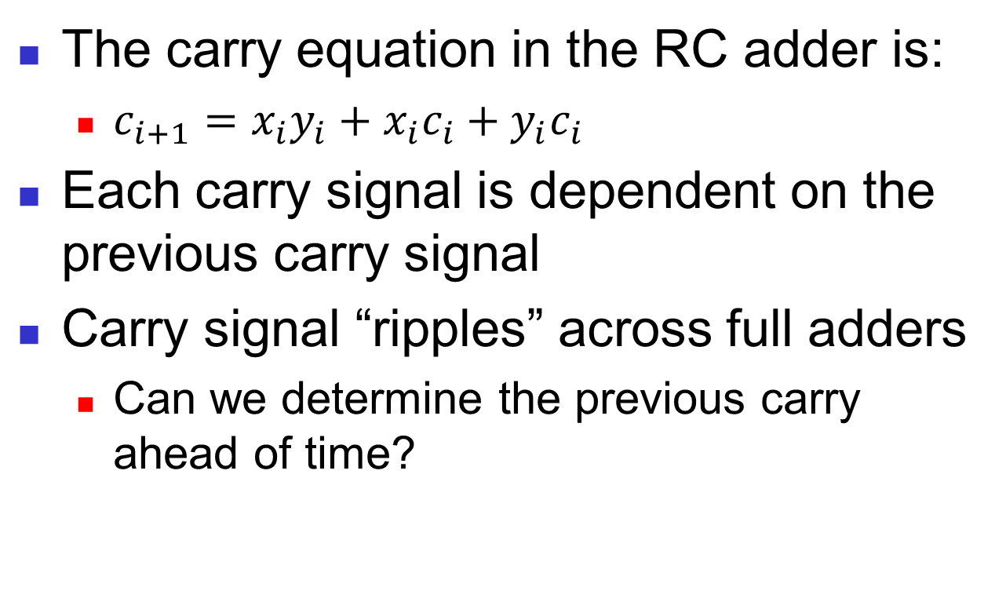
Carry Dependency
The carry equation in the RC adder is:
  $c_{i+1}=x_{i}y_{i}+x_{i}c_{i}+y_{i}c_{i}$
Each carry signal is dependent on the previous carry signal
Carry signal “ripples” across full adders
  Can we determine the previous carry ahead of time?

Slide 8
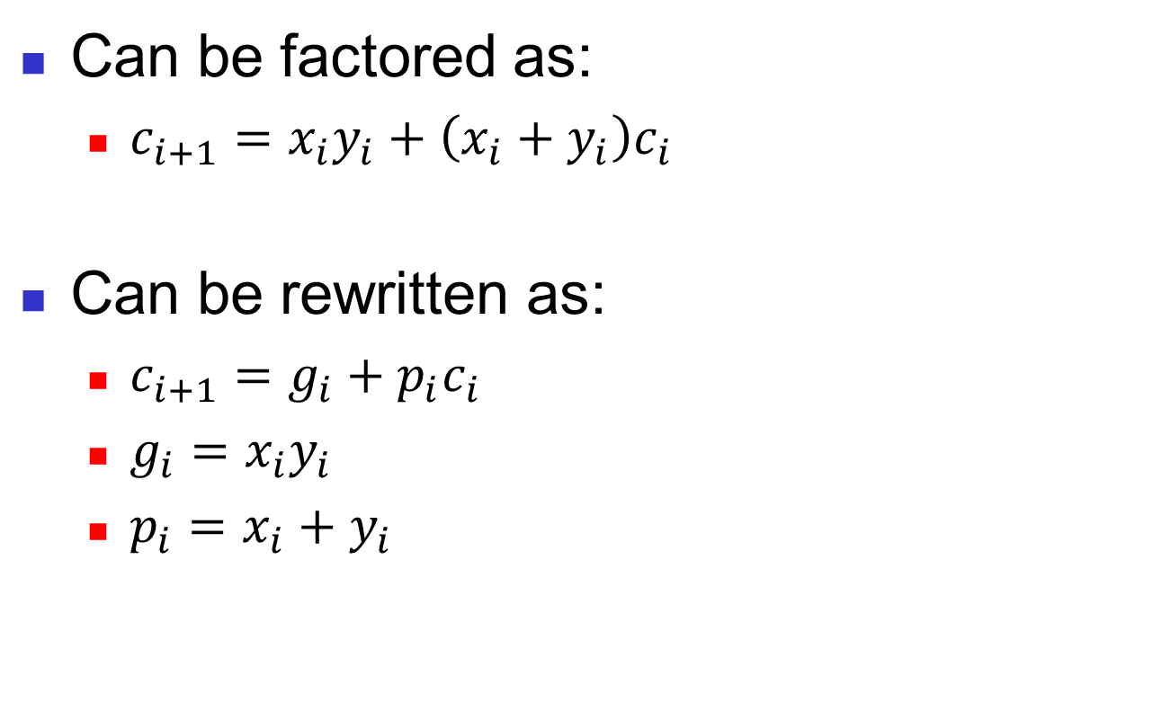
Another Look at Carry Equations
Can be factored as:
  $c_{i+1}=x_{i}y_{i}+\left(x_{i}+y_{i}\right)c_{i}$
Can be rewritten as:
  $c_{i+1}=g_{i}+p_{i}c_{i}$
  $g_{i}=x_{i}y_{i}$
  $p_{i}=x_{i}+y_{i}$

Slide 9
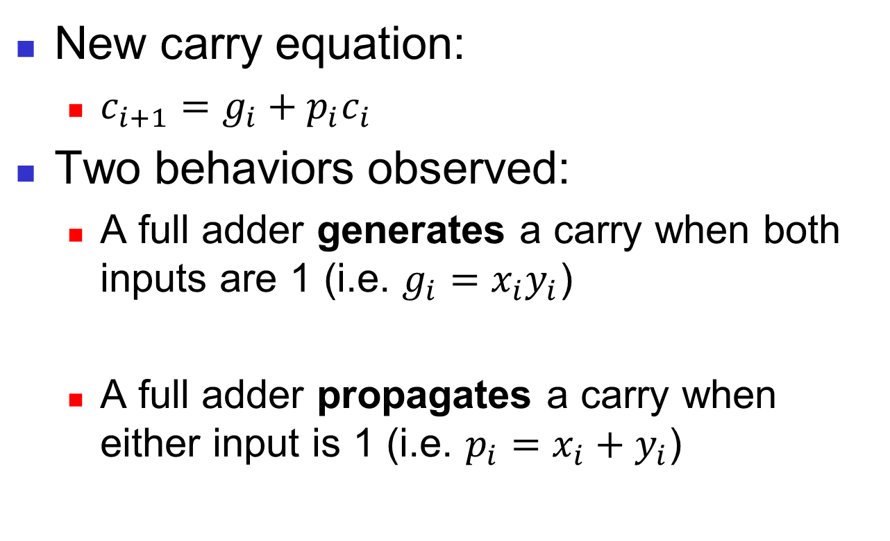
Generate/Propagate
New carry equation:
  $c_{i+1}=g_{i}+p_{i}c_{i}$
Two behaviors observed:
  A full adder generates a carry when both inputs are 1 (i.e. $g_{i}=x_{i}y_{i}$)
  A full adder propagates a carry when either input is 1 (i.e. $p_{i}=x_{i}+y_{i}$)

Slide 10
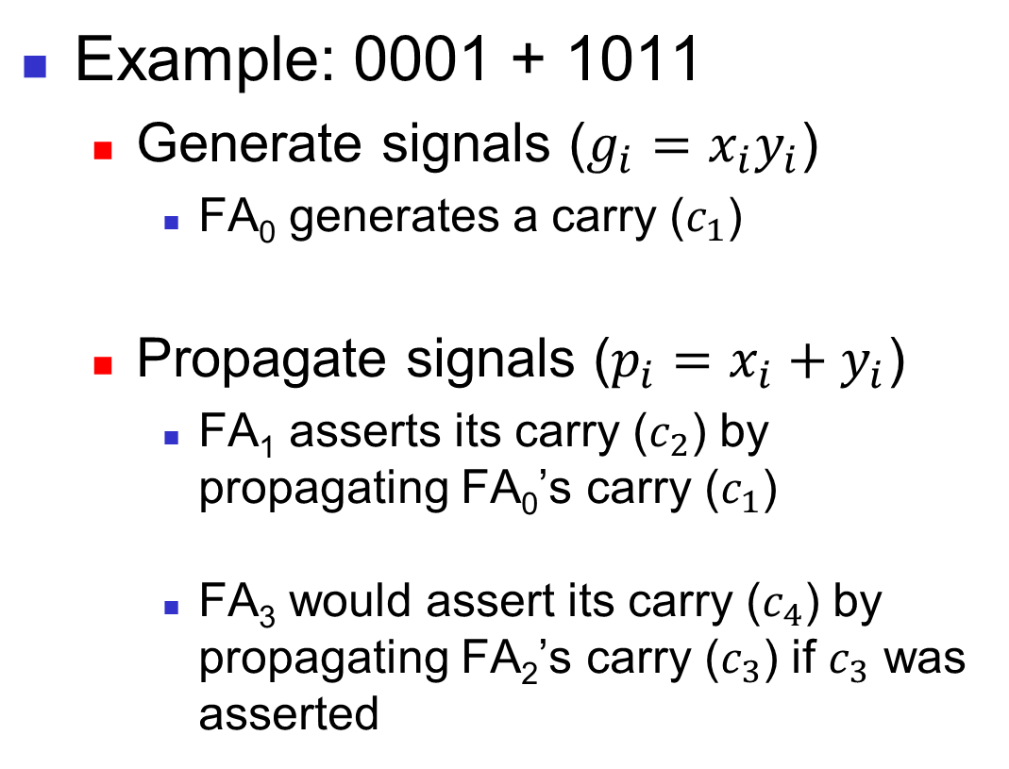
Generate/Propagate Example
Example: 0001 + 1011
  Generate signals ($g_{i}=x_{i}y_{i}$)
    FA₀ generates a carry ($c_{1}$)
  Propagate signals ($p_{i}=x_{i}+y_{i}$)
    FA₁ asserts its carry ($c_{2}$) by propagating FA₀’s carry ($c_{1}$)
    FA₃ would assert its carry ($c_{4}$) by propagating FA₂’s carry ($c_{3}$) if $c_{3}$ was asserted
1
0001
+1011
0
11
0001
+1011
00
0011
0001
+1011
1100

Slide 11
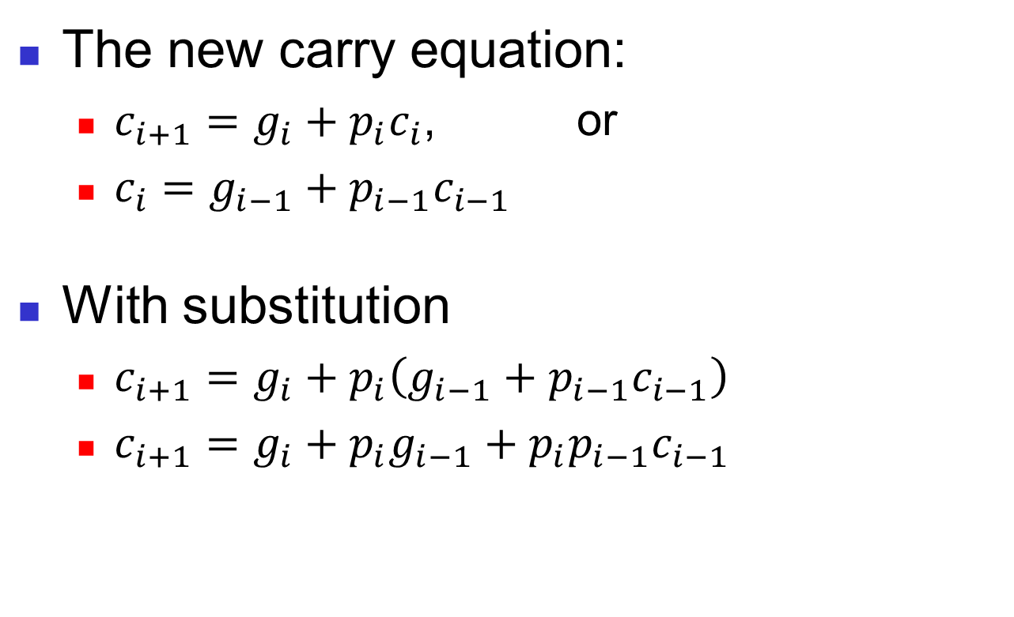
Carry Substitution
The new carry equation:
  $c_{i+1}=g_{i}+p_{i}c_{i}$, or
  $c_{i}=g_{i−1}+p_{i−1}c_{i−1}$
With substitution
  $c_{i+1}=g_{i}+p_{i}\left(g_{i−1}+p_{i−1}c_{i−1}\right)$
  $c_{i+1}=g_{i}+{p_{i}g}_{i−1}+p_{i}p_{i−1}c_{i−1}$

Slide 12
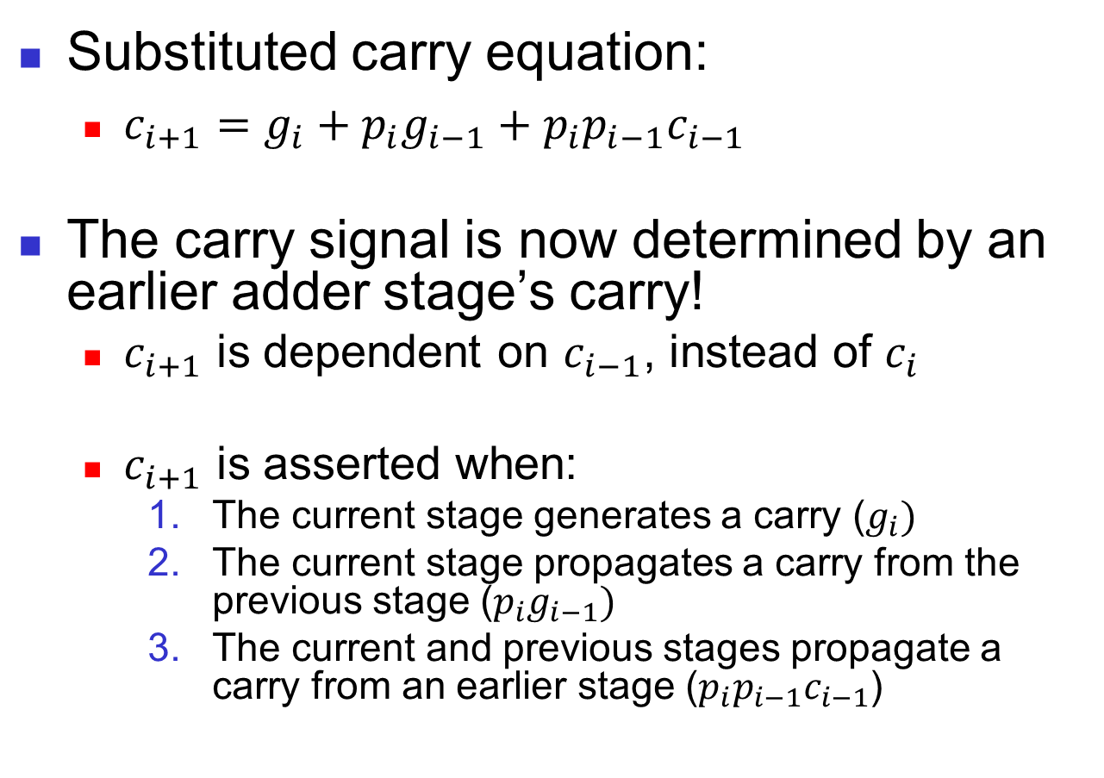
Removing Dependencies
Substituted carry equation:
  $c_{i+1}=g_{i}+{p_{i}g}_{i−1}+p_{i}p_{i−1}c_{i−1}$
The carry signal is now determined by an earlier adder stage’s carry!
  $c_{i+1}$ is dependent on $c_{i−1}$, instead of $c_{i}$
  $c_{i+1}$ is asserted when:
    The current stage generates a carry ($g_{i})$
    The current stage propagates a carry from the previous stage ($p_{i}g_{i−1})$
    The current and previous stages propagate a carry from an earlier stage ($p_{i}p_{i−1}c_{i−1}$)

Slide 13
Removing Dependencies
The increasing delay occurs because each adder stage is dependent on the previous stage
  Can we remove this dependence through substitutions?

Slide 14
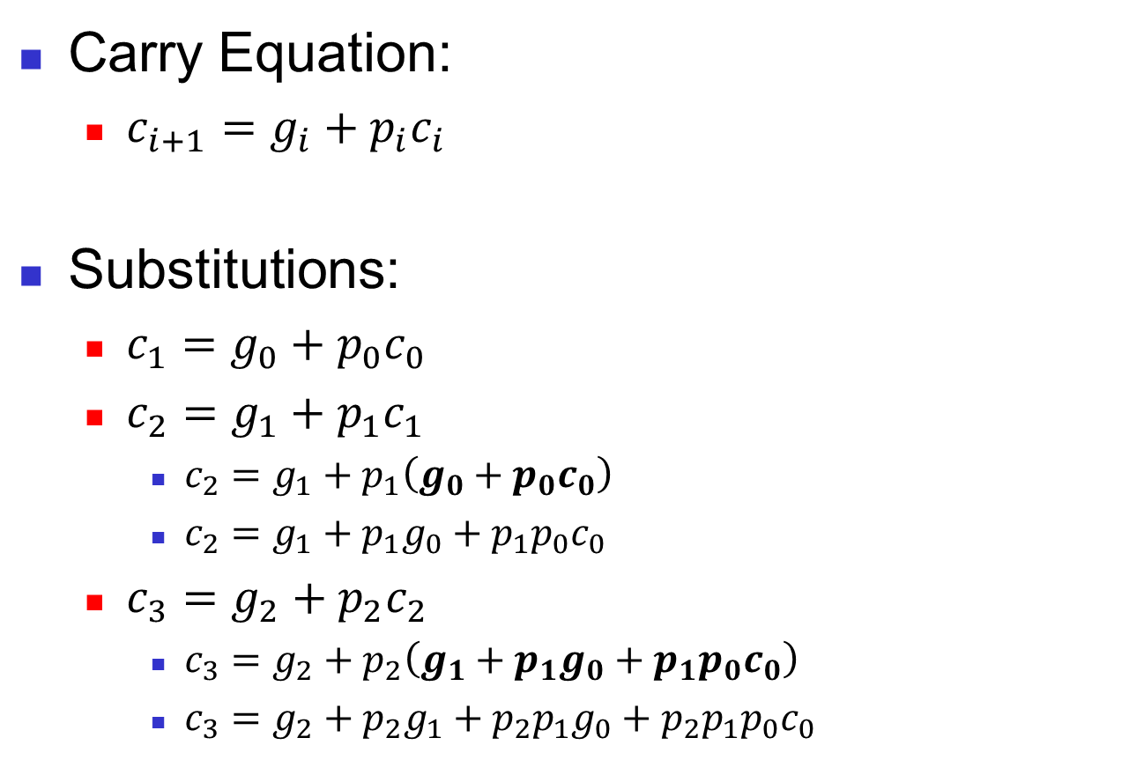
Carry Pattern
Carry Equation:
  $c_{i+1}=g_{i}+p_{i}c_{i}$
Substitutions:
  $c_{1}=g_{0}+p_{0}c_{0}$
  $c_{2}=g_{1}+p_{1}c_{1}$
    $c_{2}=g_{1}+p_{1}\left(g_{0}+p_{0}c_{0}\right)$
    $c_{2}=g_{1}+p_{1}g_{0}+p_{1}p_{0}c_{0}$
  $c_{3}=g_{2}+p_{2}c_{2}$
    $c_{3}=g_{2}+p_{2}\left(g_{1}+p_{1}g_{0}+p_{1}p_{0}c_{0}\right)$
    $c_{3}=g_{2}+p_{2}g_{1}+p_{2}p_{1}g_{0}+p_{2}p_{1}p_{0}c_{0}$

Slide 15
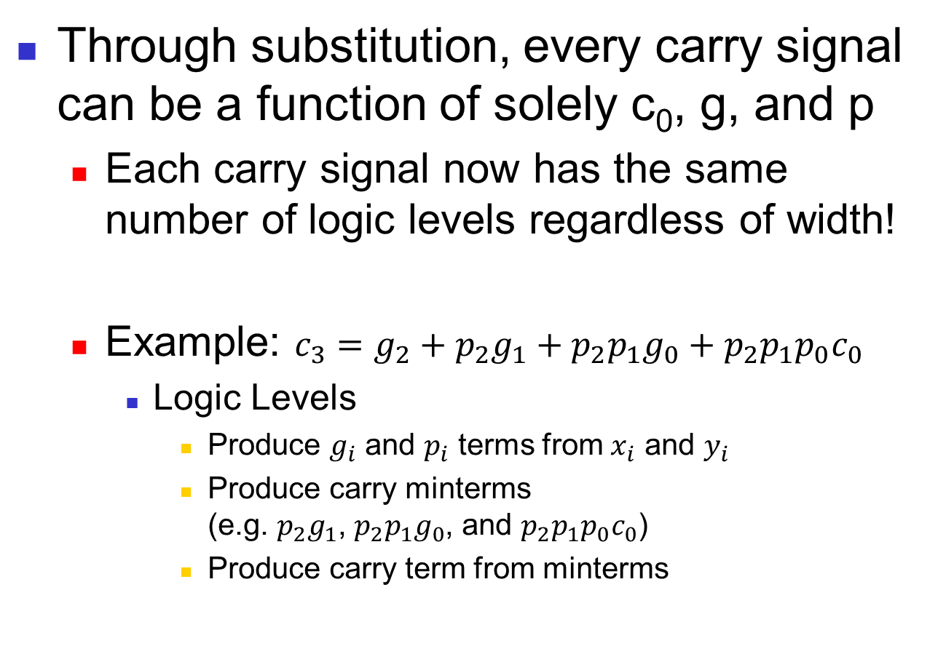
New Carry Dependence
Through substitution, every carry signal can be a function of solely c₀, g, and p
  Each carry signal now has the same number of logic levels regardless of width!
  Example: $c_{3}=g_{2}+p_{2}g_{1}+p_{2}p_{1}g_{0}+p_{2}p_{1}p_{0}c_{0}$
    Logic Levels
      Produce $g_{i}$ and $p_{i}$ terms from $x_{i}$ and $y_{i}$
      Produce carry minterms
      (e.g. $p_{2}g_{1}$, $p_{2}p_{1}g_{0}$, and $p_{2}p_{1}p_{0}c_{0}$)
      Produce carry term from minterms

Slide 16
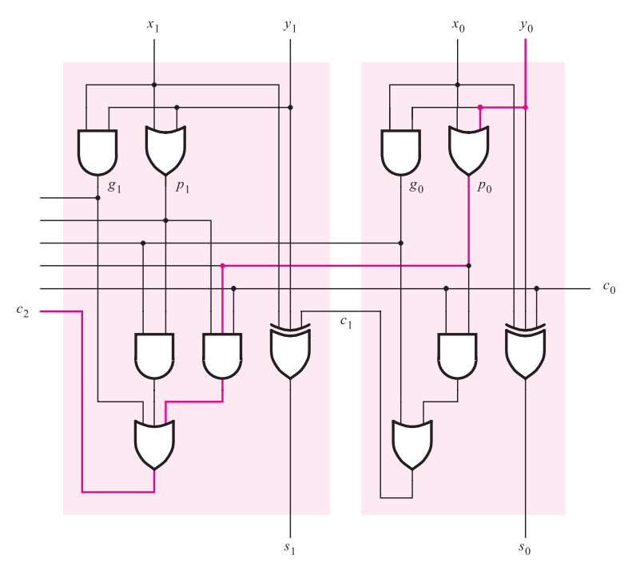
Carry Lookahead Adder
Textbook illustration of first two stages in carry lookahead (CLA) adder
  Second stage’s carry is determined concurrently with the first stage’s carry
propagate/generate terms
carry minterms
carry term
Figure 1. The first two stages of a carry-lookahead adder [1]

Slide 17
Constant Delay
The propagation delay is now constant, even as the adder width increases!
  Each of the CLA adder stages calculate its outputs concurrently

Slide 18
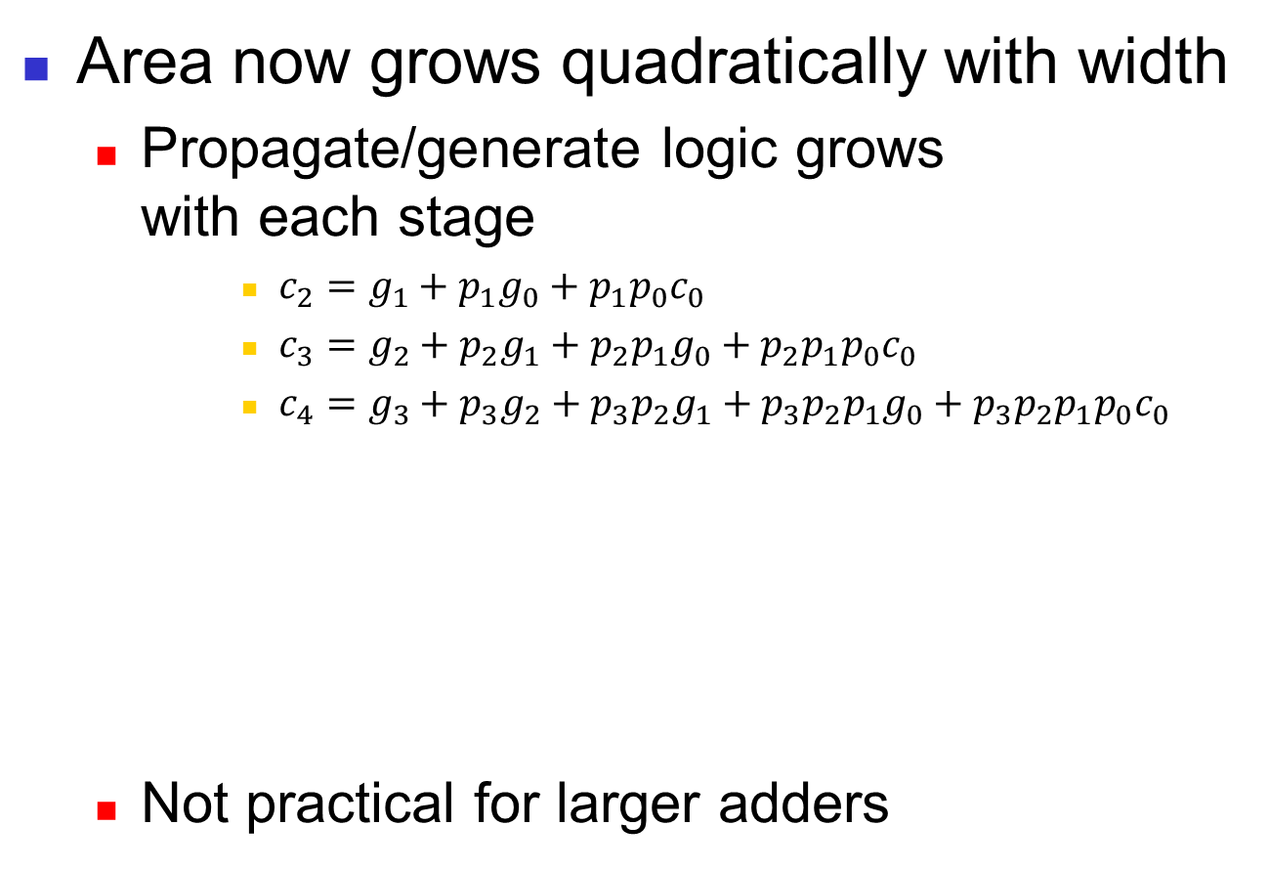
But at what cost?
Area now grows quadratically with width
  Propagate/generate logic grows
  with each stage
      $c_{2}=g_{1}+p_{1}g_{0}+p_{1}p_{0}c_{0}$
      $c_{3}=g_{2}+p_{2}g_{1}+p_{2}p_{1}g_{0}+p_{2}p_{1}p_{0}c_{0}$
      $c_{4}=g_{3}+p_{3}g_{2}+p_{3}p_{2}g_{1}+p_{3}p_{2}p_{1}g_{0}+p_{3}p_{2}p_{1}p_{0}c_{0}$
  Not practical for larger adders

Slide 19
Can we do better?
We know of two adders with different advantages as width increases
  The ripple carry’s area grows linearly, but suffers from linear growth in delay
  The carry lookahead’s delay is constant, but suffers from quadratic growth in area
Could a hybrid approach limit both area and delay growth?

Slide 20
Alternative Hybrid Approach
Make a ripple carry architecture out of multi-bit CLAs adders (or CLA blocks)

Slide 21
Area Impact
The hybrid adder’s area grows linearly
  Additional bits add another CLA adder and its associated gates
  Slower area growth than pure CLA

Slide 22
Delay Impact
The hybrid adder’s delay grows linearly
  Each CLA adder must wait for the previous CLA adder to produce outputs
    But no longer on a bit-by-bit basis!
  Lower delay growth than pure RC

Slide 23
Alternative Hierarchical Approach
In the hybrid approach, we use the RC architecture on multi-bit CLA adders
Can we use the CLA architecture on multi-bit CLA blocks?
  Why would this be beneficial?
  How does propagate/generate logic work using blocks?

Slide 24
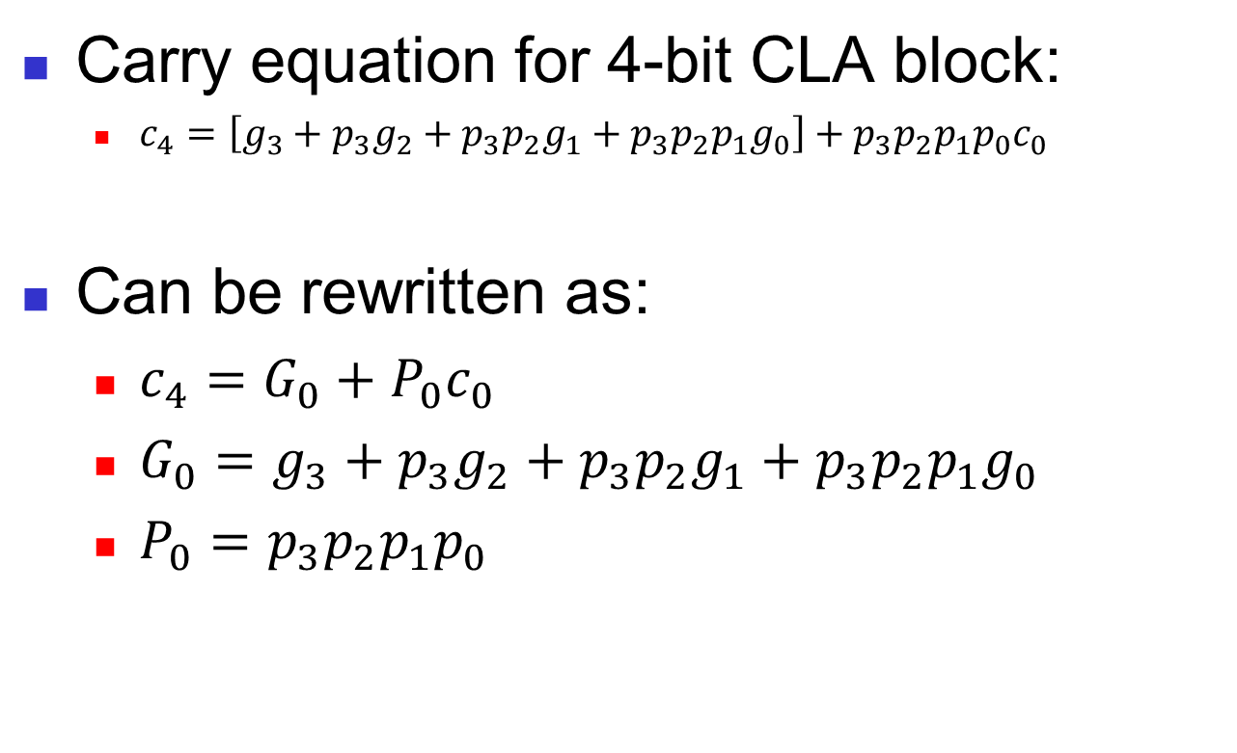
Another Look at Carry Equations
Carry equation for 4-bit CLA block:
  $c_{4}=\left[g_{3}+p_{3}g_{2}+p_{3}p_{2}g_{1}+p_{3}p_{2}p_{1}g_{0}\right]+p_{3}p_{2}p_{1}p_{0}c_{0}$
Can be rewritten as:
  $c_{4}=G_{0}+P_{0}c_{0}$
  $G_{0}=g_{3}+p_{3}g_{2}+p_{3}p_{2}g_{1}+p_{3}p_{2}p_{1}g_{0}$
  $P_{0}=p_{3}p_{2}p_{1}p_{0}$

Slide 25
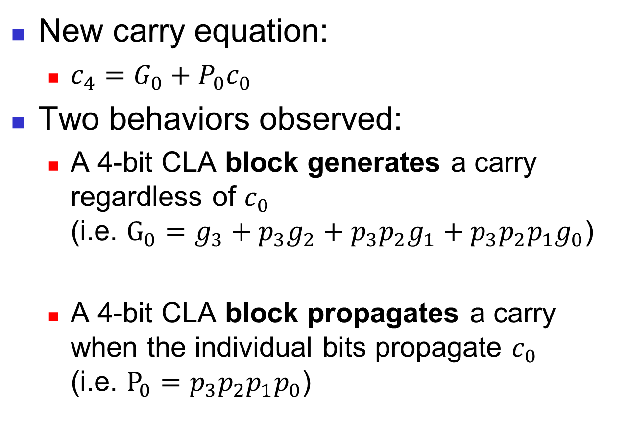
Hierarchical Generate/Propagate
New carry equation:
  $c_{4}=G_{0}+P_{0}c_{0}$
Two behaviors observed:
  A 4-bit CLA block generates a carry regardless of $c_{0}$
  (i.e. $G_{0}=g_{3}+p_{3}g_{2}+p_{3}p_{2}g_{1}+p_{3}p_{2}p_{1}g_{0}$)
  A 4-bit CLA block propagates a carry when the individual bits propagate $c_{0}$
  (i.e. $P_{0}=p_{3}p_{2}p_{1}p_{0}$)

Slide 26
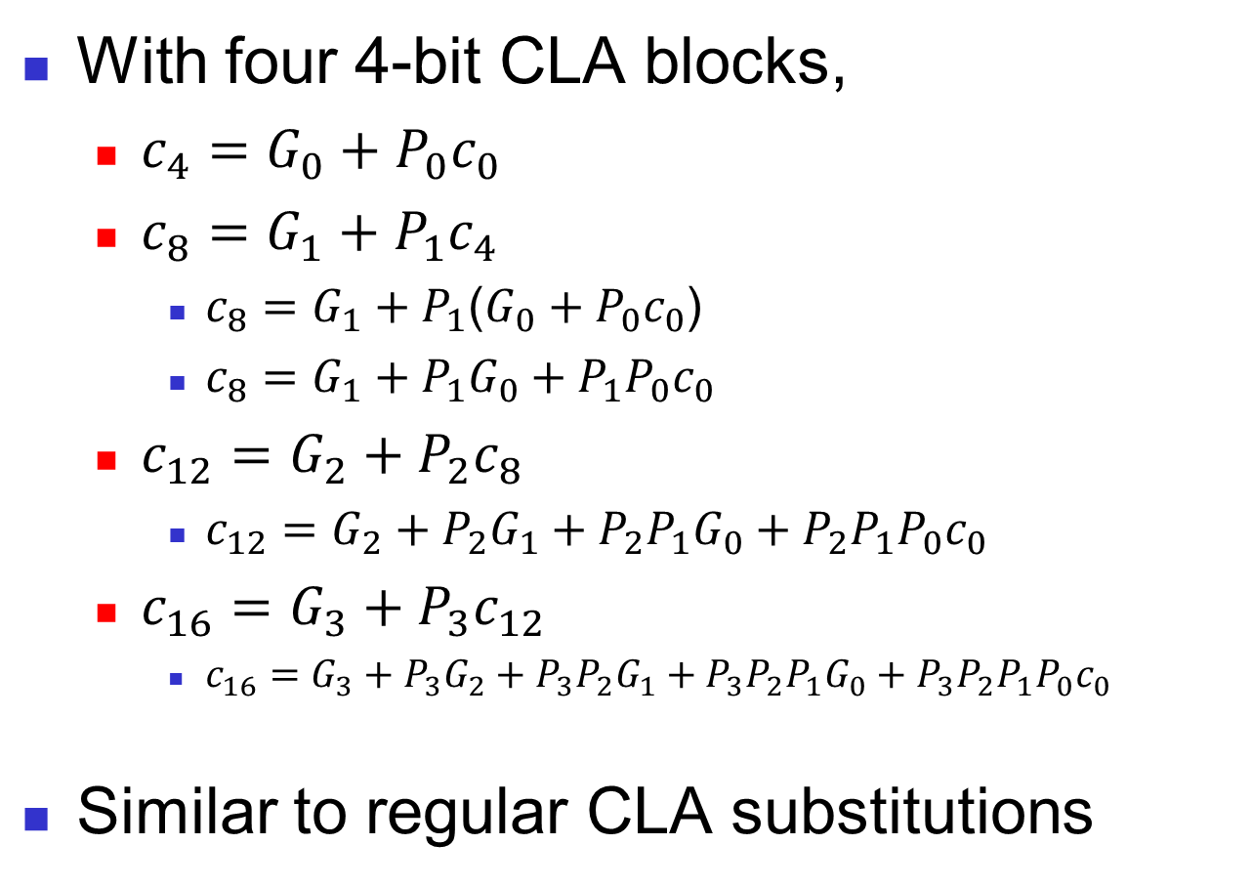
Hierarchical Substitutions
With four 4-bit CLA blocks,
  $c_{4}=G_{0}+P_{0}c_{0}$
  $c_{8}=G_{1}+P_{1}c_{4}$
    $c_{8}=G_{1}+P_{1}$($G_{0}+P_{0}c_{0}$)
    $c_{8}=G_{1}+P_{1}G_{0}+P_{1}P_{0}c_{0}$
  $c_{12}=G_{2}+P_{2}c_{8}$
    $c_{12}=G_{2}+P_{2}G_{1}+P_{2}P_{1}G_{0}+P_{2}P_{1}P_{0}c_{0}$
  $c_{16}=G_{3}+P_{3}c_{12}$
    $c_{16}=G_{3}+P_{3}G_{2}+P_{3}P_{2}G_{1}+P_{3}P_{2}P_{1}G_{0}+P_{3}P_{2}P_{1}P_{0}c_{0}$
Similar to regular CLA substitutions

Slide 27
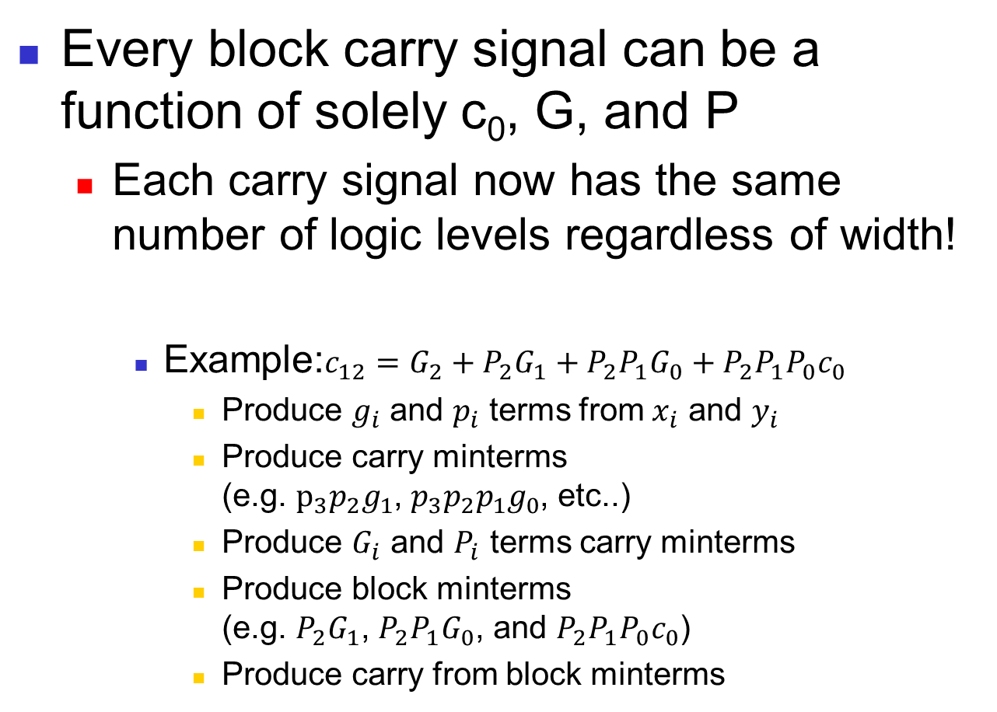
Hierarchical Carry Dependence
Every block carry signal can be a function of solely c₀, G, and P
  Each carry signal now has the same number of logic levels regardless of width!
    Example:$c_{12}=G_{2}+P_{2}G_{1}+P_{2}P_{1}G_{0}+P_{2}P_{1}P_{0}c_{0}$
      Produce $g_{i}$ and $p_{i}$ terms from $x_{i}$ and $y_{i}$
      Produce carry minterms
      (e.g. $p_{3}p_{2}g_{1}$, ${p_{3}p}_{2}p_{1}g_{0}$, etc..)
      Produce $G_{i}$ and $P_{i}$ terms carry minterms
      Produce block minterms
      (e.g. $P_{2}G_{1}$, $P_{2}P_{1}G_{0}$, and $P_{2}P_{1}P_{0}c_{0}$)
      Produce carry from block minterms
Same as before
Same process but with blocks

Slide 28
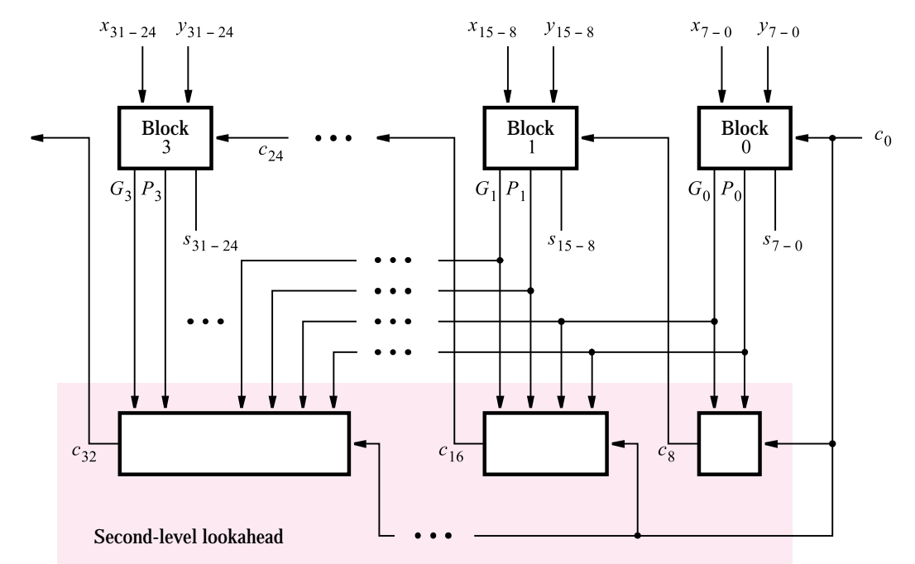
Hierarchical CLA
Textbook illustration of hierarchical CLA using four 8-bit CLA blocks
Figure 2. A hierarchical carry-lookahead adder [1]

Slide 29
Multi-level Hierarchical Approaches
Previous slides showed a couple of two-level hierarchical approaches
  RC architecture using CLA blocks
  CLA architecture using CLA blocks
We can add additional hierarchical levels for different area/delay tradeoffs
  E.g. Three-level CLA Architecture
    CLA architecture using blocks of a CLA architecture using CLA blocks

Slide 30
Practical Limitations
At larger bit-widths, the carry equations requires gates with many inputs
  Fan-in limits the number of inputs on a gate
  A network of smaller gates can be used to avoid fan-in at the cost of additional delay
Ideally
Practically

Slide 31
Practical Limitations
For the CLA, delay is practically not constant due to fan-in
  Larger adders will need networks of gates to handle fan-in in complex carry equations
  Still lower delay than RC Adder

Slide 32
References
Stephen Brown and Zvonko Vranesic. 2004. Fundamentals of Digital Logic with VHDL Design with CD-ROM (2 ed.). McGraw-Hill, Inc., New York, NY, USA.

