Slide 1
Intermediate Fabrics: Virtual FPGA Architectures for Circuit Portability and Fast Placement and Routing on FPGAs
James Coole
PhD student, University of Florida
Dr. Greg Stitt
Assistant Professor of ECE, University of Florida
CODES+ISSS ‘10

Slide 2
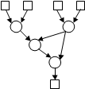

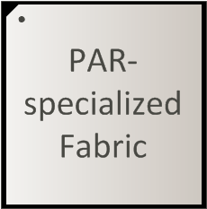
Introduction
Problem: Lengthy, increasing FPGA place & route (PAR) times are a design bottleneck
Previous work: Fabrics specialized for fast PAR [Lysecky04] [Beck05] [Vahid08]
PAR Time

Slide 3
Introduction
Ideally we want the advantages of fast PAR with the flexibility and availability of COTS FPGAs
Approach: virtualize specialized architecture on COTS FPGA

Slide 4
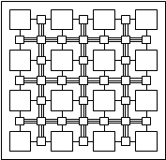
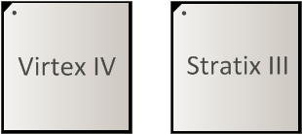
Approach
Definition
  Intermediate fabric (IF): a PAR-specialized reconfigurable architecture implemented on top of COTS FPGAs
  Serves as a virtualization layer between netlist/circuit and FPGA
Motivations
  Orders of magnitude PAR speedups are possible for coarse-grain architectures
    Reduction in problem size compared to FPGA PAR (e.g. multipliers not mapped to LUTs)
  Portability of IF configuration between any FPGAs implementing the same IF
    Enables portable 3rd party PAR tools
  Enables small embedded PAR tools for run-time construction of datapaths
    e.g. dynamic binary translation [Stitt07] [Beck05] on COTS devices
Challenge: virtualization overhead
Fast PAR
Portability

Slide 5
Previous Work
Dynamic FPGA routing and JIT compilation [Lysecky04][05]
  3x PAR speedup
  Requires specialized device architecture
Coarse grain reconfigurable device architectures [Becker01] [Ebeling96] […]
  Faster PAR because of reduced problem size compared to FPGAs
  Domain specific, not as flexible as fine-grain FPGAs
Wires on Demand [Athanas07]
  Fast PAR by routing between pre-PARed modules
  Could be complementary, with IFs being used for PAR of modules
Quku [Shukla06]
  Coarse-grained array of ALUs implemented on FPGA
  Essentially one instance of an IF
  IFs also address PAR execution time and portability

Slide 6
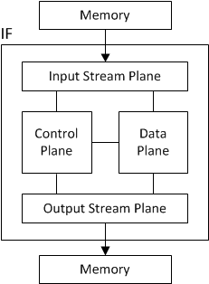
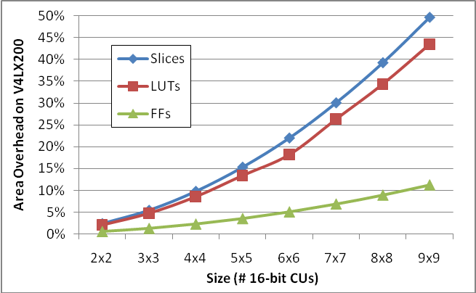
IF Architecture
Implemented in multiple planes – groups of resources with similar responsibilities and a purpose-specialized interconnect
  Stream plane: includes interfaces to off-chip memories and support for buffering
  Control plane: resources for implementing control, such as state machines
  Data plane: resources for computation and data steering *
Overhead: logic utilization and device area required to support fabric configuration
  Slice/LUT overhead primarily due to interconnect of data plane
  Flip-flops due to configuration bits and interconnect pipelining
* primary source of overhead

Slide 7
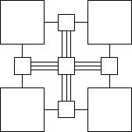
Data Plane
•••
•••
Explored architectures with 2D island topology (FPGA-like)
  Computational units (CUs): implement mathematical or logical operations found in netlists (e.g. multiplication, addition)
    Operations included depends on applications targeted by specific fabric
  Tracks – multi-bit wires used to carry signals over short distances
  Connection boxes – bring routed signals in and out of CUs by connecting to tracks
  Switch boxes – route signals around fabric by bridging tracks
    Currently use planar topology
Resources virtualized by implementation as RTL
  Configuration set by shifting stream of bits into a chain of configuration flip flops

Slide 8
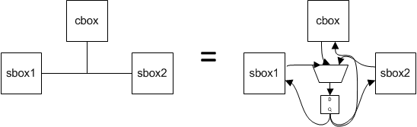
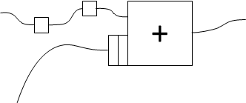
Implementation of Interconnect
Bidirectional tracks implemented as signals for all potential sources selected down to a single sink by MUX
  PAR determines actual source and configures the MUX
  MUXs are biggest contribution to area overhead of IFs
Interconnect is pipelined to maximize clock rate of deeply pipelined netlists
  Configurable-length shift registers on CU inputs used to realign routes
  Prevents combinational loops in IF RTL

Slide 9
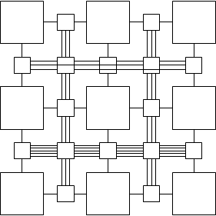
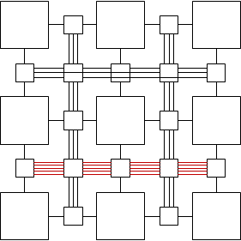
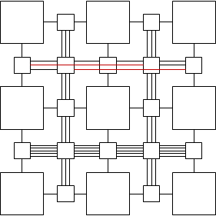
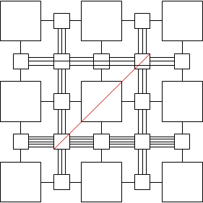
Optimizations
Because the FPGA can implement multiple different IFs, individual IFs can be specialized to particular application domains
  Optimization strategy minimizes overhead by removing or reducing impact of interconnect resources
Global properties:
  Track density – number of tracks per channel
  Connection box flexibility – how adjacent CUs connect to each connection box
Specialization techniques:
  Wide channels – only increase capacity for individual channels
  Long tracks – tracks that hop over switch boxes in a channel
  Jump tracks – long tracks that leave their channel to connect different parts of a fabric

Slide 10
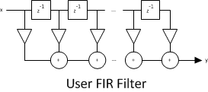

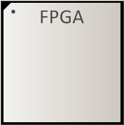
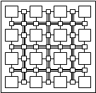
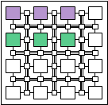

Tool Flow
Intermediate fabrics are created using device (FPGA) tool flow
  IFs stored by system as fabric specification with bitstream to configure the FPGA
  Multiple IFs may be stored in a library to enable the system to handle many applications
During execution, IF tools load bitstream for compatible IF onto FPGA
  IF technology-maps netlist nodes to CUs, and control and stream plane elements
    Should be ~1:1
  IF tools PAR netlist on IF
    Placement based on VPR [Betz97] simulated annealing (SA) placement
    Routing based on Pathfinder [McMurchie95] negotiated congestion routing
  PAR produces IF bitstream to configure the circuit on the hosted IF

Slide 11
Experimental Setup
Explored tradeoffs of area overhead and ability to route netlists (routability)
Developed tool to automate creating RTL for intermediate fabrics
  Island-style data planes with user-definable CU logic
  Parameters for CU distribution, interconnect density, and optimizations
    Track density, track length, etc.
  IFs synthesized using Synplicity Synplify Pro 2009.03 and Xilinx ISE 10.1
Developed random acyclic netlist generator to assess routability for common circuit structures
  Used to test routing a large number of random netlists on the fabric
  Routability: fraction of population that routes successfully on the fabric
    Higher precision metric and not biased by selection of netlists
    Decreases with size of fabric, so can’t compare between fabric sizes
Execution times compared against ISE 10.1 for Xilinx V4LX200s on Quad-Core 2.67GHz Core i7 Xeon workstation

Slide 12
Results: Case Studies
1) Evaluated PAR speedup for a number of example netlists
2) Evaluated area/routability tradeoffs by creating IFs optimized for each netlist
Baseline IFs: high routability, general-purpose interconnect
  Minimum size required to place netlist
  4 tracks per channel
  No long tracks or other optimizations
Specialized IFs: minimized overhead by removing/customizing interconnect
  Minimum size required to place netlist
  Minimized tracks per channel, while still routing netlist
  Randomly explored combinations of long tracks and wide channels
CUs included in IF were matched to requirements of netlist
  For fixed-point netlists, CUs were combination adders/multipliers mapped to Xilinx DSP48s
  For single-precision netlists, CUs were a mixture of Xilinx FP Cores distributed evenly
  Tracks set to CU bit width (16 or 32)

Slide 13
Case Studies: PAR Speedup
 | IF PAR | FPGA PAR | PAR Speedup | Area Overhead | Clock Overhead
Matrix multiply | 0.6s | 6min 06s | 602x | 13% | -11%
FIR | 0.6s | 4min 36s | 454x | 29% | 31%
N-body | 0.5s | 3min 42s | 491x | 10% | 29%
Accumulate | 0.1s | 0min 30s | 323x | 5% | 25%
Normalize | 0.2s | 6min 44s | 1726x | 14% | 18%
Bilinear | 0.3s | 8min 48s | 1784x | 14% | 27%
Floyd-Steinberg | 0.1s | 5min 37s | 2407x | 10% | 14%
•••
avg. floating point | 0.3s | 5min 09s | 1112x | 14% | 19%
Thresholding | 1.4s | 0min 33s | 24x | 10% | 42%
Sobel | 0.3s | 2min 28s | 500x | 6% | 24%
Gaussian Blur | 3.3s | 3min 19s | 60x | 24% | 6%
Max Filter | 0.2s | 1min 16s | 444x | 4% | 23%
Mean Filter 7x7 | 8.9s | 5min 03s | 34x | 26% | 22%
•••
avg. 16b fixed point | 1.3s | 1min 49s | 275x | 9% | 18%
PAR speedup avg. of 275x for fixed-point, 1112x for floating-point netlists
  ~1s PAR
  Speedup increases with complexity of CUs
FPGA PAR times don’t include memory interfaces (FPGA circuit IO → pins)
  Underestimates PAR speedup for many systems (e.g. +10-20 min on GiDEL ProcStar-III)

Slide 14
Case Studies: Overhead
 | PAR Speedup | Area Overhead | Clock Overhead | Routability (Specialized)
Matrix multiply | 602x | 13% | -11% | 100%
FIR | 454x | 29% | 31% | 99%
N-body | 491x | 10% | 29% | 99%
Accumulate | 323x | 5% | 25% | 100%
Normalize | 1726x | 14% | 18% | 60%
Bilinear | 1784x | 14% | 27% | 97%
Floyd-Steinberg | 2407x | 10% | 14% | 100%
•••
avg. floating point | 1112x | 14% | 19% | 94%
Thresholding | 24x | 10% | 42% | 99%
Sobel | 500x | 6% | 24% | 99%
Gaussian Blur | 60x | 24% | 6% | 58%
Max Filter | 444x | 4% | 23% | 98%
Mean Filter 7x7 | 34x | 26% | 22% | 59%
•••
avg. 16b fixed point | 275x | 9% | 18% | 90%
Specialized fabrics required avg. 9-14% more area than circuit on FPGA
  Overhead for unspecialized: 16-23% (48% savings)
  Routability: 91% for specialized, 100% for unspecialized (9% reduction)
Fabrics reduced netlist clock 19% (to ~190MHz) compared to circuit on FPGA
  FPGA circuit implementation pipelined same as IF circuits

Slide 15
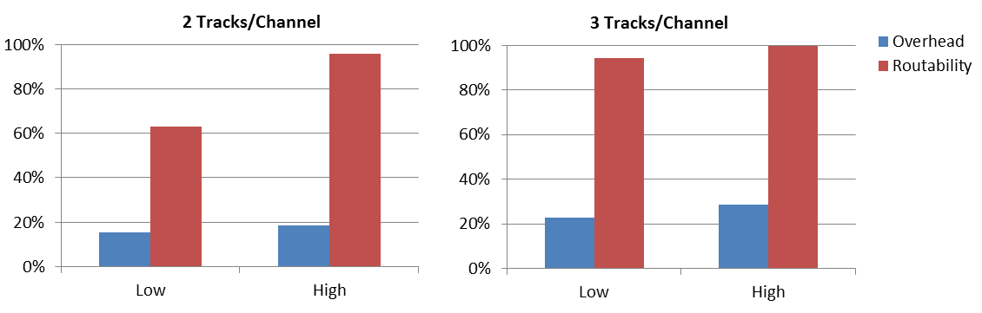
Results: General Purpose Fabrics
3) Evaluate interconnect structures for general-purpose use
Compared routability for general-purpose interconnect
  No application-specific interconnect optimizations
  Comparisons for max-sized netlists (100% of CUs) and random sized netlists
    CUs were 16 bit combination adders/multipliers
Connection box connectivity:
  ~20% decrease in area overhead by using low connectivity
  For low track densities, however, high connectivity significantly improves routability

Slide 16
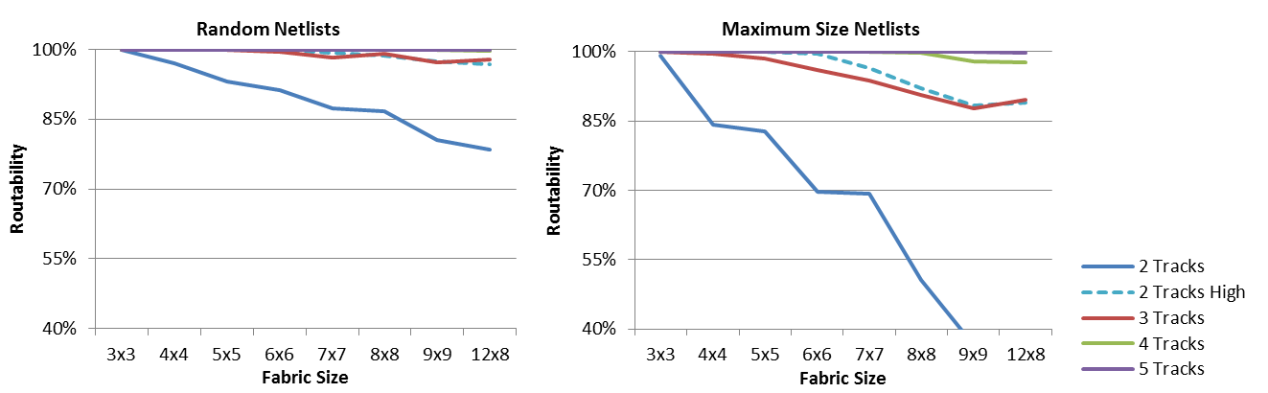
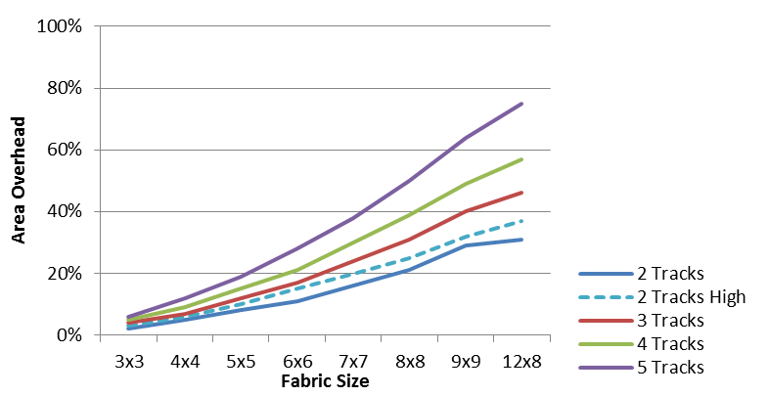
General Purpose Fabrics
For the pipelined datapath circuits we tested, greater than 3 tracks/channel provides only small gains in routability – 2-3 tracks/channel provides reasonable tradeoffs
Overhead is 37% for a 96 CU fabric with 2 tracks/channel
  Routability: 97%, 79% for max-size netlists
  Provides access to all DSP48s on V4LX200
225 CU fabric (16b add/mult) fit on V4LX200
  129 CUs in LUTs, 96 in DSPs

Slide 17
Summary and Future Work
Introduced Intermediate Fabrics: virtual coarse-grain reconfigurable architectures implemented on top of FPGAs
  Demonstrated average 554x PAR speedup across 12 case studies in of pipelined datapath circuits, with feasible area and clock overhead
  Enables small, portable PAR tools by abstracting complexity of underlying device
Main limitation is area overhead introduced by virtual routing resources
  Demonstrated for a reasonably large fabric of 96 DSP units, the virtualization overhead required ~1/3 of a Virtex 4 LX200, with high routability (97%)
  Future work involves implementing interconnect directly using device’s routing resources, with potential to significantly reduce overhead
Presented techniques to reduce overhead by specializing the fabric interconnect to particular domains
  Demonstrated average reduction in overhead of 48%, with 91% routability
  Future work involves methodologies for developing libraries of domain-specialized IFs, and algorithms for efficiently searching libraries of IFs

