Slide 1
A Close-up Lens to eFPGA ( Embedded Field Programmable Gate Array)
Tasnuva Farheen, Greg Stitt
ECE Department
University of Florida

Slide 2

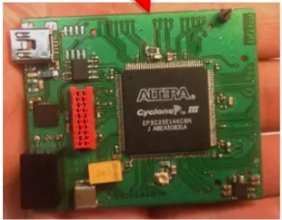
What is eFPGA?
Typical FPGA
Embedded FPGA
GPLL
GPIO
GPLL
Hardwired
RTL
Processor
SRAM
MPLL
High Speed Trans
receivers
Buses
PCI Express HIP
FPGA Core
GPIO
eFPGA
DSP
Hardwired
RTL
FPGA Core
MPLL
Integrated in a Chip
GPLL
GPIO
GPLL
No High Speed SERDES, PLLs, hard IP bus
interfaces, GPIO Buffers
Goes on PCB
SOC
SOC
FPGA
FPGA

Slide 3
eFPGA Construction
Reconfigurable Building Block
Like FPGA cores, eFPGA constructed of some building blocks.
Programmable logic and interconnect surrounded by CMOS I/O blocks.
Every supplier does things similarly. LUTs are LUTs, the inputs/outputs are CMOS and there is always an interconnect network.
What varies is LUT size: 4-input LUTs or 6-input LUTs.
Reset
Cout
6
6-in-2-out
LUT
2
2
3
FF
6
6-in-2-out
LUT
2
2
3
FF
From Interconnect Network
Carry Arithmetic Data Multiplexer
Output Selection
6
2
To Interconnect Network
6-in-2-out
LUT
2
FF
3
6
6-in-2-out
LUT
2
2
3
FF
Aux. Input
Cin

Slide 4
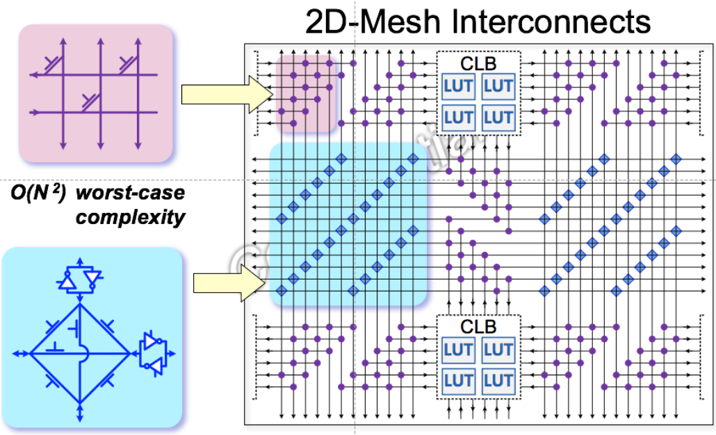
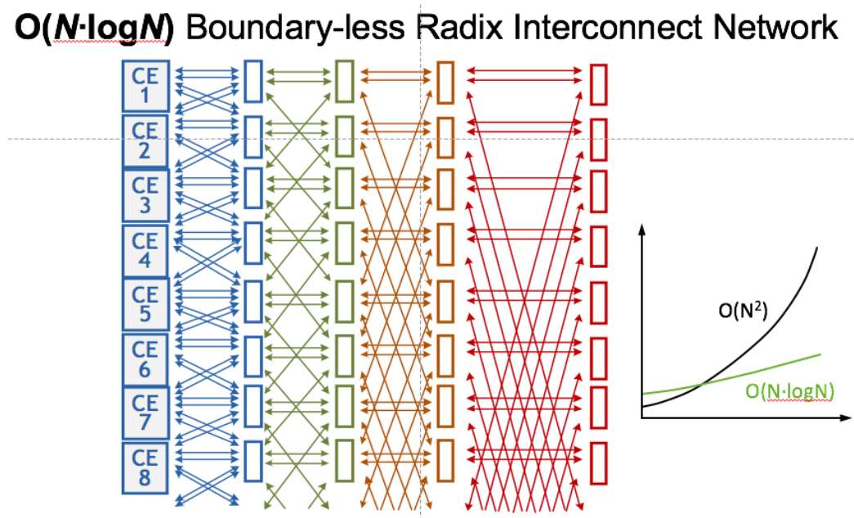
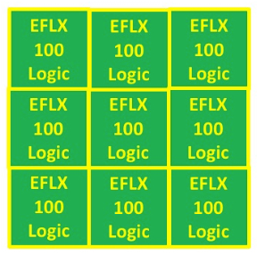
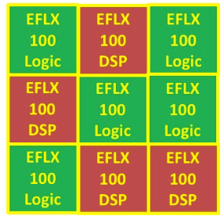
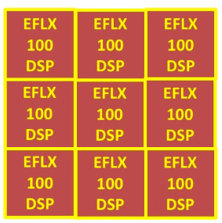
Traditional FPGA vs. eFPGA
Advantage: As the array size grows (N LUTs), the size of the interconnect grows much less than the traditional mesh interconnect.
Estimation: 2X dense interconnect in eFPGA. This is very significant because, 80% of the area is interconnect, only 20% is programmable logic.
In an FPGA chip there is usually a fixed ratio of LUTs and MACs(Multiplier Accumulators), but in eFPGA, it is possible to have all-LUTs or a mix of LUTs/MACs as the application requires.
2D-Mesh Interconnects
O(N-logN) Boundaryless Radix/
Hierarchical Interconnect Network
Source @ https://semiengineering.com/introduction-to-efpga-hardware/

Slide 5
Motivation
Why use an FPGA at all?
Performance and Flexibility
Why put a programmable fabric in your ASIC or SoC?
Application processor and the FPGA are in separate chips.
Communications between the two represent a major bottleneck.
No matter how fast the communications between the two devices, the FPGA is always logically “far away” from the processor.

Slide 6
Acceleration System
Typical FPGA Acceleration System
eFPGA Acceleration System
Traditional FPGA:
Latency in data transfer, serializing and deserializing
Memory Shuffling
Embedded FPGA:
Solves latency bottleneck instantiating as much connectivity between the on-chip processor(s) and the FPGA(s) as required by application.
Solving memory shuffling by direct access to processor’s DDR.
CPU
Cluster
FPGA Fabric
FPGA Fabric
On chip Interconnect
Communication
DDR
Controller
PCI Express
DDR
Controller
PCI Express
DDR
DDR
Area
Performance
Power

Slide 7
Programming of eFPGA
How do you program an eFPGA?
CPU
Cluster
always @ (posedge clk)
Y<=A+B;
PCI
Express
Cache
Synthesis
Clk
A
Place & Route
LUT
LUT
DSP
LUT
B
LUT
Logic
LUT
LUT
DSP
Y
LUT
LUT
DSP
Control Unit
Bit Stream
FPGA Fabric

Slide 8
Design Consideration in eFPGA
Process
Node
Compatibility
Flexibility in
types of
RAM Choosing
Metal Stack
Compatibility
Error Protection options
Time to Market: 6 months
Time to Market: Within Weeks
eFPGA process node must be compatible with the rest of the chip whereas in case of traditional FPGA it is not a matter of concern as long as it is fastest
Process node matches: Flexibility, Capacity, types of RAM and error protection options

Slide 9
Verification of eFPGA
Discrete FPGA
ASIC
Embedded FPGA
RTL
Test Vector
Wrapper
Syn
Gate
Logic to Program
FPGA Fabric
VHDL/ Verilog
FPGA
IP
(User Block)
PNR Netlist
Bit Stream
Simulation
Embedded FPGA as an IP block within the ASIC
Two aspects to verify:
Programming interface is working correctly
Verify all the connections in and out of the user block and the implemented function in the FPGA fabric working correctly in ASIC domain

Slide 10
Timing Analysis
CCS
.lib
RBB Timing
table for each
mode
TSMC
ASIC
S.T.A
(RC) Worst/best
(CC) Worst/best
T (-40/0/100)°C
SDF Timing
file for
Interconnect
.spef
Delay Model
RBB 2
RBB 0
RBB 1
LUT
FF
LUT
FF
LUT

Slide 11
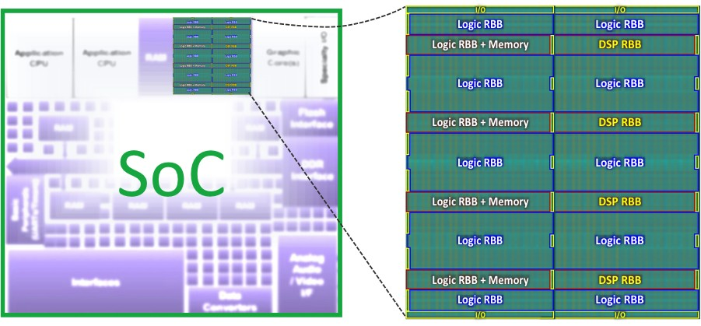
eFPGA Recap
The clock(s) for the eFPGA come from the SoC.
The configuration of the eFPGA is done by the SoC.
The input pins of the eFPGA are driven from the SoC and the output pins of the eFPGA connect to other blocks of the SoC: the connection can be to a system bus like AXI, to the data/control paths, to memory or to I/O or a combination of all of these.
SOC
Source @ https://semiengineering.com/introduction-to-efpga-Software/

Slide 12
EDA Tools for eFPGA
. V
. edif
Flex Logix
EFLX
Compiler
. bit
RTL
Synopsys
Synplify
Bit File for EFLX
eFPGA is an “RTL engine” programmed using Verilog or sometimes VHDL
eFPGA “execute” the RTL cycle by cycle from inputs through the RTL in the eFPGA to the outputs.
Synthesis Tool: Synopsys’ Synplify
Synthesis tool reads in the Verilog or VHDL and generates an EDIF file
EDIF: a vendor-neutral format to store electronic netlists.
The EDIF file then processed by the eFPGA’s own software to do packing, placing, routing, timing generation and then bit file generation
Each eFPGA’s hardware implementation is quite different in terms of LUT sizes, clocking structure, array layout, and especially interconnect network

Slide 13
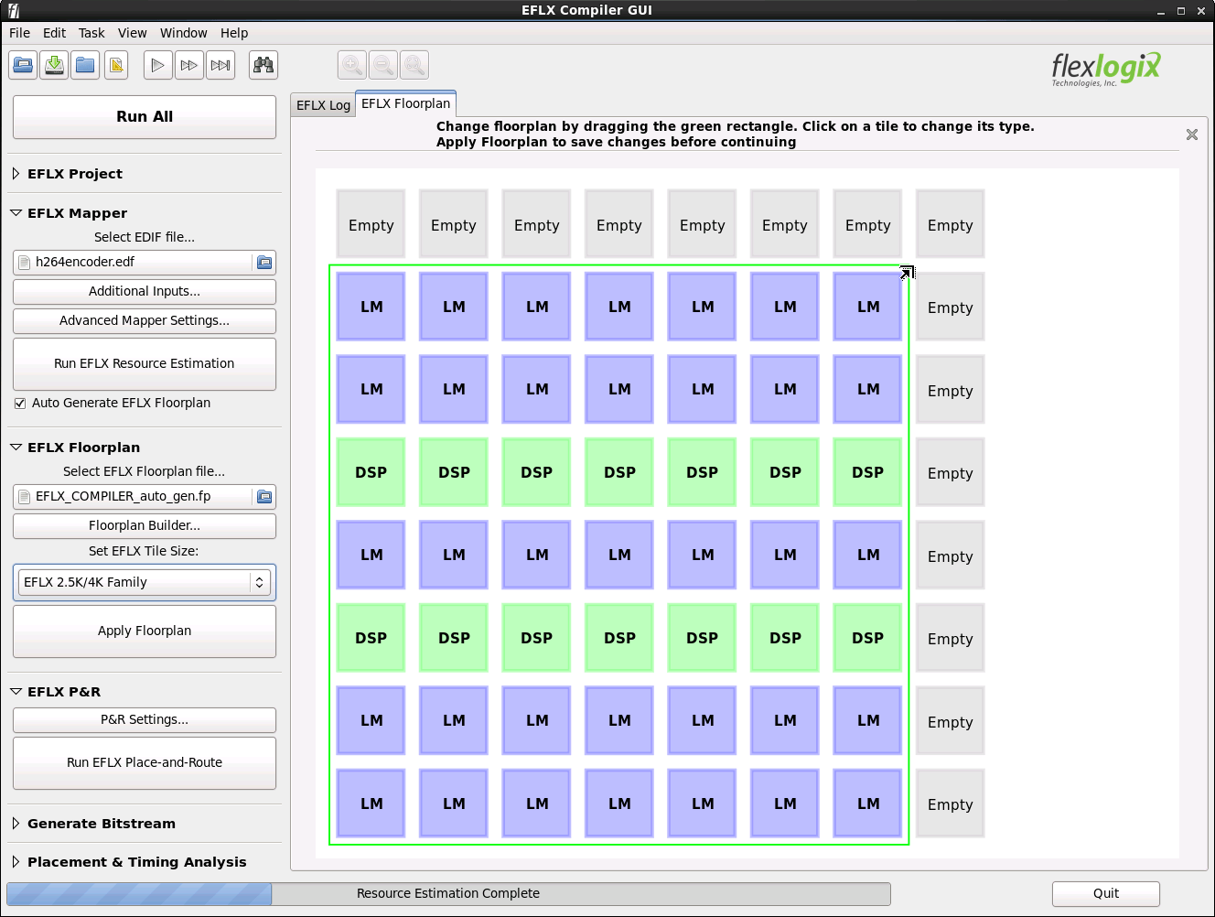
eFPGA Compiler
Input: EDIF File
‘Run All’ in the Compiler:
select an appropriate array size and configuration
Generate an appropriate I/O pin mapping file
Generate an appropriate memory (RAMDEF) file
Then place/route and generate timing
The floor planner tool allows to configure arrays
Source @ https://semiengineering.com/introduction-to-efpga-Software/

Slide 14
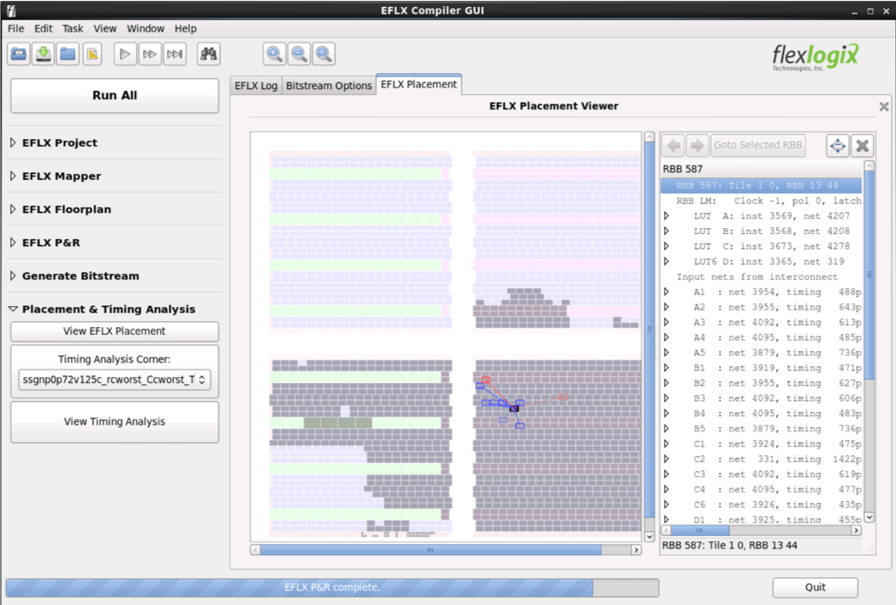
Placement Viewer
Placement viewer allow a designer to see which blocks of the core are utilized
Inspect individual timing paths
Give insight in to how to optimize the design for improved performance
Source @ https://semiengineering.com/introduction-to-efpga-Software/

Slide 15
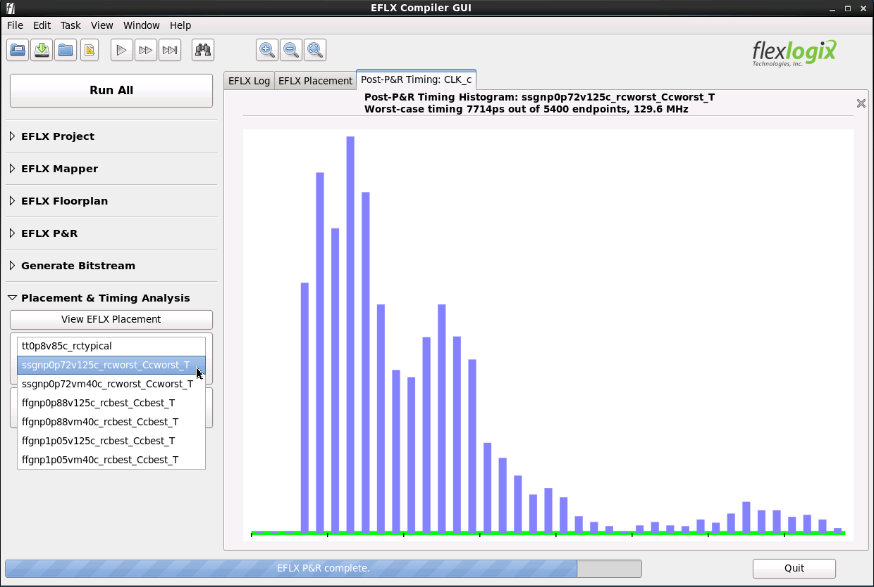
Timing Analyzer
Another tool is the timing analyzer histogram
Histogram shows the number of timing paths in each band
It is possible to clock on each column of the histogram to see a list of timing paths
Each timing path can be selected to see how it breaks down step by step from the clock input of a flop, through the logic and interconnect stages to the setup of the destination flop.
Source @ https://semiengineering.com/introduction-to-efpga-Software/

Slide 16
Security in terms of eFPGA
System level security with least PPA overhead
Provides IP protection
The flexibility of burning the bitstream after the fabrication
Don’t share the IP functionality with any entity of the supply chain
Safeguard against counterfeit parts
Obfuscating a portion of the ASIC’s circuitry in eFPGA
Program the eFPGA as part of the ASIC’s pre-boot sequence
eFPGA can also be used within an IP block itself for specific security requirements in subsystems
FPGA Array
IO RBB
Din
Din_i
Confidential Design
Dout
Dout_i
Clk

Slide 17
Applications
Wireless Telecom Industry
Specifications are constantly being updated from 3G/4G/5G
Meet stringent size, weight, and power requirements
Fintech/High-Frequency Trading
eFPGA reducing latency by a microsecond can be worth millions of dollars
Artificial Intelligence/Machine Learning (AI/ML) Inference and CNNs
Convolutional Neural Network (CNN) inference algorithms rely heavily on multiply/accumulate operations and programmable logic
Speedcore eFPGAs can significantly accelerate such algorithms using the massive parallelism made possible by including a large number of programmable DSP blocks in eFPGA specification

