Slide 1
Demystifying Recursive Architecture Descriptions in VHDL
Presenter: Austin Baylis
November 25, 2019

Slide 2
Basics of Recursion
In mathematics and computer science, a recursive definition, or inductive definition, is used to define the elements in a set in terms of other elements in the set
Example: Fibonacci Sequence
The Fibonacci numbers form a sequence such that each number is the sum of the two proceeding ones, starting from 0 and 1
0
1
1
2
3
5
8
13
21
34
55
89
144
…

Slide 3
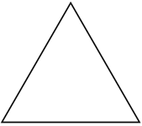
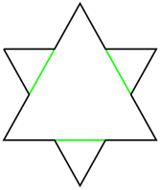
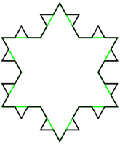
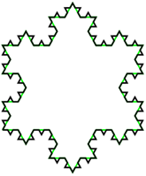
Basics of Recursion
Example: Koch Snowflake
Can be constructed by starting with an equilateral triangle, then recursively altering each line segment as follows:
divide the line segment into three segments of equal length
draw an equilateral triangle that has the middle segment from step 1 as its base and points outward
remove the line segment that is the base of the triangle from step 2

Slide 4
Basics of Recursion
The three laws of recursion:
A recursive algorithm must have a base case
A recursive algorithm must change its state and move toward the base case
A recursive algorithm must call itself, recusively
Base case
A base case is typically a problem that is small enough to solve directly
Change in state
A change of state means that some data that the algorithm is using is modified. Usually the data that represents our problem gets smaller in some way.
Algorithm must call itself
When we talk about recursion it may seem that we are talking ourselves in circles. But the logic is not circular at all; the logic of recursion is an elegant expression of solving a problem by breaking it down into a smaller and easier problems.

Slide 5
Adder Tree

Slide 6






Data Flow Graph
In_0
In_1
In_2
In_3
In_4
In_5
In_6
In_7
$$+$$
$$+$$
$$+$$
$$+$$
$$+$$
$$+$$
$$+$$
Out

Slide 7
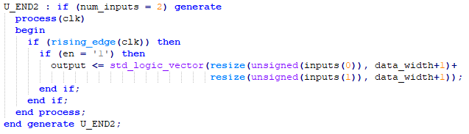




Two Base Cases
Number of inputs = 2
In_0
In_1
$$+$$
Number of inputs = 1
In_0
In_1
In_2
$$+$$
$$+$$

Slide 8
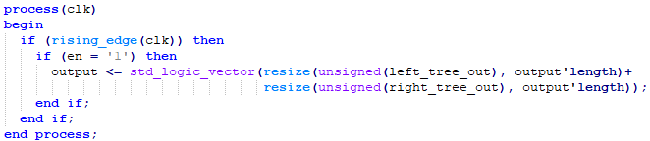



Change in State
Split the larger tree into two smaller trees
If there are more than two inputs, treat each input as its own add_tree
Add the results of the two subtrees
In_0
In_1
In_2
In_3
$$+$$
$$+$$
$$+$$
Out

Slide 9
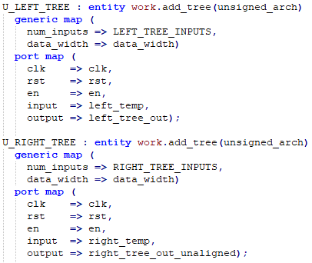



Call Itself
Each subtree is just a smaller add_tree
Divide the inputs
Feed them into add_tree entities
In_0
In_1
In_2
In_3
$$+$$
$$+$$
$$+$$
Out

Slide 10

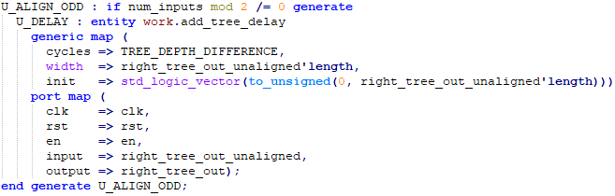


Balancing
Not so much a step in the recursion as it is maintaining the synchronization of data in the adder tree
If the number of inputs is a power of 2, then every subtree will have 2 inputs
Otherwise, at least 1 subtree will not have an adder, which means it must be delayed to keep the data synchronized
In_0
In_1
In_2
$$+$$
$$+$$

Slide 11
Demystifying Recursive Architecture Descriptions in VHDL
Presenter: Austin Baylis
November 25, 2019

