Slide 1

Partial Reconfiguration
Not just a half baked job of reconfiguring
Dr. Herman Lam
Assistant Professor of ECE
University of Florida
Rohit Kumar
Joseph Antoon
Research Students
University of Florida

Slide 2
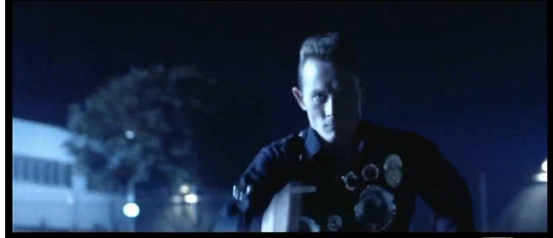
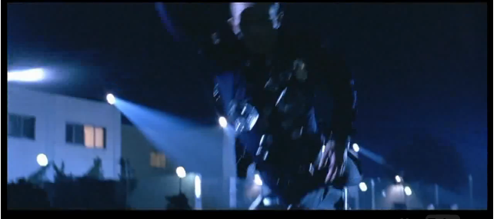
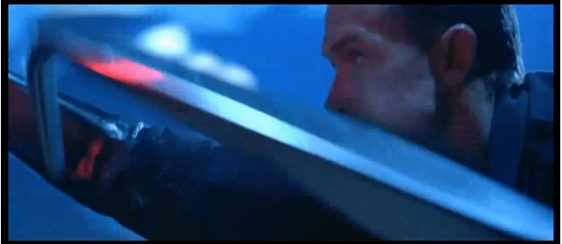
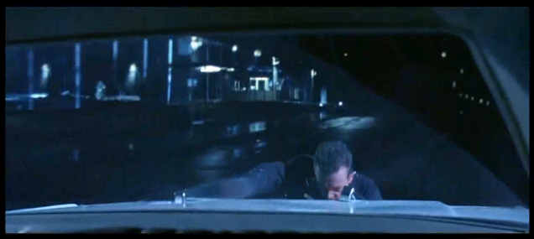
Partial Reconfiguration is All Around Us
Changing situations…
…require part of the system to reconfigure on the fly

Slide 3



Partial Reconfiguration is All Around Us
But, FPGA reconfiguration
is disruptive
  Resets the device
  Lose all data
  Causes downtime
Downtime is dangerous

Slide 4


Full Reconfiguration:
This is your
FPGA on PR
This is your FPGA
Static
Task 1
Task 2
Task 2
Task 1

Slide 5

Why Partial Reconfiguration?
So what??
I’ll just put both tasks on
the same device!
Sure, why not?
But, devices have limited space!
Not impressed
Reason #1
Sharing many tasks on a single region saves area!
FPGA
Task 1
Task 2
Task 3
Task 4
Task 5
Task 6

Slide 6

Why Partial Reconfiguration?
I got it! I’ll just use PR on a
tiny cheap FPGA and time-
multiplex everything!
Okay, we’ll give you
that one
But, it’s a trade off
  The more parallelism, the better the performance
  Plus, some tasks must be run in parallel
Reason #2
Using less area on a smaller device is less costly!

Slide 7
Why Partial Reconfiguration?
So that’s it??
I pay a bunch more just to
use less area?
Well, you know you could save power?
  Imagine you have two versions of a task
    High-performance version
    Low power version
  When performance is critical
    Load the high-performance version
  When performance is less critical
    Load the low-power one
Man, what a buzz-kill
Reason #3
Replace tasks with low-power versions when possible!
FPGA

Slide 8
Why Partial Reconfiguration?
So what??
I’ll just use clock gating (CG)
and dynamic frequency
scaling (DFS), both of which
are available for Xilinx FPGAs
Right… well… you see… actually….
Hmm…
Shut up

Slide 9

Why Partial Reconfiguration?
Okay, but I’m not sold
unless there are 4 reasons.
Did you know PR keeps your
device safe in space?
  In space, cosmic radiation corrupts SRAM!
  These are called single event upsets (SEU)s
With PR, you can patch FPGA configuration memory
  Without turning off the device
  This is called “scrubbing”
FPGA
10111011
FPGA
01101100
Reason #4
PR keeps circuits safe in harsh environments
But FPGA configuration memory uses SRAM!

Slide 10


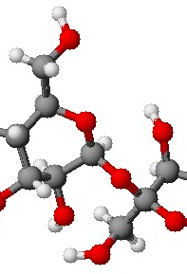

So you wanna make a PR design…
First, we make partitions
  Partitions are like black boxes
    They start out empty
    Then we load modules
  Modules run tasks
  To change tasks
    Load a new module
    Old one is overwritten
The FPGA (not to scale)
Partition 2
f
Partition 1
a
f
a
b

Slide 11

So you wanna make a PR design…
Modules have to fit like puzzle pieces
  Black boxes have a defined interface
  All modules must fit that interface
Where the ports are matters as well
  Ports must be in the same place for every module
  “Partition pins” are port location definitions
  They ensure connections are not broken during PR
The FPGA (not to scale)
Partition 2
f
Partition 1
a
f
a
b

Slide 12

So you wanna make a PR design…
Quit sugar-coating it, sirs, I
am not a child you know.
Oh, fine. This is what you’re
going to learn today:
  Logically partitioning your application into modules
  Preparing your partitioned design in ISE
  Floor-planning the layout of your device in PlanAhead
  Implementing your design in PlanAhead
  Finding your inner child through meditation (time permitting)

Slide 13

Step 1: Logical partitioning
The first step to make a PR design is breaking the application into sets of mutually exclusive components
Easy there buddy
Two components are mutually exclusive if
  Only one is used at a time
  One’s inputs don’t directly depend on the other’s outputs
Only mutually exclusive components share a partition
  So, before you can make your design…
  You must find as many of these as you can

Slide 14



Step 1: Logical partitioning
He’s still not reassured
Okay, lets do an example
This is an up/down counter
The add and the subtract
  …are mutually exclusive
  Only one is used
  They do not depend on each other
The store and the add
  …are not mutually exclusive
  The store depends on the add’s output
The add and subtract can share a partition
  The add forms one reconfigurable module
  The subtract forms another reconfigurable module
Direction = up
Result = 0
Direction = up
Result = 0
PR!
up
Direction?
down
Result ++
count
Result ++
Result --
Result ++
Store Result
Get Direction
Store Result
Get Direction

Slide 15
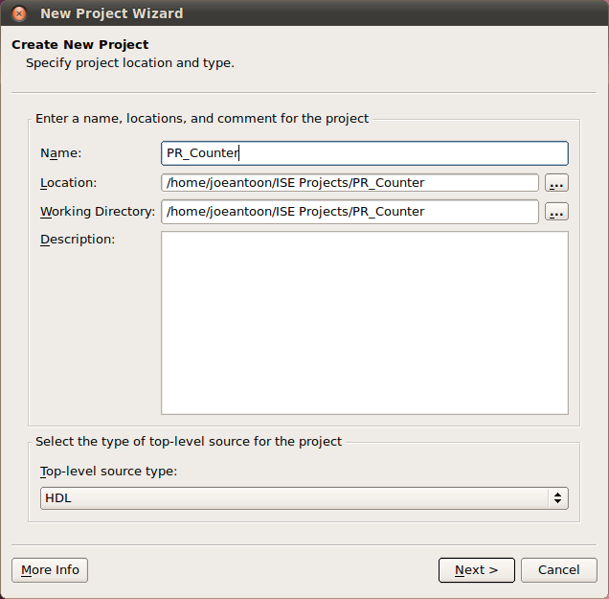
Step 2: Preparing your PR design
We’ve partitioned our design.
  Now let’s partition our code
Create a new ISE project

Slide 16
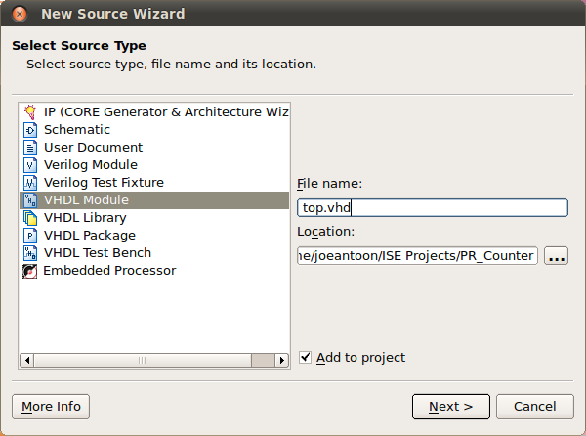
Step 2: Preparing your PR design
Add a new VHDL source file
  This is going to be our top file with all of the structural descriptions

Slide 17
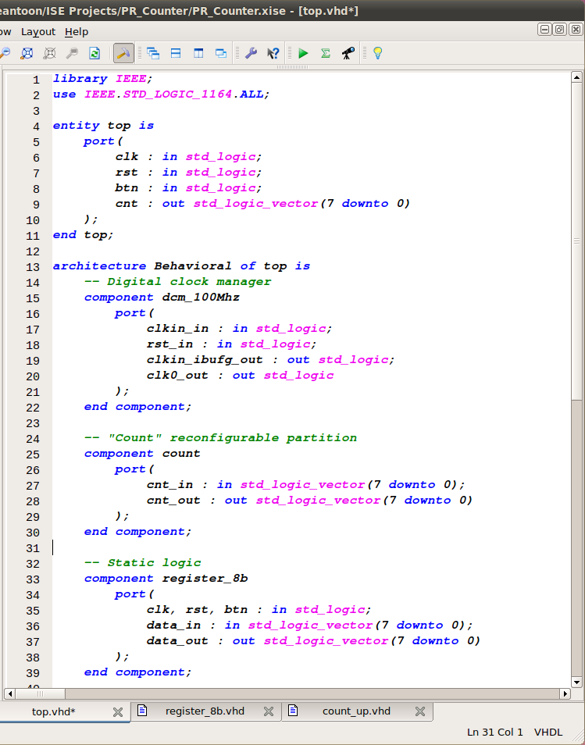
Step 2: Preparing your PR design
This is our top file
  We have components for
    The DCM to stabilize the clock
    The partition (“count”)
    The static logic (“register_8b”)

Slide 18
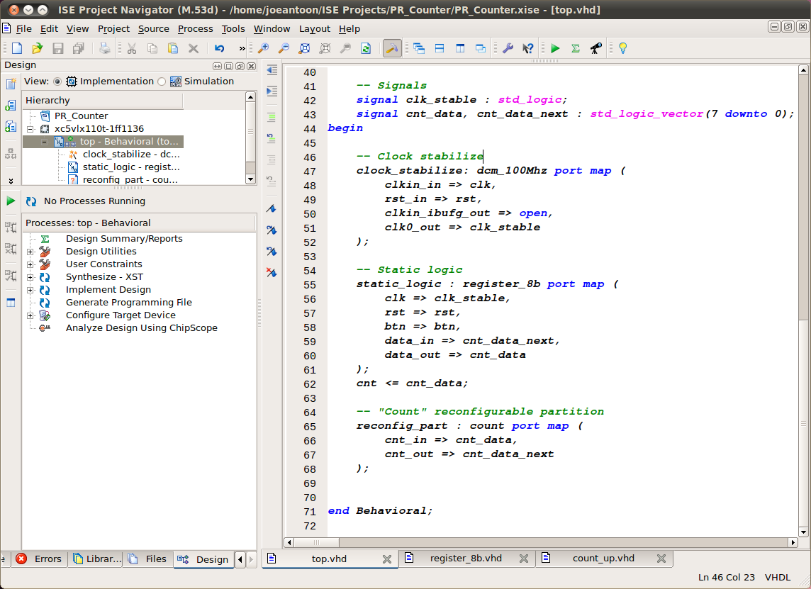
Step 2: Preparing your PR design
This is the our file
  We have components for
    The DCM to stabilize the clock
    The partition (“count”)
    The static logic (“register_8b”)
We wire it up like so

Slide 19
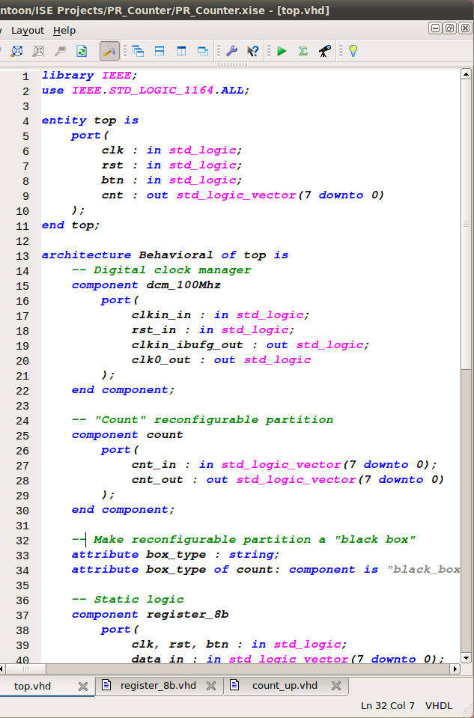
Step 2: Preparing your PR design
To avoid errors
  Set the partition as a black box
  This will let us synthesize the |
  top file without any reconfigurable
  modules
Our reconfigurable modules
  Will be synthesized separately

Slide 20
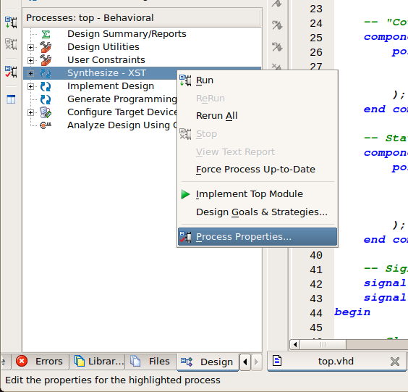
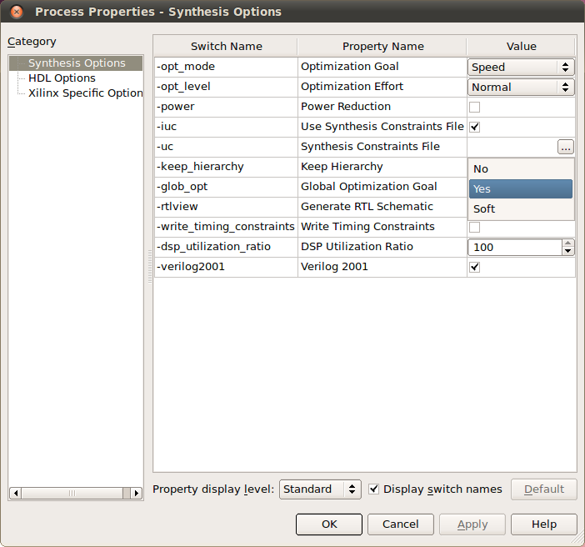
Step 2: Preparing your PR design
Now we need to make sure
that our black box is not cut
out
  Click on the top file
  Right click on “Synthesize XST”
  Choose “Process Properties…”
  Set “-keep_hierarchy” to “Yes”

Slide 21
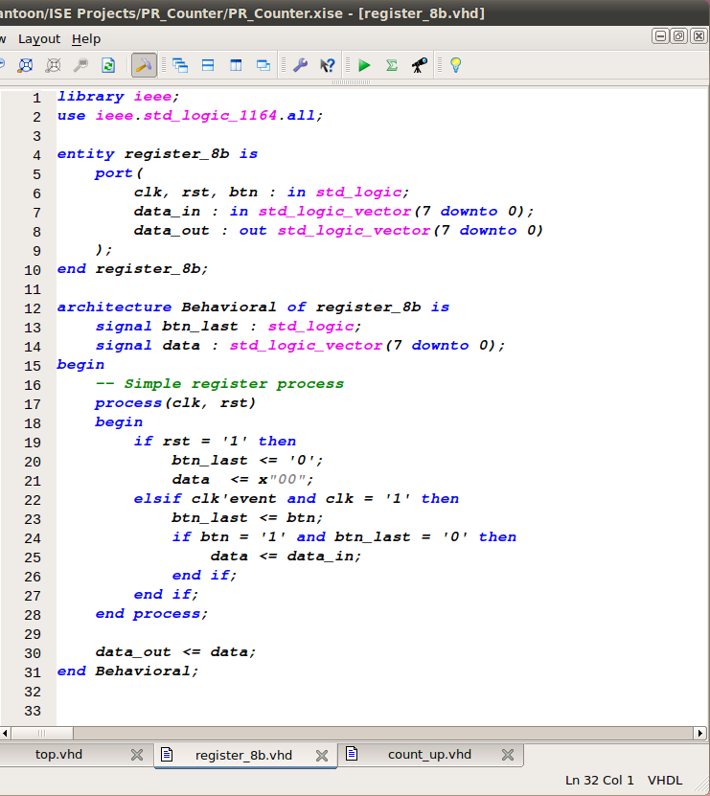
Step 2: Preparing your PR design
This our static logic
  Is basically a register
    …tied to the button
  It exports the current count
  It takes in the next value
Add this to your design

Slide 22
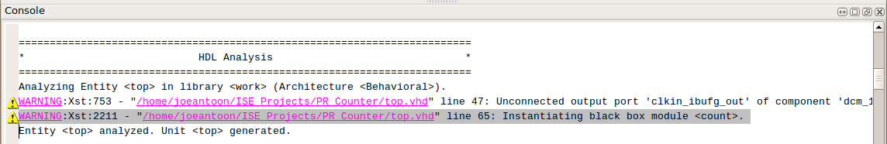
Step 2: Preparing your PR design
Synthesize the top file!
You will get a warning
  …about the black box
  Don’t worry about it

Slide 23
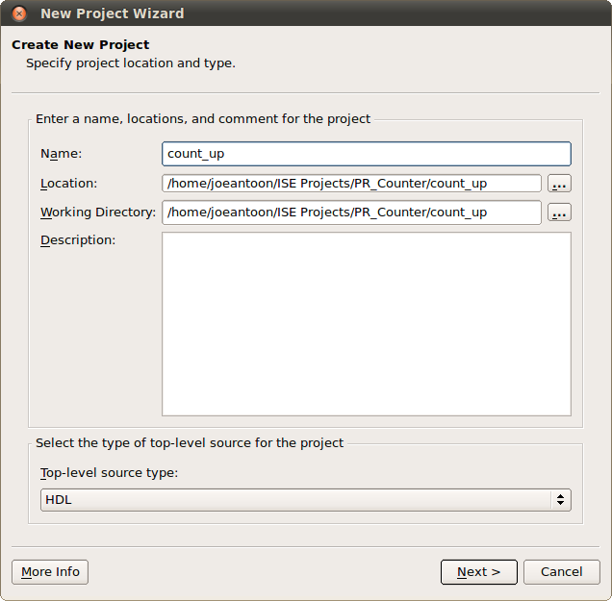
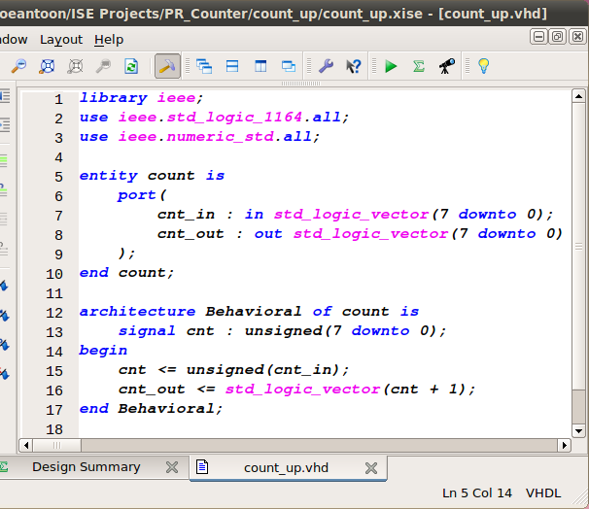
Step 2: Preparing your PR design
Now create a project for our add
  Each reconfigurable module needs its own project
  We’ll call the add “count_up”
  Add a new source, the VHDL isn’t tough

Slide 24
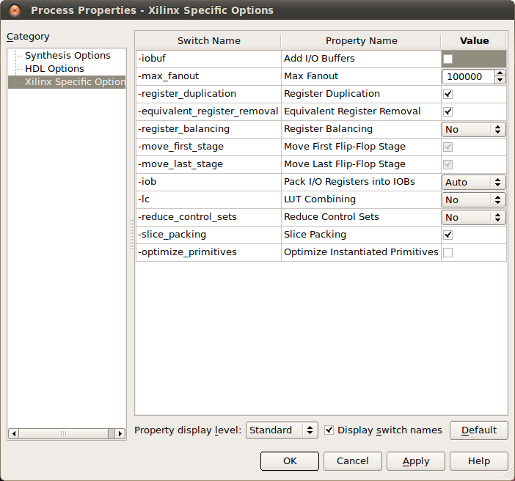
Step 2: Preparing your PR design
To avoid errors
  We need to turn off a feature
    … that adds IO buffers to all the ports
  Right click “Synthesize – XST”
  Choose “Process Properties”
  Click “Xilinx Specific Options”
    It’s on the left pane
  Uncheck “Add I/O buffers”

Slide 25
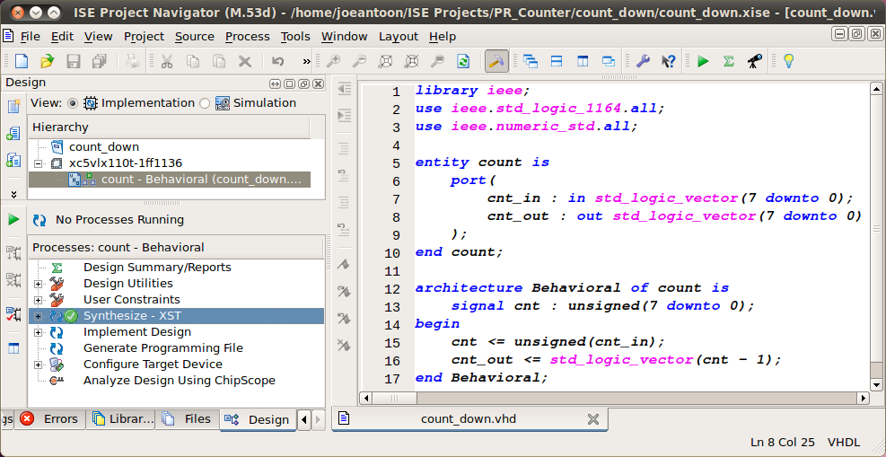
Step 2: Preparing your PR design
Make a new project for the subtract
  Call it “count_down”
  Follow the same procedure as “count_up”
  You’ll find the VHDL is very similar

Slide 26
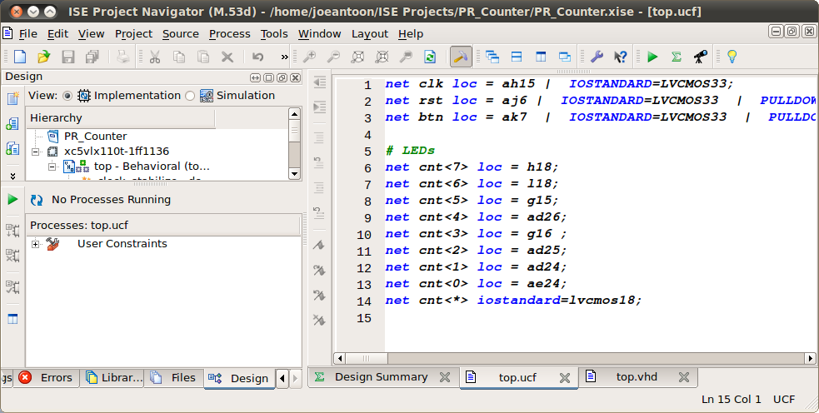
Step 2: Preparing your PR design
Synthesize both “count_up” and “count_down”
Create a UCF file for your top file
  This connects ports to physical pins on the FPGA
And now your design is ready to floor plan!

Slide 27
Step 3: Floor planning the layout
We have partitioned our code
  Now lets decide where do these partition go in FPGA i.e., floor plan our partition
Xilinx PlanAhead is used for floor planning
After creating a new project for you top design you’ll get this

Slide 28
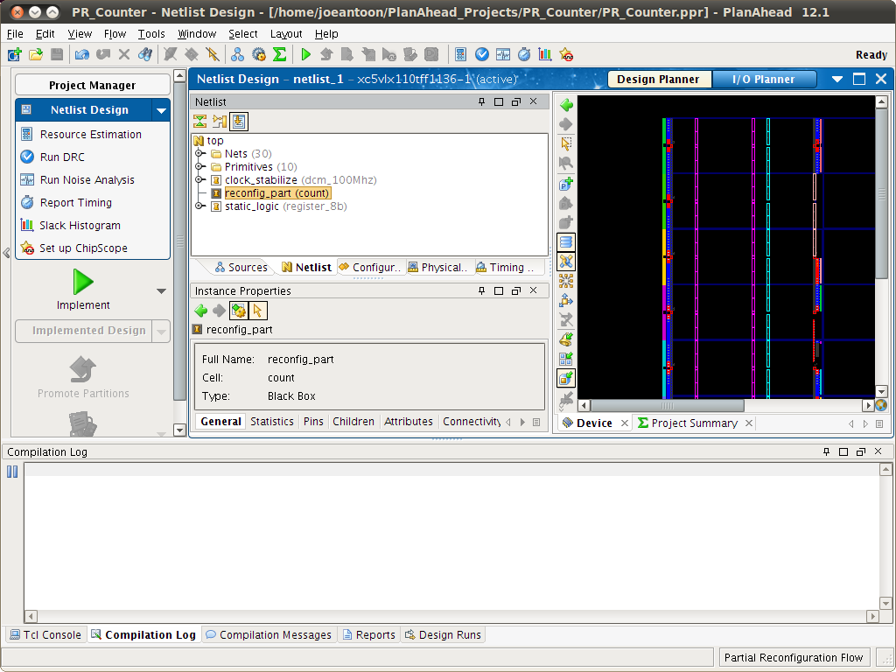

Slide 29
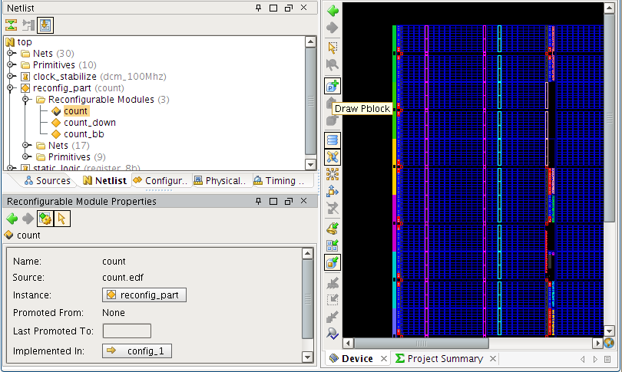
Step 3: Floor planning the layout
Set the partition as reconfigurable partition
Assign reconfigurable modules to partitions

Slide 30
Step 3: Floor planning the layout
Set the partition as reconfigurable partition
Assign reconfigurable modules to partitions

Slide 31
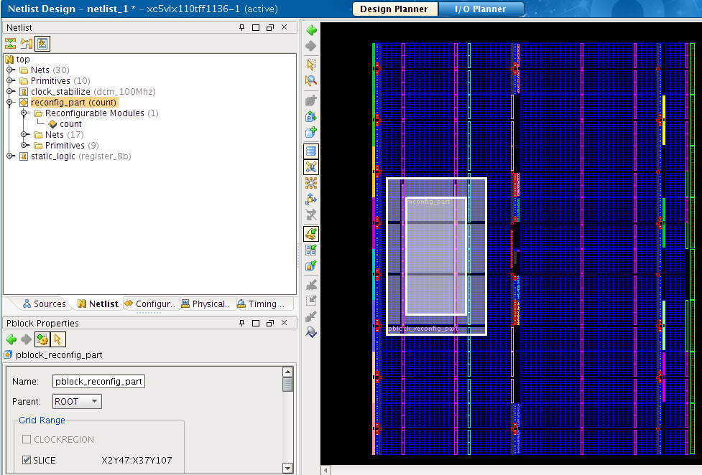
Step 3: Floor planning the layout
Assign the FPGA area to the partition

Slide 32
Step 4: Implementing your design
Now its quite a bit of mechanical clicking
  At the end you get full and partial bit streams
Full bitstream can only be loaded from outside of FPGAs
  SelectMAP based programmers
Partial bitstreams can be flashed from outside as well as inside of FPGA
  Instantiate ICAP based VHDL controllers in your design
DONE

Slide 33


Now some cool stuff that our group has been doing in CHREC

Slide 34
VAPRES:
A Virtual Architecture for Partially Reconfigurable Embedded Systems
Dr. Ann Gordon-Ross
Assistant Professor of ECE
University of Florida
Abelardo Jara
Rohit Kumar
Research Students
University of Florida
Prepared by: Joseph Antoon
Presented by: Rohit Kumar

Slide 35




Adaptive Hardware Applications
Kalman filter used for target tracking
  Finds likely location from noisy measurements
  Optimized filter depends on target type
Slow Target
Low Power | Constant gain
Low Bandwidth | Kalman Filter
Fast Target
High Power | Constant gain
High Bandwidth | Kalman Filter
Airborne Target
High Power | Variable Gain
Low Bandwidth | Multi-scale Smoother
Noisy Target
High Power | Variable Gain
Low Bandwidth | Kalman Filter

Slide 36
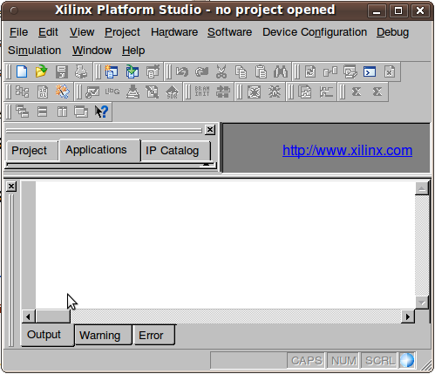
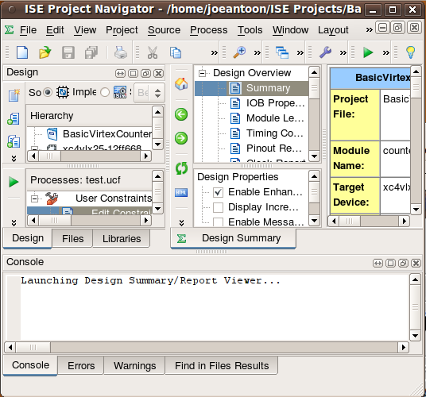


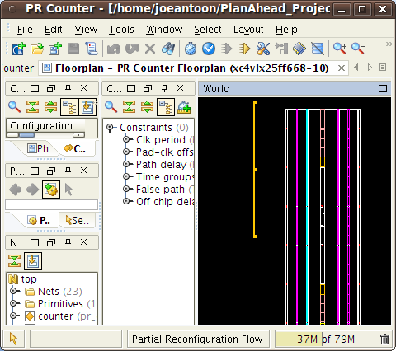

Using Partial Reconfiguration
System Specifications
1. Define system
2. Platform studio
3. Import into ISE
top
7. Synthesize!
11. Implement!
Could you make it just a bit different…
static
prr_a
prr_b
6. Code PR
region HDL
5. Set PRRs as black boxes
4. Divide project into mandated hierarchy
9. Map on to PlanAhead
10. Create “configurations”
8. Guess Estimate
a good floorplan
12. Write software

Slide 37

Identifying Issues With PR
Support
  Only supported by Xilinx
  Altera support announced
Lack of abstraction
  Manual partitioning
  Manual floor-planning
App-specific architectures
  Increased time-to-market
  Reduced flexibility
Frustrating
Design Flow!
In this work, we propose VAPRES
  A Virtual Architecture for PR Embedded Systems
  Abstracts base system from application
  Automates design flow and floor-planning
  Scalable, flexible features

Slide 38
VAPRES Architecture
  PR Regions (PRRs)
    Independent clocks
    FIFO-based I/O
    Online placement
    Created separately
  MACS
    Intermodule network
  Flexible, scalable
    PR Region Count
    PR Region Size
    MACS bandwidth
      Module channel width
      Left to right channel width
      Right to left channel width
    IO Module Count
PLB Bus
PLB Bus
DCR
Bridge
DCR
Bridge
MicroBlaze CPU
MicroBlaze CPU
PLB Bus
DCR
Bridge
MicroBlaze CPU
FSL
Fast
Simplex
Links
FSL
Fast
Simplex
Links
FSL
Fast
Simplex
Links
PR
Region 1
PR
Region 2
IO
Module
To IO
IO
Module
PR
Region 1
IO
Module
PR
Region 1
PR
Region 2
PR
Region 2
To IO
To IO
PR
Socket
PR
Socket
IF
IF
IF
IF
Switch 1
Switch 2
PR
Socket
PR
Socket
PR
Socket
PR
Socket
IF
IF
IF
IF
IF
IF
IF
IF
Switch 1
Switch 1
Switch 2
Switch 2

Slide 39
Design Methodology
Two separate design flows
  Base System
  Application
Applications made independently
  Only base system specs needed
Base system specifications
Base Flow
App Flow
App Flow
App Flow

Slide 40
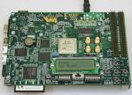
Base System Design Flow
User feeds specs to VAPRES
Base design created from specs
  Parametric templates used
System files generated
  Floorplan and Constraints
  Embedded Dev. Kit (EDK) Files
  HDL
Synthesis
Implementation
Bitstream generated
System downloaded to the board
Base system flow
System
Specs
Templates
Base Design
Floorplan
HDL
Synthesis
Implementation
Generate Bitstream

Slide 41
Application Design Flow
Partition App
  Hardware
  Software
Software flow
  Compile
  Link
Hardware Flow
  Synthesize
  Implement
  Bitstream gen
Download App
Application Flow
Application Decomposition
HDL
Source Code
API
System
Specs
Compile
Synthesis
Link
Implementation
Executable
Generate Bitstream

Slide 42




Revisiting Target Tracking
Filter
Storage
PLB Bus
Aerospace
Kalman
Filter
DCR
Bridge
MicroBlaze CPU
ICAP
Looks like a
spaceship
Aerospace
Kalman
Filter
Sensor
Blank
PR Region
IO
Module
PR
Socket
IF
IF
Switch 2

Slide 43


Seamless Filter Swapping
The target changed!
Filter tracks target
  Target slows down
  Filter swap needed
First load new filter
  Spare region used
  Old filter continues
Redirect traffic
  Downtime is now negligible
  Previously in seconds
MicroBlaze CPU
Blank
Module
High Power
Kalman
Filter
Blank
Module
Low Power
Kalman
Filter
IO
Module
Low Power
Kalman
Filter
Low Power
Kalman
Filter
Low Power
Kalman
Filter
IF
IF
IF
IF
SW2
SW2

Slide 44
Summary
We developed VAPRES
  Virtual Architecture for Partially Reconfigurable Systems
Contributions
  Modular design methodology
  PR regions with independent, selectable clocks
  Highly parametric design
  Seamless filter swapping
Future work
  Algorithms for runtime module placement
  Tools to assist system design formulation
  Context save and restore for modules

Slide 45
F4-11: High-Level Frameworks for Partially Reconfigurable Applications
Dr. Ann Gordon-Ross
Assistant Professor of ECE
University of Florida
Dr. Alan D. George
Professor of ECE
University of Florida
Abelardo Jara
Rohit Kumar
Shaon Yousuf
Joseph Antoon
Research Students
University of Florida

Slide 46












F4-11: Goals, Motivations, and Challenges
Goals
  Designer transparency in leveraging
  technologies for advanced designs
    Runtime hardware adaptation
    Partial reconfiguration (PR)
    Hardware/software (HW/SW) co-design
Motivations
  Powerful benefits tied to these technologies
    PR improves power and area
    HW/SW co-design improves productivity
  However, methodology hurdles can outweigh benefits
    PR requires low-level device knowledge
    Wide range of expertise needed for HW/SW co-design
  Large potential to automate HW/SW interoperability
    Insufficient design support for systems combining general purpose
    processors (GPPs) and reconfigurable computing (RC)
    RC resource management distracts designers from primary system targets
Challenges
  Efficient application mapping to PR architectures
  Provide sufficient application design flexibility
HW Resource
Managment
Load
Balancing
Advanced
Designs
F4-11
Adaptable
Hardware
Reconfigurable
Computing
HW/SW
Co-design
Notes:
Changes: Bullet 2.1.1, 2.3.1, 23.2

Slide 47




F4-11 Approach
GPP-enhanced
Embedded RC
Embedded Computing
Formulation: ParRAT
  Interprets application data flow model
    Generates data flow model from code
    Also accepts user-defined data flow models
    Leverages PR modeling language (PRML)
  Generates PR architectural layout
    Refines layout based on run-time profile
Design: DAPR+
  Automatically builds HW architecture
    Generates architecture HDL code
    Automates floorplanning process
    Generates HW run-time profiler
  Interfaces application HW and SW
Platform
PR HW management
  Multiple concurrent applications
  requesting system services
  System services
    PRM placement inside PRRs at runtime
    Dynamic inter-module
    communication using MACS NoC
Dynamic HW migration
  Move tasks to HW at run-time
    Exploit compatibility between Impulse C HW/SW processes
    Load balancing across nodes
GPP-enhanced Embedded RC
Platform
PR HW Management
  Multiple concurrent applications
  requesting system services
  System services
    PRM placement inside PRRs at runtime
    Dynamic inter-module
    communication using MACS NoC
Dynamic HW migration
  Move tasks to HW at run-time
    Exploit compatibility between Impulse C HW/SW processes
    Load balancing across nodes
Formulation: ParRAT
  Interprets application data flow model
    Generates data flow model from code
    Also accepts user-defined data flow models
    Leverages PR modeling language (PRML)
  Generates PR architectural layout
    Refines layout based on run-time profile
Design: DAPR+
  Automatically builds HW architecture
    Generates architecture HDL code
    Automates floorplanning process
    Generates HW run-time profiler
  Interfaces application HW and SW
Embedded Computing
Notes:
I still think everything should fall under the general title of embedded computing. Instead of GPP-based reconfigurable computing, lets call it GPP-enhanced Embedded Computing. I am assuming this change will be made, thus I will make changes in the next slides based on this. On this slide, I changed the print view, but someone needs to change the animated view as well

Slide 48


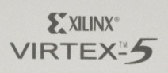




Tasks 1 & 2: Cognizant PR
PR application design is arduous
  Design space exploration (DSE) requires implementation before analysis
  Complicated PR flow requires training beyond application level design
  Result: PR is too specialized for GPP-enhanced embedded RC
Cognizant PR is a framework for PR-enabled HW/SW co-design
  Formulation-level DSE enables designers to “window shop” PR benefits
  Automatic partitioning enables developers to create a single application
    Automatic HW/SW partitioning
    Automatic partitioning of HW into static and PR regions (PR partitioning)
  Design automation removes the burden of manual implementation
A Traditional PR Experience
The Cognizant PR Approach
Application Model
Application
HW / SW
Partitioning
Manual
HW PR Partitioning
Manual
Floorplanning
HW/SW
Interfacing
HW Bitstream
Application Code
SW Binary
PR Amenability Test (ParRAT)
Design Automation for PR Plus (DAPR+)
Modeling
Automated Partitioning
Architecture Generation
HW/SW
Interfacing
Notes:
Changes: Bullet 1, 1.3, 2.1, 2,2

Slide 49
Task 1 – Formulation with ParRAT
Candidate
Architecture
Candidate Architecture Layout A
PRML
Model
Automate Partitioning
DAPR+
Profile
PR Modeling Language (PRML)
Model
HLS
Code
Candidate
Architectures
Feedback
Process
HW/SW
and PR Partitioning
Application Code
Selected
Architecture Layout
PRML
Specs
Candidate Architecture Layout B
Candidate
Architecture
Candidate Architecture Layout B
Candidate Architecture Layout B
or
…
ParRAT
HLS
Code
Automatic
Generation!
Candidate
Architecture
Candidate Architecture Layout C
Generate
Model
Automate Partitioning
Layout
DAPR
Profile
ParRAT has the potential to both help formulate and partition PR designs
Two methods of PR formulation and partitioning
  User creates an application data flow model with PRML
  ParRAT generates PRML model from source code
Partitioning
  Provides multiple optimized candidate architectures layouts
  Select the most appropriate architectural layout based on user constraints
    Speed
    Area
    Power
    Throughput
Architecture layout is optimized based on run-time profile feedback
PR formulation with ParRAT
  User defines application model in on of two ways
    User provides PRML model
    ParRAT generates model from user code
  ParRAT partitions data flow model
    Creates multiple candidate architectures
    Varies parameters across candidates
  Candidate architecture parameters:
    Granularity of PR region task
    Size of PR regions
    Number of available PR regions
    NoC architecture requirements
Architecture evaluation and selection
  Evaluation metric
    Area, power, speed, throughput
  Architecture selection
    User constraints
    HW/SW constraints
Feedback and architecture reevaluation
  Optimizes using run-time profile
  Updates due to changes in user constraints
User
Constraints
Notes:
Changes to print layout: on left, bullet 1.2; on right, bullet 2, 2.2
I also fixed the bullet layout on the right. The second major bullet looked like a second level subullet. Fixed now
For you guys to do:
Need to change bullet 2.1 (remove “s” from architectures)

Slide 50
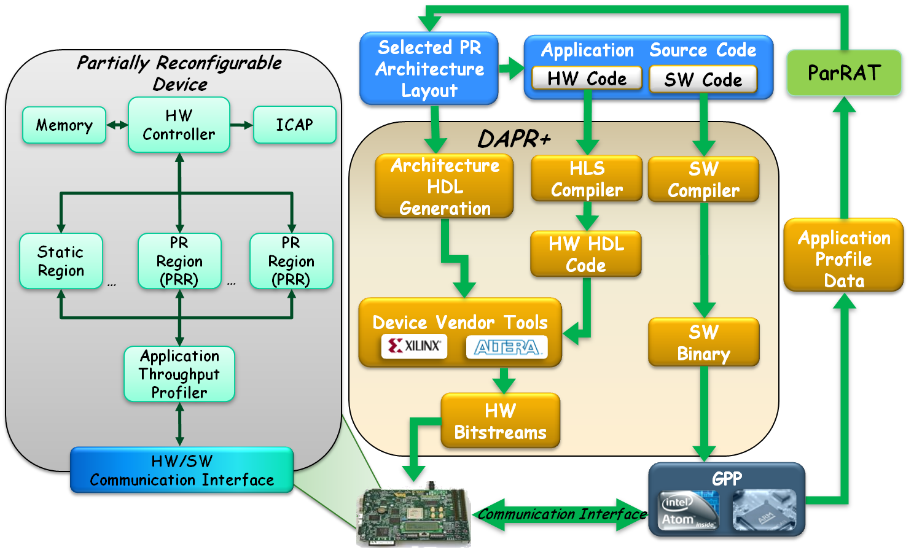




…
Task 2 – Design with DAPR+
Selected PR Architecture Layout
Application Source Code
Partially Reconfigurable Device
ParRAT
HW Code
SW Code
Memory
HW Controller
ICAP
DAPR+
Architecture HDL Generation
HLS Compiler
SW
Compiler
HW HDL Code
Application Profile Data
Static Region
PR
Region (PRR)
PR
Region (PRR)
…
…
Device Vendor Tools
SW Binary
Automated SW boot loader generation
  Utilizes SW compiler to generate SW binary
HW/SW communication interface
  Allows SW control of HW tasks
Automatically generated throughput profiler
  Captures static and PR region throughput data
  Throughput data fed to ParRAT
    ParRAT updates architectural layout
Automated HW architecture implementation
  Generates HDL code for static and PR regions
  HW bitstreams generated using vendor utilities
Automatically floorplanned custom PRRs
  PRRs can contain heterogeneous resources
Automatically generated HW controller
  Loads/unloads PR tasks
  Contains PR task schedule
Application Throughput Profiler
HW Bitstreams
HW/SW
Communication Interface
GPP
Communication Interface
50

Slide 51






Task 3: Dynamic Resource Manager (DRM)
(control region)
DRM allows multiple software applications
to share VAPRES hardware resources
  Embedded Linux kernel module
    Dynamic allocation of PRRs to PRMs
    Dynamic inter-PRR communication
  Interfacing between software applications
  and PRMs inside PRRs
Enabled computational capabilities
  Load balancing
    Distribute application’s PRMs for execution across multiple VAPRES systems
  Dynamic HW migration
    Adaptive migration of computational intensive SW functions to equivalent HW inside PRMs
DRM design and implementation
  Implement embedded Linux on VAPRES
    Includes creation of FSL and ICAP drivers
  Design, implement, and debug DRM
    Explore save/restore PRM state on Virtex-5
  Implement dynamic HW migration mechanisms
    Exploit compatibility between Impulse C HW/SW processes
Software app 1
Software app 2
SW1
HW1
HW2
SW2
HW3
HW4
3
High Priority Request 1
Low Priority Request
2
DRM (priority-based service)
1
Embedded Linux (PetaLinux)
FSL0
FSL1
FSL2
FSL3
HW1
HW2
HW3?
I/O module
PRR1
PRR2
PRR3
1
Data processing region
2
Interface
Interface
Interface
Interface
3
MACS inter-module
communication architecture
HW1, HW2, HW3, HW4 are PRMs written in Impulse C
Notes:
Changes:
Added a space “app 2” in figure in the upper right.
Bullets: 2.1.1, 3.2

Slide 52

Conclusions
Conclusions
  Leverage toolset for rapid implementation of embedded
  systems and applications using PR
    Increased productivity and reduced PR design complexity
  Architect HW and SW mechanisms for dynamic allocation and communication between HW/SW modules
    Leverage VAPRES as base platform for dynamic management of PR HW resources
  Leverage new frameworks and tools to enable modeling, design exploration, and evaluation of PR architectures
Notes:
Changes:
Bullet 1.1.1

Slide 53

Thank you for attending
Questions?

