Slide 1
Reconfigurable Computing in Space with Radiation-Hardened Xilinx FPGAs
Dr. Greg Stitt
Associate Professor of ECE
University of Florida
Tyler M. Lovelly
Research Student
University of Florida

Slide 2
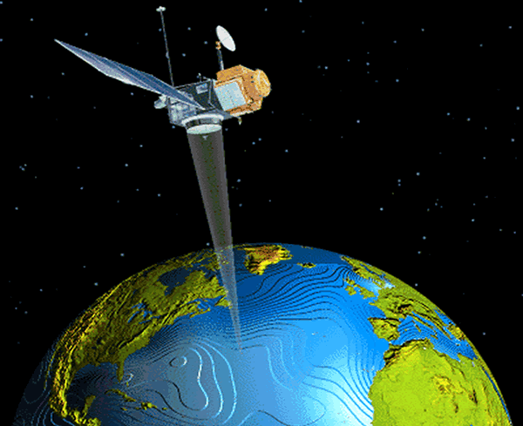
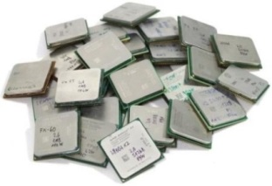
Introduction
Space computing presents unique challenges
  Harsh and inaccessible operating environment
  Severe resource constraints – power, size, weight
  Stringent requirements for performance and reliability
Increasing need for high-performance space computing
  Escalating demands for real-time sensor and autonomous processing
  Limited communication bandwidth to ground stations
  Legacy radiation-hardened (RadHard) processors cannot meet demands
    Generations behind commercial-off-the-shelf (COTS) processors
    Based upon architectures not particularly suited to needs of space computing
Quantitative and objective analysis of processor architectures
  Device metrics analysis based on architectural capabilities
  Broad and diverse set of architectures under consideration
    Targeting space processors and low-power COTS processors (≤ 30 W)

Slide 3
Lecture Overview
Intro to space computing
  Radiation hazards in space environment
  Radiation effects on electronics and FPGAs
  Radiation-hardening for techniques and outcomes
Intro to device metrics
  Analyzing performance, power, memory, and IO
  Calculations with fixed and reconfigurable architectures
Radiation-hardened Xilinx FPGAs
  Analysis of Virtex-5QV with device metrics
  Comparisons with COTS counterpart
  Comparisons with other RadHard processors
3

Slide 4
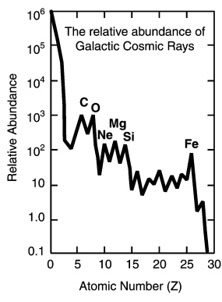
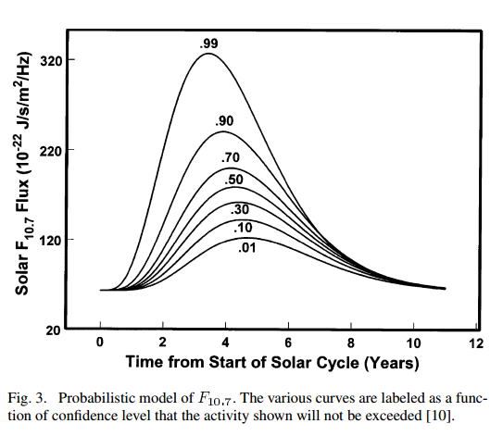
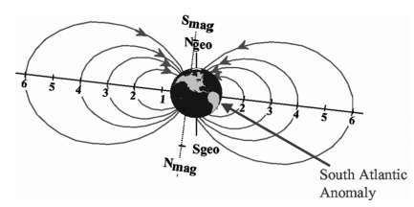
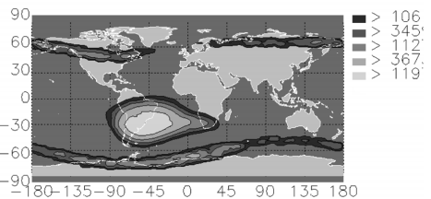
Space Environment
Radiation hazards
  Cosmic rays
    Low flux of high-energy charged particles
    Originate from sun (solar wind) and from outside solar system (galactic)
  Solar particle events
    Solar flares
      Energy bursts from coronal magnetic field
      Rich in electrons; last for hours
    Coronal mass ejections
      Eruption of plasma
      Rich in protons; last for days
  Radiation belts
    Charged particles trapped in magnetosphere
    Van Allen belts are mostly protons and electrons
GCR Elements ^{[8]}
11-year solar cycle ^{[8]}
Earth magnetic field ^{[8]}
Measured electron flux ^{[8]}
4

Slide 5
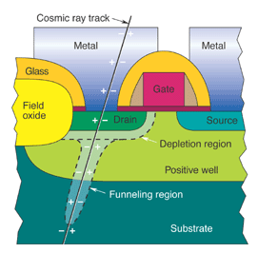
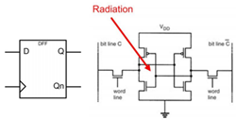
Spacecraft Electronics
Radiation effects on devices
  Electrostatic discharge
    Creates transient that couples into electronics
  Cumulative effects
    Total ionizing dose (TID)
      Silicon lattice damage, charge buildup within gate oxide
    Displacement damage (DD)
      Causes nucleus to move from normal lattice position
  Transient effects
    Single-event effects (SEEs)
      Particles pass thru lattice, cause soft errors
      SEU – transient pulses or bit flips
      SEFI – disrupts system functionality
      SEL – possible damage to device
SEU in FF ^{[7]}
5
SEU: single-event upset
SEFI: single-event functional interrupt
SEL: single-event latchup

Slide 6
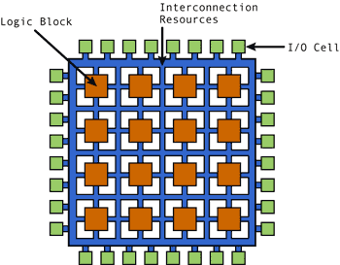
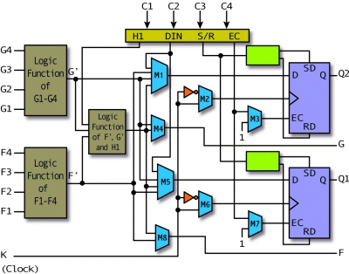
Space Computing with FPGAs
Xilinx FPGAs for space missions
  High computational capabilities; low power
  Enables parallelization and reconfiguration
  SRAM-based configuration memory
    Configures LUTs, FFs, BRAMs, DSPs, routing
    Memory sizes continually increasing
    SRAM vulnerable to SEEs
Effects of SEEs on FPGAs ^{[6]}
  Configuration memory faults
    Routing faults - broken connections or short circuits
    LUT and DSP faults - change in logical functions
    BRAM and FF faults - data errors in the running design
    Can lead to data errors or disrupt functionality
  TID limits component lifetime
    Silicon lattice damage
    Charge buildup within gate oxide
Xilinx CLB Architecture
6

Slide 7
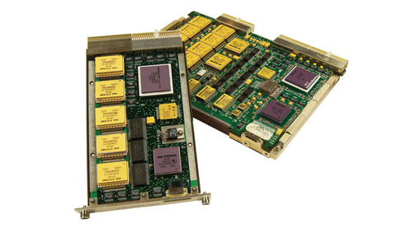
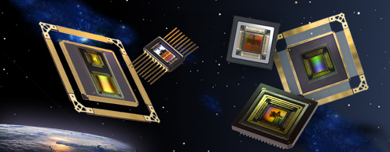
Space Processors
Radiation-hardened (RadHard) processors for high reliability
Techniques for radiation-hardening
  Radiation-hardening by process
    Insulating oxide layer used in process
  Radiation-hardening by design
    Specialized circuit-layout techniques
  Radiation-hardening by architecture
    Fault-tolerant computing strategies
Outcomes of radiation-hardening
  Cumulative effects
    Total-Ionizing Dose (TID) ≥ 300 krad(Si)
  Single-Event Effects (SEEs)
    Immunity to Single-Event Latchup (SEL), Upset (SEU), Functional Interrupt (SEFI)
  Performance and power
    Slower operating frequency, reduction in cores or execution units, increased power

Slide 8
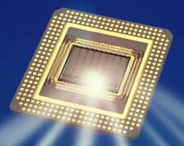
Device Metrics
Suite of quantitative and objective metrics developed by
NSF CHREC Center at University of Florida ^{[3-4]}
  For comparative analysis of broad and diverse set of processors
    Central processing units (CPUs)
    Digital signal processors (DSPs)
    Field-programmable gate arrays (FPGAs)
    Graphics processing units (GPUs)
    Hybrid combinations of above (often SoCs)
  Highly useful for first-order analyses and comparisons
    Study broad range of devices with metrics to determine best candidates
    Later, study best candidates more deeply with selected, optimized benchmarking
  Different methods used for fixed- and reconfigurable-logic devices
Metrics data collected from architectural features of device
  Determined from vendor-provided information and tools
    Experimental testbed in lab is not required for metrics analysis

Slide 9

Device Metrics Analysis
Analyzing performance (GOPS) and power (GOPS/W)
  Computational Density (CD) measures theoretical performance
    Reported in giga-operations per second (GOPS)
    Calculated separately for varying data types
      8-bit, 16-bit, and 32-bit Integer (Int8, Int16, and Int32)
      Single-precision and double-precision floating point (SPFP and DPFP)
    Determine operations mix (additions, multiplications, etc.) based on target apps
  CD per Watt (CD/W) measures performance scaled by power
Analyzing memory and input-output bandwidth (GB/s)
  Internal Memory Bandwidth (IMB) measures throughput between processor and on-chip memory (cache or BRAM)
  External Memory Bandwidth (EMB) measures throughput between processor and off-chip memory (DDR2, DDR3, etc)
  Input-Output Bandwidth (IOB) measures throughput between processor and all off-chip resources (DDR, GigE, PCIe, GPIO, etc.)

Slide 10
Device Metrics: CPU Analysis (1/2)
Example: Freescale P5040
  COTS counterpart of RadHard RAD5545 CPU from BAE Systems
  Fixed-logic CPU: 2.2 GHz, 49 W, quad-core, no SIMD engine
Calculating CD and CD/W
  Each core contains
    3 integer execution units 1 floating-point execution unit
      Can issue 2 instructions each cycle
  Calculate operations/cycle for each data type
    Int8: 2 ops/cycle Int16: 2 ops/cycle Int32: 2 ops/cycle
    SPFP: 1 op/cycle DPFP: 1 op/cycle
  CD_{Int8,Int16,Int32} = 4 cores × 2.2 GHz × 2 ops/cycle = 17.6 GOPS
  CD/W_{Int8,Int16,Int32} = 17.6 GOPS / 49 W = 0.36 GOPS/W
  CD_{SPFP,DPFP} = 4 cores × 2.2 GHz × 1 ops/cycle = 8.8 GOPS
  CD/W_{SPFP,DPFP} = 8.8 GOPS / 49 W = 0.18 GOPS/W
Operations mix of 50% add, 50% mult

Slide 11
Device Metrics: CPU Analysis (2/2)
Calculating IMB, EMB, and IOB
  Each core contains
    L1 data cache: 8-byte bus L1 instr cache: 16-byte bus L2 cache: 64-byte bus
  Total of 2 DDR3 controllers: 8-byte bus; 1600 MT/s
  IMB_{L1data} = 4 cores × 2.2 GHz × 8 bytes = 70.4 GB/s
  IMB_{L1inst} = 4 cores × 2.2 GHz × 16 bytes = 140.8 GB/s
  IMB_{L2} = 4 cores × 2.2 GHz × 64 bytes / 11 cycles = 51.2 GB/s
  EMB = 2 DDR3 × 8 bytes × 1600 MT/s = 25.6 GB/s
  IOB = DDR3 + 10GigE + 1GigE + PCIe + SATA2.0 + GPIO +
  USB2.0 + SPI + UART + I2C
  = 48.76 GB/s
Assumes 100% cache hit rate
Based on optimal SerDes lane config.

Slide 12
Device Metrics: FPGA Analysis (1/2)
Example: Xilinx Virtex-5 FX130T
  COTS counterpart of RadHard Virtex-5QV FX130 FPGA from Xilinx
  Reconfigurable-logic FPGA: different methods required for metrics ^{[5]}
Calculating CD and CD/W
  FPGA logic resources
    Look-up tables (LUTs), Flip-flops (FFs), Multiply-accumulate units (DSPs)
  Generate and implement compute cores on FPGA with vendor tools
    All combinations of operation and data types: with and without DSP resources
    Collect data on resource usage and max. operating frequencies
    Linear-programming algorithm optimally packs cores onto FPGA
    Max. cores = max. ops/cycle (with pipelined cores)
  Use vendor-provided tools for power estimation
    Calculate dynamic power based on resource usage for cores
  CD_{Int8} = 2358 ops/cycle × 0.353 GHz = 833.2 GOPS
  CD/W_{Int8} = 833.2 GOPS / 15.87 W = 52.5 GOPS/W
Operations mix of 50% add, 50% mult
Same process used for all data types

Slide 13
Device Metrics: FPGA Analysis (2/2)
Calculating IMB, EMB, and IOB
  298 Block RAM units (BRAMs): 9-byte bus, 2 ports, 0.450 GHz operating frequency
  5 DDR2 controllers: 8-byte bus, double data rate, 0.266 GHz operating frequency
  840 GPIO pins: 0.8 Gb/s data rate
  20 RocketIO GTX transceivers: 6.5 Gb/s data rate
  IMB_{BRAM} = 298 BRAMs × 0.450 GHz × 9 bytes × 2 ports = 2413.8 GB/s
  EMB = 5 DDR2 × 0.266 GHz × 8 bytes × 2 (double data rate) = 21.33 GB/s
  IOB = DDR2 + GPIO + RocketIO GTX transceivers
  = 21.33 GB/s + (840 pins × 0.8 Gb/s)
  + (20 transceivers × 6.5 Gb/s) = 121.58 GB/s
Based on max. packing of memory controllers

Slide 14

Metrics: Virtex-5 vs. Virtex-5QV (1/3)
Same for both devices
Resource usage of compute cores
  Data generated with Xilinx ISE tools + Tcl scripts
Total resources
FFs | LUTs | DSPs
81920 | 81920 | 320
Xilinx Virtex-5 (XC5VFX130T_FF1738-1)
Operation | Data type | Use DSPs? | FFs | DSPs | LUTs | Frequency (MHz)
Add | Int8 | No | 8 | 0 | 8 | 638.57
Add | Int8 | Yes | 0 | 1 | 0 | 274.50
Add | Int16 | No | 16 | 0 | 16 | 492.37
Add | Int16 | Yes | 0 | 1 | 0 | 306.84
Add | Int32 | No | 32 | 0 | 32 | 349.04
Add | Int32 | Yes | 0 | 1 | 0 | 288.77
Add | SPFP | No | 547 | 0 | 416 | 376.08
Add | SPFP | Yes | 327 | 2 | 230 | 418.24
Add | DPFP | No | 1035 | 0 | 777 | 301.30
Add | DPFP | Yes | 945 | 3 | 720 | 343.05
Mult | Int8 | No | 82 | 0 | 76 | 353.36
Mult | Int8 | Yes | 8 | 1 | 0 | 488.04
Mult | Int16 | No | 302 | 0 | 293 | 377.79
Mult | Int16 | Yes | 16 | 1 | 0 | 445.83
Mult | Int32 | No | 1125 | 0 | 1133 | 303.31
Mult | Int32 | Yes | 113 | 4 | 32 | 485.91
Mult | SPFP | No | 681 | 0 | 619 | 338.07
Mult | SPFP | Yes | 106 | 3 | 91 | 400.96
Mult | DPFP | No | 2434 | 0 | 2286 | 210.70
Mult | DPFP | Yes | 484 | 11 | 315 | 309.98
Xilinx Virtex-5QV (XQR5VFX130_CF1752-1)
Operation | Data type | Use DSPs? | FFs | DSPs | LUTs | Added LUTs | Frequency (MHz) | % of COTS frequency
Add | Int8 | No | 8 | 0 | 14 | 6 | 465.33 | 72.87
Add | Int8 | Yes | 0 | 1 | 6 | 6 | 156.57 | 57.04
Add | Int16 | No | 16 | 0 | 28 | 12 | 337.84 | 68.61
Add | Int16 | Yes | 0 | 1 | 12 | 12 | 203.79 | 66.42
Add | Int32 | No | 32 | 0 | 56 | 24 | 282.41 | 80.91
Add | Int32 | Yes | 0 | 1 | 24 | 24 | 190.73 | 66.05
Add | SPFP | No | 547 | 0 | 468 | 52 | 222.57 | 59.18
Add | SPFP | Yes | 327 | 2 | 265 | 35 | 259.27 | 61.99
Add | DPFP | No | 1035 | 0 | 890 | 113 | 236.57 | 78.52
Add | DPFP | Yes | 945 | 3 | 808 | 88 | 210.84 | 61.46
Mult | Int8 | No | 82 | 0 | 84 | 8 | 301.30 | 85.27
Mult | Int8 | Yes | 8 | 1 | 8 | 8 | 220.41 | 45.16
Mult | Int16 | No | 302 | 0 | 309 | 16 | 283.69 | 75.09
Mult | Int16 | Yes | 16 | 1 | 16 | 16 | 205.80 | 46.16
Mult | Int32 | No | 1125 | 0 | 1163 | 30 | 215.47 | 71.04
Mult | Int32 | Yes | 113 | 4 | 77 | 45 | 414.42 | 85.29
Mult | SPFP | No | 681 | 0 | 640 | 21 | 268.82 | 79.52
Mult | SPFP | Yes | 106 | 3 | 99 | 8 | 249.44 | 62.21
Mult | DPFP | No | 2434 | 0 | 2331 | 45 | 187.20 | 88.84
Mult | DPFP | Yes | 484 | 11 | 362 | 47 | 270.93 | 87.40
FF and DSP usage same for both devices
Uses more LUTs
Average of ~70%

Slide 15
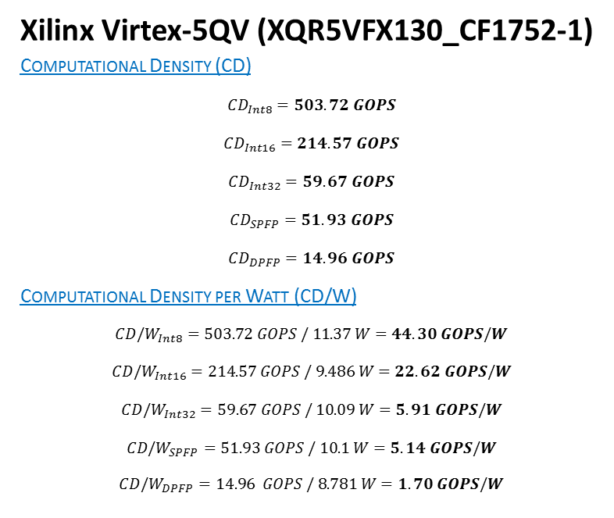
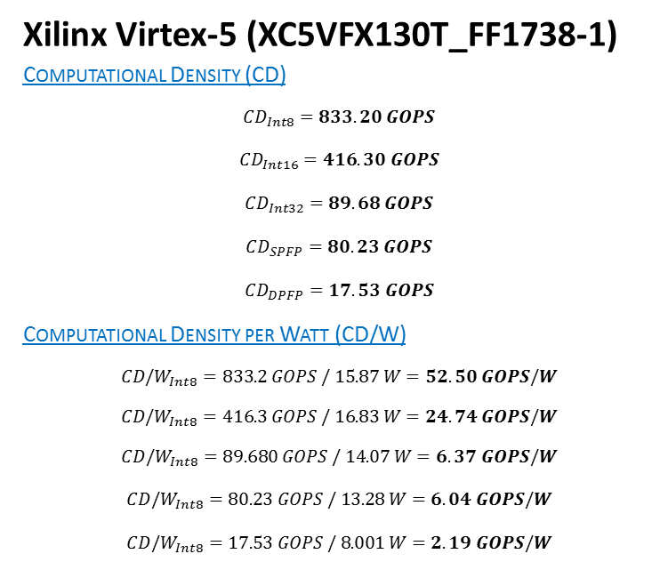
Metrics: Virtex-5 vs. Virtex-5QV (2/3)
Performance and power calculations
  CD affected by reduction in operating frequencies and additional LUTs
    Calculated with linear-programming algorithm for optimal packing of cores
  CD/W calculated with resource usage data and Xilinx Power Estimator
Xilinx Virtex-5 (XC5VFX130T_FF1738-1)
Computational Density (CD)
$${CD}_{­Int8}=833.20 GOPS$$
$${CD}_{­Int16}­=416.30 GOPS$$
$${CD}_{­Int32}­=89.68 GOPS$$
$${CD}_{­SPFP}­=80.23 GOPS$$
$${CD}_{­DPFP}­=17.53 GOPS$$
Computational Density per Watt (CD/W)
$${CD/W}_{­Int8}=833.2 GOPS / 15.87 W=52.50 GOPS/W$$
$${CD/W}_{­Int8}=416.3 GOPS / 16.83 W=24.74 GOPS/W$$
$${CD/W}_{­Int8}=89.680 GOPS / 14.07 W=6.37 GOPS/W$$
$${CD/W}_{­Int8}­=80.23 GOPS / 13.28 W=6.04 GOPS/W$$
$${CD/W}_{­Int8}­=17.53 GOPS / 8.001 W=2.19 GOPS/W$$
Xilinx Virtex-5QV (XQR5VFX130_CF1752-1)
Computational Density (CD)
$${CD}_{­Int8}­=503.72 GOPS$$
$${CD}_{­Int16}­­=214.57 GOPS$$
$${CD}_{­Int32}­=59.67 GOPS$$
$${CD}_{­SPFP}­=51.93 GOPS$$
$${CD}_{­DPFP}­=14.96 GOPS$$
Computational Density per Watt (CD/W)
$${CD/W}_{­Int8}=503.72 GOPS / 11.37 W=44.30 GOPS/W$$
$${CD/W}_{­Int16}­=214.57 GOPS / 9.486 W=22.62 GOPS/W$$
$${CD/W}_{­Int32}­=59.67 GOPS / 10.09 W=5.91 GOPS/W$$
$${CD/W}_{­SPFP}­=51.93 GOPS / 10.1 W=5.14 GOPS/W$$
$${CD/W}_{­DPFP}=14.96 GOPS / 8.781 W=1.70 GOPS/W$$
RadHard gives ~51-85% of original CD
Performance hit not as significant as RadHard CPUs
RadHard consumes lower power, but gives worse CD/W

Slide 16
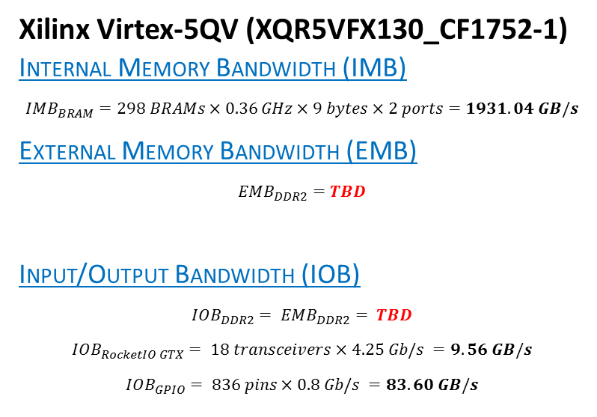
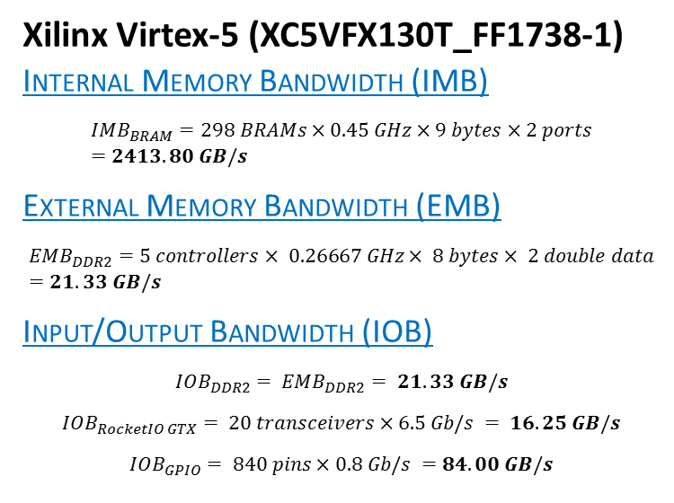

Metrics: Virtex-5 vs. Virtex-5QV (3/3)
Memory and input/output bandwidth calculations
  IMB affected by reduction in BRAM operating frequencies
  EMB calculated with DDR2 controller data from Xilinx ISE
    Roadblock: DDR2 controller not supported for Virtex-5QV tools
  IOB affected by reduction in data rates and pins for GPIO and RocketIO GTX transceivers
Xilinx Virtex-5 (XC5VFX130T_FF1738-1)
Internal Memory Bandwidth (IMB)
$${IMB}_{BRAM}=298 BRAMs×0.45 GHz×9 bytes×2 ports=2413.80 GB/s$$
External Memory Bandwidth (EMB)
$${EMB}_{DDR2}=5 controllers× 0.26667 GHz× 8 bytes× 2 double data=21.33 GB/s$$
Input/Output Bandwidth (IOB)
$${IOB}_{DDR2}= {EMB}_{DDR2}= 21.33 GB/s$$
$${IOB}_{RocketIO GTX}= 20 transceivers×6.5 Gb/s = 16.25 GB/s$$
$${IOB}_{GPIO}= 840 pins×0.8 Gb/s =84.00 GB/s$$
Xilinx Virtex-5QV (XQR5VFX130_CF1752-1)
Internal Memory Bandwidth (IMB)
$${IMB}_{BRAM}=298 BRAMs×0.36 GHz×9 bytes×2 ports=1931.04 GB/s$$
External Memory Bandwidth (EMB)
$${EMB}_{DDR2}=TBD$$
Input/Output Bandwidth (IOB)
$${IOB}_{DDR2}= {EMB}_{DDR2}= TBD$$
$${IOB}_{RocketIO GTX}= 18 transceivers×4.25 Gb/s =9.56 GB/s$$
$${IOB}_{GPIO}= 836 pins×0.8 Gb/s =83.60 GB/s$$
80% of COTS IMB
Investigate alternate source for DDR2 controller
Total IOB: 121.58 GB/s
Total IOB: $TBD$

Slide 17
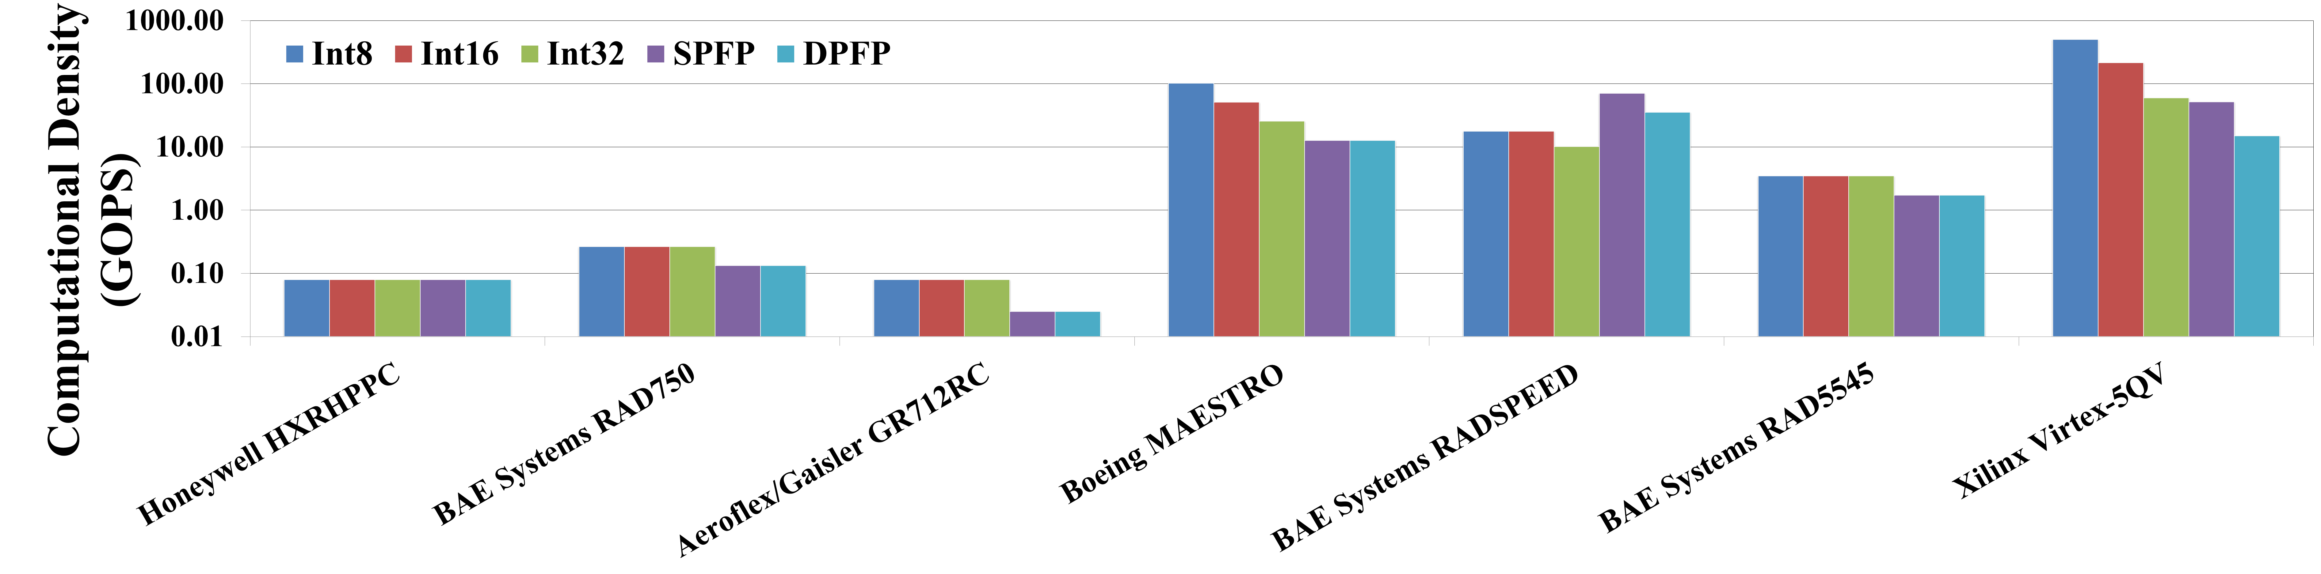
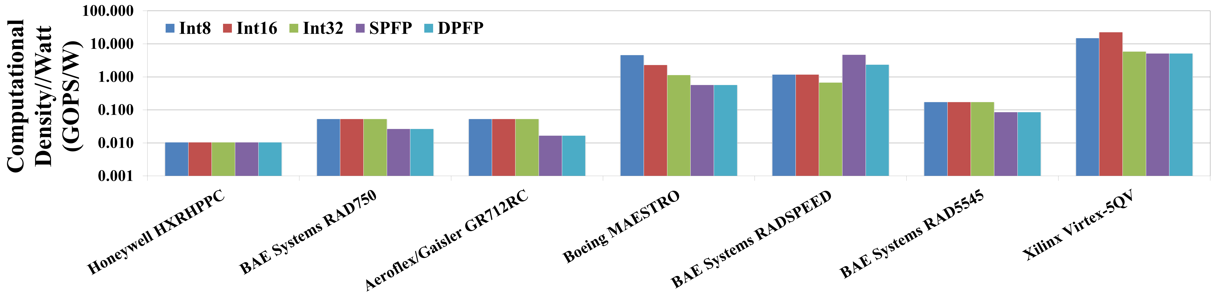
Metrics: RadHard Processors (1/2)
2nd best integer CD
Best integer CD; 2nd best floating-point CD
Best floating-point CD
Older RadHard CPUs greatly outperformed
Best integer and floating-point CD/W
2nd best integer CD/W
2nd best floating-point CD/W
Older RadHard CPUs greatly outperformed
Results displayed in logarithmic scale

Slide 18
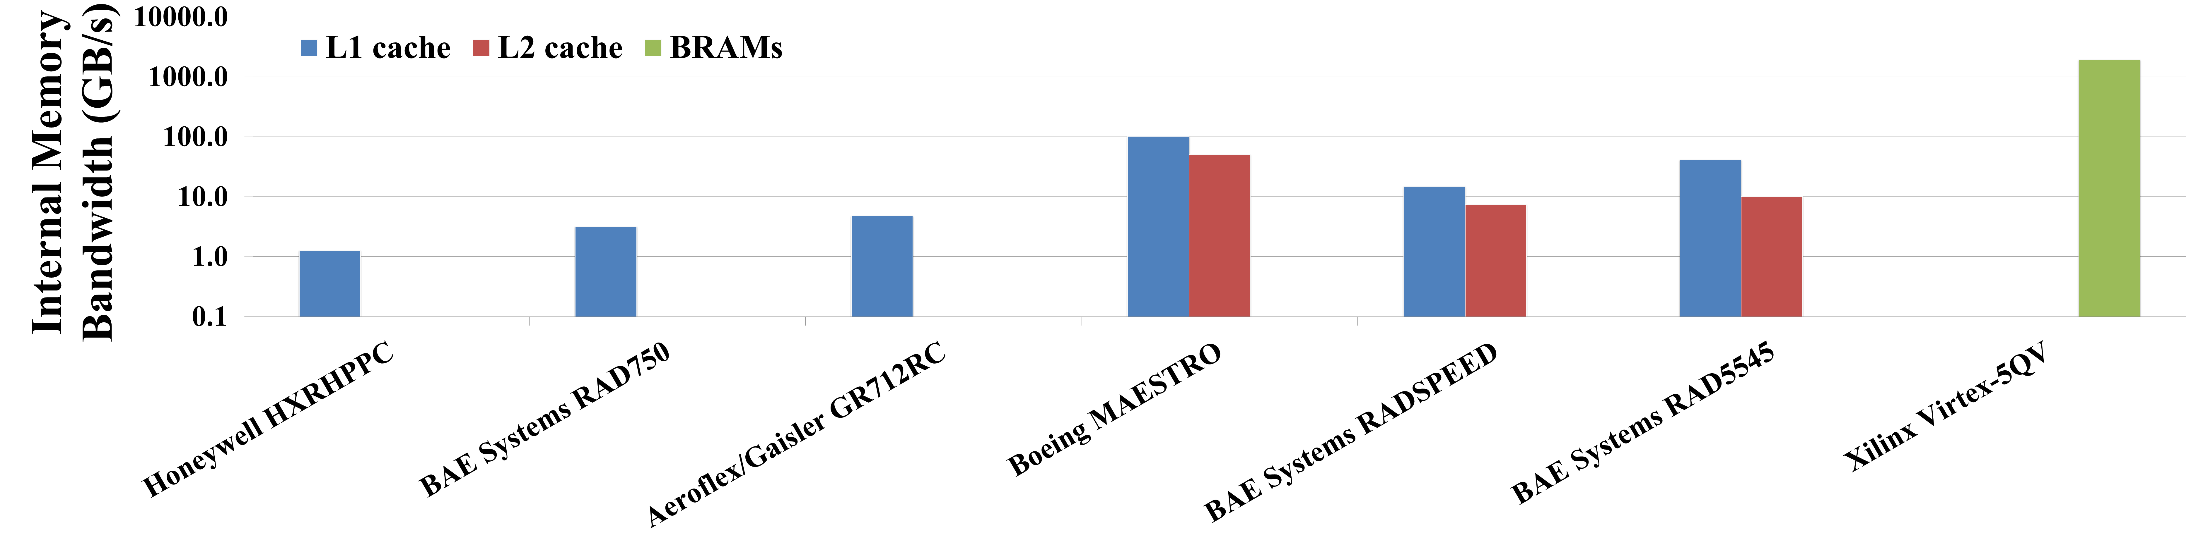
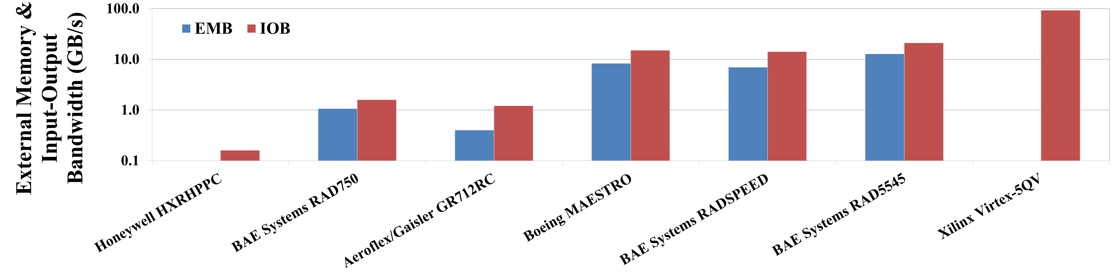
Metrics: RadHard Processors (2/2)
BRAMs in FPGA give much higher IMB than caches
Older RadHard CPUs greatly outperformed
Highest IOB by far, even without including DDR2
Highest EMB
EMB based on controller for external L2 cache
EMB still TBD
No controllers for external memory
Results displayed in logarithmic scale

Slide 19
Conclusions
SRAM-based FPGAs in space are subject to radiation hazards, including errors to configuration memory
Xilinx Virtex-5QV supports high-performance, high-reliability, low-power computing for next-generation space missions
  Comparisons with COTS counterpart
    Compute cores use same # of FFs and DSPs, but more LUTs
    Compute cores achieve average of ~70% of COTS operating frequencies
    RadHard achieves ~51-85% of COTS CD; lower power, but worse CD/W
    RadHard achieves 80% of COTS IMB; EMB and final IOB are TBD
  Comparisons with other RadHard processors
    Virtex-5QV achieves best integer CD, 2nd best floating-point CD, best CD/W
    Virtex-5QV achieves highest IMB and IOB; EMB and final IOB are TBD
19

Slide 20
CHREC Research Opportunities
Next-Generation Space Processors
  Analysis with device metrics and benchmarking
  Investigation of theoretical vs. experimental performance
On-Board Data Compression
  Exploration of pre-processing to reduce entropy
  Investigation of region-of-interest encoding
Space Networking Analysis
  Investigation of key networking protocols for space
  Quantitative analysis with models and hardware testbeds
20

Slide 21
References
T. M. Lovelly, K. Cheng, W. Garcia, and A. D. George, “Comparative Analysis of Present and Future Space Processors with Device Metrics," Proc. of Military and Aerospace Programmable Logic Devices Conference (MAPLD), San Diego, CA, May 19-22, 2014
T. M. Lovelly, D. Bryan, K. Cheng, R. Kreynin, A. D. George, A. Gordon-Ross, and G. Mounce, “A Framework to Analyze Processor Architectures for Next-Generation On-Board Space Computing,“ Proc. of IEEE Aerospace Conference (AERO), Big Sky, MT, Mar. 1-8, 2014
J. Williams, A. George, J. Richardson, K. Gosrani, C. Massie, H. Lam, “Characterization of Fixed and Reconfigurable Multi-Core Devices for Application Acceleration,” ACM Transactions on Reconfigurable Technology and Systems (TRETS), Vol. 3, No. 4, Nov. 2010, pp. 19:1-19:29
J. Richardson, S. Fingulin, D. Raghunathan, C. Massie, A. George, and H. Lam, “Comparative Analysis of HPC and Accelerator Devices: Computation, Memory, I/O, and Power,” Proc. of High-Performance Reconfigurable Computing Technology and Applications Workshop (HPRCTA), at SC’10, New Orleans, LA, Nov 14, 2010
N. Wulf, J. Richardson, and A. George, “Optimizing FPGA Performance, Power, and Dependability with Linear Programming,” Proc. of Military and Aerospace Programmable-Logic Devices Conference (MAPLD), San Diego, CA, April 9 - 12, 2013
Adam Jacobs, “Reconfigurable Fault Tolerance for Space Systems,” PhD Dissertation Defense, NSF Center for High-Performance Reconfigurable Computing (CHREC), ECE Department, University of Florida, March 22, 2013
Brock J. LaMeres, "FPGA-Based Radiation Tolerant Computing", University of Florida Research Colloquium, Gainesville, FL, November 9, 2012
Bourdarie, S.; Xapsos, M., "The Near-Earth Space Radiation Environment,“ IEEE Transactions on Nuclear Science, vol.55, no.4, pp.1810,1832, Aug. 2008
Lakshminarayana, V.; Karthikeyan, B.; Hariharan, V. K.; Ghatpande, N.D.; Danabalan, T.L., "Impact of Space weather on spacecraft," 10th International Conference on Electromagnetic Interference & Compatibility, pp.481,486, 26-27 Nov. 2008
Johnston, A.H., "Space Radiation Effects and Reliability Considerations for Micro- and Optoelectronic Devices," IEEE Transactions on Device and Materials Reliability, vol.10, no.4, pp.449,459, Dec. 2010
21

