Slide 1
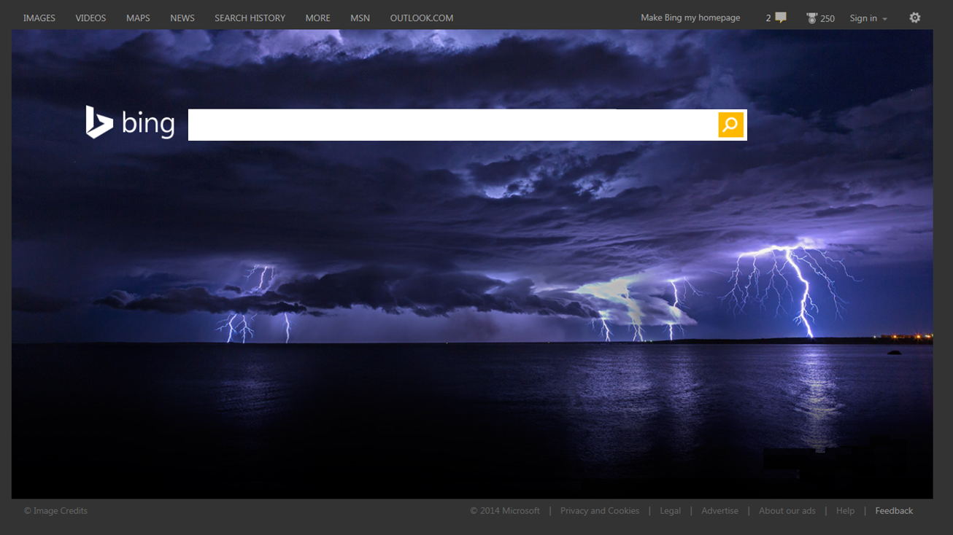
Large-Scale Reconfigurable Computing in a Microsoft Datacenter
Andrew Putnam – Microsoft
Hot Chips 26 – Aug 12, 2014

Slide 2


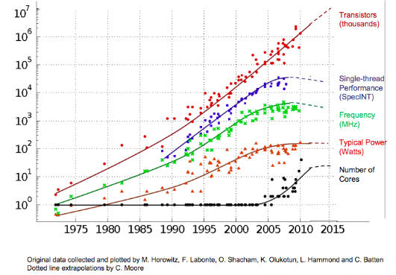









Microsoft Cloud Services
Capabilities, Costs $∝\frac{Performance/Watt}{\$}$

Slide 3
Increase Efficiency with Hardware Specialization

Slide 4
Datacenter Environment
Software services change monthly
Machines last 3 years, purchased on a rolling basis
Machines repurposed ~½ way into lifecycle
Little/no HW maintenance, no accessibility
Homogeneity is highly desirable
The paradox: Specialization and homogeneity

Slide 5
Efficiency via Specialization
FPGAs
ASICs
Source: Bob Broderson, Berkeley Wireless group

Slide 6

One Application’s Accelerator
Flexibility
Efficiency
Xeon CPU
NIC
Accelerator Opportunities

Slide 7
One Application’s Accelerator
Flexibility
Efficiency
Xeon CPU
Search Acc.
(FPGA)
Search Acc. (ASIC)
NIC
Application Changes
Xeon CPU
Wasted Power,
Holds back SW
Search Acc. v2
(FPGA)
NIC
Re-assigned Server
HPC
Cluster
Wasted Power,
One more thing that can break
Xeon CPU
Math Accelerator
NIC

Slide 8
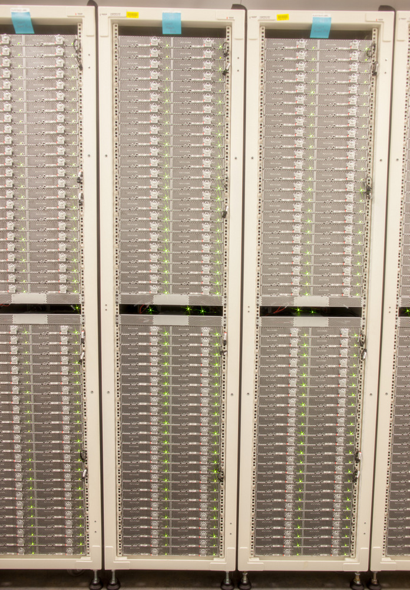
Integrating FPGAs into the Datacenter
Centralized
FPGAs
Conventional Servers
FPGAs
FPGAs
FPGAs
This looks easy – Plug into the network and go!
FPGAs
FPGAs
FPGAs
FPGAs
Centralized
Distributed

Slide 9
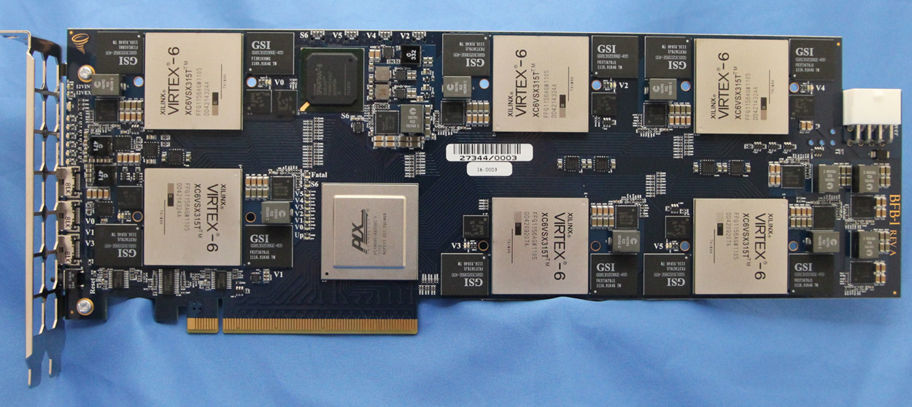
Prototype #1: BFB Board

Slide 10
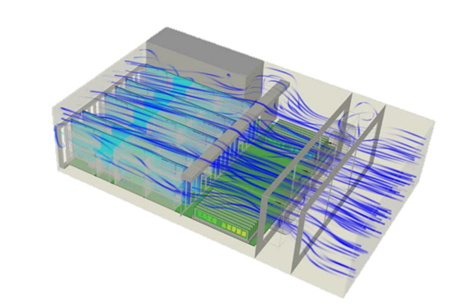
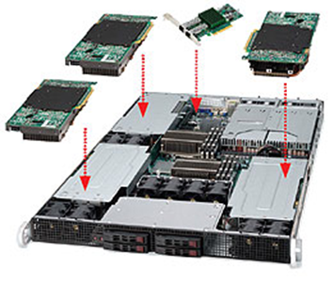
Prototype #1: BFB board
Prototyped a 6-FPGA board
3x2 GPIO mesh
PCIe connecting all FPGAs, CPU
Plugs into Supermicro GPU server
Serves L2 scoring for 48-server pod
1U, 2U, or 4U rack-mounted
1/2/4 x 10Ge ports
Up to 4 PCIe x16 slots
2 sockets, 6-core Intel Westmere

Slide 11
Centralized Model Unsuitable for Datacenter
Single point of failure
Complicates rack design, thermals, maintainability
Network communication for any use of FPGA
  Definition of the Network In-cast problem
  Precludes many latency-sensitive workloads
Limited elasticity
  What if you need more than six FPGAs?
Centralized
Conventional Servers
FPGAs
FPGAs
FPGAs
FPGAs
FPGAs
FPGAs
FPGAs

Slide 12
Our Design Requirements
Don’t Cost Too Much
<30% Cost of Current Servers
Don’t Burn Too Much Power
<10% Power Draw
(25W max, all from PCIe)
1. Specialize HW with an FPGA Fabric
2. Keep Servers Homogeneous
Don’t Break Anything
Work in existing servers
No Network Modifications
Do not increase hardware failure rate

Slide 13
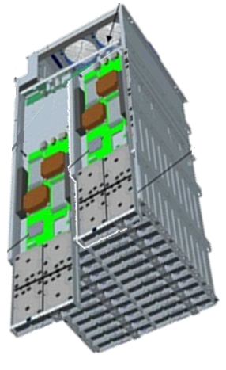
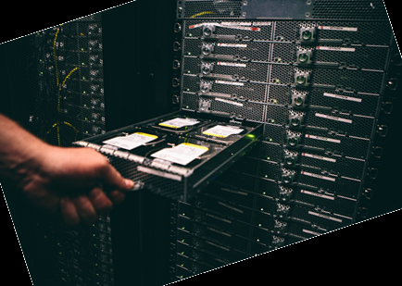
Datacenter Servers
Microsoft Open Compute Server
1U, ½ wide servers
Enough space &
power for ½ height,
½ length PCIe card
Squeeze in a single FPGA
Won’t fit (or power) GPU
http://www.globalfoundationservices.com/posts/2014/january/27/microsoft-contributes-cloud-server-specification-to-open-compute-project.aspx

Slide 14
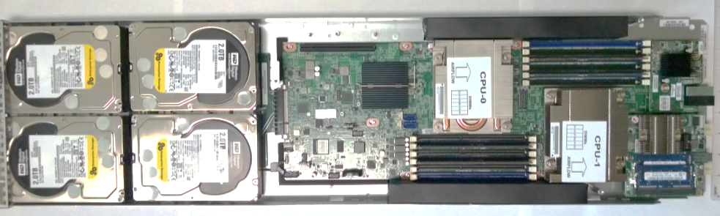
Microsoft Open Compute Server
  Two 8-core Xeon 2.1 GHz CPUs
  64 GB DRAM
  4 HDDs @ 2 TB, 2 SSDs @ 512 GB
  10 Gb Ethernet
  No cable attachments to server
Air flow
200 LFM
68 ⁰C Inlet

Slide 15
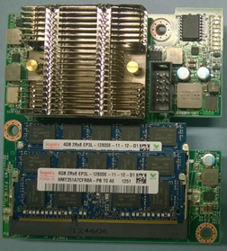
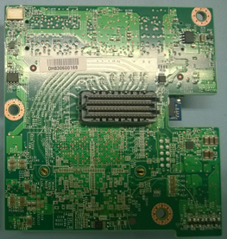
Catapult FPGA Accelerator Card
  Altera Stratix V GS D5
    172k ALMs, 2,014 M20Ks, 1,590 DSPs
  8GB DDR3-1333
  32 MB Configuration Flash
  PCIe Gen 3 x8
  8 lanes to Mini-SAS SFF-8088 connectors
  Powered by PCIe slot
Config
Flash
Stratix V
PCIe Gen3 x8
4x 20 Gbps Torus Network
8GB DDR3

Slide 16
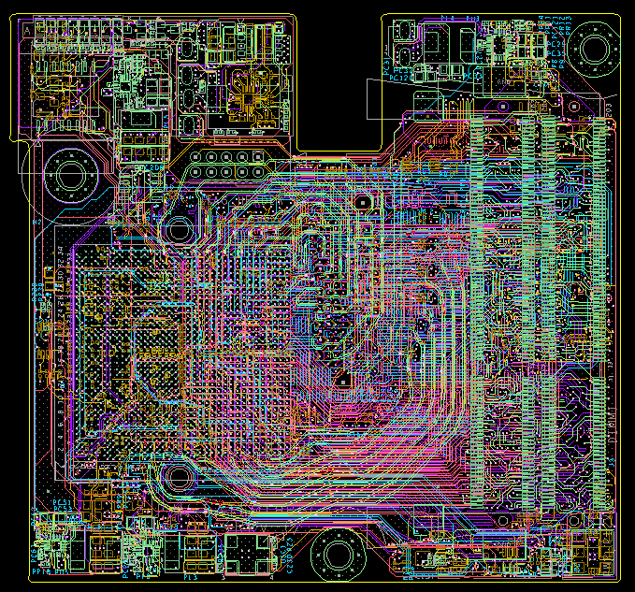
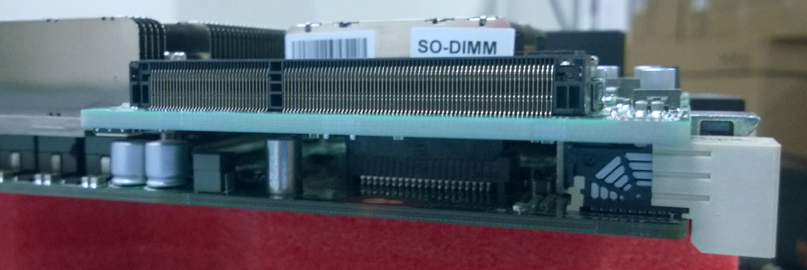
Board Details
16 Layer, FR408
9.5cm x 8.8cm x 115.8 mil
35mm x 35mm FPGA
14.2mm high heatsink
DIMM 0
DIMM 1
Mezz Conn. (Bottom)
FPGA
1U
Mezz Conn.

Slide 17
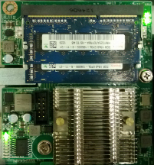

Scalable Reconfigurable Fabric
1 FPGA board per Server
48 Servers per ½ Rack
6x8 Torus Network among FPGAs
  20 Gb over SAS SFF-8088 cables
Data Center Server (1U, ½ width)

Slide 18
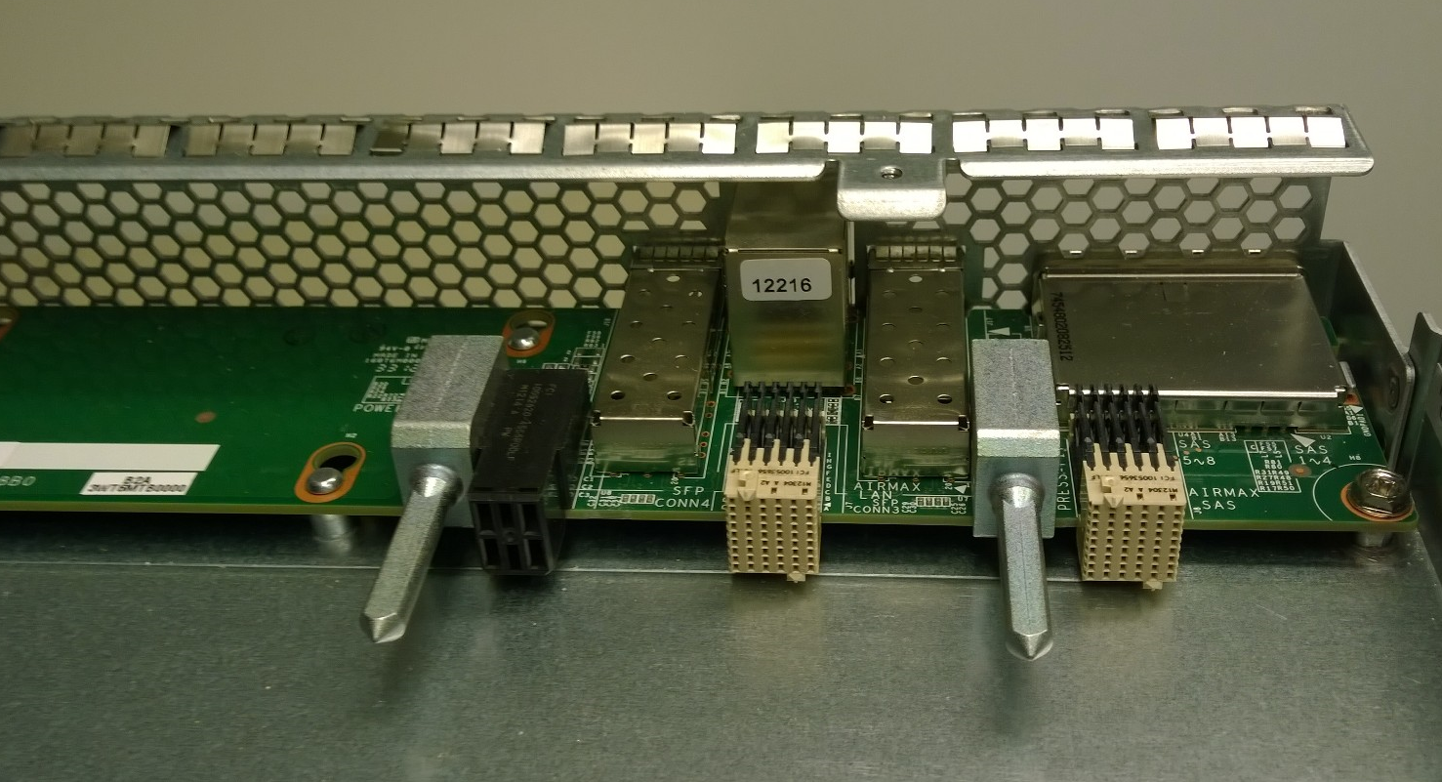
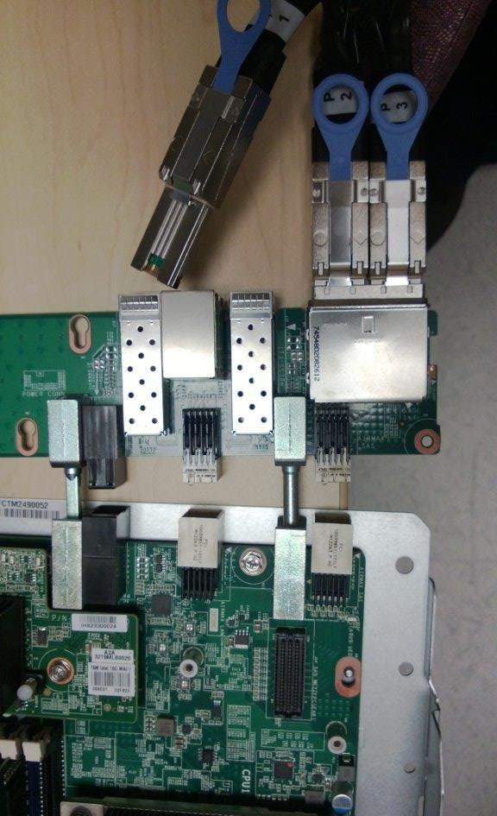
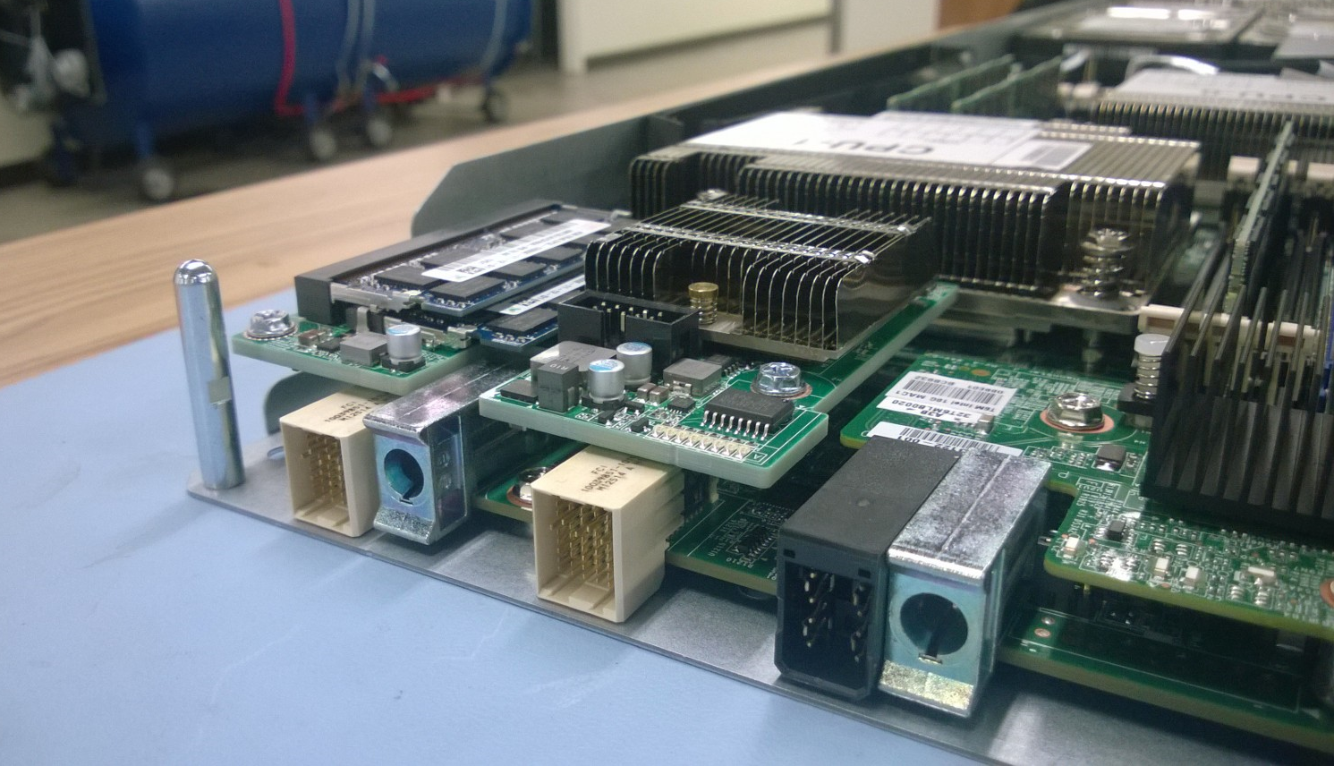
Board / Server Integration
Catapult Network Cables
(Mini-SAS / SFF-8088)
I/O Backplane
Boards Connected Together
Server w/ Catapult Board
Catapult Board Mezzanine Slot

Slide 19
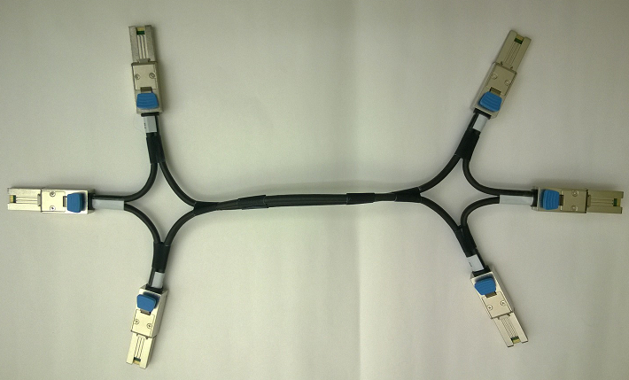
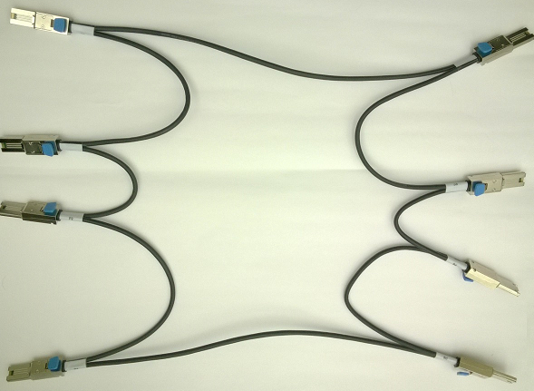
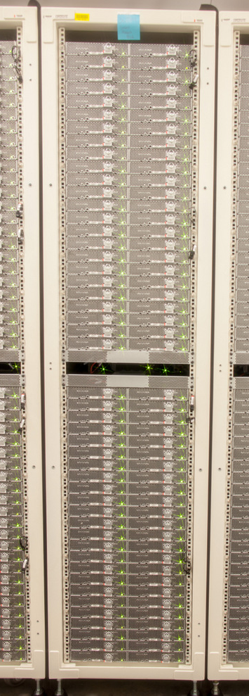
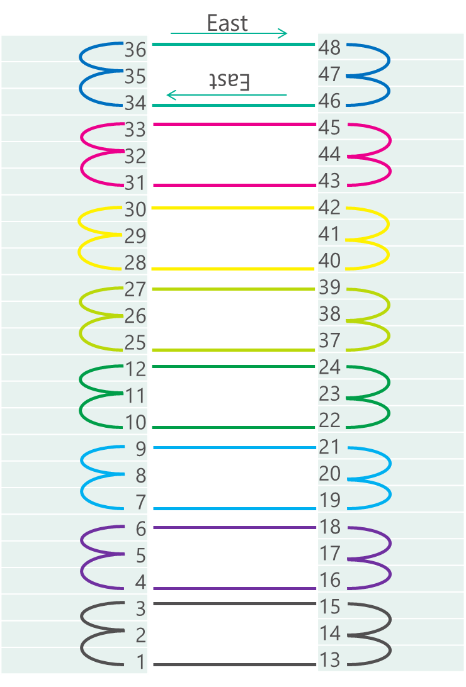
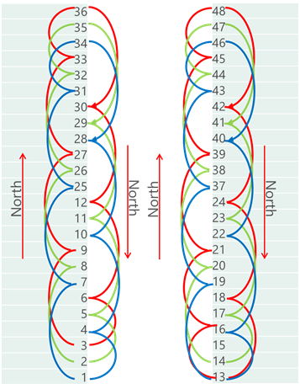
6x8 Torus in a 2x24 Server Layout
8-Shell Cables
6-Shell Cables

Slide 20
An Elastic Reconfigurable Fabric
Web Search Pipeline
FPGA
FPGA
FPGA
FPGA
CPU
CPU
CPU
CPU
PCIe (8.0 GB/s)
Top-of-Rack Switch (TOR)

Slide 21
An Elastic Reconfigurable Fabric
Math Acceleration Service
Physics Engine
Comp. Vision Service
Web Search Pipeline
FPGA
FPGA
FPGA
FPGA
CPU
CPU
CPU
CPU
PCIe (8.0 GB/s)
SLIII (2.0 GB/s)
400 ns latency/hop

Slide 22

Shell & Role
4 GB DDR3-1333 ECC SO-DIMM
4 GB DDR3-1333 ECC SO-DIMM
Shell handles all I/O &
management tasks
Role is only application logic
Shell exposes simple FIFOs
Flight data recorder for
scale-out debug
Role is Partial Reconfig boundary
72
72
Shell
DDR3 Core 0
DDR3 Core 1
Config Flash (RSU)
4
256 Mb QSPI Config Flash
Application
Role
JTAG
Host CPU
8
x8 PCIe Core
LEDs
Temp Sensors
DMA Engine
I²C
xcvr reconfig
Inter-FPGA Router
SEU
North SLIII
South SLIII
East SLIII
West SLIII
2
2
2
2

Slide 23
Bing Document Ranking Flow
Selection as a Service (SaaS)
Ranking as a Service (RaaS)
SaaS 1
RaaS 1
IFM 1
IFM 1
IFM 1
IFM 1
IFM 1
IFM 1
SaaS 2
RaaS 2
IFM 2
Selected
Documents
IFM 2
IFM 2
IFM 2
IFM 2
IFM 2
Query
SaaS 3
RaaS 3
10 blue links
IFM 3
IFM 3
IFM 3
IFM 3
IFM 3
IFM 3
SaaS
48
RaaS
48
IFM 44
IFM 44
IFM 44
IFM 44
IFM 44
IFM 44
Ported to Catapult
Selection-as-a-Service (SaaS)
- Find all docs that contain query terms,
- Filter and select candidate documents for ranking
Ranking-as-a-Service (RaaS)
- Compute scores for how relevant each selected document is for the search query
- Sort the scores and return the results

Slide 24
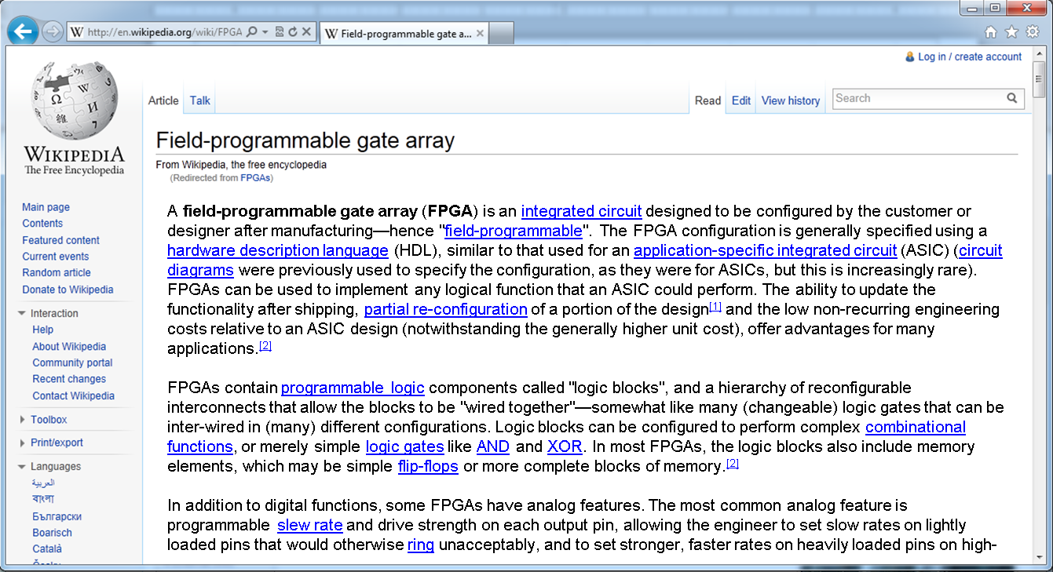
FE: Feature Extraction
Query: “FPGA Configuration”
{Query, Document}
Document
Features:
NumberOfOccurrences_0 = 7
NumberOfOccurrences_1 = 4
NumberOfTuples_0_1 = 1
FE: Feature Extraction
FFE: Free-Form Expressions
MLS: Machine Learning Scoring
Score
L2 Score

Slide 25
FFE: Free Form Expressions
{Query, Document}
Document
Features:
NumberOfOccurrences_0 = 7
NumberOfOccurrences_1 = 4
NumberOfTuples_0_1 = 1
FE: Feature Extraction
FFE #1 =(2*NumberOfOccurrences_0 + NumberOfOccurrences_1)
(2 * NumberOfTuples_0_1)
FFE: Free-Form Expressions
MLS: Machine Learning Scoring
Metafeature #1 = 9
Score
L2 Score

Slide 26
Feature Extraction Accelerator
Compressed
Document
Control/Data Tokens
Stream Preprocessing FSM
Distribution latches
PCIe
Free Form Expression (FFE)
Feature
Gathering
Network
196 feature families
54 state machines
2.6K dynamic features extracted in less than 4us (~600us in SW)

Slide 27
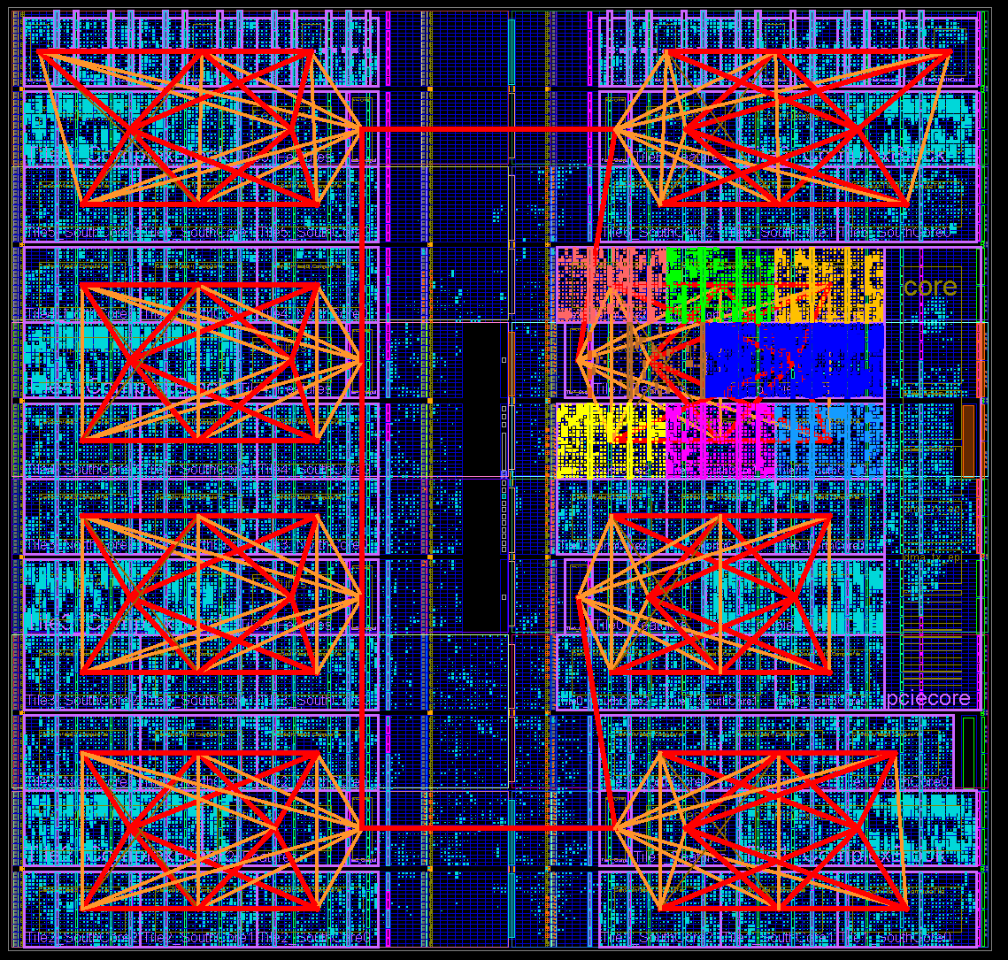
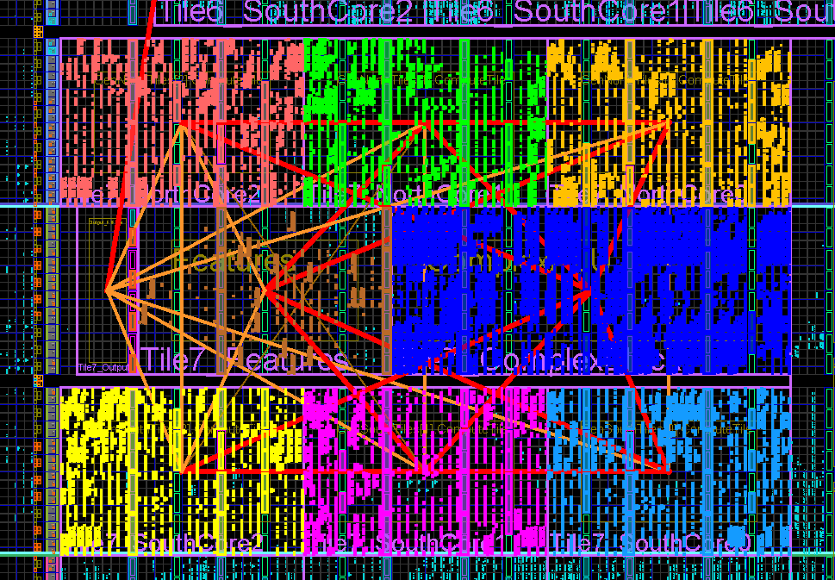
FFE Soft Cores
Cluster 0
Soft processor for multi-threaded throughput
4 HW threads per core
6 cores share a complex ALU
log, divide, exp, float/int conv.
10 clusters (240 HW threads) per FPGA
Core 0
Core 1
Core 2
Output
FST
Complex
Core 3
Core 4
Core 5
Scheduler
I-Mem
Feature
Store
Ranker Model File (INI)
Model Compiler
C++
FFE
Backend
Compiler
FFE
Assembly
Thread 0
F
D
E
M
W
Thread 1
Thread 2
Thread 3

Slide 28
Putting it all together
Document
8-Stage Pipeline
RaaS Servers
Route to
Head
FE: Feature Extraction
FPGA 0
Server
Route to
Head
FPGA 1
Server
FPGA 2
Document
Scoring
Request
Server
FFE: Free-Form Expressions
FPGA 3
Server
Return
Score
FPGA 4
Server
MLS: Machine Learning Scoring
Document
Scoring
Request
FPGA 5
Server
FPGA 6
Server
Return
Score
Score
Compute
Score
FPGA 7
Server
Compute
Score

Slide 29
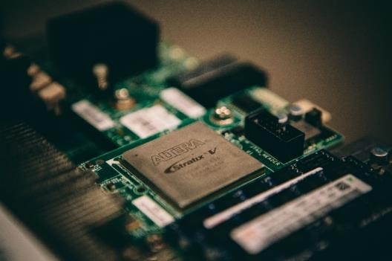
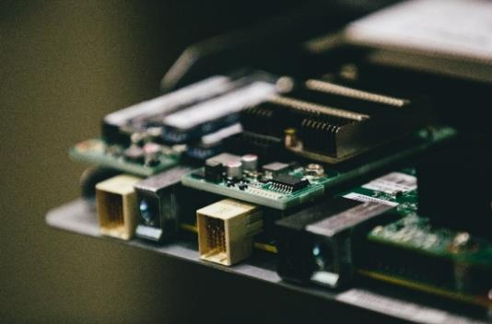
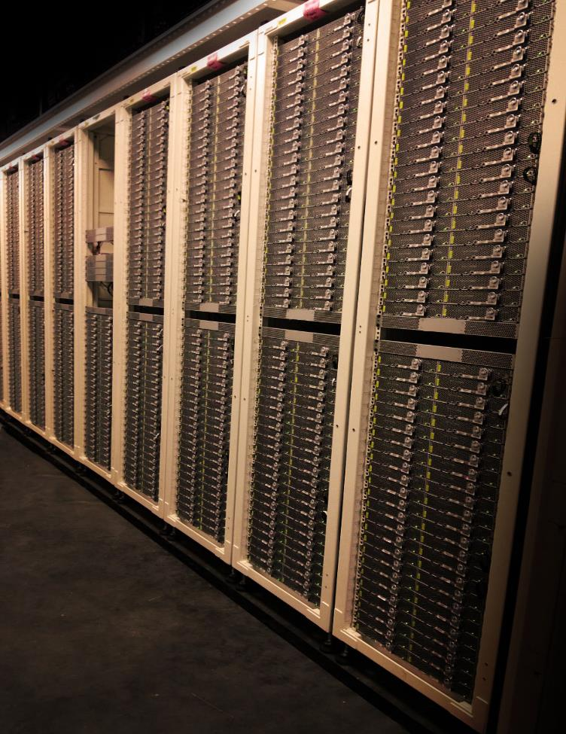
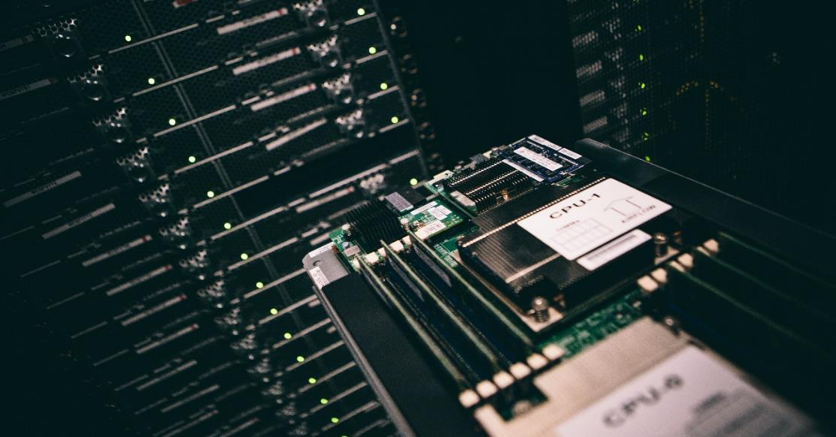
1,632 Server Pilot Deployed in a Production Datacenter

Slide 30
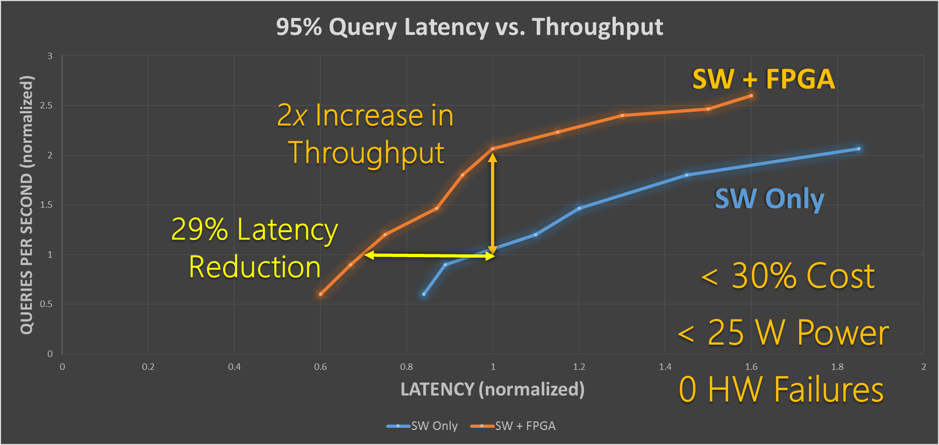
Accelerating Large-Scale Services – Bing Search
1,632 Servers with FPGAs Running Bing Page Ranking Service (~30,000 lines of C++)
Reduced # of servers
More compute time for improving relevance
Production in Early 2015

Slide 31
FPGAs for Application Acceleration
Hardware is the “easy” part
Software changes fast
Services last across hardware generations
Compiler
C++
FPGA
Software &
Language
Compiler &
Tools
RTL &
Hardware

Slide 32
Ensuring Maintainability & Sustainability
Structure software for explicit data communication
  Pass-by-value vs. Pass-by-reference
Create programmable substrates
  “Programming” FFE is just writing C++ code
  Wide spectrum between CPU and full custom RTL
Shell & Role, Common APIs
  Abstract away board interfaces & FPGA details from the application
Software &
Language
Cluster 0
Core 0
Core 1
Core 2
Output
FST
Complex
Compiler &
Tools
Core 3
Core 4
Core 5
4 GB DDR3-1333 ECC SO-DIMM
4 GB DDR3-1333 ECC SO-DIMM
72
72
Shell
DDR3 Core 0
DDR3 Core 1
Application
Config Flash (RSU)
4
256 Mb QSPI Config Flash
Role
x8 PCIe Core
JTAG
Host CPU
8
LEDs
DMA Engine
Temp Sensors
RTL &
Hardware
I²C
Inter-FPGA Router
xcvr reconfig
North SLIII
South SLIII
East SLIII
West SLIII
SEU
2
2
2
2

Slide 33
Key Needs for FPGA Computing
Huge need for high-productivity languages
  C-to-gates tools did not do well on FE state machines
  Domain-specific languages, OpenCL, BlueSpec both show promise
Faster compilation times
Fewer warnings… NO warnings on IP libraries
Better debugging integration
Hardened PCIe, DDR, JTAG debugging
Faster, more efficient DDR
Improved floating-point performance
Software &
Language
Compiler &
Tools
RTL &
Hardware

Slide 34
Conclusions
Hardware specialization is a (the?) way to gain efficiency and performance
The Catapult reconfigurable fabric offers a flexible, elastic pool of resources to accelerate services
Results for Bing: ½ the number of ranking servers, lower latency, reduced variance, proven scalability, proven resilience
Bing going to production in early 2015
Biggest future problem is programmability

Slide 35

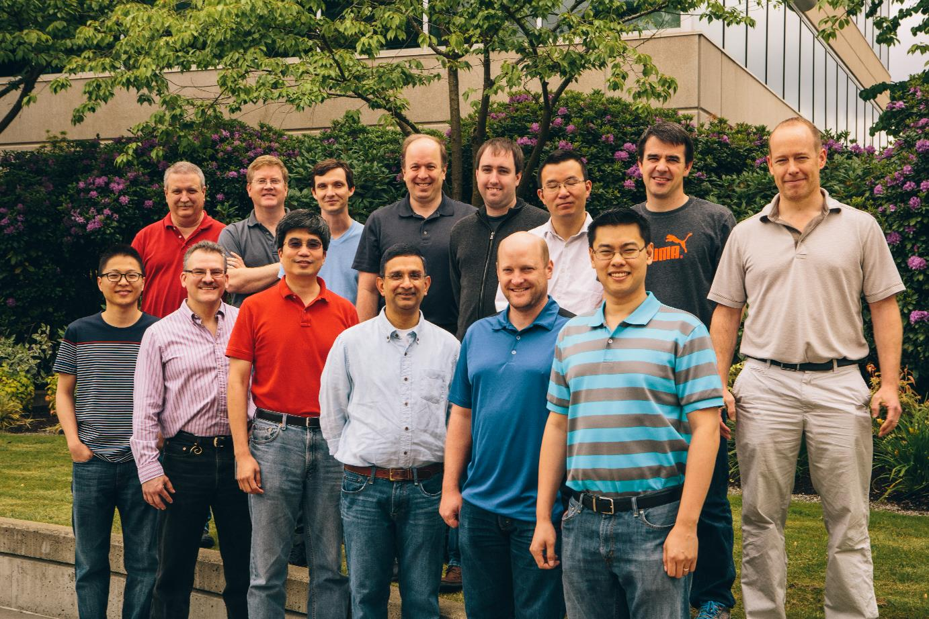

Top Row: Eric Peterson, Scott Hauck, Aaron Smith, Jan Gray, Adrian M. Caulfield, Phillip Yi Xiao, Michael Haselman, Doug Burger
Bottom Row: Joo-Young Kim, Stephen Heil, Derek Chiou, Sitaram Lanka, Andrew Putnam, Eric S. Chung,
Not Pictured: Kypros Constantinides, John Demme, Hadi Esmaeilzadeh, Jeremy Fowers, Gopi Prashanth Gopal, Amir Hormati, James Larus, Simon Pope, Jason Thong
Huge thanks to our partners at

Slide 36
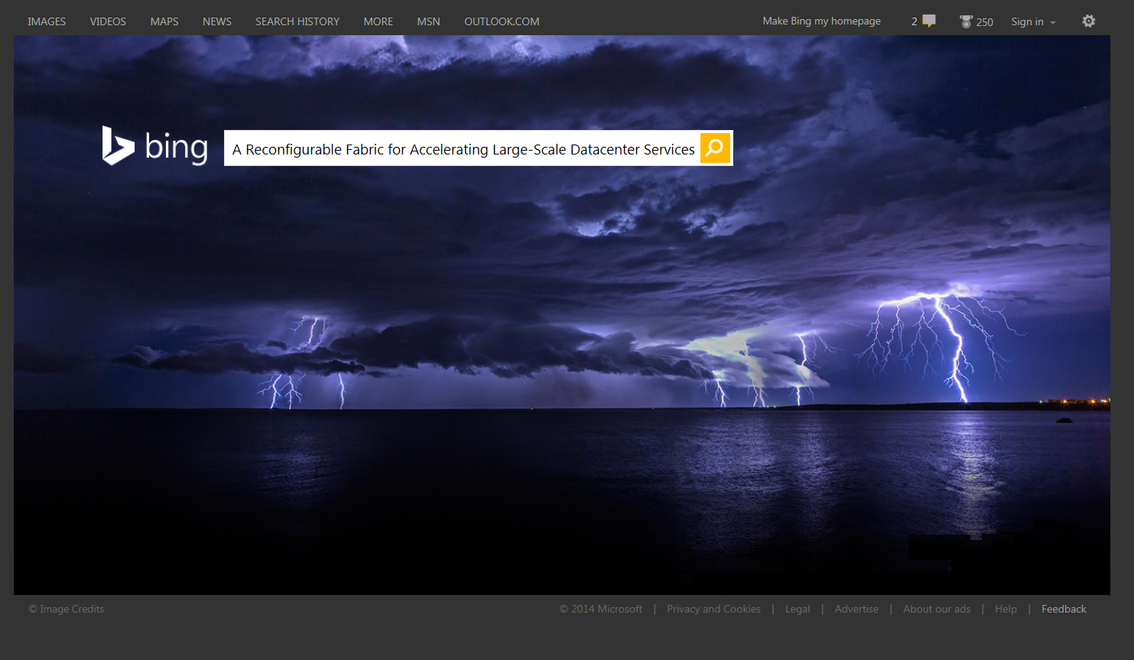
Enter your questions here

Slide 38
© 2014 Microsoft Corporation. All rights reserved. Microsoft, Windows and other product names are or may be registered trademarks and/or trademarks in the U.S. and/or other countries.
The information herein is for informational purposes only and represents the current view of Microsoft Corporation as of the date of this presentation. Because Microsoft must respond to changing market conditions, it should not be interpreted to be a commitment on the part of Microsoft, and Microsoft cannot guarantee the accuracy of any information provided after the date of this presentation. MICROSOFT MAKES NO WARRANTIES, EXPRESS, IMPLIED OR STATUTORY, AS TO THE INFORMATION IN THIS PRESENTATION.

