Slide 1
F1-17: Architecture Studies for
New-Gen HPC Systems
Dr. Herman Lam
Assoc. Professor of ECE
University of Florida
Dr. Janise McNair
Assoc. Professor of ECE
University of Florida
Dr. Abhijeet Lawande
Postdoc Researcher
University of Florida
Kenneth Hill
Vinayak Deshpande
Allen Starke
Yu Zou
Research Students
University of Florida
Number of requested memberships: ≥ 4

Slide 2



Project Motivations, Goals, & Challenges
F1
Motivation
New generations of HPC systems are increasingly heterogeneous, with accelerators, memory-centric computing, & specialized interconnects
BOF*
Explore & advance key technologies for new-gen HPC
Scalable framework for reconfigurable supercomputing
Role of Custom Memory Cube (CMC) for new-gen HPC
(CMC architectures & apps)
Advanced interconnect technologies for new-gen HPC
Goal
Challenges
Achieve performance gain while maintaining productivity
Study CMC before existence of CMC
Achieve high-performance interconnections for
distributed systems
*BOF: Birds-of-a-Feature event

Slide 3
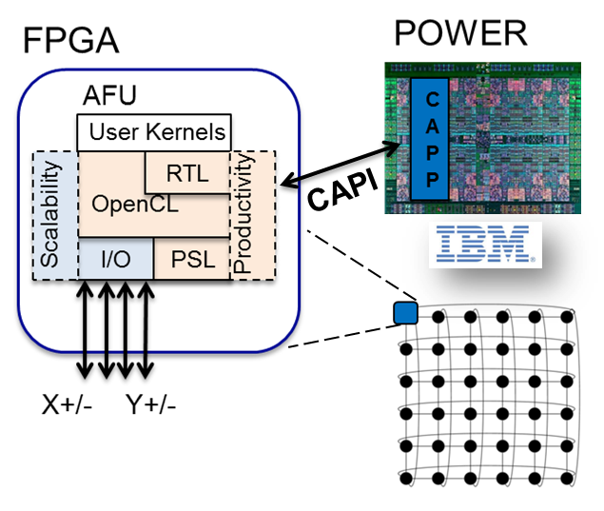
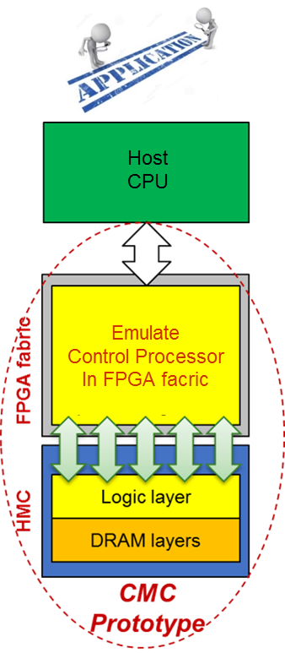
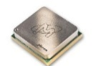

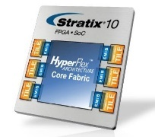
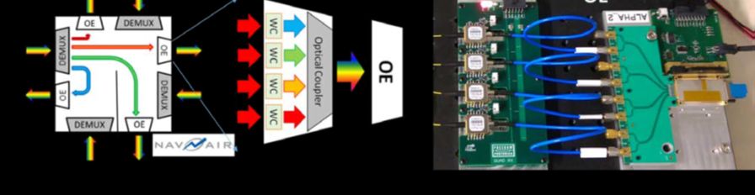
F1-17: Architecture Studies for HPC Systems
F1
T1: Scalable Framework for RSC* on Power Arch.
  Framework = Architecture + Tools for FPGA accelerators
  that is scalable & productive
T2: Custom Memory Cube (CMC) Research Platform
  To explore CMC apps & archs before existence of CMC
T3: Reconfigurable Intra-node Networks for RSC
  Single-node, highly-connected Stratix-10 system to explore
  large-scale multi-FPGA app acceleration through OpenCL
T4: Network Architecture Analysis for New-Gen Interconnects
  To explore new switching and routing structures in aerospace systems, specifically optical networks and wireless networks
* RSC: Reconfigurable Supercomputing

Slide 4
T1: Scalable Framework for RSC on Power Architecture
F1
Motivation
Goal
Large-scale, heterogeneous systems,
Becoming a necessity for big data & extreme-scale computing (toward Exascale)
  Develop
  Framework = Architecture + Tools
  for FPGA accelerators
  that is scalable and productive
F3-16
F1-17
  Architecture + Tool Achievements
Memory coherency w/ CAPI
    OpenCL+ RTL programming model
    OpenCL integration w/
    PSL Simulation Engine
  Architecture
OpenPOWER CAPI SNAP*
  Leverage SNAP framework to access accelerator resources (CAPI, DDR, I/O)
  Add multi-device routing capability
  to CAPI SNAP
  * CAPI SNAP: Storage, Network, and Analytics Programming Framework
  Tools
    Hybrid programming model
  Provide OpenCL library for
  CAPI SNAP framework
    DSE of large-scale systems
  Develop system simulation tools
  for network and data flow modeling
AFU: Accelerator Functional Unit
CAPI: Coherent Accelerator Processor
Interface from IBM
CAPP: Coherent Accelerator Processor Proxy
PSL: POWER Service Layer
DSE: design space exploration

Slide 5
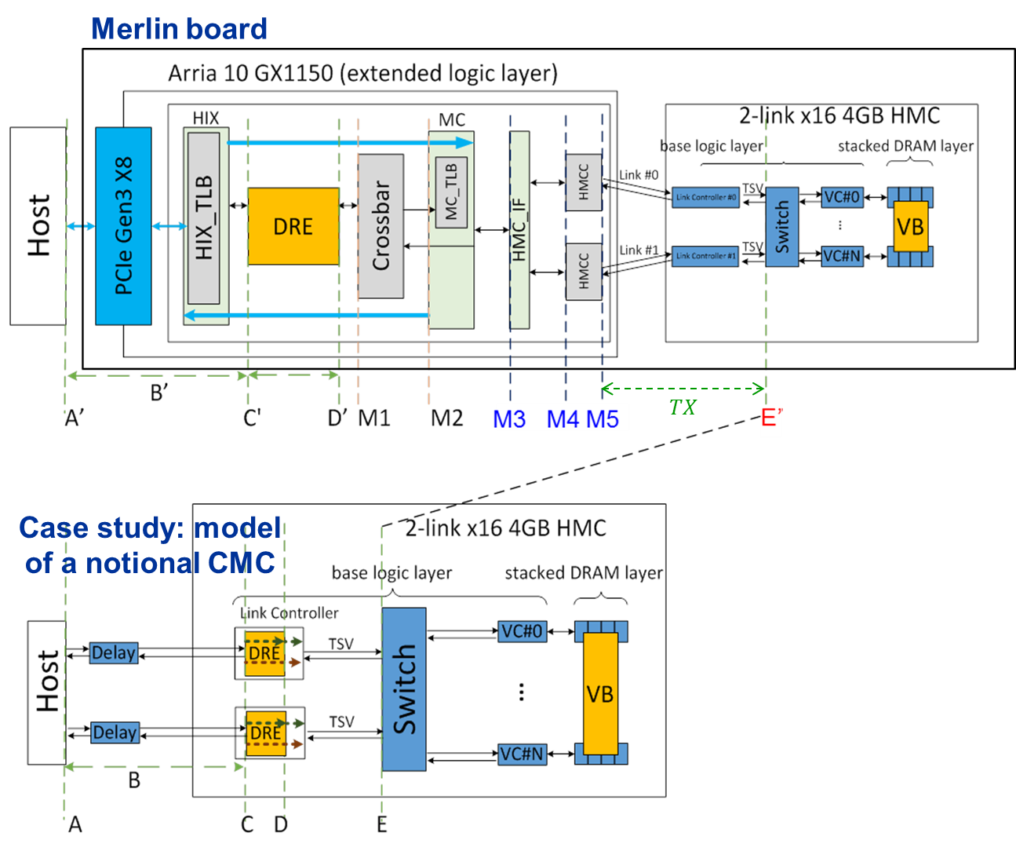
T2: Custom Memory Cube Research Platform
F1
Motivation
Memory bottleneck - critical for memory-intensive Big Data apps
Promise of CMC for C-RAM* & PIM** processing
Goal
Create flexible research platform for design space exploration of CMC apps & arch before existence of CMC
F3-16
Prototype platform:
FPGA + HMC: Implemented & instrumented for observability on Convey Merlin board from Micron
Case study:
Initial model of notional CMC⁺:
Initial case-study app
  DRE: Data Reordering/Rearrangement Engine (LLNL)
⁺ Nair, R., et al. "Active Memory Cube: A processing-in-memory architecture for exascale systems.“ IBM Journal of Research and Development 59.2/3 (2015): 17-1.
*C-RAM: Computational RAM
**PIM: Processor In Memory

Slide 6
T2: Custom Memory Cube Research Platform
F1
Platform development
Complete development & instrumentation of CMC platform
Develop library for customization of notional CMC architecture under study
Explore CMC apps using HT, a high-level synthesis language/tool from Micron/Convey
Case studies to explore:
Notional CMC architectures
CMC apps, including:
  Data Reordering/Rearrangement Engine
  Sorting algorithms
  Bloom filter
Lessons learned, including:
  Characteristics of CMC-amenable apps
  How to re-factor algorithms to become CMC-amenable
F1-17

Slide 7

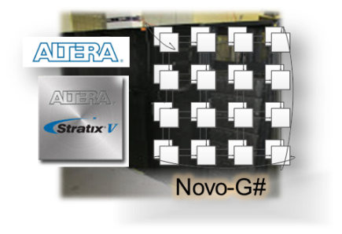
T3: Reconfigurable Intra-node Networks for RSC
F1
  Interconnected, high-performance FPGAs hold promised for acceleration of key apps in science
  Performance & usability a must!
Motivation
  Create a single-node, highly connected RC system to explore
  large-scale multi-FPGA app acceleration through OpenCL
Goal
F1-17
  Approach
  Design a high-density Stratix 10-based system for app acceleration
  Leverage multi-FPGA OpenCL framework to support multi-FPGA apps
  Explore large-scale RC apps from various scientific domains
    Computational fluid dynamics
    Monte Carlo options pricing
    Seismic data processing
F3-16
  Leveraged achievements
  Inter-FPGA network protocols (Novo-G - Stratix V)
  Multi-FPGA OpenCL framework
  Reconfigurable topology studies
* RSC: Reconfigurable Supercomputing

Slide 8
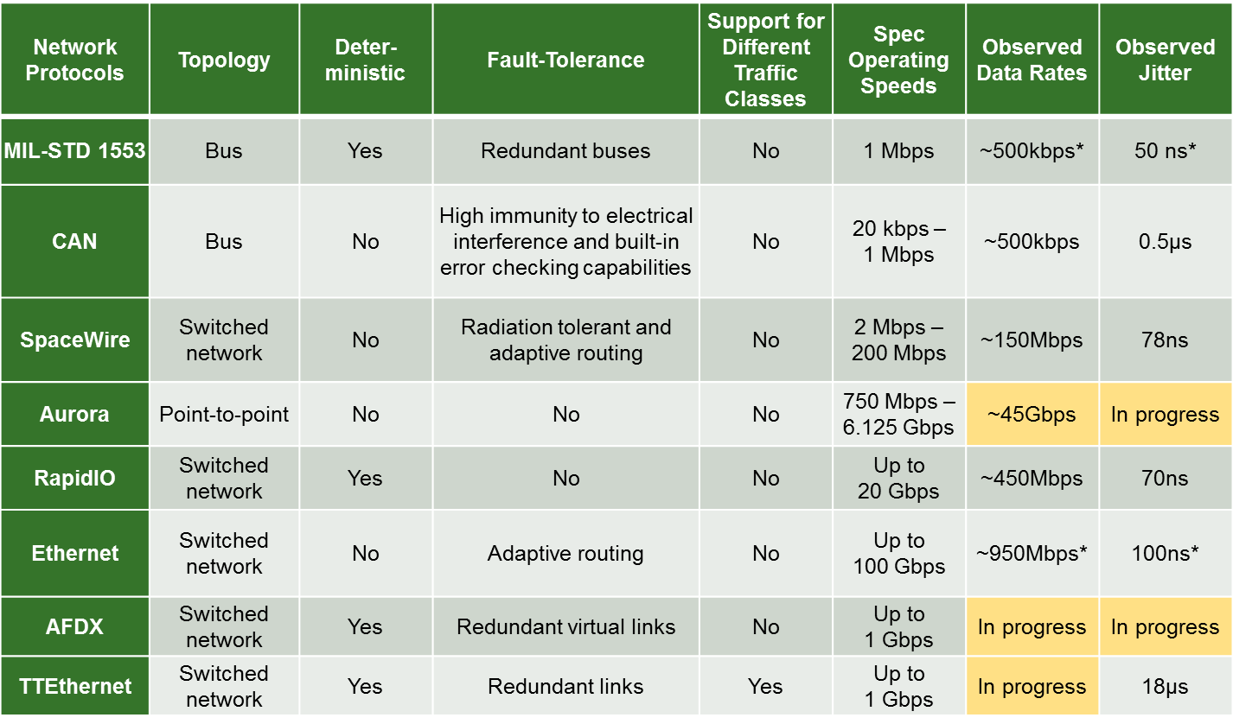
T4: Network Architecture Analysis for New-Gen Interconnects
F1
Motivation
Goal
Links require high bandwidth, fault tolerance and EMP resilience*
New-gen technology, e.g., fiber optic networks and/or wireless networks may improve performance
Network topology design and simulation for aerospace networks with new-gen interconnects
  Simulation and modeling
  Proof of concept development
F7-16
Completed wired analysis of leading-edge switch, bus, & P2P network technologies
Developed library of network simulation models for experimenting with scaled network topologies
* EMP resilience: Electromagnetic Pulse resilience

Slide 9
T4: Network Architecture Analysis for New-Gen Interconnects
F1
F1-17
Hardware​
Develop new proof-of-concept switching tools
Optimize use of WDM LAN or wireless LAN approaches for aerospace
Develop network management techniques using built-in fault tolerance mechanisms
Simulation
Development of simulation tools for network and data-flow modeling
Fault-tolerance analysis of links, switches, and nodes
Link budget analysis of various types of links, switches, and nodes (optical, wireless)

Slide 10

Milestones, Deliverables & Budget
F1
Milestones
CMW (06/17): Showcase midway progress on framework, platform, and interconnect exploration
CAW (12/17): Present completed project results
Deliverables
Application source code and tech. transfer support
Progress reports documenting research methods, progress, results, and analysis
Several conference and/or journal publications
Membership Budget
Requesting ≥ 4 memberships

Slide 11

Conclusions & Member Benefits
F1
Conclusions
New generations of HPC systems increasingly heterogeneous
  With accelerators, memory-centric computing, & specialized interconnects
Great opportunities to explore & advance key technologies for new-gen HPC
  Scalable framework, custom memory cube, advanced interconnect technologies
Member Benefits
Direct influence and technology transfer
of accelerated apps of interest to members
Direct influence over selected device, inter-connect, and app studies
Key insights, tradeoff analyses, and lessons learned from app, tool, and architectural studies

