Slide 1
FPGAs in Networking Applications & Graduate Studies
By: Alexis Rodriguez

Slide 2
Outline
Part 1: Networking Applications (35 Min)
  Networking 101
  Four Key Trends
  What is Software Defined Networking (SDN)?
  What is a SmartNIC?
  Who is involved?
  Microsoft Catapult
  O-RAN & IEEE-1588 [Wireless 5G]

Slide 3
Outline
Part 2: Graduate Studies (15 Min)
  Why?
  My Background
  Courses
  Job Differences (Undergrad vs Masters vs PhD)
  Masters vs PhD
  Job Reimbursement vs Research Assistant
  Mentoring

Slide 4
Part 1: Network Applications

Slide 5
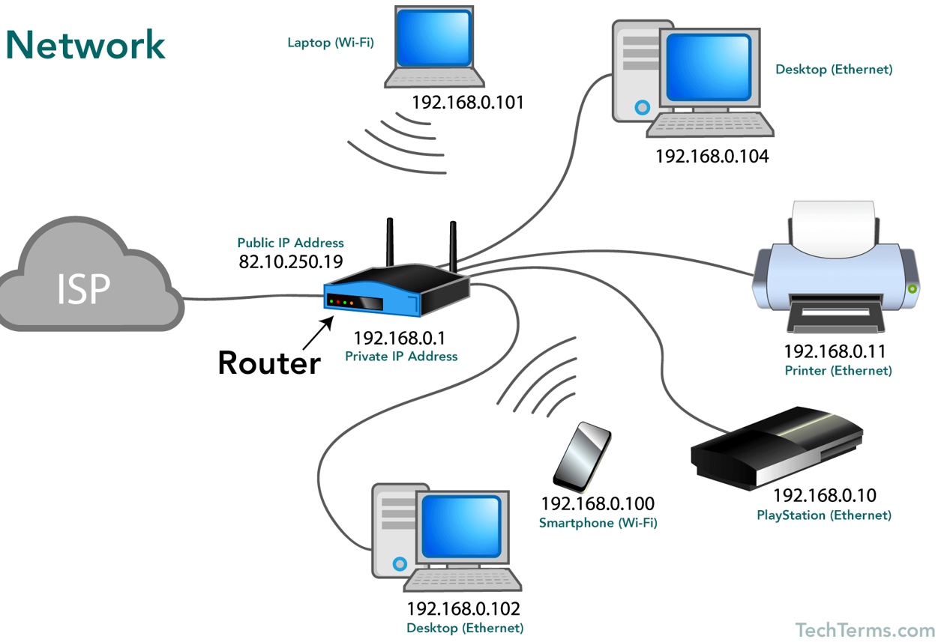
Networking 101
Source: https://techterms.com/definition/network

Slide 6
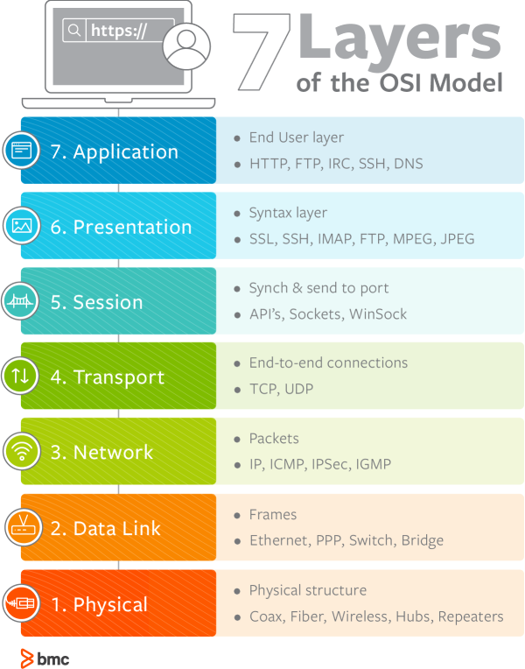
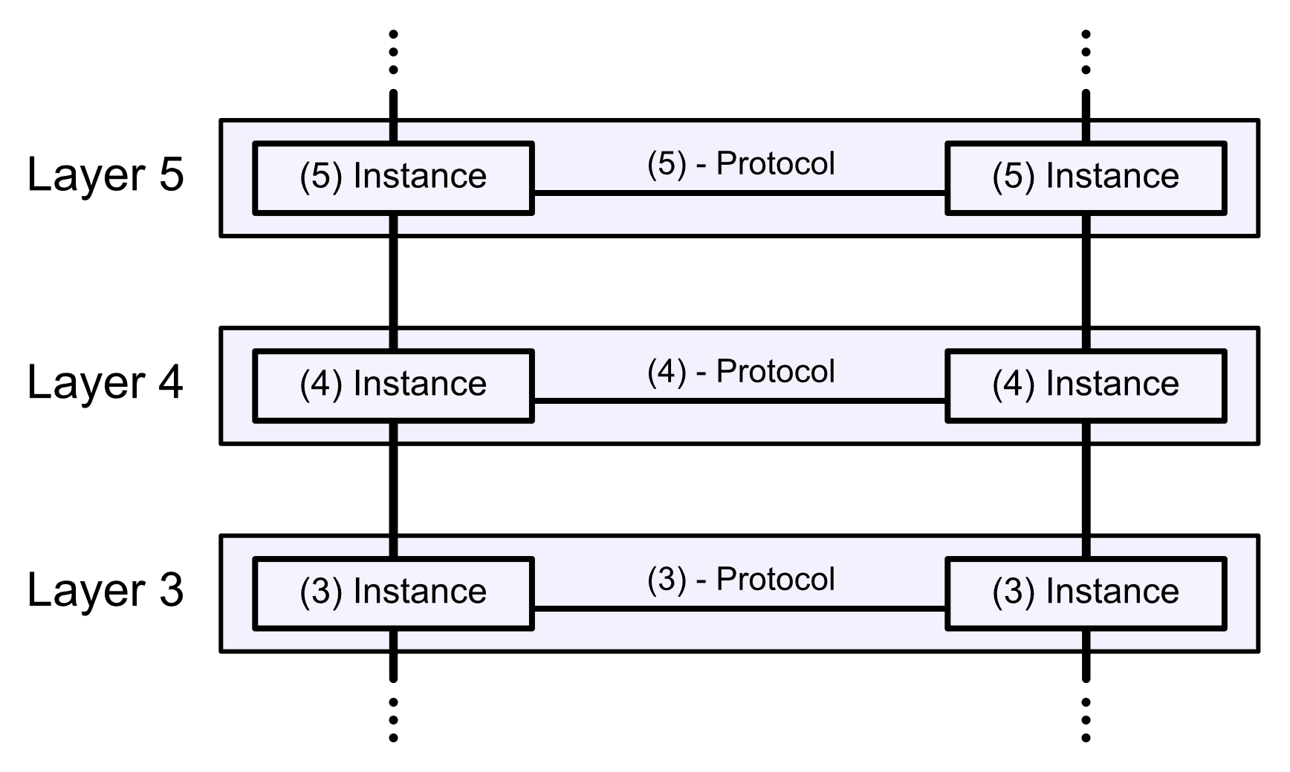
OSI (Open Systems Interconnect) Model
Source: https://en.wikipedia.org/wiki/OSI_model
Source: https://www.bmc.com/blogs/osi-model-7-layers/

Slide 7
Four Key Trends
Source: https://www.arista.com/assets/data/pdf/Whitepapers/Trends-in-FPGA-WP.pdf

Slide 8
Four Key Trends
High Frequency Trading
Source: https://www.arista.com/assets/data/pdf/Whitepapers/Trends-in-FPGA-WP.pdf

Slide 9
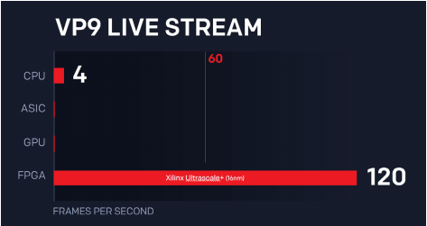
Four Key Trends
High Frequency Trading
Video Streaming
  Twitch (https://www.xilinx.com/publications/powered-by-xilinx/Twitch-Case-Study.pdf)
Source: https://www.arista.com/assets/data/pdf/Whitepapers/Trends-in-FPGA-WP.pdf

Slide 10
Four Key Trends
High Frequency Trading
Video Streaming
  Twitch (https://www.xilinx.com/publications/powered-by-xilinx/Twitch-Case-Study.pdf)
Software Defined Networking (SDN)
  Microsoft Catapult (https://www.microsoft.com/en-us/research/project/project-catapult/)
Source: https://www.arista.com/assets/data/pdf/Whitepapers/Trends-in-FPGA-WP.pdf

Slide 11
Four Key Trends
High Frequency Trading
Video Streaming
  Twitch (https://www.xilinx.com/publications/powered-by-xilinx/Twitch-Case-Study.pdf)
Software Defined Networking (SDN)
  Microsoft Catapult (https://www.microsoft.com/en-us/research/project/project-catapult/)
Network Capture & Timestamping
  O-RAN/IEEE 1588 (https://www.intel.com/content/www/us/en/programmable/documentation/ycv1586051310815.html)
Source: https://www.arista.com/assets/data/pdf/Whitepapers/Trends-in-FPGA-WP.pdf

Slide 12
What is Software Defined Networking (SDN)?
Software-Defined Networking (SDN) is an emerging architecture that is dynamic, manageable, cost-effective, and adaptable, making it ideal for the high-bandwidth, dynamic nature of today’s applications. This architecture decouples the network control and forwarding functions enabling the network control to become directly programmable and the underlying infrastructure to be abstracted for applications and network services. - https://opennetworking.org/sdn-definition/
Source: https://techterms.com/definition/network

Slide 13
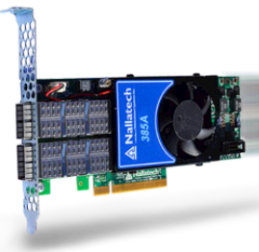
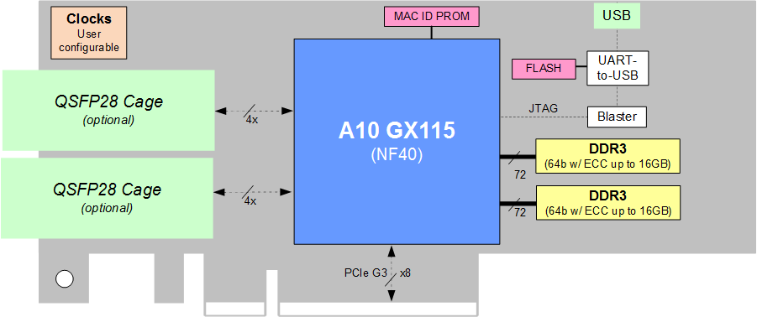
What is a SmartNIC?
A DPU based SmartNIC is a network adapter that accelerates functionality and offloads it from the server (or storage) CPU. - https://blog.mellanox.com/2018/08/defining-smartnic/
Source: https://www.bittware.com/fpga/385a/
Notes:
Offset DDoS attack

Slide 14
Who is involved?
Intel
  Bought Altera
    FPGA (Terasic DE Board)
  Bought Barefoot Networks
    Network SoCs
  Started DPDK which is now open source
Xilinx
  FPGA Company
    Zedboard
  Partnered with AMD and now bought by AMD

Slide 15
Who is involved?
ARM
Microsoft
Arista Networks
Juniper Networks
Cisco
Ciena
Mellanox
And more…

Slide 16
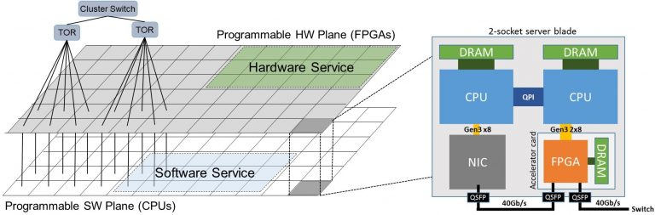
Microsoft Catapult
https://www.microsoft.com/en-us/research/publication/configurable-cloud-acceleration/

Slide 17
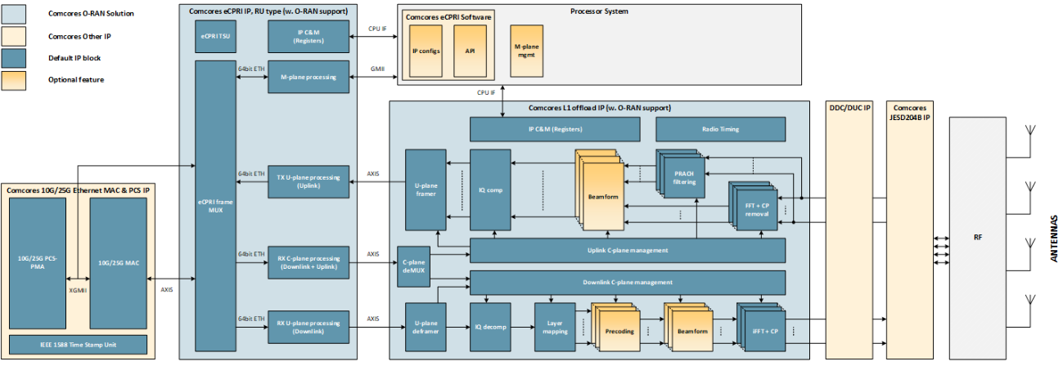
O-RAN & IEEE-1588 [Wireless 5G]
Intel: https://newsroom.intel.com/news/intel-tech-power-rakutens-revolutionary-fully-virtualized-end-cloud-native-mobile-network/

Slide 18
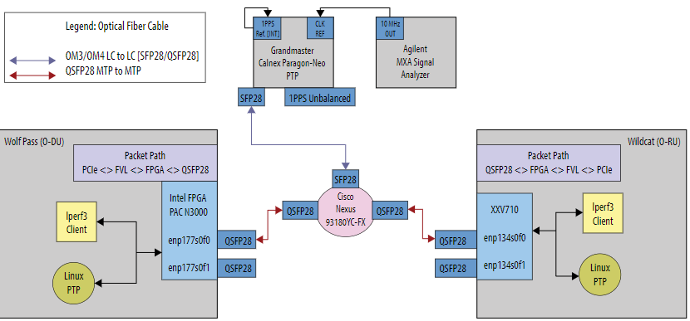
O-RAN & IEEE-1588 [Wireless 5G]
Schematic
Specifications
Intel PAC N3000 (Arria 10): https://www.intel.com/content/www/us/en/programmable/documentation/ycv1586051310815.html
International Telecommunications Union (ITU) Specifications: https://www.itu.int/rec/T-REC-G/en

Slide 19
Part 2: Graduate Studies

Slide 20
Why?
Why am I discussing this?
Why am I discussing my background?
Why is this important?

Slide 21
My Background
Education
  Started MDC in 2007
  MCSE/CCNA Completed in 2008
  Graduated with AA in 2011
  Finished pre-reqs for UF: Spring 2014
  Started UF BS EE: Fall 2014
  Graduated with BS EE in Summer 2018
  Started UF Grad in 2018 but took a year off
  Graduating with MS ECE Spring 2021
Work
  Property Management: 2005-2008
  GPS Tracking: 2009-2014
  RA: 2018-Current

Slide 22
Related UF ECE Courses
Computer Architecture (EEL5764)
Principles of Computer System Design (EEL5737)
Advanced Systems Programming (EEL5934)
Hardware Security (EEE5716)
Cross Layered Computer Security (EEL5855)
Computer Communications (EEL5718)
Foundations of DSP (EEE5502)
Approximate Computing
Fundamentals of Machine Learning (EEL5840)
Notes:
Computer Architecture – Implementing custom architectures like RISC V (Why you would use RISC V)
PoCSD – The ECE OS equivalent class but also has assignments involving dealing with the Linux file system and implementing in a distributed like system
ASP – Kernel Drivers
Hardware Security – Hardware Trojans, IDs, counterfeiting, detection, side channel attacks
Cross Layered Computer Security – Software side of security, buffer overflow, database attacks, stack manipulation
Computer Communications – Networking class
Foundations of DSP –
Approximate Computing – Helpful for research
Machine Learning- Linear Algebra, Statistics, Calculus, etc

Slide 23
Other Courses
Machine Learning by Andrew Ng (Coursera)
Cisco Certified Network Associate [CCNA] (Cisco)

Slide 24
Job Differences
Undergrad
  Entry-level
Masters
  Above entry-level
PhD
  Academia
  Research
    Intel Labs
    AMD Research
    Microsoft Research

Slide 25
Masters vs PhD
Masters (2 Years)
  Non-thesis
    30 graduate level credit hours (~10 Courses)
  Thesis
    Thesis + 24 graduate level credit hours (~8 Courses)
Source: Graduate Guidelines https://www.ece.ufl.edu/academics/graduate/graduate-advising/graduate-guidelines/

Slide 26
Masters vs PhD
PhD (4+ Years)
  24 graduate level credit hours (~8 Courses)
  6 professional development credit hours
  Survey Paper (Written Exam)
  Dissertation
  Oral Defense
Source: Graduate Guidelines https://www.ece.ufl.edu/academics/graduate/graduate-advising/graduate-guidelines/

Slide 27
Job Reimbursement vs RA
Job Reimbursement
  Most companies offer this
  Requires you to work there
  Some require courses to be in-line with company interest
  No minimum credits

Slide 28
Job Reimbursement vs RA
Research Assistant (RA)
  Work under a professor in the department
    Usually PhD Advisor
  20 hours/week
  GatorGradCare (Insurance)
  Minimum 9 credits/semester
  Offered to Masters/PhD students
  Get to work on and learn what you want to work on and learn

Slide 29
Mentoring
Network! (The social kind)
Find people that align with your goals
Don’t be afraid to ask questions
Notes:
-Find someone in the department, place of work, somewhere
-Ask educated questions
-You don’t know what you don’t know

