Slide 1
How to Choose the Best Device for your Application
Greg Stitt
Professor
Department of Electrical and Computer Engineering
University of Florida

Slide 2
Introduction
How do you identify the best technology for an application?
FPGAs and reconfigurable hardware enable design of digital circuits without fabricating a device
  Can be used anytime a digital circuit is needed
  e.g., ASIC prototyping, ASIC replacement
When should FPGAs (or any device) be used instead of other technologies?
Implementation Possibilities
Microprocessor
FPGA/GPU
ASIC
Performance
Why not use an ASIC for everything?

Slide 3
Moore’s Law
Moore's Law is the empirical observation made in 1965 that the number of transistors on an integrated circuit doubles every ~2 years [Wikipedia]
1993: 1 million transistors
2007: > 1 billion transistors

Slide 4
Moore’s Law
Moore's Law is the empirical observation made in 1965 that the number of transistors on an integrated circuit doubles every ~2 years [Wikipedia]
2007: > 1 billion transistors
Becoming extremely difficult to design this - ASICs are expensive!
$10s of millions
2017: > 20 billion transistors
https://www.eetimes.com/author.asp?section_id=36&doc_id=1266014

Slide 5
Moore’s Law
Solution: Make billions of transistors into a reconfigurable device - fabricate 1 big chip and use it for many things
  Area overhead: circuit in FPGA can require 20x more transistors
    But, that’s still equivalent to a 1 billion transistor ASIC
      Six-core Core i7 (Gulftown) 2010: ~1.2 billion transistors
Solution: Make this reconfigurable
2017: > 20 billion transistors

Slide 6
Economic Considerations
When should a device be used?
Situation 1: when it provides the cheapest solution
  Depends on:
    NRE Cost - Non-recurring engineering cost
      Cost involved with designing application
    Unit cost - cost of a manufacturing/purchasing a single system
    Volume - # of units
  Total cost = NRE + unit cost * volume
  FPGAs are typically more cost effective than ASICs for low/mid volume applications
    Typical trends:
      FPGA: lower NRE, high unit cost
      ASIC: very high NRE, low unit cost

Slide 7
Application Requirements
Microprocessors (µP) have similar cost issues
  General trend:
    Very low NRE cost (coding is cheap)
    Unit cost varies from several dollars to several thousand
Wouldn’t cheapest microprocessor always be the cheapest solution?
  Yes, but …
Often, microprocessors cannot meet performance constraints
  e.g., video decoder must achieve minimum frame rate
  Common reason for using custom circuit implementation
Different applications and use cases have different constraints
  Performance, energy, power, cost, size, weight, etc.
Device must meet constraints to be considered
  Must also consider optimization goals (will revisit)

Slide 8
Example
FPGA: Unit cost = 5, NRE cost = 200,000
Microprocessor (µP): Unit cost = 8, NRE cost = 100,000
Problem: Find cheapest implementation for all possible volumes (assume both implementations meet constraints)
µP
Cost
FPGA
5v+200k = 8v+100k
v = 33k
200k
100k
Answer: For volumes less than 33k, µP is cheapest solution. For all other volumes, FPGA is cheapest solution.
Volume
33k

Slide 9
Example: Your Turn
FPGA
  Unit cost: 6, NRE cost: 300,000
ASIC
  Unit cost: 2, NRE cost: 3,000,000
Microprocessor (µP)
  Unit cost: 10, NRE cost: 100,000
Problem: Find cheapest implementation for all possible volumes (assume that all possibilities meet performance constraints)

Slide 10
Another Example
FPGA
  Unit cost: 7, NRE cost: 300,000
ASIC
  Unit cost: 4, NRE cost: 3,000,000
Microprocessor (µP)
  Unit cost: 1, NRE cost: 100,000
FPGA
ASIC
Cost
Answer: µP cheapest solution at any volume – not uncommon
µP
Volume

Slide 11
Other Economic Considerations
Time to market
  Huge effect on total revenue
FPGAs have faster time to market than ASIC (but still much slower than software)
Growth
Decline
Revenue
Total revenue = area of triangle
Time
Time to market
Delayed time to market = less revenue

Slide 12
Misc Considerations
Will application have to change or adapt after deployment?
  Can’t change ASIC (actual hardware)
  Can change circuit implemented in FPGA (virtual hardware)
Uses
  When standards change
    e.g., codec changes after device fabricated
  Allows addition of new features to existing devices
  Allows bug and security fixes
  Fault tolerance/recovery
  “Partial reconfiguration” allows virtual device with arbitrary size - analogous to virtual memory
Without FPGA
  Anything that may have to be reconfigured is implemented in software
    Performance loss

Slide 13
Optimization Goals and Constraints
Goals and constraints have huge impact on device choice
High-performance computing
  Common goal: maximize performance given a power and cost constraint
  GPU attractive if power constraints met
  FPGA attractive if GPU consumes too much power, or if goal is to minimize energy costs
Embedded systems
  Common goal: minimize power given a performance constraint
  High-end GPU might violate power constraints, low-power GPU might be slower than FPGA
  FPGA often attractive because of low energy and power
Data center
  Common goal: meet throughput constraints while minimizing energy & cooling costs
  FPGA attractive even if GPU faster due to lower power, energy, cooling costs
    Examples: Microsoft Catapult, Amazon EC2 F1

Slide 14
Application Characteristics
Many characteristics can affect best choice of device
Common characteristics:
  Parallelism (types and amounts) and dependencies
  Arithmetic type (floating point, fixed point, integer, bitwise logic)
  Branching
  Memory requirements
  Sensitivity to memory and I/O bandwidth
  Data structures and memory access patterns
No known equation to automatically determine best device
Understanding these characteristics is first step in exploration

Slide 15
Architecture Characteristics
Device architecture considerations
  Peak computational throughput
  GPU: number of cores, clock frequency, on-chip memory, etc.
  FPGA: # of look-up tables (LUTs), DSPs, embedded RAM, clock frequency, etc.
Board architecture often just as important
Different boards provide different tradeoffs
  PCIe accelerators
    High peak computational throughput
    But, data must be transferred from CPU into board/device memory
    Different boards with same accelerator may provide different memory sizes and bandwidths
  System-on-Chip (SoC)
    Eliminates PCIe overhead, external memory bandwidth overhead
    But, limited peak computation throughput
  Custom boards
    Example: FPGA on a network-interface card (e.g., Microsoft Catapult) for ultra-low latency network processing

Slide 16
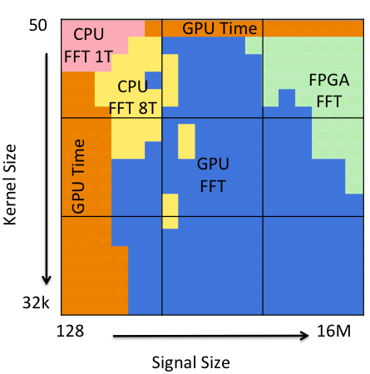
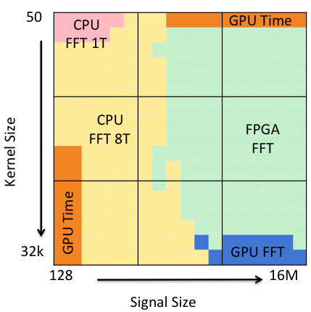
Input Size and Characteristics
Input can have significant effect on performance and/or energy
  Small inputs might not use all GPU cores, or amortize PCIe overheads
  Large inputs might not fit in on-board memory on one accelerator
Example convolution study*
  Different devices:
    GPU, FPGA, multi-core CPU
  Different algorithms:
    Time-domain convolution (Time)
    Frequency-domain convolution (FFT)
Some apps have data-dependent performance
  e.g., different amounts of thread divergence in GPU
Fastest convolution
accelerator and algorithm
Lowest-energy convolution accelerator and algorithm
*J. Fowers, G. Brown, J. Wernsing, and G. Stitt, “A performance and energy comparison of convolution on GPUs, FPGAs, and multicore processors,” ACM Transactions on Architecture and Code Optimization (TACO) - Special Issue on High-Performance Embedded Architectures and Compilers, vol. 9, pp. 25:1–25:21, January 2013.

Slide 17
Common GPU/FPGA Trends
GPUs usually provide fastest performance when application:
  Has large amounts of SIMT floating-point parallelism (loops with fine-grained, independent iterations)
  Control flow does not diverge (i.e. all threads follow the same path through a function)
FPGAs can provide fastest performance when:
  GPU can’t realize peak performance due to SIMT bottlenecks
    Divergence, stalls, communication overhead, insufficient SIMT parallelism
  Custom fixed-point precision or bit operations
FPGAs usually consume less power than GPU
  10s of Watts vs. 100+ Watts
FPGAs can use less energy
  Depends on performance difference
GPUs usually much easier to program compared to FPGA
  Intel OneAPI and DPC++ trying to hide many of the programming differences

Slide 18
How to choose a device?
Bare minimum approach:
Determine architectures that meet all constraints
  Not trivial, requires performance analysis/estimation - important problem
    Will study later in semester
Estimate volume of application
  Require understanding of market
Determine cheapest solution
The best device for an application is typically the cheapest one that meets all design constraints

Slide 19
How to choose a device?
More complicated approach:
Determine devices that meet all constraints
Analyze Pareto-optimal tradeoffs of those devices
    Includes cost and optimization goals
Choose solution that is most attractive for application and use case

Slide 20
Where are FPGAs used?
ASIC prototyping (first main market for FPGAs)
  Validate ASIC on many FPGAs before fabricating
ASIC replacement
  If ASIC is prototyped in FPGA, and FPGA has attractive tradeoffs, just deploy the FPGA
IoT, embedded systems, cyber-physical systems
  e.g., networking, signal-processing, automotive,
  Advantages
    FPGAs achieve performance close to ASIC, sometimes at much lower cost (ASIC replacement)
      High-volume systems still use ASICs (e.g. cell phones)
        But, ASICs becoming less common due to increasing costs
    Reconfigurable!
      If standards change, architecture is not fixed
      Can add new features (or fix bugs) after production

Slide 21
Where are FPGAs used?
Data centers, cloud computing (most recent trend)
  Intel Xeon+FPGA processor
  IBM Power9
  Microsoft Catapult
    Originally used FPGA to accelerate Bing searches
    Used for a variety of machine-learning applications
    https://www.microsoft.com/en-us/research/project/project-catapult/
  Amazon F1
    FPGAs integrates into EC2 compute cloud
    https://aws.amazon.com/ec2/instance-types/f1/
  Baidu
    Uses FPGAs for machine learning
Advantages:
  Low power, ASIC rarely feasible, microprocessor too slow

Slide 22
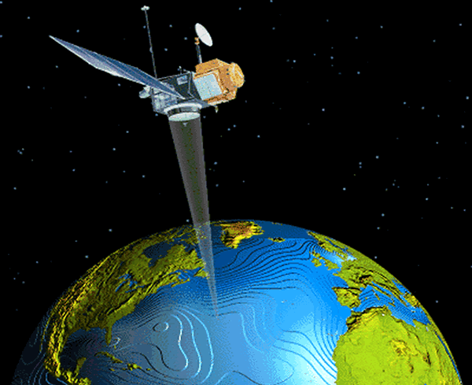
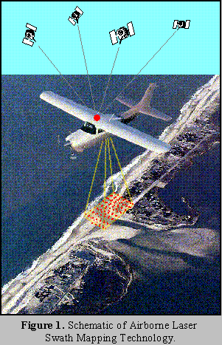
Where are FPGAs used?
High-performance embedded computing (HPEC)
  High-performance/super computing with special needs (low power, low size/weight, etc.)
    Satellite image processing
    Defense applications
  FPGA advantages
    Much smaller and lower power than a supercomputer
    Provide fault tolerance mechanisms

Slide 23
Potential Future FPGA Trends
Energy efficient high-performance computing (HPC)
  Mid 2000s: first appearance of high-end processors with FPGA accelerator boards
    Cray, SGI, DRC, GiDEL, Nallatech, XtremeData
      Combine high-performance microprocessors with FPGA accelerators
    Novo-G
      192 Altera Stratix III FPGAs integrated with 24 quad-core microprocessors
  ~2016: shared-memory “coherent” systems
    Intel Xeon+FPGA processor
    IBM Power9
FPGA advantages
  HPC used for many scientific apps
    Low volume, ASIC rarely feasible, microprocessor too slow
  Lower power consumption
    Increasingly important
    Cooling and energy costs are dominant factor in total cost of ownership

Slide 24
Where are FPGAs not used?
General-purpose computing (most applications)
  Problems
    FPGAs can be very fast, but not for all applications
      Generally requires parallel algorithms
    Common coding constructs are not appropriate for hardware
    Subject of tremendous amount of past and ongoing research
High-volume applications
  Cell phones
  Machine learning (FPGAs are a competitor, but ASICs increasingly common)
    Google’s Tensor Processing Unit (TPU)
      https://en.wikipedia.org/wiki/Tensor_processing_unit
    FPGA vs GPU competition has no clear winner yet
      GPUs are usually faster, but consume more power
      FPGAs are usually slower and harder to program, but use much less power and can adapt to exotic new models
  Gaming, 3D graphics
    nVidia’s GPUs are specialized ASICs

Slide 25
Limitations of FPGAs
Peak throughput far below high-end GPUs
  For any application that maps well onto GPU, FPGA will be at least an order of magnitude slower
Programming FPGAs considerably more difficult than software
  FPGA productivity at least 10x worse than software
  Generally requires low-level digital-design expertise to perform well
Device costs can be prohibitive
  Largest FPGAs cost ~$10k
  Symptom of productivity limitations
    Making FPGAs more usable would lower unit costs via economy of scale

