Slide 1
SystemVerilog and Verification
Cody Rigby

Slide 2
Topics
What is SystemVerilog
  Differences from VHDL
  Features
Constructing a Basic Testbench Topology in SystemVerilog
  Modules
  UVM SystemVerilog
Verification Concepts
  Assertions
  Coverage

Slide 3

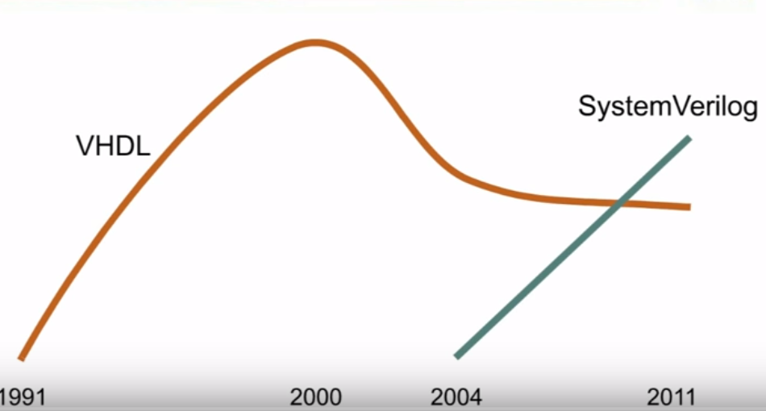
SystemVerilog
Hardware Description and Verification Language (HDVL) combines features of HDL’s with features from C and C++
  Borrows features from Verilog Superlog, VHDL, PSL, C, Vera,
  Most of the verification functionality is based on the OpenVera language by Synopsys
  Adopted as IEEE standard in 2005, most current version is IEEE standard 1800-2017
  Can be used to describe hardware behavior but typically used for verification
  SystemVerilog is an Object Oriented language that supports a single-inheritance model
  Verification features allow for complex testbenching and random stimuli in simulation

Slide 4
SystemVerilog VHDL
C-style data types 7 control –enum, struct, typedef, ++ break return Yes
Packages Yes
Synthesis –friendly “concise” RTL notation No
Interfaces No
Systemverilog Assertions Yes
Clocking Blocks No
Object Oriented Programming –Classes No
Constrained random stimulus generation No
Function Coverage No
Dynamic Processes, Dynamic arrays, queues, mailboxes, semaphores No
Direct Programming Interface(DPI) –calling C from Systemverilog Yes
RTL
Assertions
Test Bench
DPI

Slide 5
SystemVerilog Types
wire : acts like real write in circuits
reg : holds values until another value is assigned, like register in hardware
real, shortreal : single and double precision floating point numbers
Time : 64 bit quantity used to hold simulation time
Logic : improved version of reg from Verilog to SystemVerilog, can be driven by continuous assignments, gates and modules in addition to being a variable
Two State Types : byte, bit, int, shortint, longint : improved performance and memory usage
event : event is a handle to a synchronization object that can be passed around to routines, SystemVerilog introduces triggered function that lets you check whether an event has been triggered

Slide 6
SystemVerilog Data Structures
Fixed Arrays : collection of variables all the same type
  bit [7:0] array4 [2:0]; //unpacked array declaration
  bit [2:0][7:0] array5; //packed array declaration
Vector width/dimensions declared before the object name referenced as packed array, array size/dimensions declared after object name is refereed as unpacked array
Dynamic Arrays : one dimension of an unpacked array whose size can be set or changed at run-time
data_type array_name [ ];
data_type is the data type of the array elements.
Methods for Dynamic Arrays
new[ ] --> allocates the storage.
size( ) --> returns the current size of a dynamic array.
delete( ) --> empties the array, resulting in a zero-sized array.

Slide 7
SystemVerilog Data Structures
Queues: variable size, ordered collection of homogeneous elements. Queues can grow and shrink, supports adding and removing elements anywhere
Queues are declared using the same syntax as unpacked arrays, but specifying $ as the array size, In queue 0 represents the first and $ represents the last entree
  Queue Declaration
  data_type queue_name[$];
  where:
  data_type - data type of the queue elements.
  queue_name - name of the queue.
Mailboxes: mechanism to exchange messages between processes, data can be sent to a mailbox by one process and retrieved by another. Very effective in testbenches to transfer packets of data between modules

Slide 8
Blocking and Non-Blocking Assignments
Blocking Assignment
Non-Blocking Assignments
Executes in series order, uses ‘=’, blocks execution of next statement until completion of current assignment
initial begin
//initializing a and b
a = 10;
b = 15;
x = a + b;
y = a + b + x;
Executes in parallel, uses ‘<=’, assignments occur at the same time (during the end of the simulation time stamp)
initial begin
//initializing a and b
a = 10;
b = 15;
x <= a + b;
y <= a + b + x;

Slide 9
SystemVerilog Control Flow
Unique if : evaluates all the conditions in parallel
Priority if : evaluates all the conditions in sequential order
Loops: While/Do While, For Loop/For each break/continue etc.,
Repeat: executes statements for loop variable number of times
Event Control : any change in a variable or net can be detected using the @ event
module event_ctrl; bit clk; always #2 clk = ~clk; //always block will be executed at every posedge of clk signal always @(posedge clk) begin $display($time,"\tInside always block"); end

Slide 10
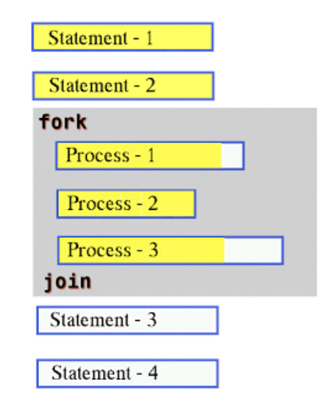
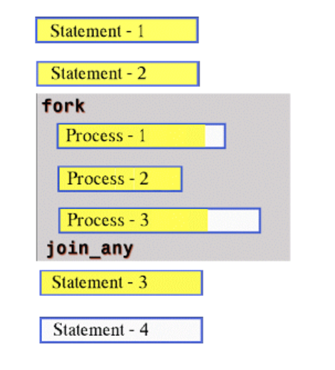
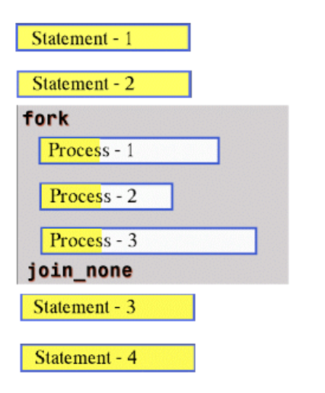
Processes
Fork-join : will start all the processes inside it in parallel and wait for the completion of all processes
Fork-Join_any will be un-blocked after the completion of any of the Process
Fork-Join_none does not wait for the completion of Process inside the fork-join_none before following processes are executed

Slide 11
Tasks and Functions
Function : must execute in one simulation time unit, cannot enable a Task, must have at least one input argument, returns a single value
Task : can contain time-controlling statements, can enable tasks or functions, can have zero or more arguments, does not return a value (used for performing actions during simulation time)

Slide 12
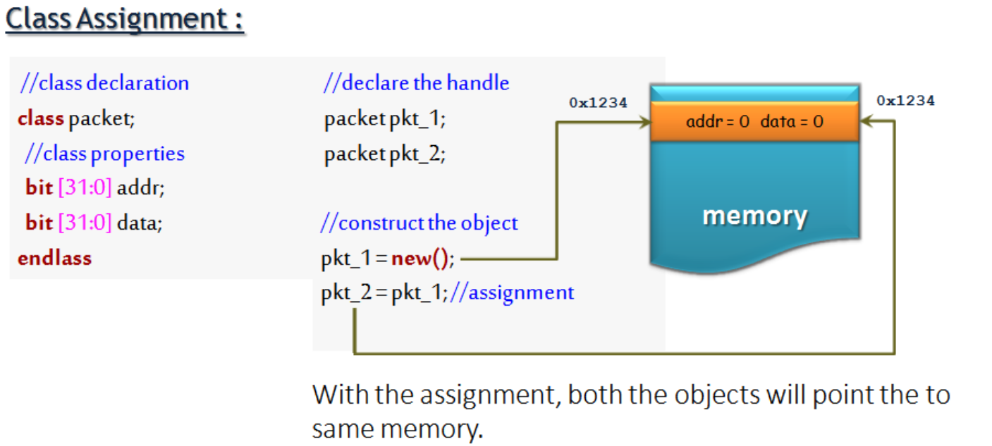
Classes
User defined data type that includes data, functions, and tasks that operate on data. Classes allow objects to be dynamically created, deleted assig and accessed via object handles.

Slide 13
Modules
Basic building block that can be used in design or verification.
RTL Design: contains synthesizable constructs which represents physical hardware, can be low level (logic gates) or complex (state machines) and can instantiate other design elements.
RTL Testbench :contains top-level RTL DUT instance, interfaces, assertions and other components

Slide 14
Constructing a Basic Testbench Topology in SystemVerilog

Slide 15
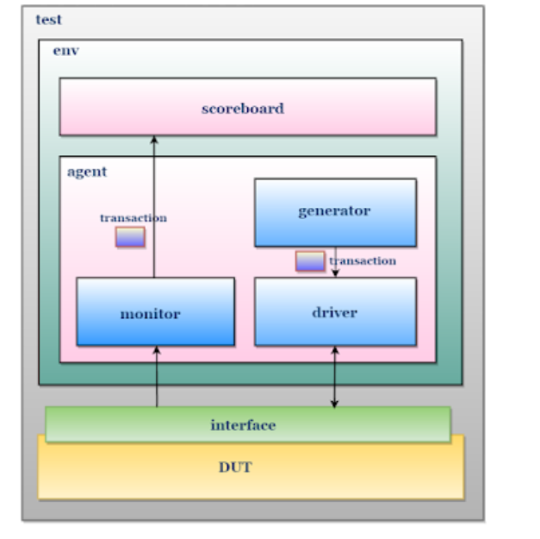
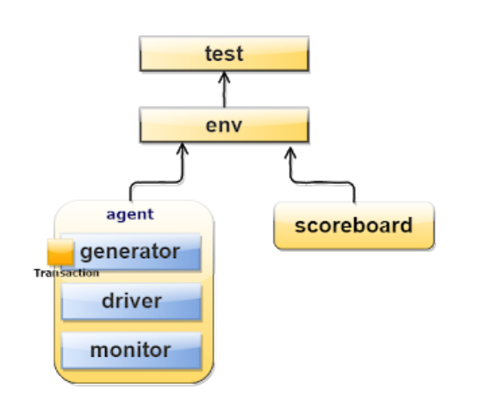

Slide 16
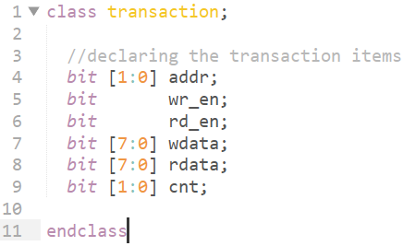
Transaction Class
Field required to generate stimulus are declared in transaction class
Transaction class can also be used as placeholder for the activity monitored by monitor on DUT signals
Generator sends transactions to be interpreted by the driver to provide stimulus to the DUT through the interface
Monitor interprets outputs of the DUT into transactions then pushes them to the scoreboard

Slide 17
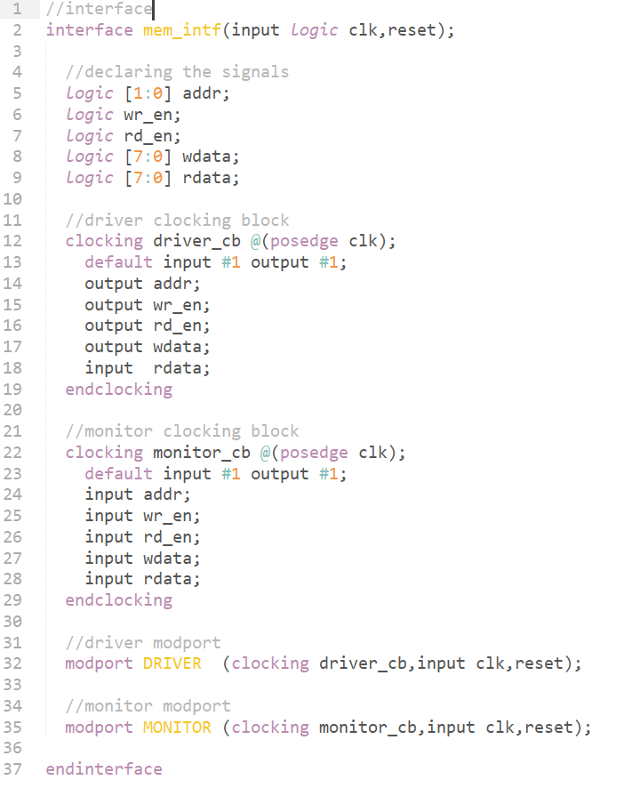
Interface
Systemverilog construct to encapsulate communication between modules
Can contain modports which provides direction information for module interface ports and controls the uses of tasks and functions within certain modules
Shared by multiple entities (driver, monitor, etc.)

Slide 18
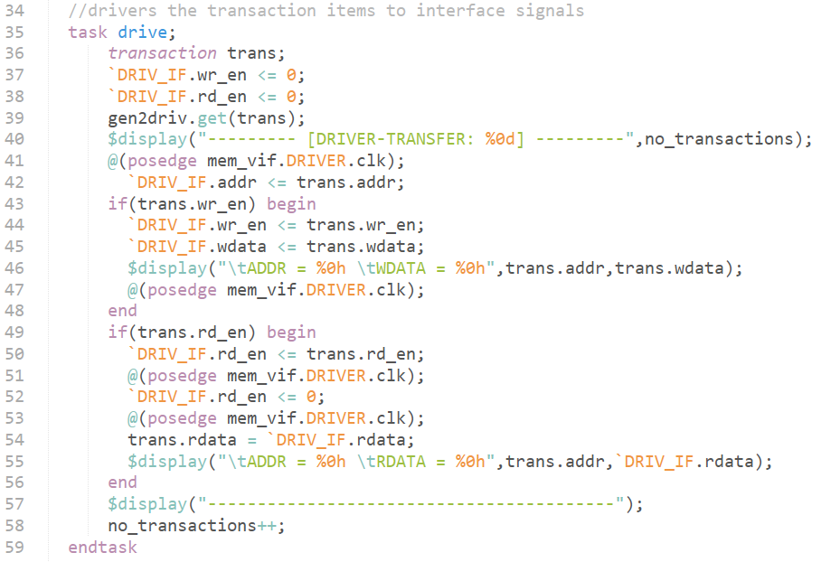
Driver
Driver Class receives the stimulus from a generator in the form of a transaction through a shared mailbox
Driver converts transaction level data to signal level activity

Slide 19
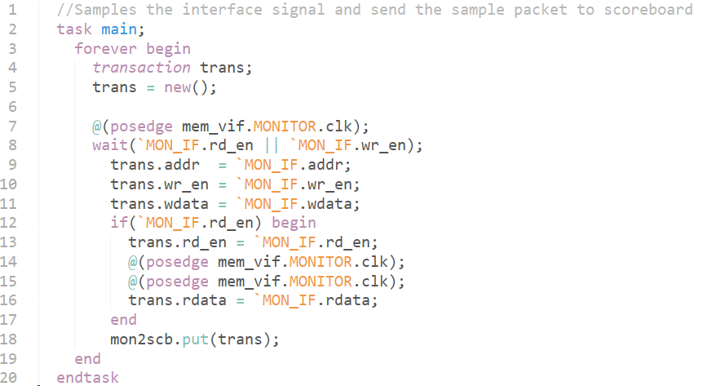
Monitor
Samples the Interface signals and convert signal level activity to transaction level
Sends transaction to scoreboard via mailbox

Slide 20
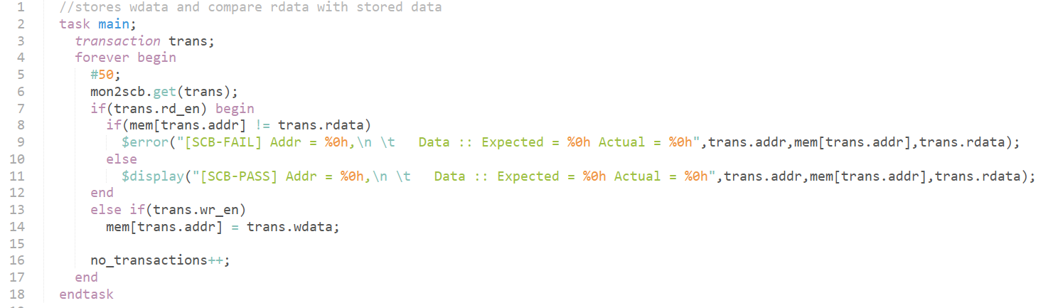
Score Board
Scoreboard receives the sampled transaction from the monitor
Used to perform the actual verification, is the output correct?

Slide 21
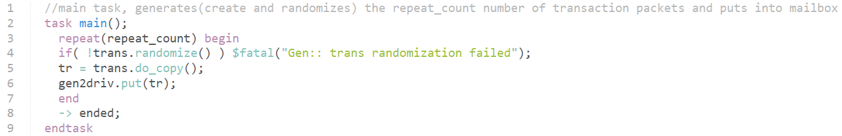
Generator
Generates transactions that will be translated into stimulus for the DUT
Sends generated transactions to driver over mailbox

Slide 22
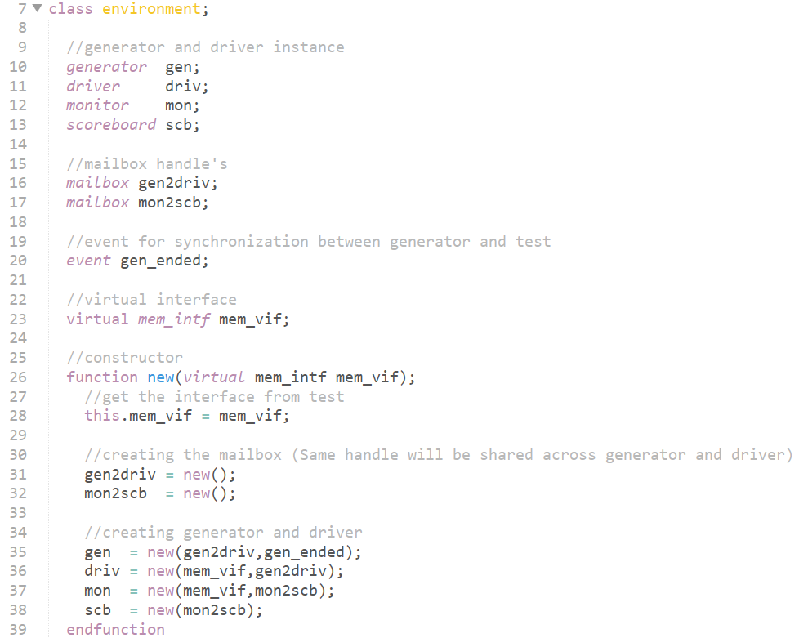
Environment
Contains instances of the generator, driver, monitor, and scoreboard, connects generators to drivers and monitors to scoreboard with mailboxes, and provides instance of the interface to all
Main task which runs a test

Slide 23
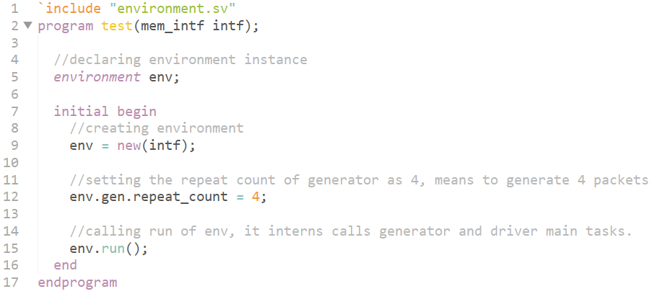
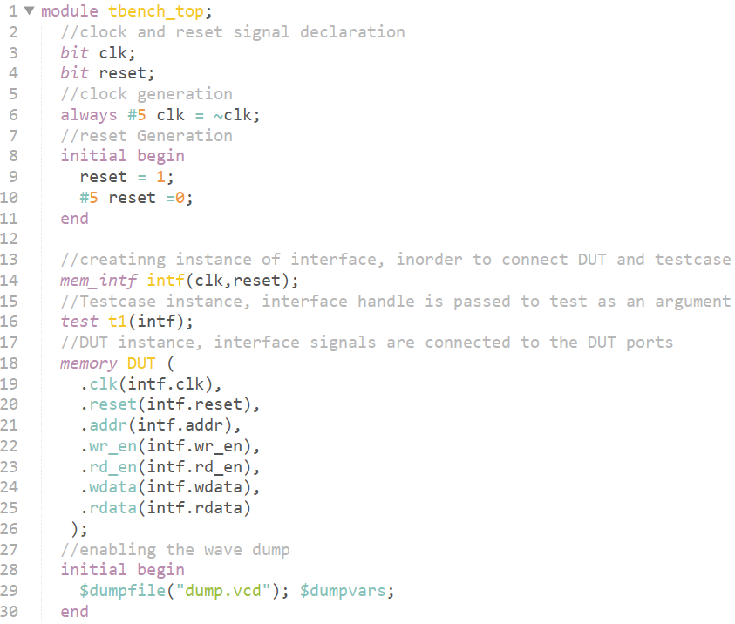
Testbench and Test
Test Bench is the top level entity and a module. Instantiates the DUT, interface and the test
The test is a module that instantiates the environment and calls its run() procedure.

Slide 24
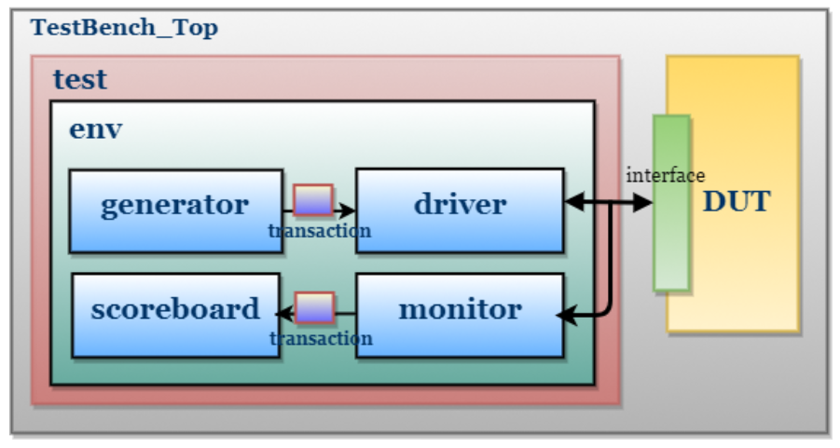

Slide 25
UVM SystemVerilog
Universal Verification Methodology
  Provides framework for modular and layered verification components
  Developed and maintained by Accellera
  Consists of class libraries that allow for robust, reusable verification environments
  Used widely in industry for RTL verification

Slide 26
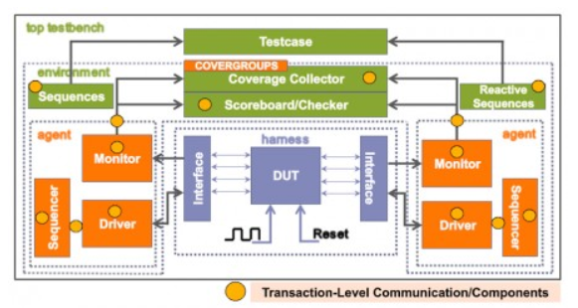

Slide 27
UVM Features
Sequences : UVM gives comprehensive control on stimulus, can be developed by randomization, layered sequences, virtual sequences etc. (sequences of transactions)
Stimulus/sequences are kept separate from actual testbench hierarchy.
Uses TLM instead of mailbox
Uses modular components, Driver, Sequencers, Agents, Env etc.
Configuration class : database where all the parameters for the testbench hierarchy are located

Slide 28
Verification Concepts
Simulation Verification : Verify that design meets spec for a given input stimuli
Formal Verification : Verify that design meets spec for any valid input stimuli
  Equivalence Checking
  Model Checking

Slide 29
Model Checking
Given a model of a system, exhaustively and automatically check whether this model meets a given specification as described by assertions
  Assertions are provided by the user that describe legal or illegal behavior
  Assertions include coverage properties that help ensure thoroughness of verification
  How to do this ? SystemVerilog Assertions (SVA)

Slide 30
Why use Assertions ?
Reducing verification time
Catch errors earlier
Pinpointing sources of error

Slide 31
Types of Assertions
Concurrent assertions must always be satisfied by a design.
Temporal assertions must by satisfied by the design under certain defined (often clock-based) conditions. These conditions can either contain an individual set or a sequence of sets

Slide 32
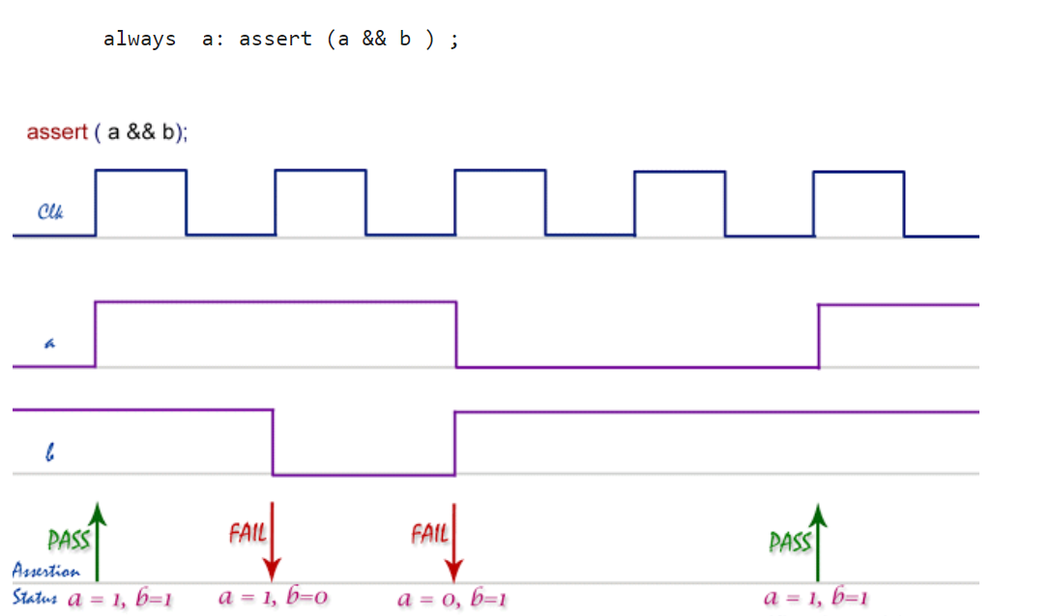
SVA Immediate Assertion Example

Slide 33
SVA Concurrent Assertions
SVA allows for concurrent assertions which detect behaviors over a period of time
Evaluation of concurrent assertions are associated with clock edges
4 Layers:
  Boolean Expression Layer : evaluates a single expression to be true or false
  Sequence Layer : sequence of Boolean expressions over time
  Property Layer : defines a behavior of the design defined elsewhere
  Assertion Layer : asserts the property

Slide 34
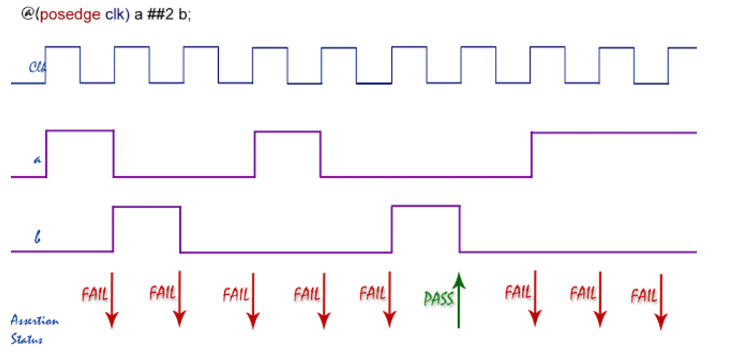
Example :
sequence seq;
a ##2 b;
endsequence
property p;
@(posedge clk) seq;
endproperty
a_1 : assert property(p);

Slide 35
Coverage:
Coverage is used to measure tested and untested portions of the design. Defined by the percentage of objective that have been met
Two Types :
  Code Coverage:
    How much of the design code is exercised, Number of lines, conditions, States in FSM, paths taken etc.
  Functional Coverage:
    User defined metric:
      Data-oriented : values of inputs and outputs
      Control-oriented Coverage : checks for sequences of behaviors

Slide 36
SVA Coverage
Defined by creating coverage points using the covergroup construct
Cover point is an expression or a variable, each associated with a bin
Bins increment if the condition given to that cover point is satisfied

Slide 37
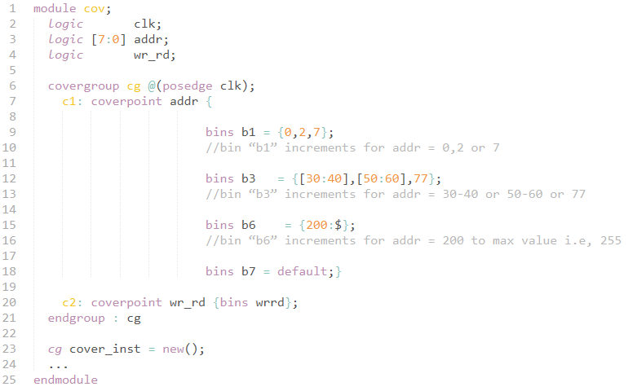

Slide 38
References
https://www.verificationguide.com/

