Slide 1
A Novel heterogeneous approximate multiplier for low power and high performance
Ihsen Alouani, Hamzeh Ahangari, Ozcan Ozturk, and Smail Niar
Presentation by Tiffany Walker

Slide 2
Author information
LAMIH lab, University of Valenciennes, France
Department of Computer Engineering, Bilkent University, Ankara, Turkey
Ihsen Alouani
Hamzeh Ahangari
Ozcan Ozturk
Smail Niar

Slide 3
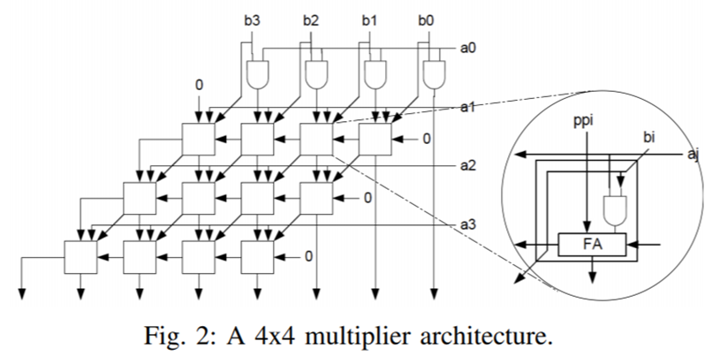
Background
What is this paper about?
Approximate Multipliers
What type of approximation?
HW architecture
What is the problem?
Homogeneous approximate multipliers aren’t precise enough
What is the proposed solution?
Heterogeneous Approximate Multiplier architecture

Slide 4
Related Works
GOAL: Reduce Delay and Power Consumption
Reduce combinational Circuit Complexity
Use less transistors in circuit design
Reduction of circuit complexity at transistor level >> conventional low power design techniques
Error Rate (ER) as a metric for accuracy
Segmented Adders

Slide 5
Related works
What about an approximate multiplier?
Partial products
Implement approximate adders
Error tolerant multiplier
All homogeneous design patterns

Slide 6
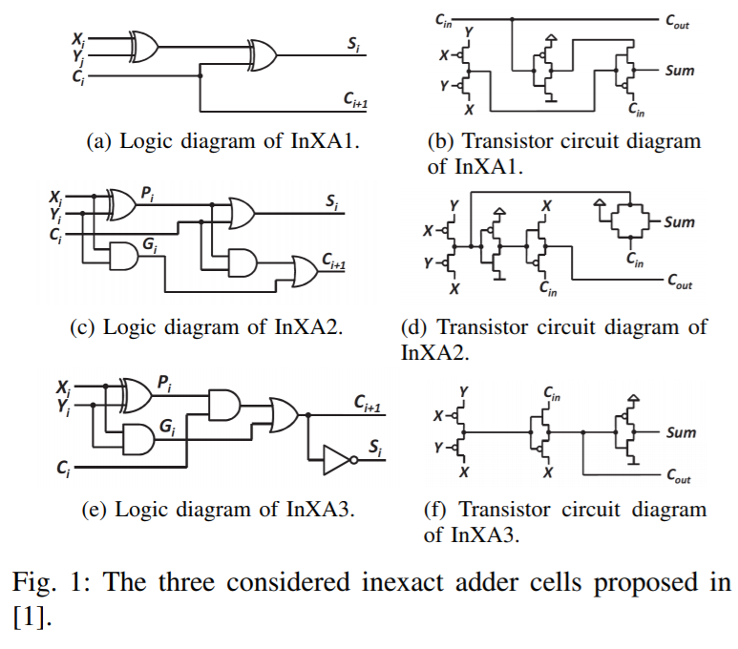
Proposal
Heterogeneous Multiplier
3 different Full Adders
Flexible Architecture
Improve Precision
Find best set of inexact implementations

Slide 7
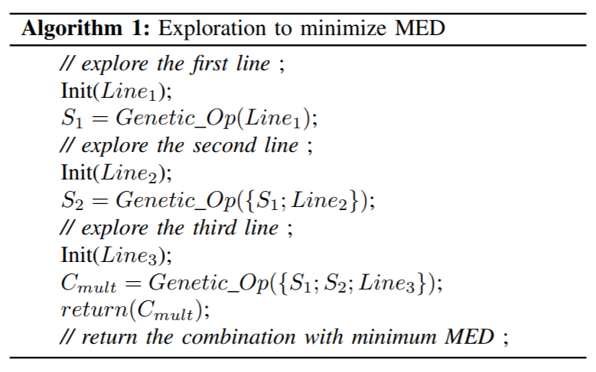
Proposed architecture
Algorithm
Mean Error Distance (MED) to find design combination
Based on Genetic Algorithm (GA)
3 steps

Slide 8
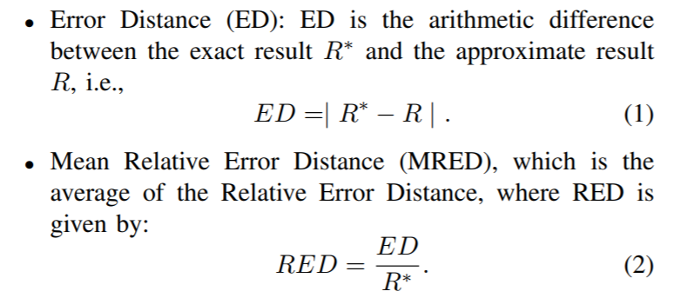
Precision evaluation

Slide 9
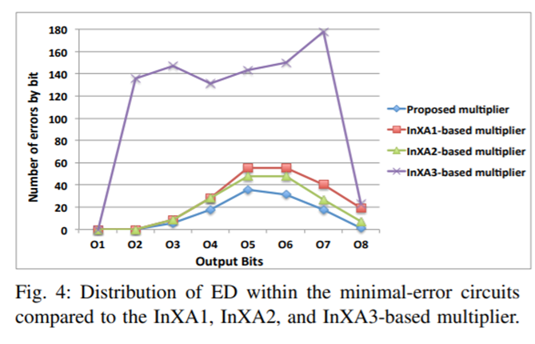
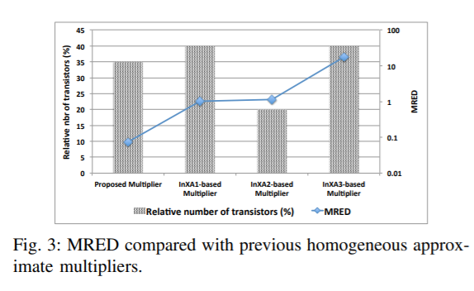
Precision evaluation

Slide 10
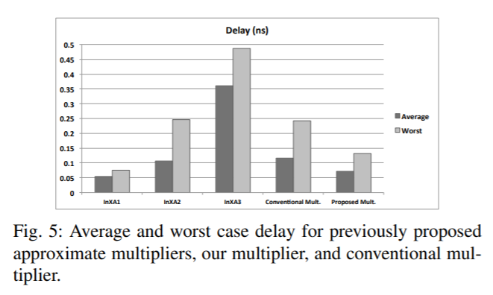
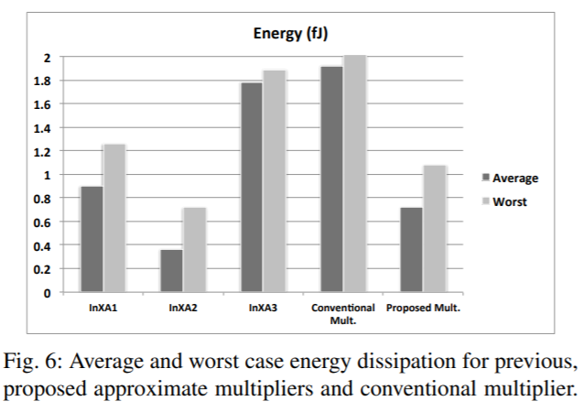
Performance and energy evaluation

Slide 11
Approximate computing applications
Edge detection through Sobel filter
K-means clustering

Slide 12
Edge detection through sobel filter
Sobel Filter ~ Image Gradient
Mean Square Error (MSE) → assess quality of different approximate filters using proposed multiplier

Slide 13
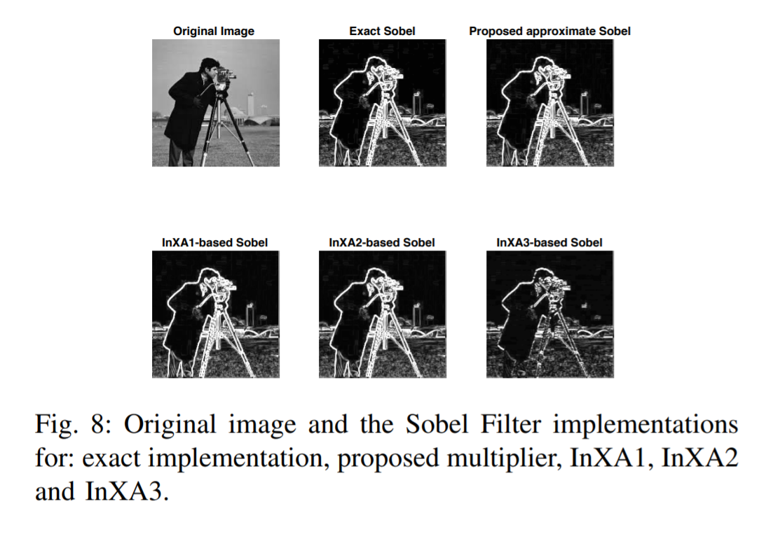

Slide 14
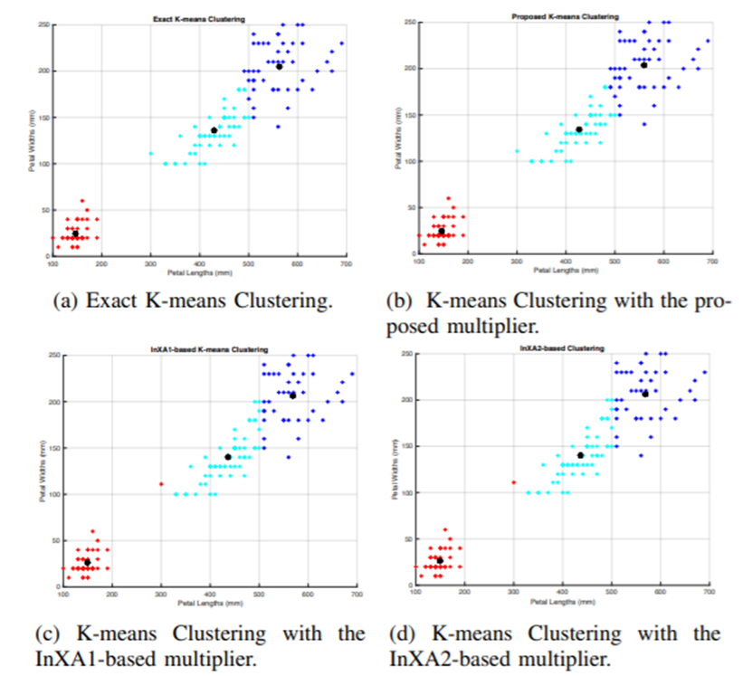
K-Means based clustering
~ Vector Quantization
“K-means clustering algorithm aims to partition n observations into k clusters in which each observation belongs to the cluster with the nearest mean, serving as a prototype of the cluster”

Slide 15
conclusion
Proposed Heterogeneous Multiplier → GOOD
High precision results
Low Error Rates
Improves Performance

Slide 16
Sample questions
A heterogeneous multiplier architecture consists of…
A) a single adder block that is replicated to build the multiplier
B) a combination of different adder blocks that are replicated to build the multiplier
C) Replications of the InXA3 approximate adder
D) One full adder
What performance metrics were used to assess precision of the homogeneous multiplier architecture?
A) Error Distance (ED)
B) Mean Relative Error Distance (MRED)
C) Mean Square Error (MSE)
D) All of the above
What are the Approximate Computing applications that were simulated using a heterogeneous multiplier in “A Novel heterogeneous approximate multiplier for low power and high performance?”
A) Edge detection through Sobel filter
B) K-Means based clustering
C) Machine Learning
D) Approximate Computing

Slide 17
Questions?

