Slide 1
Modeling and Synthesis of Quality-Energy optimal Approximate Adders
Jin Miao, Ku He, Andreas Gerstlauer and Michael Orshansky

Slide 2
General Idea
Finding a way to reduce energy required for Approximate Computing.
Paper focuses on voltage over-scaling at the cost of errors due to timing starvation in addition.

Slide 3
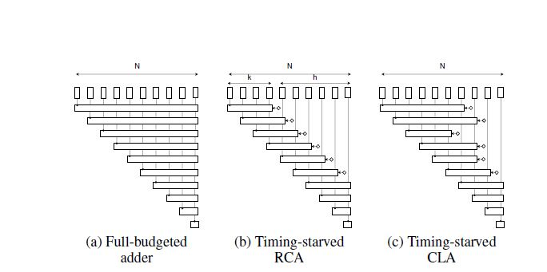
Experimental methods
Introduced time-starved adder
Study error frequency and magnitude patterns in approximate additions

Slide 4
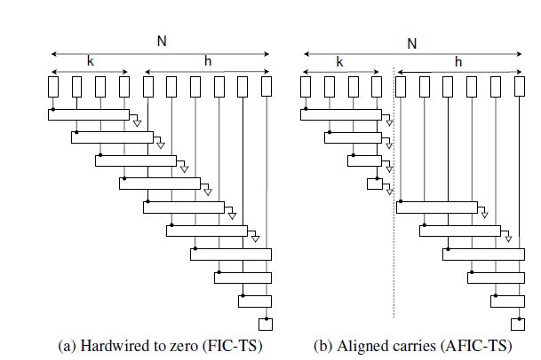
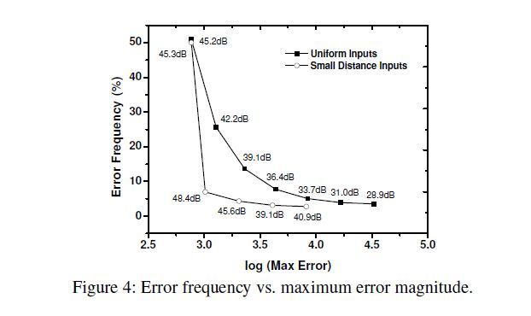
Experimental methods cnt’d
Introduced time-starved adder cnt’d
Study error frequency and magnitude patterns in approximate additions

Slide 5
Experimental methods cont’d
Synthesizing Conditional Bounding Logic
After maximum error is minimized, reduction of the average error is next
Introduce logic that generates LSB bits that bound its correct output when an error is generated in the MSB, i.e. conditionally.
$\min{L\left(f^{′}\right) s.t. ∆\left(f^{′}, f\right)≤ ∆ target}$
Synthesizing Conditional Bounding Logic cont’d
The equation further introduces a proxy distance metric measuring decimal distance and total distance of Peak Signal-Noise Ratio(PSNR)
Total Distance(TD) was found with the following equation:
$TD=\sum_{j}^{r}{D_{j}^{2}}$

Slide 6
Experimental methods cont’d
Synthesis of Conditional Bounding Logic
Comparison made for Pareto-optimal Solutions

Slide 7
Results of Experiments
Sometimes you must add to subtract! - =)… I’m sorry that was pretty bad……
After introduce Timing-starved adders and messing around with toggling bits and $∆\left(f^{′}, f\right)$s(changing of distances).
Observations showed a wide range of trade-offs.
Some solutions with 1/5th of the area at moderate quality loss
Energy savings are possible at the individual level up to 60%
Developed approximate adders utilized in image processing range up to 40% Energy savings

Slide 8
Results of Experiments
Normalized Energy comparison
16-bit Carry look ahead adders (CLAs)
16-bit Aligned Fixed Internal-carry (AFIC) adders

Slide 9
Results of Experiments
Normalized Energy comparison
Table ultimately showing yielded Energy for different LSB types

Slide 10
Results of Experiments
Image Processing Comparisons
Approximate Adders
Truncated adders with different dithering schemes

Slide 11
Conclusions
This is the end
As mentioned earlier it is important to note
Quality-energy tradeoffs can actually be synthesized
Various combinations of priorities in the LSB design could yield various results.
Energy savings were achieved within the space of AFIC adders

Slide 12
General Housekeeping
Questions for Approximate Computing
What type of Approximation is it?
I would say it is hardware approximation
What is the approximation Strategy?
Closer to Digital-Signal Processing
What is being approximated?
Hardware used in a system to decrease the required energy.

Slide 13
General Housekeeping cont’d
Questions for Approximate Computing
How is the Approximation Done?
Manually adding adders into circuit
Changing the output and bits

Slide 14
Questions for Class
What does AFIC stand for?.
Aircraft Finance Insurance Consortium
Aligned Fixed Internal-Carry
American Finance & Investment Company
Adders For Intelligent Chips
What is a Timing-Starved Adder?
An adder that needs more time to operate correctly
array of overlapping and translated sub-adders that each sum bit is constructed using exactly the same amount of preceding carry stages, except the first ones.
An adder that irrespective of the circuit constraints will lways operate outside the designated clock.

Slide 15
Questions for Class
What does the word dithering mean in context to Approximate Computing?.
Hesitating or indecisiveness
To purposely apply noise
This is was a made up term
An arbitrary group

