Slide 1
Approximate Storage in Solid-State Memories
Paper by: Adrian Sampson, Jacob Nelson, Karin Strauss, Luis Ceze
Presentation by: Sean Minchin

Slide 2
Context
Many applications, such as computer vision, media processing, machine learning, and sensor data analysis, are already inherently approximate and can sacrifice accuracy for efficiency.
We’re hitting limits to further scaling of most common memory technologies. Thus, new technologies like multi-level cells (MLC) are emerging, which store >1 bit of data in a single memory cell (we’ve discussed something similar with serial communication protocols using >2 voltage levels).
Phase-change memory (PCM) is being introduced, which utilizes special alloys for storage that can literally change “phase” with heat (crystalline or amorphous), where the phase state stores the binary data. Compared to flash, PCM is faster and uses less power.
However, MLC memories have slower write speeds (because more complex programming) and PCM degrades over time, so they’re not perfect solutions. Therefore, there is still room for approximation in storage.

Slide 3
Outline
Approximation strategy => approximate storage (hardware)
How to approximate => reduce number of programming pulses when writing to MLCs, map approximate data to blocks without hardware error correction
What to approximate => persistent storage and data memory

Slide 4
Approximate Persistent Storage
SRAM and DRAM are volatile and therefore limited to transient storage; Flash and PCM can be used for persistent storage
Most common interfaces to persistent memories include file systems, and database managements systems
For approximate mass storage, use cases include server, mobile, and embedded applications

Slide 5
Approximate Persistent Storage
This paper assumes each object in a store is either approximate or precise. This precision level is set by the load/store instruction and when the object’s memory is allocated.
Therefore the nature of every read or write must be determined at compile-time.
The compiler and memory allocator ensure that precise data is always stored in precise blocks.

Slide 6
Hardware Interface
The interface to approximate memory is simply read and write operations, and for persistent memory, these requests are blockwise.
The hardware allocator uses one of two mechanisms depending on whether the memory supports software control of approximation
With software control, the memory gets instructed by the program when it sets the precision state of each memory block via the flag on the write instruction. Reads do not affect the precision state, as this state is set only during allocation (see mechanism 1).
With hardware control, the memory reports a list of approximate blocks to the operating system (see mechanism 2).

Slide 7
Hardware Interface
To support “mixed-precision” objects, i.e. objects with a combination of approximate and precise fields, the allocator can either use ordered layout or forwarding pointers.
Ordered layout: mixed objects lay out their object header and precise data first, then the approximate data
Extra fragmentation
Forwarding pointers: all object are in precise memory, but mixed objects contain a pointer to approximate memory where its approximate data is stored
Extra memory overhead
Can also specify data element size in a memory access to specify the relative importance of bits within a block.

Slide 8
Approximate multi-level cells (mechanism 1)
Solid-state memories store an analog value that can be quantized as a digital value. MLCs take advantage of this by storing multiple bits. Precise MLC storage requires error-correction overhead and a tradeoff between size and cost, access time, and energy.
Approximate MLCs relax precision restraints to reduce power consumption, increase performance, and utilize denser cells. The authors’ approach is to reduce or eliminate “guard bands” that separate the analog ranges for writes that represent digital values.
These guard bands lead to higher tolerance, limiting write performance. By removing or eliminating them, writes can be sped up at the cost of more errors.

Slide 9
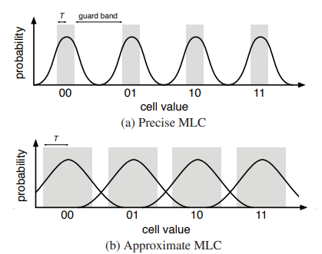
Approximate multi-level cells

Slide 10
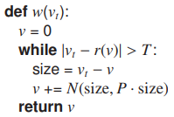
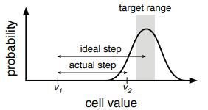
Writes
Write pulses adjust a cell value according to a probability distribution rather than a precise amount, but a single pulse has poor precision. To account for this, MLCs in Flash and PCM use program and verify mechanisms to iteratively adjust and read back a cell value until an “acceptable” value has been set.
T, the threshold distance from the target, determines the error rate. P is the proportional constant that controls the effect of each pulse. Together, these determine the number of iterations to write to a cell.

Slide 11
Reads
Read operations are identical for approximate and precise memory, so the programming language’s precision flag goes unused.
The authors suggest a different approximate MLC design could use this flag to control the resolution of the ADC circuitry that digitizes the cell value.

Slide 12
Encoding values
When combining multiple MLCs to store larger data types, two approaches are:
concatenation, which appends bits from the cells to form a larger word
striping interleaves the cells such that the MSBs of each cell collectively map to the higher-order bits of a word.
Ideally, error correction codes allow errors in low bits while making errors in high bits rare.
What if the MLC with the most-significant bits is off by one digital value?
With concatenation, a single-level error can cause a bit flip of high significance, while a striping code may mitigate high-bit errors.

Slide 13
Using Failed Memory Cells (mechanism 2)
PCM and Flash cells wear out over time. Typically, techniques involve abandoning memory regions containing uncorrectable failures and only use failure-free blocks.
By instead using failed blocks to store approximate data, memory lifetime can be extended so long as enough precise memory remains.
Since we know which memory blocks contain failures, and therefore approximate data, we can more effectively implement error correction using bit priorities.

Slide 14
Prioritized Bit Correction
Correction schemes like error-correcting pointers (ECP) mark failed bits in a memory block.
Blocks have limited correction resources (pointers), so a block is considered unusable for precise storage once these resources have been exhausted.
For approximate storage, we can keep using exhausted resources and only correct high-position bits within words.

Slide 15
OS-memory Interface
When the memory module is new, all block are considered precise. When the first uncorrectable failure occurs, the memory triggers a failed-block interrupt. The OS then adds this block to the collection of approximate blocks.
The memory allocators consult this collection, as precise data must be stored in memory without any failures.
Once too many blocks are approximate to properly store precise data, the memory allocator will determine that the memory module needs to be replaced.

Slide 16
OS-memory Interface
The memory system needs to be able to detect every write failure. The write operation’s precision level determines the next action taken:
For a precise write, the memory module attempts to construct ECPs for all failed bits, and if not possible, triggers an interrupt.
For an approximate write, however, no interrupt is triggered. The memory attempts to silently correct errors but will leave certain bits uncorrected.
To implement bit prioritization, memory needs information from software indicating which bits are important. Software specifies this with a value size indicating the byte-width of approximate values stored within a block.
For an array of shorts, for example, the value size is 2 bytes, or 16 bits. This indicates that memory increases in importance for its mod(index, 16) value, e.g., 0 mod 16 = 16 mod 16 = 0 = most important, 15 mod 16 = 31 mod 16 = 15 = least important.

Slide 17
OS-memory Interface
When a block has a new failure, the memory module masks the bit index of each failure to obtain the modulo result, from which it corrects the bits with the lowest offsets and leaves the remaining failures uncorrected.
This interface requires blocks to contain the same-sized values, which the authors found was common, particularly for arrays of floats and doubles.

Slide 18
Evaluation
Tested using two different applications: main-memory and persistent storage
The authors evaluated main-memory applications as Java programs using EnerJ
For persistent storage, the authors tested using four sets of approximate DSP data

Slide 19
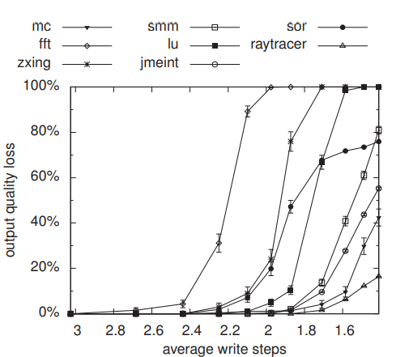
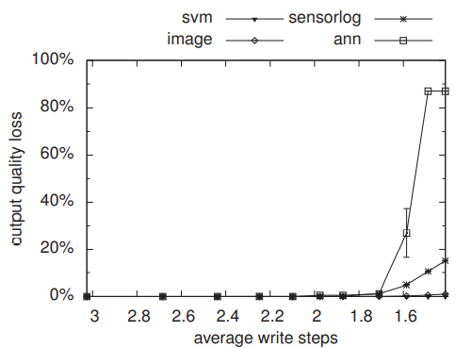
Results (1)
For MLCs, map all approximate data to arrays of 2-bit PCM cells. Benchmarks were run multiple times with differing threshold (T) parameters.

Slide 20
Results (1)
Main memory
Decreasing number of iterations by 2x increases write speeds by 2x
Error stays low and then sharply increases once hardware errors become too frequent
Persistent storage
More tolerant than main memory benchmarks
In configurations with <10% quality loss, benchmarks observe 1.7x faster writes to approximate MLCs
Encoding
Striped code had a statistically significant more positive impact on quality than negative impact for almost all applications (except Monte Carlo)

Slide 21
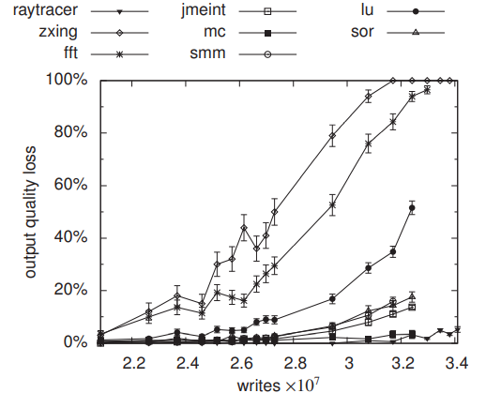
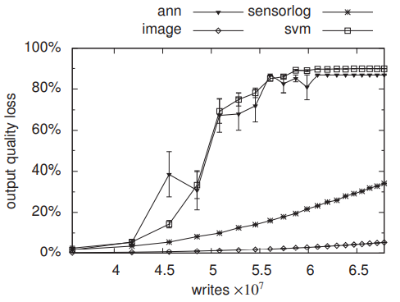
Results (2)
For failed-block recycling, authors simulated the benchmarks on PCM cells at different wear out stages.

Slide 22
Results (2)
Main memory
Wide range of lifetime extensions
With quality unconstrained, the mean lifetime extension is 34%
Persistent storage
Also more tolerant than main memory benchmarks
Bit priority
Bit prioritization had a statistically significant positive impact on quality for almost all applications (except Monte Carlo) (again)

Slide 23
Conclusion
Approximate solid-state storage can be implemented with approximate MLCs and failed-block recycling.
Results for write acceleration and lifetime extension suggest that approximate storage can help mitigate the drawbacks of solid-state, non-volatile memories such as PCM and Flash while compromising only a small amount of storage quality.

Slide 24
Question 1
Which techniques were used to approximate sold-state memory?
A) Applying machine learning predictions to automatically determine which memory cells can function with lower source current
B) Mapping approximate data onto memory blocks that have exhausted error-correction resources
C) Shorting the anode and cathode in approximate solid-state cells with special metal
D) Reducing programming pulses used to write to multi-level cells

Slide 25
Question 2
Which techniques were implemented to support storing mixed-precision objects in solid-state memory?
A) Instruction pipelining
B) Forwarding pointers
C) Ordered layouts
D) Watchdog timers

Slide 26
Question 3
How does an approximate solid-state memory module communicate to the OS that a memory block is approximate?
A) I2C transmissions
B) WiFi
C) CPU interrupts
D) Neural net neurons

