Slide 1
Verifying Quantitative Reliability for Programs That Execute on Unreliable Hardware
Michael Carbin, Sasa Misailovic, Martin C. Rinard
Presentation by Marco Menendez

Slide 2
Overview
This paper introduces the Rely programming language.
Rely will generate a quantitative reliability measure for an application depending on inputted reliability specifications.
This language allows a developer to determine if a program running on unreliable hardware produces a correct response enough of the time according to a preset threshold.

Slide 3
Background
Soft Errors – A type of error where a signal or datum is wrong.
Critical Regions – Pieces of code that need to be performed without soft errors.
Approximate Regions – Pieces of code that can tolerate a percentage of soft errors.
Paper differentiates Rely from existing tools that binarily define critical versus approximate regions.
Rely’s purpose is to show that approximate regions meet a minimum level of correct execution.

Slide 4
Quantitative Reliability
Rely computes the Quantitative Reliability of a computation.
The probability with which the computation produces a correct result when its approximate regions execute on unreliable hardware.
Simply, given a hardware reliability specification and a program written in Rely, an analysis produces, for each resulting computation, a conservative probability that the value is correctly generated despite the presence of soft errors.

Slide 5
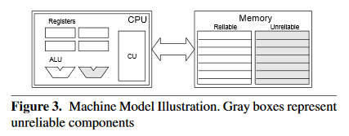
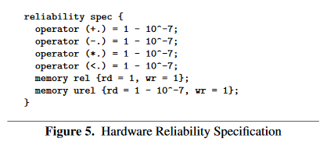
Machine Model Defining “Unreliable Hardware”
Rely assumes an architecture with reliable/unreliable ALUs and reliable and unreliable memory.
Unreliable components have a probability of incorrect result.
Unreliable components in real life would be faster or more energy efficient than reliable ones.

Slide 6
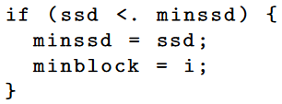
Unreliable Syntax
Unreliable Operators
Unreliable Memory
Unreliable Comparisons

Slide 7
Output Reliability Specifications
search_ref’s outputs must have a joint reliability that is at least 99% correct given the inputs being reliable.
Parameters of this function are pblocks(3), a three-dimensional array of pixels, and cblocks(2), a two dimensional array of pixels.

Slide 8
Reliability Analysis
Probabilities based solely on whether no faults occur. Pathways that lead to a correct result are not considered.
Probabilities calculated with preconditions that start from the return statement and work up through the program flow until the start of the function.
First Precondition

Slide 9
Reliability Analysis
After generating preconditions, the results are checked against the specifications in order to validate the calculations to the required reliability specification.

Slide 10
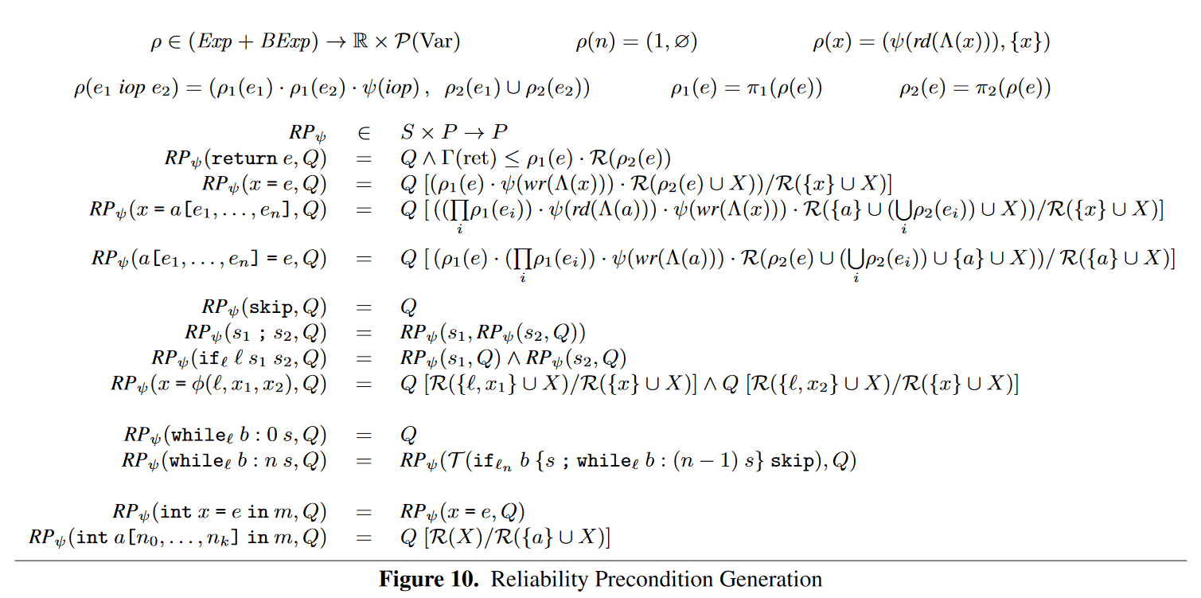
Reliability Analysis Special Cases
While loops come in bounded and unbounded varieties in Rely.

Slide 11
Applications Checkable Computations
Checkable Computations:
Benefit sourced solely from running on unreliable hardware perfectly.
Feasible calculations include only those with a quick way to check for correctness. i.e. Newton’s method for finding function roots.
Paper highlights an implementation where upon a verified failure the result is rerun on reliable hardware. Depending on the reliable vs. unreliable benefit and the probability of error, a net positive can be gained.

Slide 12
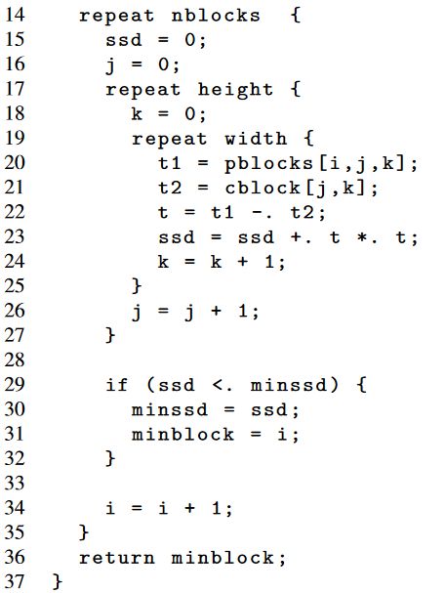
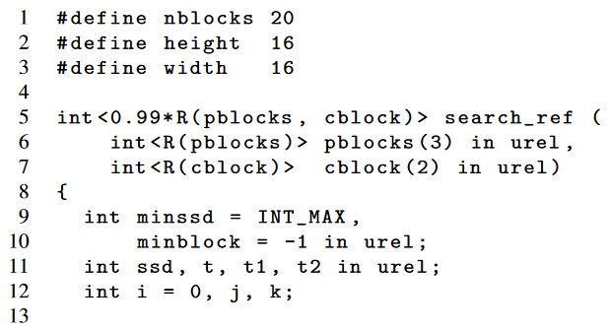
Applications Approximate Computations
Example:
search_ref: x264 pixel block search algorithm

Slide 13
Applications Approximate Computations
Paper detailed finding a reasonable reliability value using experiments.
In a custom reliable search-ref, a percentage of the time the worst-case block was chosen, then the quality of the output was compared using the Quality Loss Metric (QLM) used in a previous paper

Slide 14
Applications Approximate Computations
With Rely, the implementation on the unreliable hardware could be verified to be within the reliability specification needed to be within the acceptable quality loss.
Depending on unreliable hardware speedup/efficiency a net positive can be achieved.

Slide 15
Final Thoughts
Very specific use case due to targeted special reliable/unreliable architecture.
Entire language and analysis structured on unreliable hardware meaning generating quantitative probabilities with approximate computing software algorithms incompatible by design.
Depends on fixed reliability specifications for hardware.
Actual implementation work of approximate computing completely manual.
This paper’s spiritual successor is Chisel - a system for reliability- and accuracy-aware optimization of approximate computational kernels that run on approximate hardware platforms.

Slide 16
Multiple Choice Questions
What is a “soft error” in memory?
a) An error that still allows a program to continue.
b) A corruption in/of a piece of data.
c) An error caused specifically by physical damage.
d) An error that comforts you when things break.
What is “unreliable” hardware in the context of the Rely programming language?
a) Hardware that is generally slower than conventional hardware.
b) Hardware that has been damaged by external forces.
c) Hardware that may be tampered with by foreign adversaries.
d) Hardware that has a probability of failure with each operation.

Slide 17
Multiple Choice Questions
What is a checkable computation in the context of the Rely programming language?
A computation that can be evaluated continuously while being calculated.
A computation that can be quickly evaluated for correctness afterwards.
A computation that will generate an error if the computation fails.
A computation that will generate a status alongside an answer upon completion.

Slide 18
Questions?

