Slide 1
Designing Distributed Systems Using Approximate Synchrony in Data Center Networks
By: Ports, Li, Liu, Sharma, Krishnamurthy @ UW
Presented By: Alexis Rodriguez
Group: De’Andre Miles, Tevin Thames, Alexis Rodriguez

Slide 2
Outline
How it relates to us?
Part 1
Background Information
Mostly-Ordered Multicast (MOM)
Results
Part 2
Background Information
Speculative Paxos
Results

Slide 3
How it relates to us?

Slide 4
Answers To What We Are Looking For
Type of approximation? Software, communication, algorithmic
Approximation strategy? Exploits assumptions and network behavior
How is it done? Superquorum
What is being approximated? Synchronization in an asynchronous environment (packet ordering)
How to determine what to approximate? N/A
How much approximation is acceptable? None
What applications are being targeted? Timestamping, databases, lock managing
Notes:
WHAT IS BEING APPROXIMATED: Rollback netcode, branch prediction, like ML already exploiting an already “approximate” type of environment due to message resends

Slide 5
What is Being Solved?
Latency and congestion reduction and throughput improvement in distributed networks/systems
Notes:
The whole point of networking is to go fast but also be accurate

Slide 6
How is it Solved?
Mostly-Ordered Multicast
Speculative Paxos
Notes:
What the paper proposes is MOM and Speculative Paxos

Slide 7
Part 1 - MOM

Slide 8
Background Information
Unicast
One to one (e.g. machine A to machine B)
Broadcast
One to all (e.g. machine A to all machines)
Multicast
One to many (e.g. machine A to machine B & C)
Notes:
Broadcast: Printer services
Multicast: Services specific

Slide 9
Background Information
Unicast
One to one (e.g. machine A to machine B)
Broadcast
One to all (e.g. machine A to all machines)
Multicast
One to many (e.g. machine A to machine B & C)

Slide 10
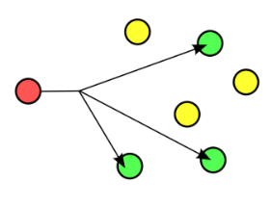
Background Information
Multicast
One to many (e.g. machine A to machine B & C)
Mostly-Ordered Multicast (MOM)
Same as multicast but better.

Slide 11
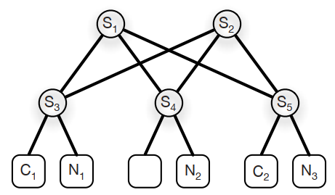
Background Information
m₁
m₁ @ t = 0
m₂ @ t = ε

Slide 12
Background Information
m₁
m₂
m₁ @ t = 0
m₂ @ t = ε

Slide 13
Background Information
m₁
m₂
m₁
m₁ @ t = 0
m₂ @ t = ε

Slide 14
Background Information
m₁
m₂
m₁ @ t = 0
m₂ @ t = ε
m₂
m₁

Slide 15
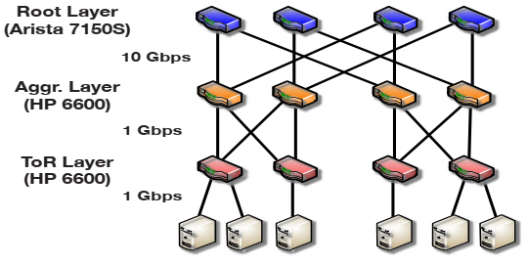
Mostly-Ordered Multicast
Topology-aware multicast
All same link counts
High-priority multicast (QoS)
Messages stay in order regardless of congestion
In-network Serialization
Send to the top then distribute
All of this done via SDN (OpenFlow)

Slide 16
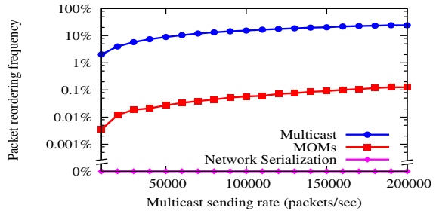
Results
Notes:
Shows increasing the number of packets sent makes multicast behave worse and worse and that MOM and Network Serialization performs significantly better

Slide 17
Results
Notes:
Sidenote: 8% difference from simulation vs real world

Slide 18
Part 2 – Speculative Paxos

Slide 19
Background Information
What is Paxos?
Paxos is a family of protocols for solving consensus in a network of unreliable or fallible processors. Consensus is the process of agreeing on one result among a group of participants. - Wikipedia
See references for more details
Why is it important?
Need to ensure replication is consistent across all services
Notes:
Leader

Slide 20
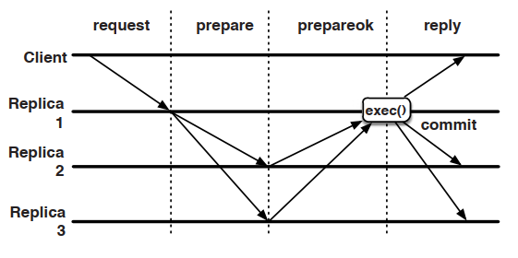
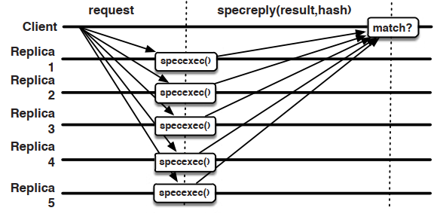
Speculative Paxos
What is Speculative Paxos?
An improved Paxos protocol proposed in this paper
Relies on MOM for efficiency and is a network primitive
Paxos
Speculative Paxos
Notes:
Client is not you but a host application requesting something, maybe a database. Checking stock for the latest AMD CPUs, can’t have only one database. Client doesn’t know about speculation, only committed things

Slide 21
Speculative Paxos
Sub-Protocols
Speculative processing
Can still continue when < f/2 replicas have failed
Synchronization
Reconciliation
Speculative Paxos
Notes:
Leader is determined by round robin and the view number. All replicas make an assumption on what the view number is. Leader is only for sync and reconciliation
Speculative processing commits requests efficiently in the normal case where messages are ordered and < f/2 replicas have failed (Section 4.2.2) • Synchronization periodically verifies that replicas have speculatively executed the same requests in the same order (Section 4.2.3) • Reconciliation ensures progress when requests are delivered out of order or when between f/2 and f nodes have failed (Section 4.2.4)
Each state has it’s own type of messages

Slide 22
Speculative Paxos
Replica States
Normal
Reconciliation
Recovery
Reconfiguration
Log States
Committed
Speculative
Speculative Paxos
Notes:
Recovery – Failed and recovered
Reconfiguration – Failed and replaced
Committed – only clients see this

Slide 23
Speculative Paxos
A superquorum of f + [f/2] + 1 is required, not majority
Speculative Paxos

Slide 24
Results

Slide 25
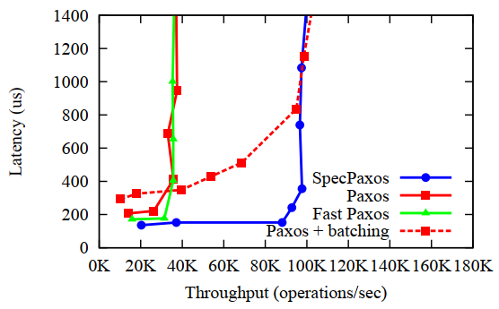
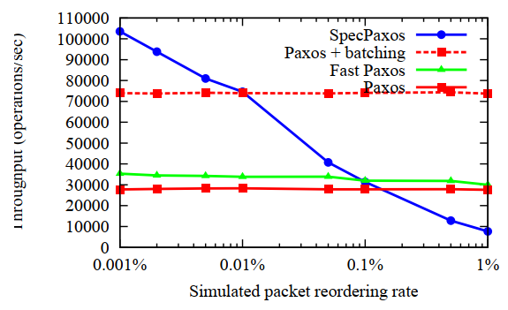
Results
Notes:
Right figure does not take into account the latency.

Slide 26
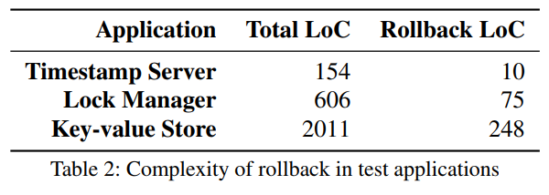
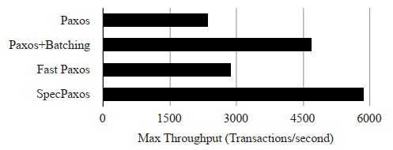
Results
Library LoC: 10k
Key-value Store
Speculative Paxos: 1.01 ms
Fast Paxos: 1.12 ms
Paxos: 1.44 ms

Slide 27
References
Explanation of Paxos
https://en.wikipedia.org/wiki/Paxos_(computer_science)
http://www.read.seas.harvard.edu/~kohler/class/08w-dsi/mazieres07paxos.pdf
Multicast
https://en.wikipedia.org/wiki/Multicast

Slide 28
Questions
Question 1
Which methods were used to improve multicast via MOM?
A) Topology-aware multicast
B) High-priority multicast
C) In-network serialization
D) Link redundancy
E) Shortest path first
Answer: A, B, and C

Slide 29
Questions
Question 2
How much latency did Speculative Paxos achieve?
A) 1
B) 2
C) 3
D) 4
Answer: B

Slide 30
Questions
Question 3
What is Paxos?
A) A rival convention of PAX
B) An operating system for network devices
C) A protocol for determining a majority of disagreement
D) A family of protocols for solving consensus in a network of unreliable or fallible processors
Answer: D

