Slide 1
Green: A Framework for Supporting Energy-Conscious Programming using Controlled Approximation
Authors: Woongki Baek, Trishul M. Chilimbi
Presented by Jake Freedman

Slide 2
Overview
What problem is being solved?
Programmers often approximate as-needed and heuristically without quantifying the error or benefits
Why is that problem important?
Programs that are approximated in an ad-hoc manner are hard to maintain as programs evolve, and understanding the effects of approximation is important
How do the authors solve the problem?
The Green framework uses a loss model based on approximations of functions, loops, and an error threshold to determine how and when to approximate a program while quantifying the tradeoffs in performance, energy consumption, and quality of service
How is the approximation done?
The approximated functions and approximation targets are provided and identified by the programmer, and the approximate program is generated at both compile time and runtime

Slide 3
Overview

Slide 4
QoS_Compute()
Function must be provided by the programmer to calculate loss between approximated functions and precise functions
Default loss computation is calculated by comparing precise values to approximated values
This is used for simple computations and loop approximations
Can become very complicated depending on the application
Individual QoS_Compute() functions are integrated into one global function
Works with the QoS target and approximations to construct the approximation model

Slide 5
QoS_Approx()
Function determines if a loop or function should be approximated
Loops…
Static approximation is determined in the calibration phase
QoS_Approx() checks if breaking the loop at the current iteration would violate the target threshold, and if not, will terminate the loop
Adaptive approximation periodically determines what the QoS improvement would be if the loop were to iterate one more time
If the QoS improvement is greater than the target QoS improvement (referred to as delta), the loop will continue to iterate until the QoS improvement is less than the target delta
For functions, QoS_Approx() determines if the function should be approximated and by which function

Slide 6
QoS_ReCalibrate()
Implemented because the program behavior may differ from the training inputs, and the approximation can be recalibrated to either increase or decrease the loss
For static loops, the number of iterations can either be increased to reduce loss or decreased to increase speed and decrease power consumption
For adaptive loops, the target delta and period that the QoS improvement is measured can be changed
Functions can be switched to more or less precise versions

Slide 7
Global Recalibration
Because each function has its own QoS_Compute() function, local approximations can be changed in recalibration
These changes are treated as independent
When the loss is too great, the approximations are switched in an order that enables the greatest change in QoS while mitigating changes in performance
If the effects of approximation are not independent or linear, the number of loop iterations are increased to a random number within a specific range, and functions are replaced with higher precision functions until the non-linear effects disappear
The paper claims that this method quickly converges on an effective solution

Slide 8
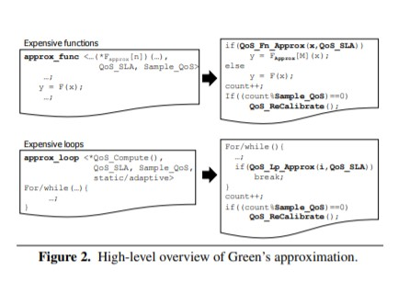

Slide 9
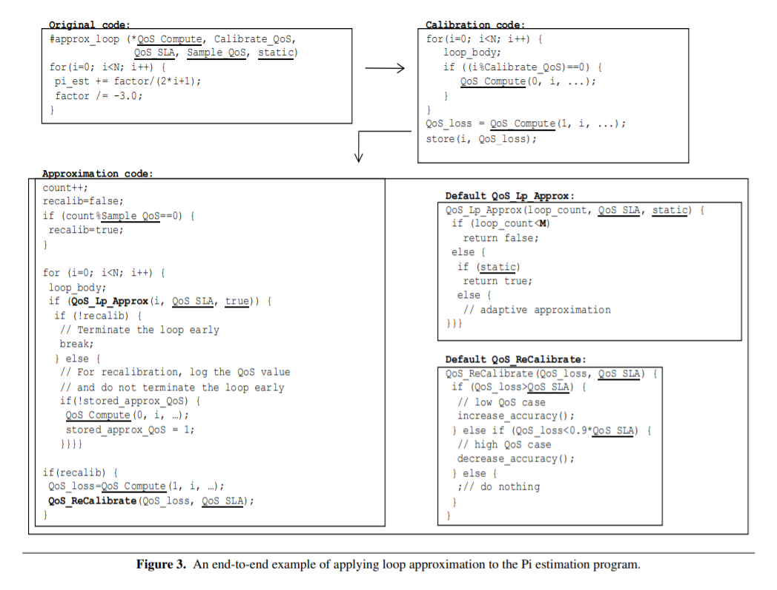

Slide 10
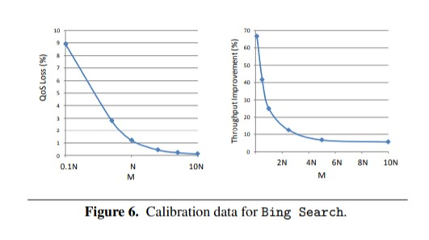
Bing Search

Slide 11
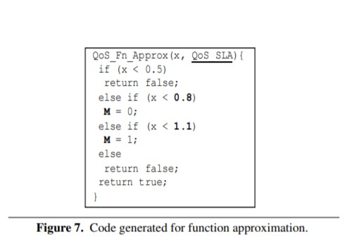
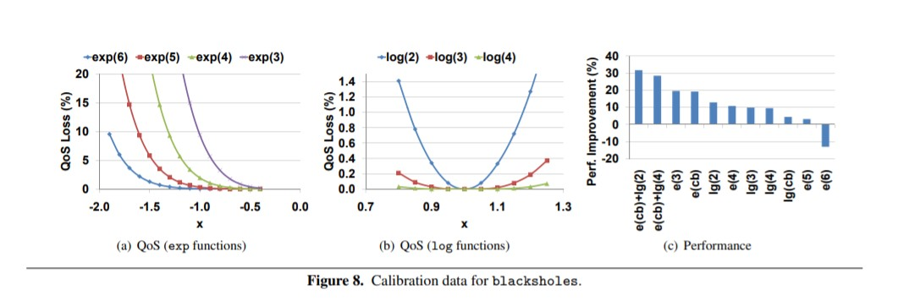
Blacksholes

Slide 12
Evaluation
Green was tested on 5 different applications
Measures of performance, energy consumption, and speed were recorded for each test
All 5 tests are very different applications which shows the flexibility of the Green framework
In each case, Green shows significant improvement in speed and power while maintaining reasonable loss

Slide 13
Bing search
Bing takes a series of queries as arguments and searches an index of all available documents and returns the top N documents
The documents are ranked according to how they match the queries
The approximated version only searches a subset of the documents up to a maximum M, essentially using early loop termination
The loss metric was defined by the percentage of queries that either return a different set of N documents or return N documents in a different order
Because of the definition of the loss metric, custom loss and recalibration functions had to be written

Slide 14
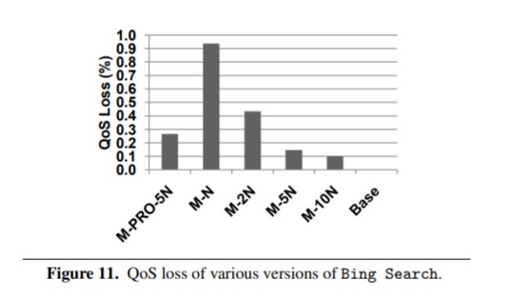
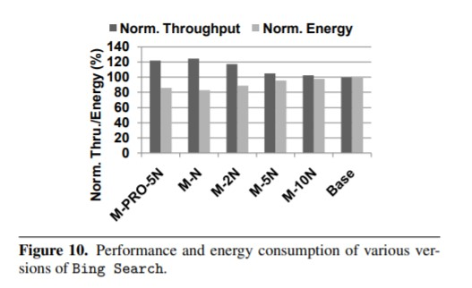

Slide 15
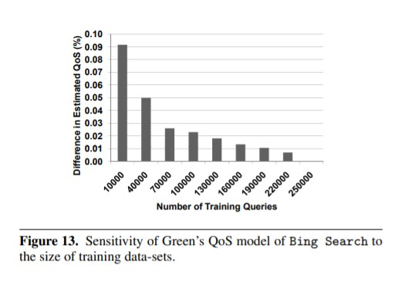
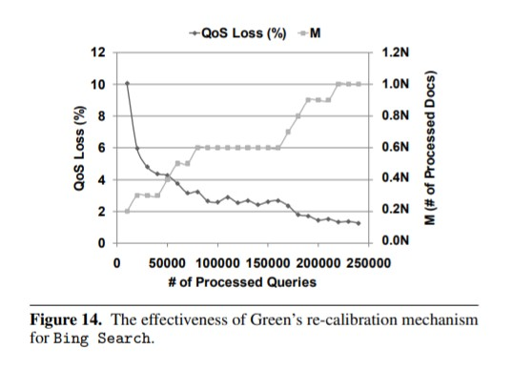

Slide 16
252.eon
252.eon is a ray tracer used to include light in 3D renderings and video games
The application can be approximated using early loop termination, as QoS improvements decrease over time
Green was applied to 252 rendering a 3D model
Performance was measured in terms of execution time
QoS was calculated by comparing the approximated pixels to the precise pixels

Slide 17
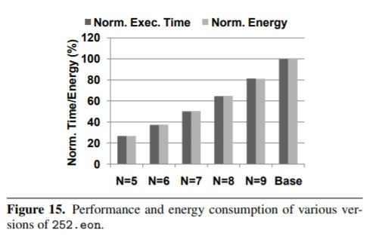
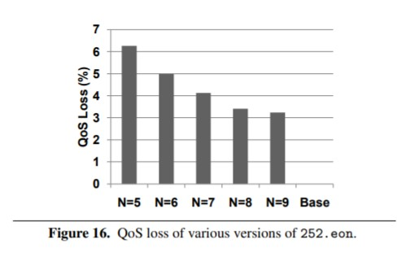

Slide 18
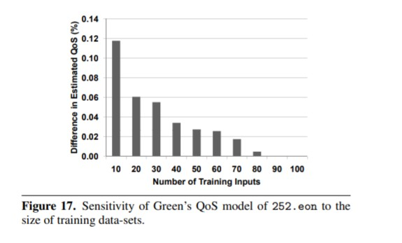

Slide 19
Cluster GA
Machine learning process to parallelize a program
Runs and refines until it reaches a maximum QoS output
The later refinements can be marginal improvements, so Green terminates the loop early
Speed was measured in terms of execution time
Loss was calculated by comparing the runtime of the output program from the precise CGA to the runtime of the output from the approximated CGA

Slide 20
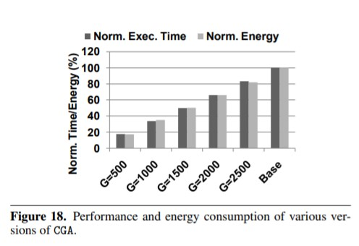
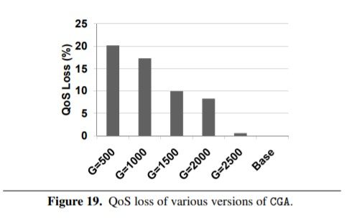
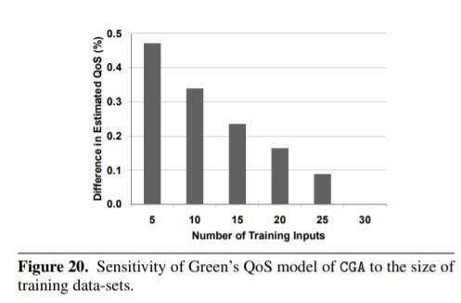

Slide 21
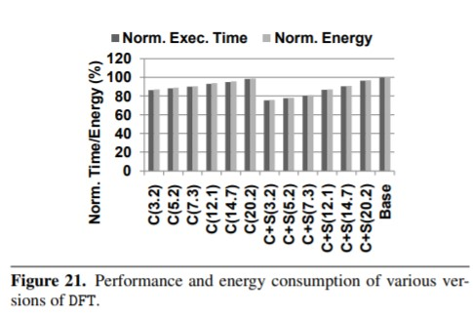
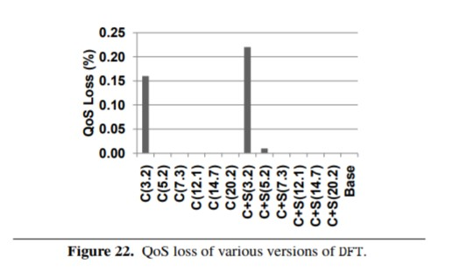
Discrete Fourier Transform
DFT uses sine and cosine functions that can be very expensive
Sine and cosine can be approximated
Loss was calculated by comparing the output sample of the precise and approximate program

Slide 22
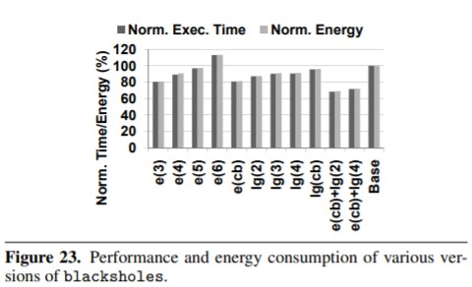
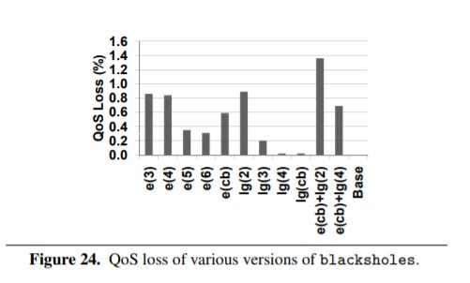
Blacksholes
Prices stock options using a partial differential equation
Approximated by using exponential and logarithmic functions as a part of Taylor Series expansions
Difference in output price between approximated and precise programs used to determine accuracy

Slide 23
Related Work
Green is similar to several works including a paper we will read later in the semester: Probabilistic accuracy bounds for fault-tolerant computations that discard tasks
The key takeaways that make this approach different are the…
Flexibility
Less focus on fault tolerance
More granular approximation
Approximation of complex functions
Level of control
Safety

Slide 24
Multiple Choice
Green requires that the programmer provide…
Approximate functions
Approximate loops
An error threshold/QoS target
A and C
If the QoS target is not met Green can…
Replace approximate functions with more precise versions
Increase loop iterations
Nothing can be done, and the program will fail
A and B
Green requires…
A relatively large number of training inputs
A relatively small number of training inputs

