Slide 1
Approximate Computing
Genetic Programming
Christopher Crary
Brit Chesley
Wesley Piard

Slide 2
Special Thanks
The material in this presentation is adapted from the book A Field Guide to Genetic Programming.
Thank you, Riccardo Poli, William B. Langdon, and Nicholas F. McPhee!
Christopher Crary | Brit Chesley | Wesley Piard

Slide 3
Genetic Programming in a Nutshell
With genetic programming (GP), a population of computer programs is stochastically (i.e., randomly) evolved with techniques inspired by natural selection.
Overall goal: Automatically create computer programs.
Evolution is greatly (but not completely) influenced by some notion of fitness.
Ultimately, evolution is random, to allow for diversity among programs.
GP is enormously versatile and mature, yet there is still much potential for future work.
Computing from GP has produced many human-competitive results.
Christopher Crary | Brit Chesley | Wesley Piard
Notes:
GP is one type of evolutionary algorithm, but there exist many other types. GP is one of the most general types, however.

Slide 4
Lecture Outline
GP in a nutshell. (~2 mins)
Basic GP. (~25 mins)
Typical characteristics and implementations of GP. (~15 mins)
First look at applications of GP. (~10 mins)
Advanced GP. (~15 mins)
Other implementations of GP. (~4 mins)
A very brief look at some theory for GP. (~1 mins)
Second look at applications of GP. (~10 mins)
Conclusion. (~1 min)
Christopher Crary | Brit Chesley | Wesley Piard

Slide 5
Lecture Outline
GP in a nutshell. (~2 mins)
Basic GP. (~25 mins)
Typical characteristics and implementations of GP. (~15 mins)
First look at applications of GP. (~10 mins)
Advanced GP. (~15 mins)
Other implementations of GP. (~4 mins)
A very brief look at some theory for GP. (~1 min)
Second look at applications of GP. (~10 mins)
Conclusion. (~1 min)
Christopher Crary | Brit Chesley | Wesley Piard
Notes:
Now we are going to discuss the typical characteristics and terminology of genetic programming

Slide 6
Genetic Representation of Programs
Syntax Trees
Most common representation
Terminals are variables/constants, terminal set
Internal nodes are functions, function set
Arithmetic operations, anything represented as a function
Allowed functions + terminals = primitive set
Max(x+x, x+3*y)
(max (+x x) (+ x (* 3 y)))
Max + x x + x * 3 y
Christopher Crary | Brit Chesley | Wesley Piard
Notes:
Lets start off by talking about the basic tools and terminology used in genetic programming.
In GP, programs are usually (but not always) expressed as syntax trees, rather than lines of code.
Figure on the right is showing the tree representation of the program max(X+X, X+3*Y). Direction of computation here is bottom to top, so 3*y computed then that result is used in the above addition computation.
if not familiar with trees, max is the root and the nodes are the other leaves of the tree, such as the +, 3, y
Syntax trees are created with terminals, which are the variables/constants and make up the terminal set, and functions, which make up the function set.
Functions can be arithmetic operations, or anything that can be represented as a function such as Booleans, conditionals, or looping
Together, the allowed terminals and functions creates the primitive set of operations.
**The architecture of the program is the number and type of the branches in a program, together with certain features of their structure (will go into more depth later). ** IF TIME
Trees are sometimes represented in prefix notation, which is what the 2nd to last bullet point is showing
The term “arity” is used to describe the number of arguments a GP primitive accepts, in this case the arity of all functions is 2.
Since arity of all functions is the same (very common) can use linear representation, which is the last bullet point

Slide 7
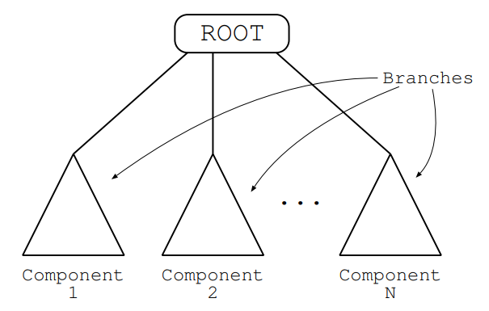
More Generic Representations
Christopher Crary | Brit Chesley | Wesley Piard
Notes:
Programs can be composed of multiple components (such as subroutines). In this case the sub trees are referred to as branches
I think we will stick to simple tree representations for now

Slide 8
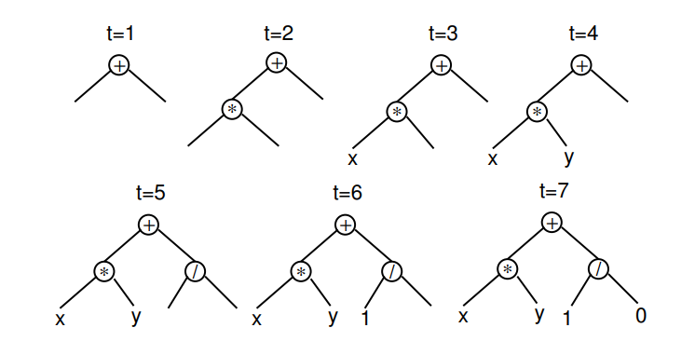
Population Initialization : Common Approaches
Depth of a node is # of edges traversed to reach that node
Depth of tree = depth of largest node
Full method
Randomly choose nodes from function set
Rather limited diversity
Christopher Crary | Brit Chesley | Wesley Piard
Notes:
Similar to other genetic algorithms, individuals in GP are typically randomly generated. ->LOTS of different ways to do this!
In the two methods we will be discussing, full and grow, maximum depth is specified by the user.
The depth of a tree is the depth of its largest node, where the depth of a node is the number of edges traversed to reach that node
In the full method, nodes are taken at random from the function set until the maximum tree depth is reached.
->called full method because it generates full trees.
-> doesn’t mean all initial trees will have same number of nodes, this is only the case because the arity of the functions is equal across the primitive set.
–> even with mixed-arity primitives, range of program sizes and shapes produced by full method is rather limited.
Figure on the right showing construction of a single individual using the grow method

Slide 9
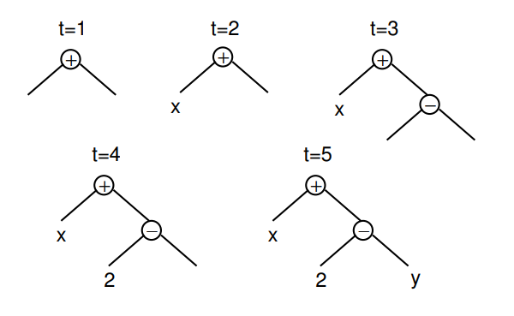
Population Initialization : Common Approaches
Grow method
Randomly choose nodes from entire primitive set
Rather limited diversity
Still not very diverse, maybe a combination of both?
Called ramped half-and-half
Christopher Crary | Brit Chesley | Wesley Piard
Notes:
Grow method allows for creation of trees of more varied shapes and sizes.
Nodes are selected from the whole primitive set (functions and terminals) until the depth limit is reached.
-after depth limit reached, can select ONLY terminals, similar to full
At t=2, a terminal is chosen as the left child of the root. This effectively closes off that branch preventing it from growing any more before it reached the depth limit
Neither grow or full method provide a very wide array of sizes or shapes, can use a combination of both called ramped half and half.
-> half of the population is constructed using full, other half constructed using grow. Done using a range of depth limits, hence the “ramped” part of the term.
Can be hard to control distributions of properties such as the size and shape of the trees.
-> size and shape are highly sensitive in the grow method to sizes of the function and terminal set. Can yield very short trees.
-> arities of functions also plays critical role in these methods

Slide 10
Selection
Overall goal is to create fitter individuals
Individuals that perform better on our fitness function more likely to have child programs
How to choose fitter individuals?
Tournament selection
Individuals compared with each other, best is chosen as parent
Most common, but are many other selection mechanisms
Christopher Crary | Brit Chesley | Wesley Piard
Notes:
In tournament selection, a number of individuals are chosen at random from the population. These are compared with each other and the best of them is chosen to be the parent. When doing crossover, two parents are needed, so two selection tournaments are made. Will go over crossover soon
Tournament selection only looks at which program is better than another. It does not look at HOW much better!
->advantageous because a single super-fit program will not immediately swamp the next generation with its children, which would kill program diversity
Tournament selection randomly selects candidates, which allows even average quality programs to have some chance of having children.
-> the beautiful candidates don’t hog all of the potential mates ☺

Slide 11
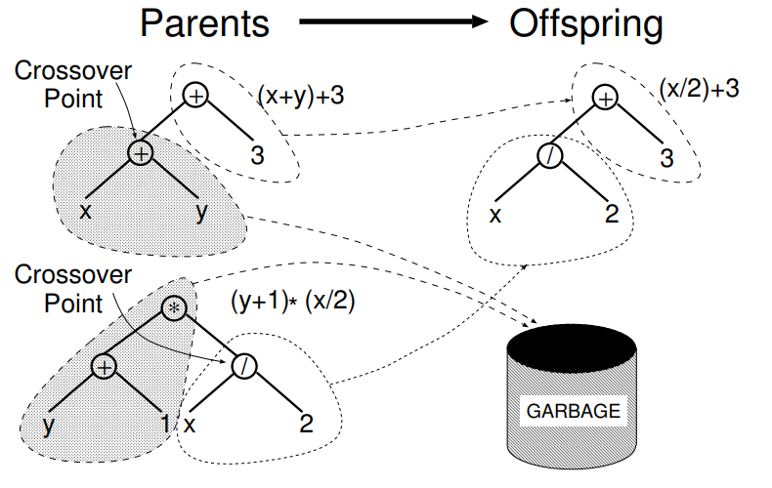
Genetic Operations: Crossover
Select crossover point in each parent tree
Creates offspring by replacing the subtree rooted at crossover point in first parent by subtree rooted at crossover point in second parent
Christopher Crary | Brit Chesley | Wesley Piard
Notes:
Given two parents, subtree crossover randomly (and independently) selects a crossover point (a node) in each parent tree. Then, it creates the offspring by replacing the subtree rooted at the crossover point in a copy of the first parent with a copy of the subtree rooted at the crossover point in the second parent. This is shown in the figure
Often the crossover points are NOT selected with uniform probability.
-> this can lead to crossover operations frequently exchanging only miniscule amounts of genetic material (small subtrees).
Too many crossovers may in fact reduce to simply swapping leaves
->To counter this, a widely used approach is choosing functions 90% of the time and leaves (terminals) 10% of the time.

Slide 12
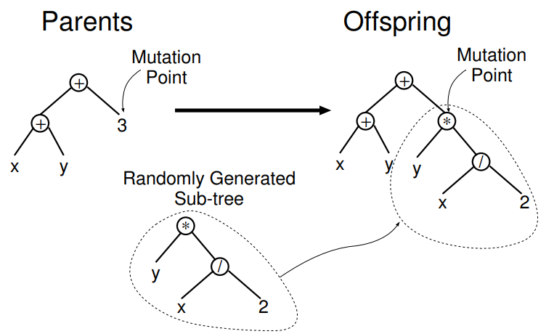
Genetic Operations: Subtree Mutation
Randomly selects mutation point, substitutes current subtree with random subtree
Christopher Crary | Brit Chesley | Wesley Piard
Notes:
The most commonly used form of mutation in GP randomly selects a mutation point in a tree and substitutes the subtree rooted there with a randomly generated subtree. This is what the figure is showing, where the mutation point is the terminal “3”, which is where the randomly generated subtree is inserted.
Can also use point mutation, where a random node is selected and the primitive stored there is replaced with a different random primitive of the same arity taken from the primitive set. Each node is considered for mutation in this scheme.
Typically crossover is applied with much higher probability than mutation. 90% crossover rate with 1% mutation rate is usual.
->We apply crossover at a higher rate since it ensures the exchange of genetic material between the parents and thus creates chromosomes (offspring) that are more likely to be better than the parents
->when the crossover rate and mutation rate don’t add up to 100%, an operator called reproduction is introduced, with a rate of 1-p, where p is the current total operator probability. Reproduction selects an individual based on fitness and inserts a copy of it in the next generation.

Slide 13
Genetic Operations: Reproduction
If the mutation rate and crossover rate don’t add up to 100%, insert copy of an individual in the next generation
Christopher Crary | Brit Chesley | Wesley Piard
Notes:
when the crossover rate and mutation rate don’t add up to 100%, an operator called reproduction is introduced, with a rate of 1-p, where p is the current total operator probability. Reproduction selects an individual based on fitness and inserts a copy of it in the next generation.

Slide 14
Preliminary Steps of Genetic Programming
What is the terminal set?
What is the function set?
What is the fitness measure/metric?
What parameters will control the run?
What is the termination criteria? What is the result of a run?
Christopher Crary | Brit Chesley | Wesley Piard
Notes:
All of these questions will be discussed shortly.

Slide 15
Terminal Set
Programs external inputs
x, y
Functions with no arguments
rand(), distance_to_wall()
Can produce “side effects” or not
Constants
Ephemeral random constant: $𝔑$
Specific node chosen to be random value, stays this value
Christopher Crary | Brit Chesley | Wesley Piard
Notes:
What should we include in the terminal set? A terminal set may consist of:
-the programs external inputs. Typically take the form of named variables such as x or y
-Functions with no arguments. These may be included because they return different values each time they are used, such as rand() or a function distance_to_wall() that returns the distance to an obstacle from a root that GP is controlling.
-> these functions can produce side effects, meaning they do more than return data. Such as updating a global structure, draw something on the screen, control motors of a robot etc.
-Constants. These can be pre-specified, randomly generated as part of the tree creation process, or created by mutation.
Using functions such as rand() can cause the behavior of an individual program to vary each time it is called, even if it is given the same inputs. This could be desirable, but more often we want a set of fixed random constants that are generated during population initialization .
-> accomplished by introducing a terminal that represents an ephemeral random constant. Every time this node is chosen in construction of a tree, or new tree during genetic operations, a different random value is generated which is used for that particular terminal. This is fixed for the rest of the run

Slide 16
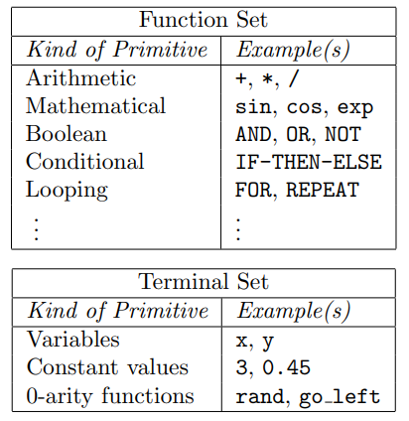
Function Set
Mathematical operations, sin, cos, Boolean
Anything that can be represented as a function
Can embed prior knowledge about the application
Functions need to satisfy:
Type consistency
Evaluation safety, ex: protected division
Sufficiency
Primitive set needs to be able to express true solution
Christopher Crary | Brit Chesley | Wesley Piard
Notes:
Now what should we include in the function set? Typically we have mathematical operations such as sin, cos, and Boolean operations.
->Not just mathematical operations, can also include if statements, looping, even subroutines. Just needs an input-output mapping to be represented as a function.
->in the robot example, can have a function that controls the robot’s motors via certain sensor inputs such as an IR sensor
->embed a priori knowledge of the application here
Type consistency is required because subtree crossover can mix and join nodes arbitrarily. As a result, it is necessary that any subtree can be used in any of the arguments positions for every function in the function set, because it is always possible that subtree crossover will generate that combination. So all functions need to return the same type.
->not as limiting as it suggests
Evaluation safety is required because many commonly used functions can fail at run time. An expression could divide by zero and crash the program. Or call Move_forward when facing a wall or cliff. This is usually dealt with by using protected versions of numerical functions such as logs, square roots, division. In the case of division, a 1 would be returned if the function tries to divide by zero
Primitive set needs to exhibit sufficiency, meaning that it is possible to express a solution to the problem at hand using the elements of the primitive set
->can only be guaranteed for problems where theory or experience tells us that a solution can be obtained by combining elements of the primitive set

Slide 17
Fitness Function
Need to define how “good” or fit an individual is
Amount of error, time, accuracy, payoff are common desired outputs.
Sometimes interested in the program’s output, other times we are interested in the actions performed by a program
Christopher Crary | Brit Chesley | Wesley Piard
Notes:
Fitness can be measured in many ways. For example, in terms of: the amount of error between its output and the desired output; the amount of time (fuel, money, etc.) required to bring a system to a desired target state; the accuracy of the program in recognizing patterns or classifying objects; the payoff that a game-playing program produces; the compliance of a structure with user-specified design criteria.
In some applications we are interested in the output of a program, other times we are interested in the actions performed by a program with side effects.
Can also have multi-objective fitness functions that aim to optimize multiple goals that are often in competition with one another

Slide 18
Parameters, Termination
Population size
As large as possible, 500 individuals typical
Probabilities of performing genetic operations
90% crossover, 1% mutation, 9% reproduction
Max size of programs
Termination criterion
Max number of generations
Take best individual
Christopher Crary | Brit Chesley | Wesley Piard
Notes:
Hard to make generalities for good parameter choices. Genetic programming is pretty robust, so testing different configurations Is your best bet for a good solution.
Usually want a large population size, but it takes lots of time to evaluate the fitness of each individual. Use the largest population that your system can handle.
->This should at least be 500 individuals.
Typically use ramped half and half for population initialization with a depth of 2-6.
90% of children created by subtree cross over and 1% of children created with mutation operations. However, can also use 50-50 split of crossover and other mutations.
The termination criterion may include a maximum number of generations to be run as well as a problem-specific success predicate. Typically, the single best-so-far individual is then harvested and designated as the result of the run

Slide 19
Lecture Outline
GP in a nutshell. (~2 mins)
Basic GP. (~25 mins)
Typical characteristics and implementations of GP. (~15 mins)
First look at applications of GP. (~10 mins)
Advanced GP. (~15 mins)
Other implementations of GP. (~4 mins)
A very brief look at some theory for GP. (~1 min)
Second look at applications of GP. (~10 mins)
Conclusion. (~1 min)
Christopher Crary | Brit Chesley | Wesley Piard

Slide 20
Applications of GP
In principle, there are as many possible applications of GP as there are applications for computer programs – in other words, virtually infinite.
However, for an application to be viable to GP, one must first define a suitable fitness function.
This is not a trivial task, depending on the application.
One common, straightforward application of GP is known as symbolic regression.
Christopher Crary | Brit Chesley | Wesley Piard

Slide 21
Symbolic Regression
Symbolic regression aims to dynamically find a function whose output has some desired property, e.g., the function matches (or approximately matches) some target values.
For those familiar with (statistical) regression, symbolic regression is essentially just regression with no assumptions made about the structure of the underlying function.
Instead, the structure of this function is determined dynamically.
Symbolic regression need not be implemented via GP, but such implementations are the most common.
Christopher Crary | Brit Chesley | Wesley Piard

Slide 22
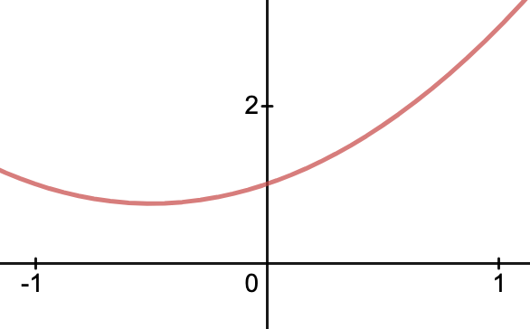
Symbolic Regression via GP
As a simple example, suppose that we wish to use GP to automatically create a program with an input/output behavior equivalent or approximately equivalent to that of the quadratic polynomial $x^{2}+x+1$ in the range $[−1.0,+1.0]$.
Suppose that $x$ is an input to the GP tool.
Let us walk through the five preparatory steps previously established for setting up GP.
Christopher Crary | Brit Chesley | Wesley Piard

Slide 23
Symbolic Regression via GP, cont.
What is the terminal set?
The terminal set (i.e., the inputs of the to-be-evolved programs) should include the relevant independent variable, $x$, and some ephemeral random constants drawn from some reasonable range, say [-5.0, +5.0] for this example.
$T= \{x,ℜ\}$
Christopher Crary | Brit Chesley | Wesley Piard

Slide 24
Symbolic Regression via GP, cont.
What is the function set?
The function set need not include addition and multiplication, but an exact solution would almost surely not be found without them.
Let us suppose that we use the simple function set consisting of addition, subtraction, multiplication, and division.
Division is “protected” so that division by zero equals one.
$F= \{+, − , ∗ , \%\}$
Christopher Crary | Brit Chesley | Wesley Piard

Slide 25
Symbolic Regression via GP, cont.
What is the fitness measure?
At a high-level, we wish to evaluate how closely the output of a function generated by GP matches the true underlying function.
We typically measure the sum of squared differences or sum of absolute differences at different samples of the independent variable(s) within the relevant range, e.g., [-1.0, +1.0].
With such fitness objectives, fitter individuals have a lower fitness value.
Suppose that we are to measure sum of absolute differences for $x∈\{−1.0, −0.9,…,0,…,+0.9,+1.0\}.$
Christopher Crary | Brit Chesley | Wesley Piard
Notes:
In principle, we might wish to compute the integral of the difference between the evolved function and target function, but this is typically not practical or even possible to compute.
For these fitness measures, error for each measurement is approximately proportional to the area between the parabola and the generated function.
There still could exist many different viable fitness functions, depending on the particular application.

Slide 26
Symbolic Regression via GP, cont.
What parameters will be used for controlling the run?
Suppose that we have the extremely small population of four individuals, where ramped half-and-half is used for initialization.
Suppose that an initial tree depth of 1 to 2 is utilized, where 50% of terminals are to be constants, and that evolved tree size will not be limited.
Suppose that selection rate is proportional to fitness value, but non-elitist (i.e., inferior solutions still can affect future generations).
To generate new individuals, suppose that crossover will be used 50% of the time, mutation 25% of the time, and reproduction 25% of the time.
Christopher Crary | Brit Chesley | Wesley Piard
Notes:
GP runs typically can contain thousands of individuals.

Slide 27
Symbolic Regression via GP, cont.
What will be the termination criteria and designated result?
For this example, suppose that the GP tool will terminate after fitness values fall below 0.1.
Such a threshold, like almost everything else with GP, is extremely application-dependent.
We will see that, in this contrived example, our example run will atypically yield a perfect algebraic solution with a fitness of zero after just one generation of programs has been created.
Christopher Crary | Brit Chesley | Wesley Piard

Slide 28
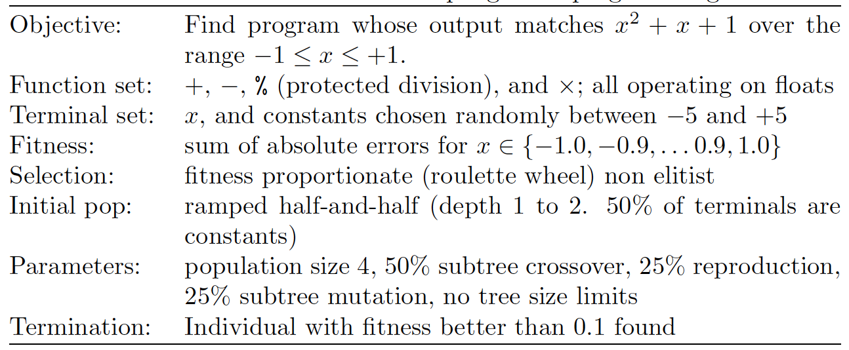
Symbolic Regression via GP, cont.
Christopher Crary | Brit Chesley | Wesley Piard

Slide 29
Symbolic Regression via GP, cont.
Initialization.
After ramped half-and-half, suppose that the following programs are created.
Christopher Crary | Brit Chesley | Wesley Piard

Slide 30
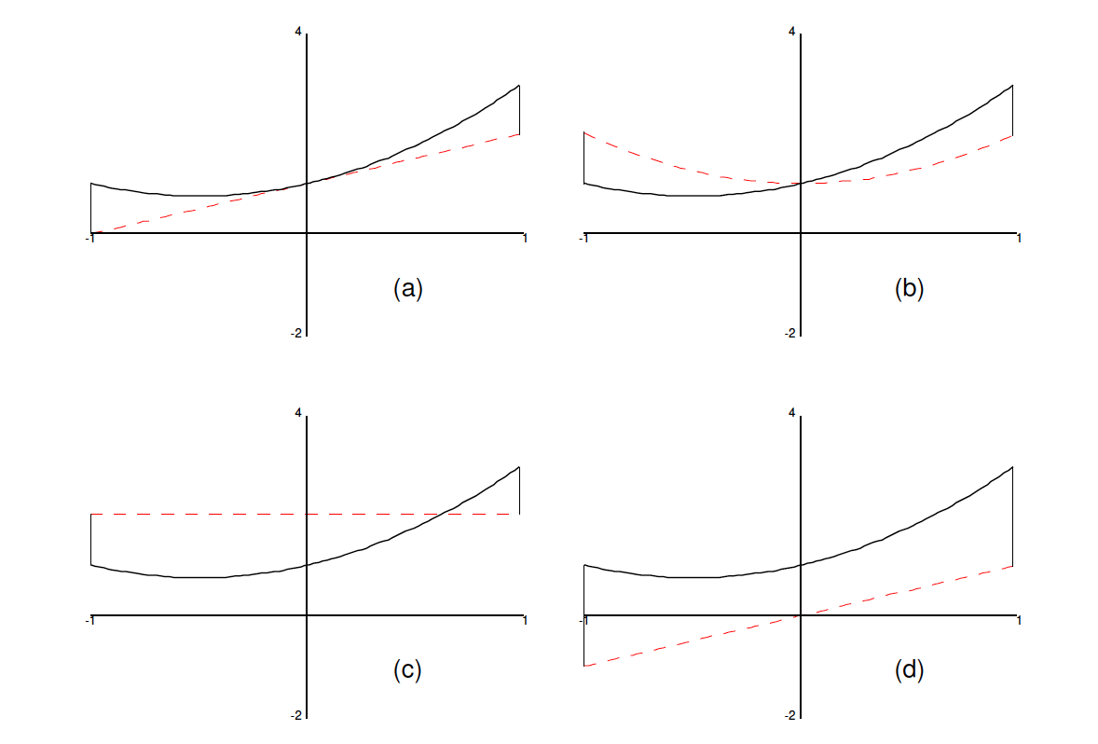
Symbolic Regression via GP, cont.
Fitness Evaluation, First Generation.
(a), $x+1$ → Fitness: 7.7o
(b), $x^{2}+1$ → Fitness: 11.00
(c), $2$ → Fitness: 17.98
(d), $x$ → Fitness: 28.70
Christopher Crary | Brit Chesley | Wesley Piard

Slide 31
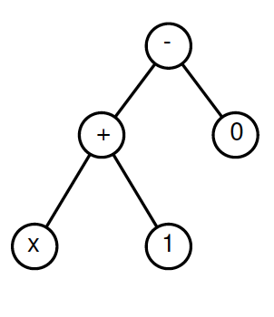
Symbolic Regression via GP, cont.
Selection/Reproduction, First Generation.
GP is now to create a new generation of four individuals from the first generation.
For the first individual of the new generation, suppose that GP happens to apply the reproduction operator to the most fit individual, i.e., the function $x+1$.
Christopher Crary | Brit Chesley | Wesley Piard

Slide 32
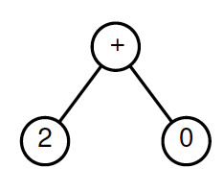
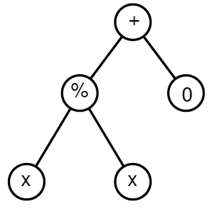
Symbolic Regression via GP, cont.
Selection/Reproduction, First Generation, cont.
For the second individual of the new generation, suppose that GP happens to apply the mutation operator to the third most fit individual, i.e., the function $2+0$.
Suppose that GP chooses to mutate the terminal that is the constant $2$ into the function $x \% x$, so that the overall function is the constant 1.
Christopher Crary | Brit Chesley | Wesley Piard

Slide 33
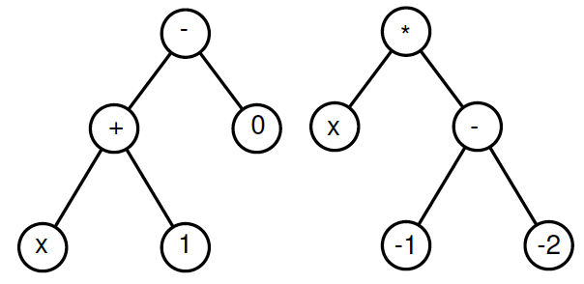
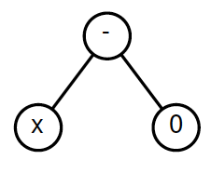
Symbolic Regression via GP, cont.
Selection/Reproduction, First Generation, cont.
For the third individual of the new generation, suppose that GP happens to apply the crossover operator to the most and least fit individuals, i.e., the functions $x+1$ and $x$, respectively.
Suppose that GP chooses to crossover the subtree rooted at the node $x$ in the least fit individual with the subtree rooted at the node $+$ in the most fit individual, resulting in the overall function $x$.
Christopher Crary | Brit Chesley | Wesley Piard

Slide 34
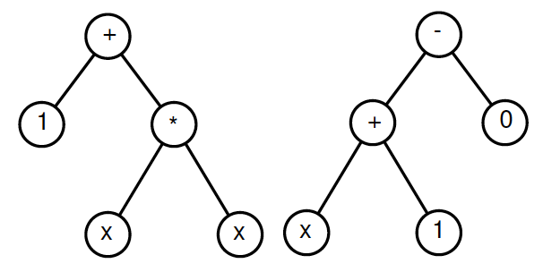
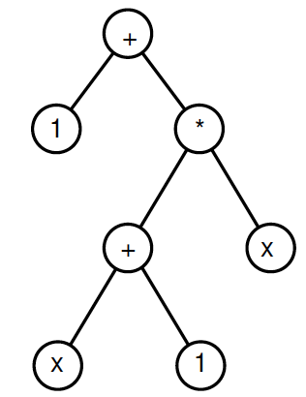
Symbolic Regression via GP, cont.
Selection/Reproduction, First Generation, cont.
For the fourth and final individual of the new generation, suppose that GP happens to apply the crossover operator to the two most fit individuals, i.e., the functions $x+1$ and $x^{2}+1$, respectively.
Suppose that GP chooses to crossover the subtree rooted at the node $+$ in the second most fit individual with the subtree rooted at the node $x$ in the most fit individual, resulting in the overall function $x^{2}+x+1$!
Christopher Crary | Brit Chesley | Wesley Piard

Slide 35
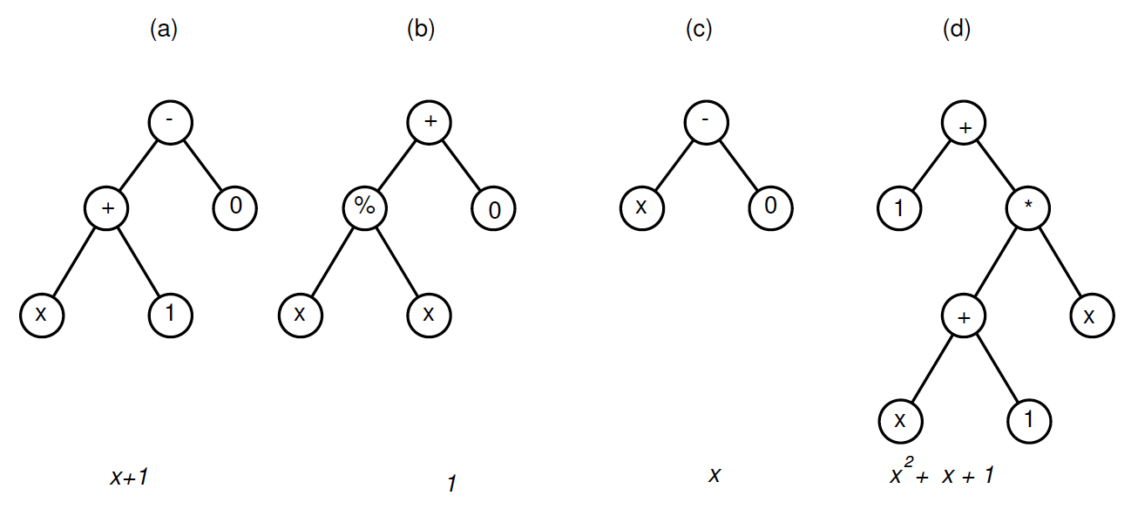
Symbolic Regression via GP, cont.
Thus, after selection/reproduction, the following four programs are generated.
Christopher Crary | Brit Chesley | Wesley Piard

Slide 36
Symbolic Regression via GP, cont.
Fitness Evaluation, Second Generation.
(a), $x+1$ → Fitness: 7.7o
(b), $1$ → Fitness: 11.00
(c), $x$ → Fitness: 28.70
(d), $x^{2}+x+1$ → Fitness: 0
Because the fitness of at least one of the individuals is less than 0.1, the terminating condition has been met.
Christopher Crary | Brit Chesley | Wesley Piard

Slide 37
Symbolic Regression via GP, cont.
Termination.
The most fit individual, i.e., the program equivalent to the function $x^{2}+x+1$, is chosen as output of GP run.
The exact function was found! (Again, this is not typical.)
Christopher Crary | Brit Chesley | Wesley Piard

Slide 38
Symbolic Regression via GP, cont.
Concluding Remarks.
Note that the most fit individual incorporated a good trait (the quadratic term $x^{2}$) from the first parent with two other good traits (the linear term $x$ and the constant term of $1$) from the second parent.
Thus, the crossover operation used two fit parents to produce fitter offspring. (Just as in standard natural selection.)
Separately, note that there could be other functions that exhibit a fitness of zero for this particular setup.
Christopher Crary | Brit Chesley | Wesley Piard

Slide 39
Lecture Outline
GP in a nutshell. (~2 mins)
Basic GP. (~25 mins)
Typical characteristics and implementations of GP. (~15 mins)
First look at applications of GP. (~10 mins)
Advanced GP. (~15 mins)
Other implementations of GP. (~4 mins)
A very brief look at some theory for GP. (~1 min)
Second look at applications of GP. (~10 mins)
Conclusion. (~1 min)
Christopher Crary | Brit Chesley | Wesley Piard

Slide 40
Is GP Godly?
Maybe a little, but it is not (yet) a silver bullet.
GP can derive solutions that are not complex enough.
GP can derive solutions that are too complex. (Program bloat.)
GP can perform too slowly, in terms of runtime.
Several decades have been spent by researchers exploring the above points and more.
Many different implementations of GP now exist.
Forms of GP have also been hybridized with other techniques, e.g., hill climbing, simulated annealing, etc.
Christopher Crary | Brit Chesley | Wesley Piard

Slide 41
Variants of Tree-based GP
Many different initialization strategies have been proposed, in addition to full, grow, and ramped half-and-half.
Why? Because the initial shape of the tree affects the search algorithm!
Biasing the initial population in some way can help the search algorithm start in a meaningful part of the search space.
Variants of the standard genetic operations and additional genetic operations can help.
Some additional structure (by way of software libraries, grammars, etc.) can be incorporated to allow for more modularity or constraints.
Christopher Crary | Brit Chesley | Wesley Piard

Slide 42
Additional Variants of GP
Linear GP represents programs with sequential series of instructions, to be more like typical computer programs.
Graph-based GP (e.g., Parallel Distributed GP, Cartesian GP, etc.), aims to represent programs with different types of graphs.
Probabilistic GP uses probability distributions to decide how to evolve programs, so that there may be higher fitness values.
Multi-objective GP optimizes multiple fitness objectives simultaneously.
GP can be hardware-accelerated with distributed computing, GPUs, and FPGAs.
Christopher Crary | Brit Chesley | Wesley Piard

Slide 43
Lecture Outline
GP in a nutshell. (~2 mins)
Basic GP. (~25 mins)
Typical characteristics and implementations of GP. (~15 mins)
First look at applications of GP. (~10 mins)
Advanced GP. (~15 mins)
Other implementations of GP. (~4 mins)
A very brief look at some theory for GP. (~1 min)
Second look at applications of GP. (~10 mins)
Conclusion. (~1 min)
Christopher Crary | Brit Chesley | Wesley Piard

Slide 44
Some Theory for GP
Ultimately, GP is a search technique that explores the space of computer programs.
Understanding mathematical models of evolutionary search and structures of search spaces is crucial to understanding when and how GP may or may not be successful.
Much is yet to be understood about such general characteristics of GP.
GP commonly experiences bloat, where programs of enormous size are unintentionally generated. Understanding why bloat happens and how to combat it is another key theoretical research subfield of GP.
Christopher Crary | Brit Chesley | Wesley Piard

Slide 45
Lecture Outline
GP in a nutshell. (~2 mins)
Basic GP. (~25 mins)
Typical characteristics and implementations of GP. (~15 mins)
First look at applications of GP. (~10 mins)
Advanced GP. (~15 mins)
Other implementations of GP. (~4 mins)
A very brief look at some theory for GP. (~1 min)
Second look at applications of GP. (~10 mins)
Conclusion. (~1 min)
Christopher Crary | Brit Chesley | Wesley Piard

Slide 46
Where GP has Done Well
Unknown, untrusted, or misunderstood relationship between variables
Finding the size and shape of the solution is a major part of the problem
Significant amounts of test data are available
GP and other machine learning techniques benefit from having a lot of data.
Christopher Crary | Brit Chesley | Wesley Piard
Notes:
While genetic programming can be used in a ton of applications, it is especially effective in areas with certain features:
The first of which is in applications where the relationships between variables is either unknown or misunderstood. Because of genetic programming’s random or stochastic search process, solutions can be found that a human may not think of immediately or ever. It can also reveal relationships between certain variables that may have been considered independent of each other.
Genetic programming is also useful when a major part of the problem is simply finding the overall size or shape of the solution.
Like machine learning, genetic programming benefits from having a lot of test data to work with.
0:45

Slide 47
Where GP has Done Well, cont.
For problems where finding solutions is hard, but there are readily available simulation tools
Circuit simulation (e.g., SPICE), vehicle/aircraft simulation, etc.
When conventional mathematical analysis does not, or cannot, provide analytic solutions
Unless GP’s solution has other benefits (power consumption, run time, etc.)
Christopher Crary | Brit Chesley | Wesley Piard
Notes:
Modern simulation tools in a lot of scientific fields are very complex. They can be taken advantage of to test and refine the results of genetic programming algorithms in problems where finding an analytical solution is either hard or impossible.
Some examples include electronic circuit simulation and vehicle simulation
Genetic programming is also very useful in applications where it is infeasible to find a perfect analytical solution. If an analytical solution is known, however, then there isn’t always a reason to employ genetic programming which may end up with an approximate solution.
One exception to this, however, would be if the genetic programming solution has some other desirable properties such as lower power consumption, shorter execution times, etc.
0:50

Slide 48
Where GP has Done Well, cont.
When an approximate solution is acceptable
Sometimes an approximate solution is the only possible solution
Small improvements in performance are often measured and highly desired
Generic examples: satellite antenna design, evolution of new quantum computing algorithms that out-performed all previous approaches. No analytical solutions
Christopher Crary | Brit Chesley | Wesley Piard
Notes:
The next feature is related to the previous one; the fact that a solution can be approximated is a good excuse to use genetic programming.
In some applications, a perfect solution is either impossible to determine, or infeasible to run due to complexity.
The last feature mentioned is when small improvements in an application’s performance are highly desired and easy to measure.
Genetic programming allows for easy, rapid augmentations to a program, and if the results are easily measured, then improvements can potentially be made quickly.
Two examples the book mentioned that satisfied a lot of these features were satellite antenna design and the evolution of new quantum computing algorithms. For both of these examples, no analytic solutions were possible, and there were readily available simulators.
0:45

Slide 49
Applications – Symbolic Regression
One very popular use case for GP is symbolic regression.
Not reliant on knowledge of the exact underlying function(s)
One of the earliest applications of GP, and still a very popular one
Christopher Crary | Brit Chesley | Wesley Piard
Notes:
Symbolic regression is one of the most popular applications for genetic programming, as discussed earlier.
One of its main benefits is that it doesn’t require knowledge about the underlying functions
It was one of the first applications of genetic programming
0:20

Slide 50
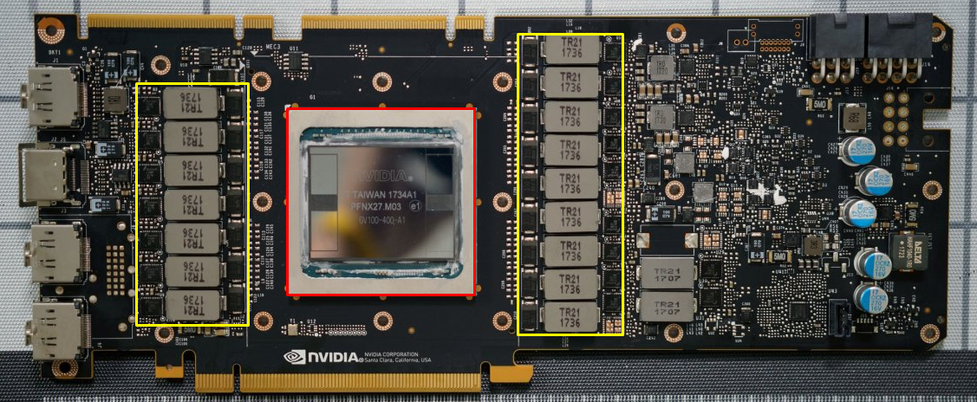
Applications – Symbolic Regression
Real application (soft sensor)
Generate approximately the same result as a real sensor would, given data from other hard, or actual sensors.
?
T2
T1
Christopher Crary | Brit Chesley | Wesley Piard
Notes:
A real-world application for genetic programming in this context is the evolution of a “soft sensor”,
which is simply a function that is given input from “hard” or actual sensors and outputs a value that is equal to or approximately equal to what a hard sensor in its place WOULD HAVE returned.
As a trivial example, lets assume we have a GPU and we would like to measure the temperature of the silicon die (bound in this image by the red rectangle), but for some reason can’t physically attach a temperature sensor (assume we don’t have access to the actual internal GPU temperature via software…)
We may assume that the temperature of the GPU die is somehow correlated to the power stage circuitry (highlighted with yellow rectangles). This should make sense – the more power the GPU is drawing, the hotter it gets (and thus the power circuitry)
If we can attach temperature sensors to the locations labeled T1 and T2, then we may be able to evolve a “soft” sensor that returns a pseudo-GPU temperature using the temperature readouts of these two sensors.
This could also perhaps be expanded by using the GPU clock frequency as another input.
Again, this was a trivial example that isn’t extremely useful, but there are several industrial applications where soft sensors could be applied to save time or other resources.
1:30

Slide 51
Human Competitiveness
One of the main goals of fields such as artificial intelligence and machine learning is to produce human-like results using machines/computers.
Alan Turing developed the Turing test to objectively assess machine intelligence.
Decades later, the idea of human competitiveness was introduced by Koza, Bennett, and Stiffelman, and was a better metric than intelligence.
Christopher Crary | Brit Chesley | Wesley Piard
Notes:
AI and machine learning only exist because we have the desire for machines to be able to produce human-like results.
Soon after these fields began, the Turing test was developed to determine objectively how “intelligent” a system/machine was.
The Turing test was not practical, however, and was later basically replaced by the idea of what is coined “human competitiveness”, which was less objective and applied to more application domains.
0:30

Slide 52
Human Competitiveness - Criteria
An automatically generated result should only be considered competitive if at least one of the following are true:
Already patented, is an improvement over an existing patent, or would qualify today as a patent.
At least as good as a result published in a peer-reviewed journal.
At least as good as a result maintained by an internationally recognized panel of experts.
Publishable as a new scientific result, independent of the fact that it was mechanically created.
At least as good as the most recent human-created solution to a long-standing problem for which there has been increasingly better human-created solutions.
At least as good as a result considered an achievement when it was first discovered.
Solves a problem of indisputable difficulty in its field.
Holds its own or wins a competition involving human contestants (humans or human-written programs)
Christopher Crary | Brit Chesley | Wesley Piard
Notes:
To be considered competitive, a result generated by some “intelligent” system is required to have at least one of the following traits:
It must be an improvement to an existing patent, already patented, or could be a new patent
It must be at least as good as a result published in a peer-reviewed scientific journal
It must be at least as good as a result maintained by a panel of experts
It must be considered a new scientific result, regardless of the fact that it was mechanically created
It must be at least as good as the most recent human-created solution to a problem for which increasingly better human-created solutions have been made
It must be as good as a result that was considered an achievement when it was first discovered
It must solve a problem that is indisputably difficult
And finally, it must be competitive when put up against a human contestant (or human-written program)
1:00

Slide 53
Human Competitiveness – Examples
Creation of a competitive soccer-playing program (RoboCup 1997 competition) (https://www.youtube.com/watch?v=4QtBSDSC2pk)
Creation of algorithms for the identification of protein characteristics
Creation of a sorting network for seven items using only 16 steps
Synthesis of topologies for PID and non-PID controllers
Synthesis of analog circuits (amplifiers, circuits computing mathematical equations, robot control, thermometer, etc.)
Christopher Crary | Brit Chesley | Wesley Piard
Notes:
One example of the idea of human competitiveness is RoboCup, which is an annual competition in which teams develop autonomous soccer-playing robots. Over the years they have progressed from small battle-bot style robots with wheels to larger humanoid robots that walk and kick with their legs. The video linked here highlights the progression since 1997 when the competition started. It is actually pretty funny and interesting to watch and see how things have progressed. They even matched up robots against real human players.
More examples include algorithms for the identification of certain protein traits,
Sorting algorithms,
The synthesis of topologies for PID and non-PID controllers
As well as the synthesis of analog circuits such as amplifiers, robot control, etc.
0:55

Slide 54
Human Competitiveness – The Humies
The Humies is a competition held annually at ACM’s Genetic and Evolutionary Computation Conference, and a $10,000 prize is awarded to projects that have produced human-competitive results.
The following web page contains a list of all human-competitive awards given since 2004:
http://www.human-competitive.org/awards
Christopher Crary | Brit Chesley | Wesley Piard
Notes:
To emphasize the idea of human competitiveness, there is a competition called “the humies” that awards people for coming up with human-competitive projects.
If you are curious, you can find a list of all of the awards given since 2004 at the following link. If you look at the awards given, you will notice that since 2004, the algorithms developed become more and more niche or obscure.
0:30

Slide 55
Applications – Image and Signal Processing
GP has also seen success in the field of image and signal processing, e.g.:
Military applications (radar-based ship detection, airborne photo vehicle detection, civilian surveillance, etc.)
Geographical studies (polar ice feature searching, searching for valuable minerals)
Digital filtering and neural networks
Preprocessing images to find points of interest
Image classification and speech recognition
Text recognition in more difficult written languages (Arabic, Chinese, etc.)
Christopher Crary | Brit Chesley | Wesley Piard
Notes:
Finally, let’s end with some quick real-world applications of genetic programming. The first of which is the field of image and signal processing.
Some common applications in this domain for genetic programming are military,
geographical studies,
digital filtering,
point of interest detection within images,
image classification
Text recognition, especially for more difficult written languages
0:30

Slide 56
More Applications
Medicine and biology
Make predictions about behavior and properties of biological systems
Bioinformatics
Computational chemistry (properties of molecules and their interactions)
Industrial process control
Control of industrial milling and cutting machinery
Detecting bomb fragments and unexploded ordnance
Reduce cost of running jet engines
Control of IC fabrication plant
Christopher Crary | Brit Chesley | Wesley Piard
Notes:
Another big field for genetic programming is the medical industry.
It can be used to make predictions about certain biological systems,
As well as bioinformatics,
And computational chemistry which can determine properties of molecules and how they may interact. This may have big use cases in the pharmaceutical industry.
Genetic programming has also less publicly been used in industrial applications such as
Control of milling or cutting machinery,
Detecting bomb fragments or explosives
Reducing the cost of running jet engines
As well as the control of an IC fabrication plant
Note that it is less common for results in the industrial field to be published.
0:40

Slide 57
More Applications
Media generation
Video games (bots, AI for humans to compete with)
Movie feature generation (herds of animals, flocks of birds, insects, etc.) is more easily generated by evolutionary programs as opposed to manually by human graphic designers
Compression
Lossy/lossless image compression
Fractals
Wavelet compression for images/signals
Christopher Crary | Brit Chesley | Wesley Piard
Notes:
An increasingly common application for genetic programming is for media or entertainment production purposes.
Video game developers use it for creating AI for humans to practice or compete with. Chess is one common example of this.
Another very useful example is the generation of large quantities of objects in movies such as herds of animals, flocks of birds, hoards of zombies, etc. It is much more cost-effective to create a program that can generate these automatically in a natural-looking way, as opposed to paying human graphic designers by the hour to generate these objects manually.
It has also been used for lossy and lossless image compression,
fractal compression,
As well as wavelet compression which is most commonly used for images and signals
0:50

Slide 58
Lecture Outline
GP in a nutshell. (~2 mins)
Basic GP. (~25 mins)
Typical characteristics and implementations of GP. (~15 mins)
First look at applications of GP. (~10 mins)
Advanced GP. (~15 mins)
Other implementations of GP. (~4 mins)
A very brief look at some theory for GP. (~1 min)
Second look at applications of GP. (~10 mins)
Conclusion. (~1 min)
Christopher Crary | Brit Chesley | Wesley Piard

Slide 59
Conclusion
Genetic programming (GP) is a very powerful methodology.
Based on Darwin’s Theory of Evolution, GP stochastically evolves computer programs in a manner similar to natural selection.
Ultimately, GP allows for the discovery of computer programs that meet some (pretty much any!) application-specific or domain-specific criteria.
Much empirical evidence gathered throughout the past few decades shows that GP works well in a lot of application domains.
There is still much potential work for developing GP, particularly in developing (1) more efficient/effective architectures and (2) theory.
Christopher Crary | Brit Chesley | Wesley Piard
Notes:
To wrap things up, I’d like to just reiterate the fact that genetic programming is extremely powerful when used for certain applications.
It is based on Darwin’s Theory of Evolution, and stochastically evolves programs in a way that mimics natural selection processes.
It can discover computer programs in almost any domain that may have not been discovered by a human.
Over the past few decades genetic programming has proven that it works well across a wide variety of application domains.
Although genetic programming is revolutionary and is producing very impressive results, it could still use improvements in efficiency, effectiveness, and general theory.
0:45

Slide 60
Questions?
Christopher Crary
Brit Chesley
Wesley Piard

