Slide 1
Approximate Computing
ExpAX and Chisel
Christopher Crary
Wesley Piard

Slide 2
Introducing ExpAX and Chisel
ExpAX and Chisel are frameworks for automating approximate programming.
Overall goal: Decrease both energy consumption and programmer effort.
Improves upon EnerJ/Rely, using less tedious forms of annotation
Christopher Crary | Wesley Piard

Slide 3
Introducing ExpAX
Instead of having to manually specify individual instructions as approximable (Rely, EnerJ), the programmer can specify the reliability constraints of program/function outputs.
For a given set of operations that can produce an approximate output, ExpAX uses genetic programming to automatically find the combination of these operations that should or should not be approximated.
Christopher Crary | Wesley Piard
Notes:
With previous methods such as Rely/EnerJ/ACCEPT, etc., the programmer had to annotate every operation they wished to be approximated.

Slide 4
Genetic Programming
Genetic programming (GP) is an evolutionary computation technique that automatically solves problems without requiring the user to know or specify the form or structure of the solution in advance.
Its main benefit to ExpAX is that it doesn’t require the programmer to know, or attempt via trial and error, what the best combination of approximations is.
Due to the random nature of GP, the result of ExpAX will not be the same every time for the same input program.
Christopher Crary | Wesley Piard
Notes:
ExpAX may not achieve the same quality of results every time it runs. Other methods such as Chisel generate a mathematically optimal solution instead.

Slide 5
ExpAX Overview
Christopher Crary | Wesley Piard
Notes:
This diagram shows the overall process of ExpAX. we start out with some source code provided by the programmer. Expectations that list the reliability and/or accuracy constraints are then inserted into the source code by the programmer.

Slide 6
Expectations
ExpAX allows the programmer to insert expectations into the provided source code, to specify reliability/accuracy constraints to certain variables.
Three kinds of expectations are supported:
Error rate
Magnitude
Error rate + magnitude
Christopher Crary | Wesley Piard
Notes:
The first step is for the programmer to insert “expectations” into the source code. These expectations are essentially reliability goals or constraints.
There are only three kinds of expectations a programmer can specify: error rate, magnitude, and a combination of the two.

Slide 7
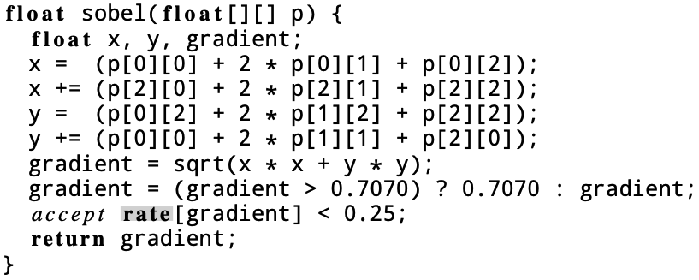
Expectations - Rate
The rate expectation places a limit on the rate at which the specified variable can incur any error.
For example, the highlighted line of code is placing a rate expectation on the gradient variable.
This means that the gradient variable should never have an incorrect value more than 25% of the time.
Christopher Crary | Wesley Piard
Notes:
One of the expectations is called ‘rate’. It limits the rate at which a variable can receive an erroneous value.
For example, here is a function called ‘sobel’ that contains a variable named ‘gradient’. The contents of this function are irrelevant, it’s just to illustrate the highlighted line which specifies a rate expectation on the gradient variable.
This expectation specifies that the gradient variable should have a perfect result at least 75% of the time, or that it shouldn’t have an ‘incorrect’ value more than 25% of the time.

Slide 8
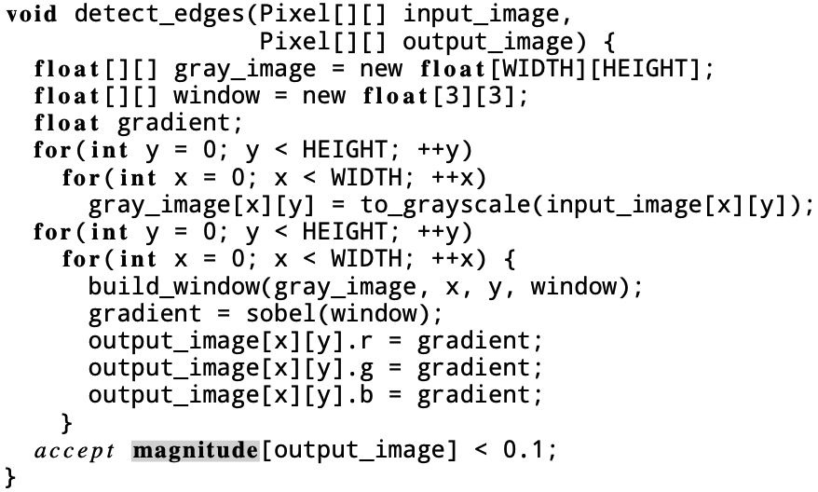
Expectations - Magnitude
The magnitude expectation places a limit on the normalized magnitude of an error that can occur for the specified variable.
In this example, the expectation is specifying that the maximum normalized error on the output_image array should never be greater than 0.1, or 10%.
Christopher Crary | Wesley Piard

Slide 9
Expectations – Rate and Magnitude
These two expectations can also be combined to produce more complex expectations.
This example combination of expectations specifies that the luminance variable can only have an error greater than 90% less than 35% of the time.
Christopher Crary | Wesley Piard
Notes:
More complex constraints can be imposed on a variable by combining the rate and magnitude expectations.
In this example, the luminance variable can only have an error greater than 90% less than 35% of the time.
A more intuitive way to think about this one is that the variable must have an error less than 10% at least 75% of the time.

Slide 10
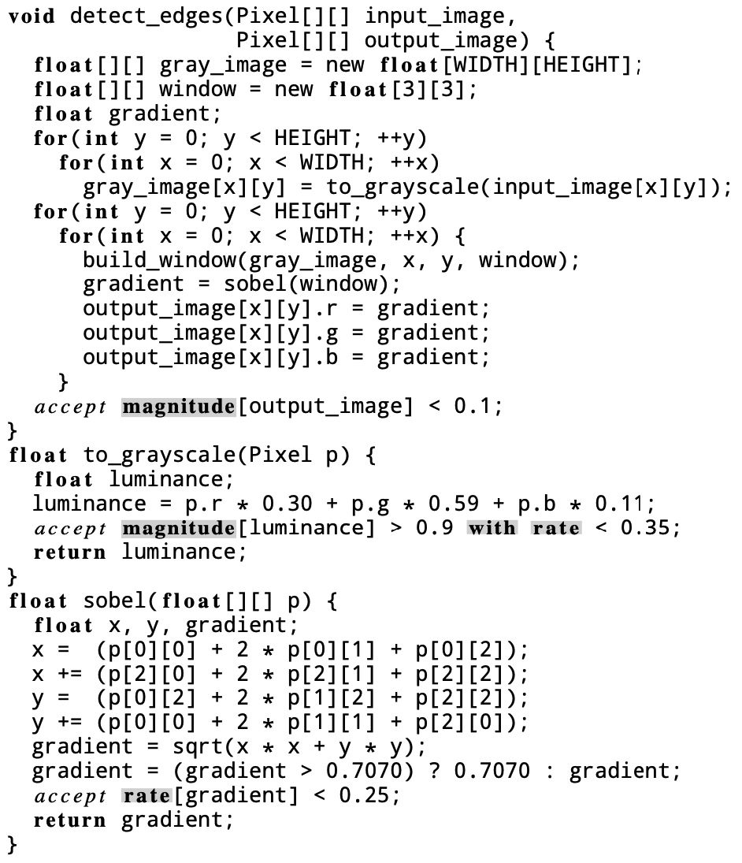
Expectations – Summary
The key benefit for this part of ExpAX is that the amount of manual annotation required by the programmer to approximate some function outputs is significantly less than previous work, e.g., Rely.
Think of all the possible operations in these functions (add, multiply, etc.) that could potentially be individually approximated.
Now imagine trying to determine which combination of them should be approximated vs. remaining precise.
Christopher Crary | Wesley Piard
Notes:
I’d like to re-emphasize the benefits of ExpAX’s annotation method.
You simply annotate the variables of interest for your application, apply expectations to these variables, and then ExpAX will do the rest.
Note that to determine these expectations, you should, as the programmer, have some insight as to the level of approximation that is sufficient for each of these variables.

Slide 11
ExpAX Overview
Christopher Crary | Wesley Piard
Notes:
Now that the programmer has applied expectations to certain points in the source code, the code can be analyzed to find the largest set of operations that can safely be approximated.
The authors refer to this as “approximation safety analysis”.

Slide 12
Approximation Safety Analysis
Approximation safety analysis removes operations that are “unsafe” to approximate such as the following:
Memory access violations (null pointers, out of bounds array indexing, etc.)
Control flow violations
Operations that may influence variables that had no expectations set by the programmer (expectations are only used for variables that are desired to be approximated)
After all the unsafe operations are removed from the list of possibilities, this step then attempts to find the largest set of approximable instructions possible.
Typically, as the total number of approximated operations goes up, so does the amount of energy savings.
Christopher Crary | Wesley Piard

Slide 13
ExpAX Overview
Christopher Crary | Wesley Piard
Notes:
After finding the full list of possible safe-to-approximate operations, the next step is to automatically identify a subset of these operations that meet the programmer’s specified expectations.

Slide 14
Selecting Approximate Operations
The process of selecting a unique combination of operations to approximate is what separates ExpAX from the previous options such as Rely and EnerJ.
This process is automated using two phases:
Genetic filtering
Greedy refining
Christopher Crary | Wesley Piard

Slide 15
Genetic Filtering
The genetic filtering phase uses a genetic programming algorithm to filter out the approximated operations that would produce results that don’t meet the programmer’s specified expectations.
The algorithm iterates a specified number of “generations” and then chooses the best combination of operations to approximate.
Christopher Crary | Wesley Piard
Notes:
For each generation, input datasets which come from the hardware system specification (error, energy consumption metrics, etc.) are tested.

Slide 16
Greedy Refining
After genetic filtering produces a full list of the operations (which to approximate and which to leave precise), the greedy refining step extracts a list of only the operations to approximate.
Then, it greedily finds the combination of these operations that results in the highest energy savings.
This relatively optimal set of operations is the final result that is then implemented on the targeted hardware platform.
Christopher Crary | Wesley Piard
Notes:
In this figure, the lower score is better chance for energy benefits

Slide 17
Concluding ExpAX
Less programmer knowledge about the underlying hardware required
Less manual annotation required by the programmer
Automatic search using genetic programming
The results ExpAX can yield are only at least as reliable as the underlying hardware specification it is targeting
Christopher Crary | Wesley Piard

Slide 18
Intermission
ExpAX-related questions?
Christopher Crary | Wesley Piard

Slide 19
Introducing Chisel
Chisel is a system that can automatically create approximations of an exact (i.e., non-approximate) software program by mapping certain portions of the exact program to unreliable hardware.
Such an approximation, when generated by Chisel, is [1] mathematically guaranteed to be reliable (i.e., produce exact results) with some probability r and [2] mathematically guaranteed to be the most energy-efficient approximation for that particular rate of reliability, r.
In practice, a developer would decide which reliability rate r is reasonable for a given application and then let Chisel mathematically determine how to generate the most energy-efficient approximation for that particular value of r.
Christopher Crary | Wesley Piard

Slide 20
Strengths of Chisel
The main strengths of Chisel are that:
Software can be automatically* mapped to unreliable (approximate) hardware.
Any generated approximation is mathematically guaranteed* to be reliable for some probability r.
For a given rate of reliability r, any generated approximation is mathematically guaranteed* to be the most energy-efficient approximation for the relevant unreliable hardware.
From empirical evidence, energy savings can be significant. (Will be discussed further on, if time permits.)
*Assuming that some other, non-trivial items are provided to Chisel. (See next slide.)
Christopher Crary | Wesley Piard

Slide 21
Weaknesses of Chisel
The main weaknesses of Chisel are that:
Any mathematical guarantee provided by Chisel regarding reliability can only be meaningful if the developer knows of statistical guarantees for the reliability of the underlying hardware. This is not trivial!
Any mathematical guarantee provided by Chisel regarding energy efficiency can only be meaningful if the developer provides Chisel with the ability to mathematically model the energy of the relevant computing system. This is not trivial! (But more trivial than the previous item.)
Any software that is to be mapped to unreliable hardware must be written with the Rely programming language. (However, all other portions of the relevant program can be written in any other language.)
Christopher Crary | Wesley Piard

Slide 22
Quick Review of Rely
The Rely programming language provides a framework for [1] specifying and [2] verifying the reliability of software that is to execute on unreliable hardware.
Essentially, Rely is an oversimplified implementation of the “C” programming language, which supports syntax regarding one-dimensional arrays but not pointers.
To do [1] and [2] in a meaningful manner, one must be aware of statistical guarantees for the reliability of the underlying hardware, which is otherwise referred to here as a hardware specification. This is not trivial!
Christopher Crary | Wesley Piard

Slide 23
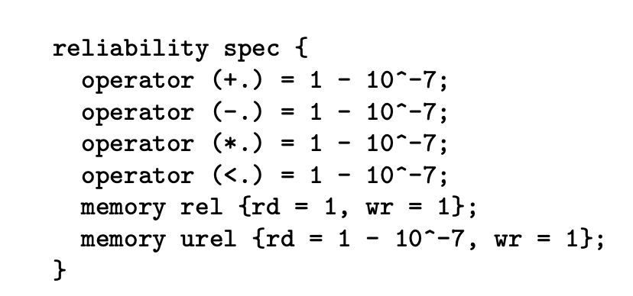
Quick Review of Rely, cont.
Below, a rate of reliability is defined for some arithmetic hardware and some memory.
Christopher Crary | Wesley Piard

Slide 24
Quick Review of Rely, cont.
Below, a rate of reliability is defined for each of the outputs of some function, f.
Christopher Crary | Wesley Piard

Slide 25
Quick Review of Rely, cont.
Below, a general joint reliability is defined.
Christopher Crary | Wesley Piard

Slide 26
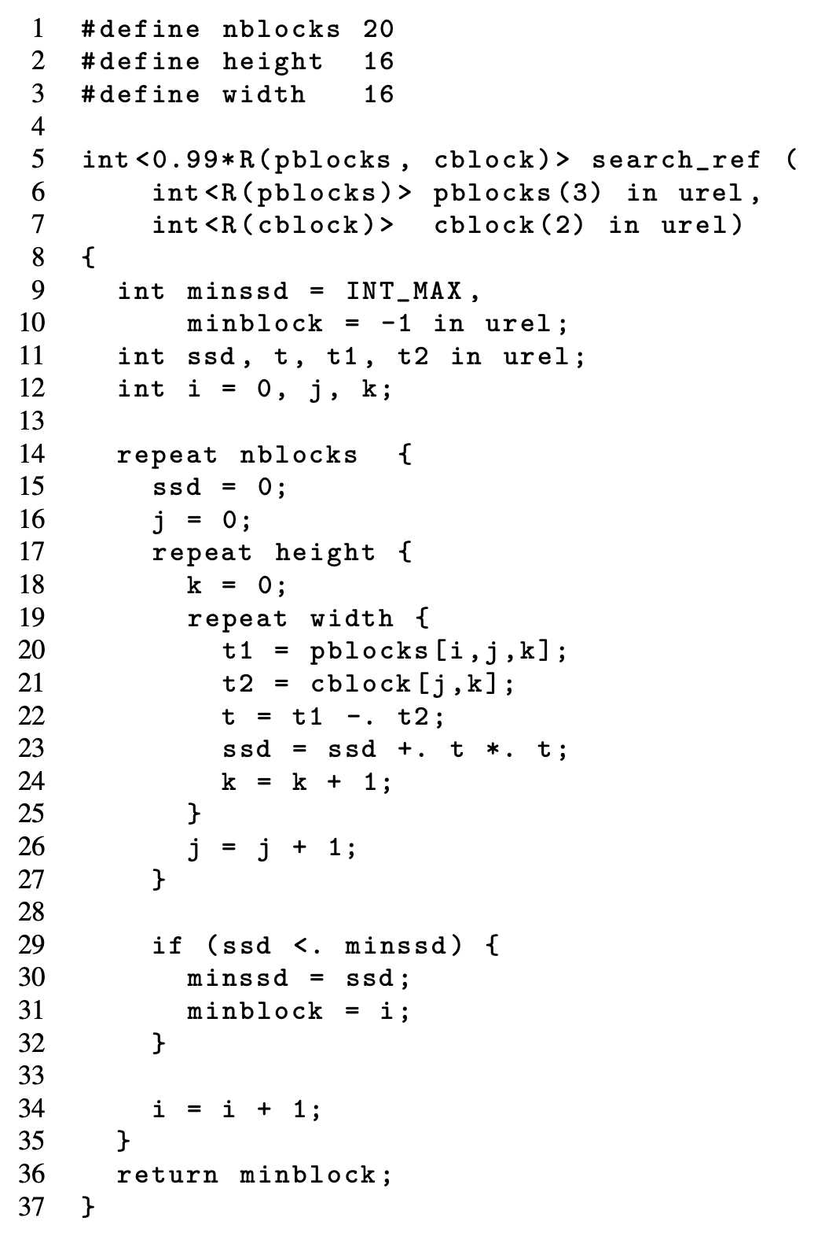
Quick Review of Rely, cont.
On the right, a function is written in Rely.
Christopher Crary | Wesley Piard

Slide 27
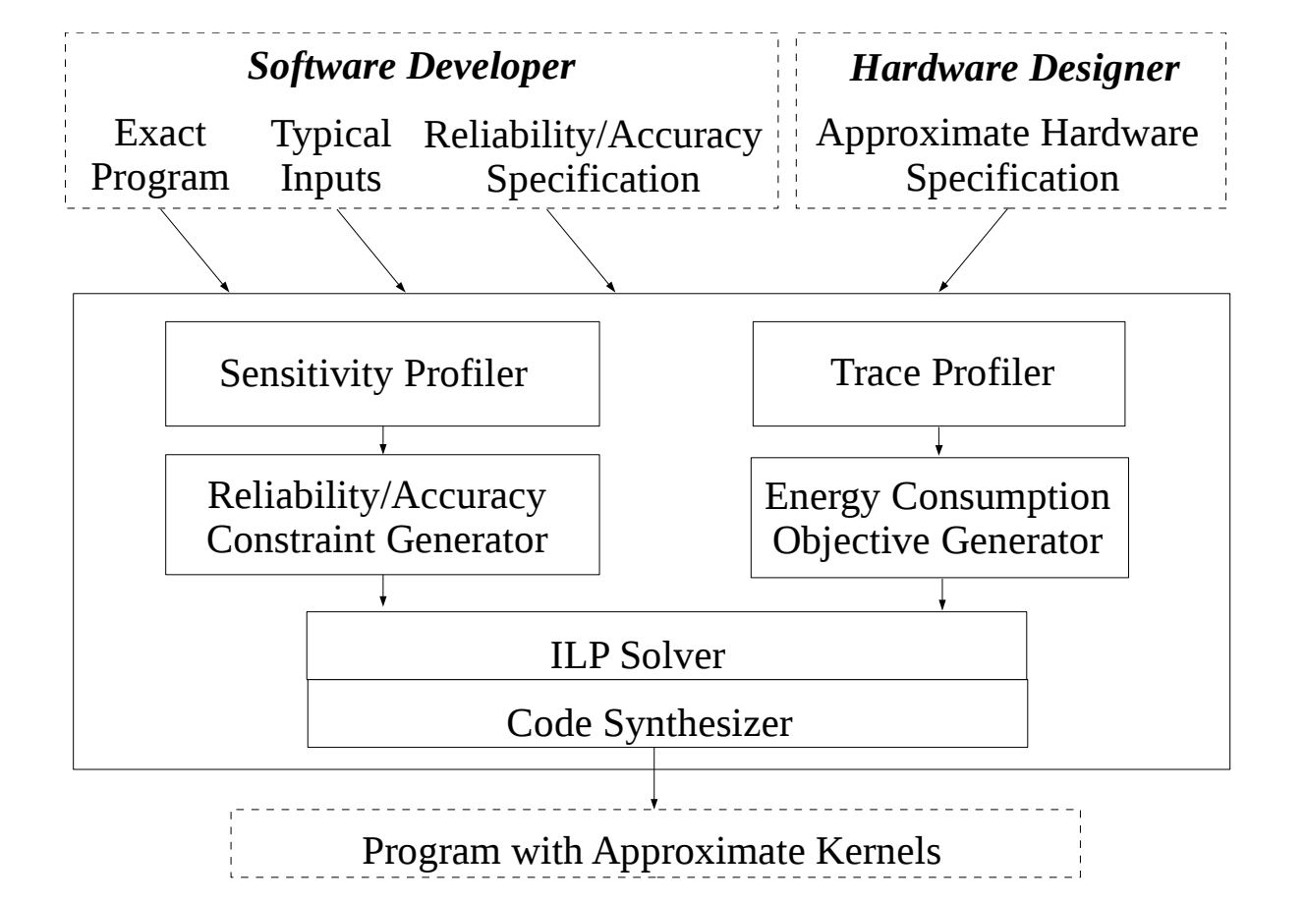
Chisel System Flowchart
To make sense of the system flowchart, let’s go through an overall example.
Christopher Crary | Wesley Piard

Slide 28
Overall Example of Chisel Workflow
Assume that we wish to make a program that can scale an image to be larger by some integer factor. Assume that we wish to execute this program partially on unreliable hardware.
Christopher Crary | Wesley Piard

Slide 29
Overall Example of Chisel Workflow, cont.
In general, the exact program is the portion of the program that is to be approximated.
As such, it must be written in Rely.
Christopher Crary | Wesley Piard

Slide 30
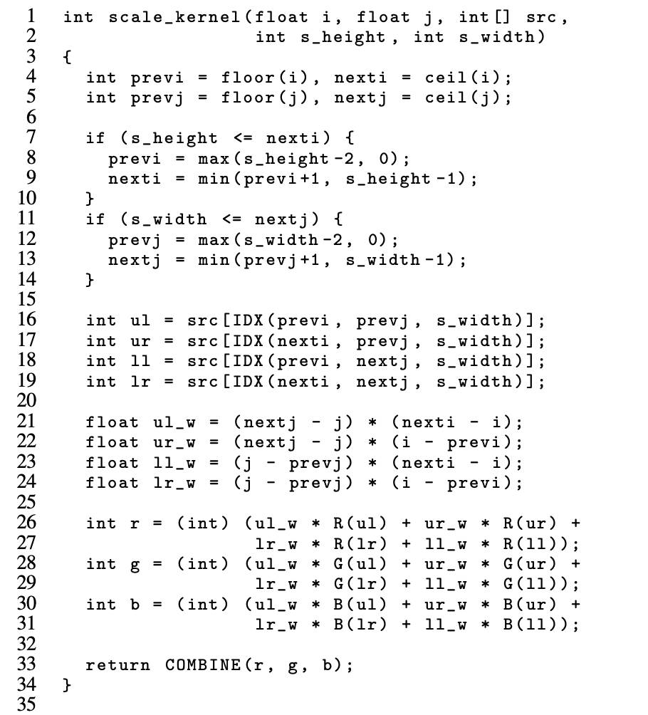
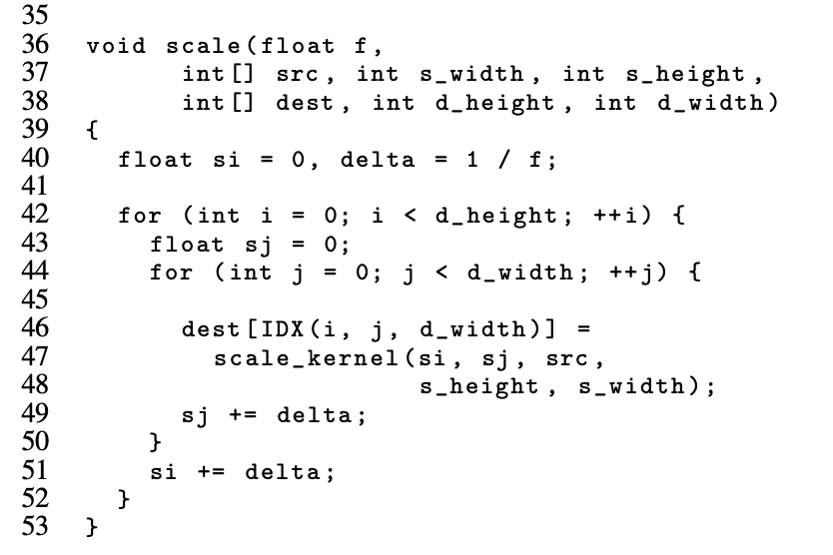
Overall Example of Chisel Workflow, cont.
The `scale_kernel` function ends up being worthwhile to approximate by way of unreliable execution.
Christopher Crary | Wesley Piard

Slide 31
Overall Example of Chisel Workflow, cont.
Approximate hardware specification would be the same as previously expected by Rely.
Christopher Crary | Wesley Piard

Slide 32
Overall Example of Chisel Workflow, cont.
Reliability/accuracy specification is for code that we wish to approximate on unreliable hardware.
Christopher Crary | Wesley Piard

Slide 33
Overall Example of Chisel Workflow, cont.
IMPORTANT: How do we meaningfully determine the reliability rate for the output, e.g., “.995”?
ANSWER: Sensitivity profiling!
Christopher Crary | Wesley Piard

Slide 34
Overall Example of Chisel Workflow, cont.
Sensitivity profiler provides the developer with a tool to automatically exploring levels of output reliability, r.
However, for the sensitivity profiler to function, the developer has to provide [1] a way for injecting faults, [2] a measure of “error”, and [3] an “error” tolerance.
Note that [1]-[3] are generally application dependent.
Christopher Crary | Wesley Piard

Slide 35
Overall Example of Chisel Workflow, cont.
Fault-injection routine
Christopher Crary | Wesley Piard

Slide 36
Overall Example of Chisel Workflow, cont.
Results of sensitivity profiler, based on previously given fault-injection function.
Christopher Crary | Wesley Piard

Slide 37
Overall Example of Chisel Workflow, cont.
So, we have now decided our output reliability rate r, now what do we do?
Well, remember, we ultimately wish to determine how to approximate our exact program (in our case, which portions of the `scale_kernel` function) such that, when executed on approximate hardware, it is the most energy-efficient that it could possibly be for the particular reliability rate r.
Christopher Crary | Wesley Piard

Slide 38
Overall Example of Chisel Workflow, cont.
Well, first, how do we even know what is optimal in regard to energy efficiency for our particular program?
As of now, we don’t know!
This is where this guy comes in!
Christopher Crary | Wesley Piard

Slide 39
Overall Example of Chisel Workflow, cont.
The trace profiler runs “instruction traces” on some version of the exact program to determine what the typical energy usage of the relevant hardware, e.g., how much energy is used by the CPU, memory, etc.
But wait, are the energy results for a particular run of the exact program generally representative of the energy model as a whole?
Nope!!
To solve this, you have to provide a set of representative program inputs that statistically guarantee your energy results are generally representative. This is not trivial!
Christopher Crary | Wesley Piard

Slide 40
Overall Example of Chisel Workflow, cont.
Okay, let us now assume that we have both [1] the reliability rate r and [2] energy estimates that are generally representative of our hardware. How do we now determine how our `scale_kernel` function should be approximated?
Integer Linear Programming!
This is ultimately going to provide us with the mathematical rigor for being able to guarantee a certain approximate program meets our specified reliability constraints.
Christopher Crary | Wesley Piard

Slide 41
Overall Example of Chisel Workflow, cont.
Essentially, integer linear programming (ILP) aims to maximize or minimize a linear function subject to some particular constraints.
Easy, right?
Nope! NP-complete.
Thankfully, there’s a bunch of heuristic algorithms that work well.
How do we model our optimization problem as an ILP problem?
Well, first, it should be clear that we wish to minimize the energy model of our system.
Okay, but how do we formulate a set of constraints that allows us to properly minimize the energy model?
Christopher Crary | Wesley Piard

Slide 42
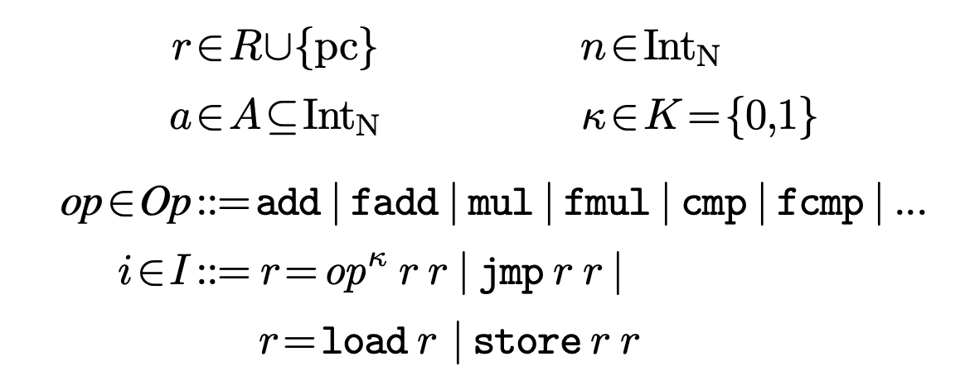
Overall Example of Chisel Workflow, cont.
First, we map our Rely code to an assembly language that supports approximate hardware. (In general, this can be any ISA.)
Then, we consider that we could mark every instruction with a label $κ$ that identifies whether or not the instruction is executed with exact hardware ($κ=0$) or approximate hardware ($κ=1$).
Assumed assembly language syntax
Christopher Crary | Wesley Piard

Slide 43
Overall Example of Chisel Workflow, cont.
With this and some additional formal definitions in mind, we can then formulate a series of constraints in which the reliability r is tied to [1] each assembly instruction and [2] whether or not it is approximated.
Ultimately, this series of constraints is defined in such a way that the solution to our ILP problem (i.e., the solution that minimizes the energy of our system) informs us which assembly instructions must be computed exactly and which should be computed approximately.
Sound like we’re “hand-waving” the math?
That’s ‘cause we totally are! Trust in Martin Rinard!
Christopher Crary | Wesley Piard

Slide 44
Overall Example of Chisel Workflow, cont.
So, we have a proper optimization goal and a proper set of constraints for our ILP problem! Can we solve it now?
Almost. We need to generate a format that will make sense for one of the ILP heuristic algorithms, e.g., Gurobi, which is the one that is used by Chisel.
That is where these guys come in.
Christopher Crary | Wesley Piard

Slide 45
Overall Example of Chisel Workflow, cont.
Yay, we have successfully formulated our ILP problem that can be solved!
What do we do now?
First, solve the ILP problem. This will ultimately tell us which assembly instructions should be executed with approximate hardware.
Then, we just synthesize machine code from the result of the ILP problem with this sly guy.
Christopher Crary | Wesley Piard

Slide 46
Overall Example of Chisel Workflow, cont.
Then, we got ourselves the most energy-efficient approximation of the `scale_kernel` code for our particularly chosen output reliability rate r!!!
Christopher Crary | Wesley Piard

Slide 47
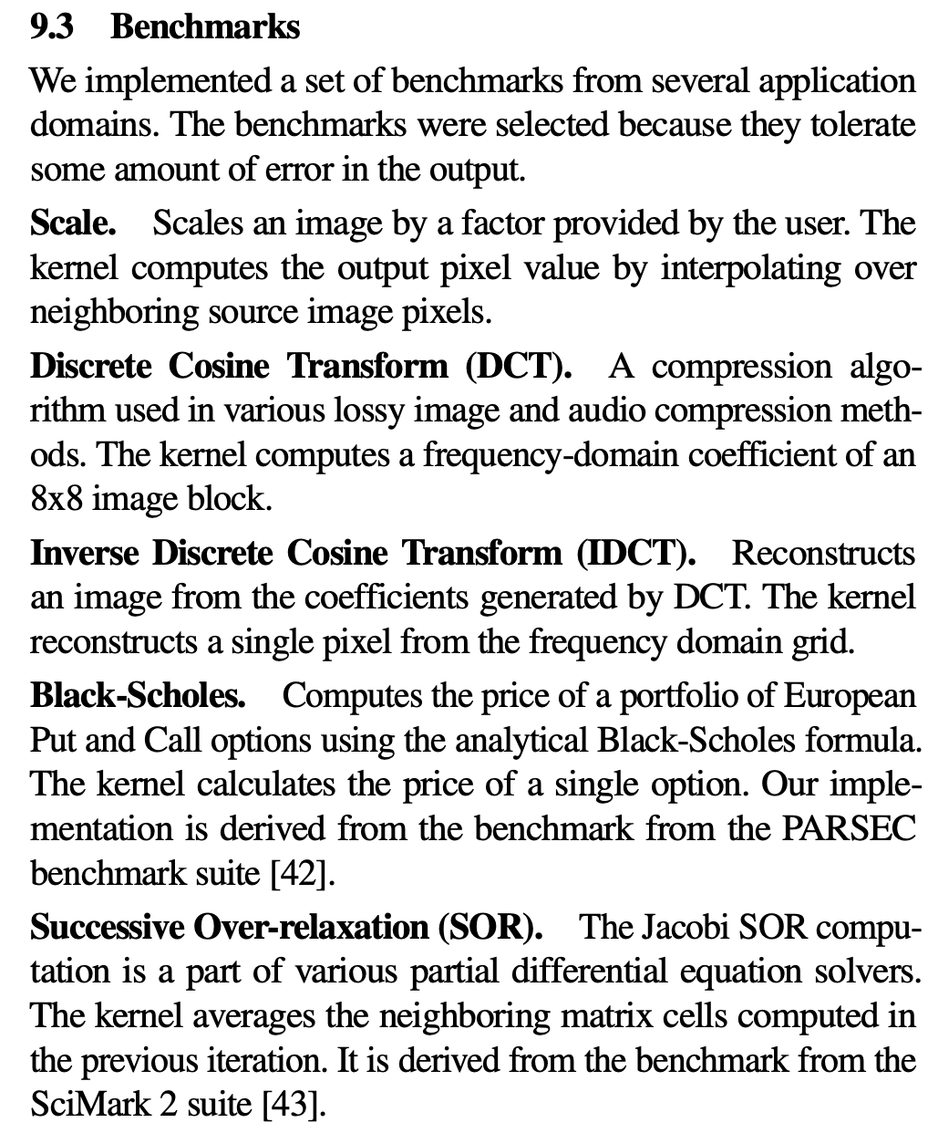
Results in Thirty Seconds, cont.
Christopher Crary | Wesley Piard

Slide 48
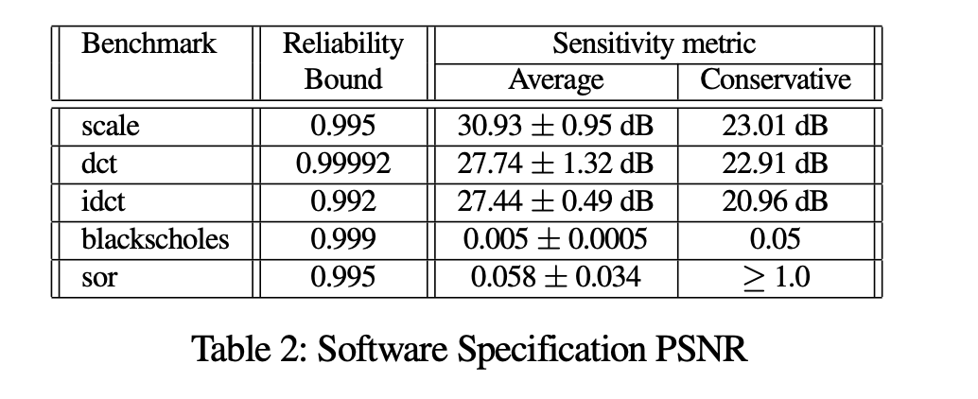
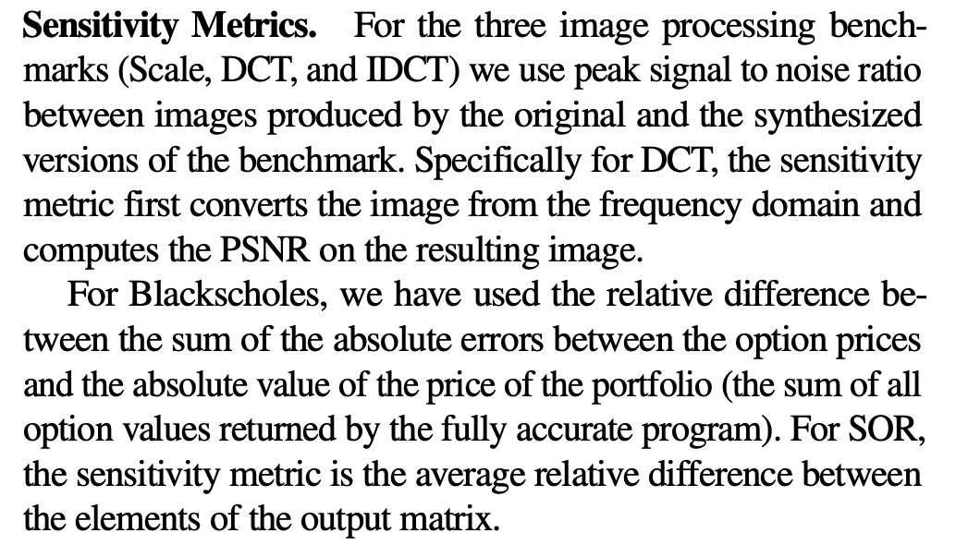
Results in One Minute, cont.
NOTE: Sensitivity metrics are for measures of error between exact and approximate solutions.
Christopher Crary | Wesley Piard

Slide 49
Results in One Minute, cont.
Christopher Crary | Wesley Piard

Slide 50
Concluding Chisel
Does Chisel solve all our problems?
Unfortunately, no.
However, for instances of approximate computing in which unreliable hardware execution is considered, Chisel could provide formal guarantees that do not seem to be offered by any other current tool.
Thank you, Martin Rinard et. al!
Christopher Crary | Wesley Piard

Slide 51
Summary (ExpAX vs. Chisel)
Both require some form of annotated program input, but they differ in syntax and languages.
The underlying hardware specifications need to be known to generate approximations
Chisel can mathematically “guarantee” a reliability with a higher statistical confidence than ExpAX.
They are both innovative and have interesting solutions for the same type of problem.
Christopher Crary | Wesley Piard

Slide 52
Questions?
Christopher Crary
Wesley Piard

