Slide 1
Approximating to the Last Bit
Thierry Moreau, Adrian Sampson, Luiz Ceze, Mark Oskin
Presented by Brit Chesley

Slide 2
Overview
Existing architectures provide little incentive to reduce precision of arithmetic and memory operations
If hardware could trade precision for energy savings, would push more programmers to think about quality
They present Axe, an approximation aware precision tuning framework for C/C++ built upon ACCEPT compiler
Automatic approximation via precision scaling of instructions
Notes:
Axe maximizes bit savings while satisfying user-defined quality constraints
They use Axe to explore instruction-level precision reduction on PERFECT benchmark suite

Slide 3
How Much to Approximate?
Axe takes annotated (EnerJ style) approximate program and greedily finds a configuration that maximizes bit-savings while maintaining quality constraints
Bit savings is hardware agnostic metric
r_{i} and a_{i} is the precision in bits of memory-reference and approximate instruction i
e_{i} is the number of times instruction i is executed
Notes:
Bit savings quantifies how aggressively precision can be reduced over execution of an approximate program
For floating point instructions, precision variables r,a get computed over mantissa bits

Slide 4
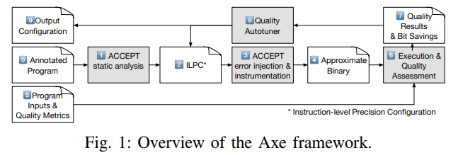
Programmer provides annotations to approximate program
ACCEPT statically identifies safe-to-approximate instructions in an Instruction-Level Precision Configuration (ILPC)
ILPC adjusts safe-to-approximate instructions to maximize bit savings
Axe emulates effect of reduced-precision execution using ACCEPTS error-injection library
Notes:
On low-precision arithmetic and load instructions, ACCEPT truncates destination register value after the operation executed
On low precision stores, ACCEPT truncates data register value before its written to memory
Instrumentation pass is to collect dynamic statistics to analyze the framework performance

Slide 5
Approximate binary is created and assessed using programmer provided quality metrics
Output quality score and bit savings score both calculated
Autotuner finds ILPC that maximizes bit savings
O(m² * n) time complexity. m is number of static safe-to-approximate instructions, and n is number of precision levels (knob settings)
Notes:
Output quality score and bit savings score both calculated by combining the ILPC parameters with execution statistics gathered from the instrumentation pass
Autotuner finds ILPC that maximizes bit savings while satisfying the user-provided quality constraints
Autotuner is an iterative greedy search algorithm. Finds local-minimum configuration in O(M^2 * n). Not global solution, but typically we never deal with global solutions
->Algorithm uses trial and error approach. At each step of its search, the autotuner identifies the instruction that affects the output the least, and relaxes its precision by a single bit
-> this continues until the user defined quality metrics are violated

Slide 6
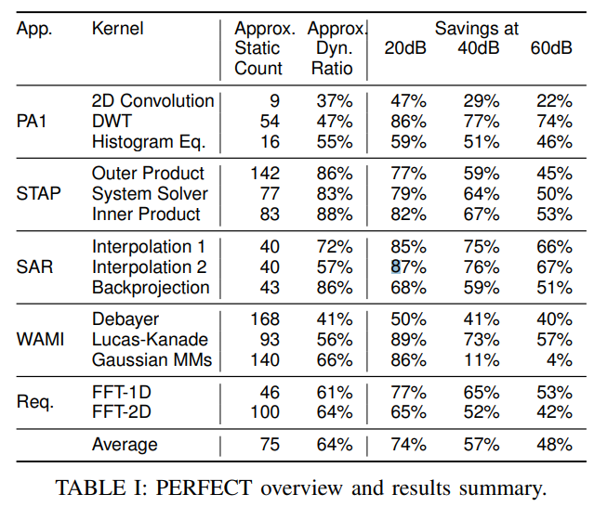
Results
Use Signal-to-Noise Ratio (in dB) quality metric across all benchmarks
Static instruction count is number of instructions the program contains
Dynamic instruction count is the actual number of instructions executed
Notes:
Talk about the savings at different signal to noise ratios. Higher ratio => better quality result, so energy savings should be less
Dynamic instruction count takes into consideration sections of iterable code like for loops, recursion etc.
Approximate static count is the number of static instructions that are safe-to-approximate according to the ACCEPT compiler
->The more safe-to-approximate static instructions the more work the autotuner will have to perform (bigger space of solutions)
Approximate dynamic ratio is the ratio of safe-to-approximate dynamic instructions to total dynamic instructions
Large approximate dynamic ratio, lots of approximation can be done on these benchmarks
Most of the not safe-to-approximate instructions are branches or pointer arithmetic used for address computation
LOOK UP HOW PERFECT BENCHMARK EVALUATES ENERGY

Slide 7
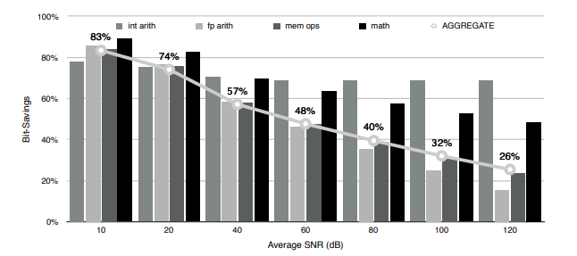
Average bit-savings obtained across PERFECT benchmark for different types of approximable code
Notes:
Math functions are from standard C math functions
Aggregate is the aggregate bit-savings for each benchmark averaged over all benchmarks
Clear trend of the lower the quality of target, the higher the bit savings
Bit-savings for integer arithmetic remains large due to the most-significant bits being able to be trimmed without having a large effect on the final output

Slide 8
Future Challenges
Need to design precision-scalable architectures
Mechanism to dynamically scale precision
Minimal control overheads that wont impede energy efficiency gains
Will go over another paper with such a design
Notes:
Authors use the result of the study to motivate the need to design precision scalable architectures, that can graciously translate bit-savings to energy savings
Need to exhibit mechanism to dynamically scale precision in memory and compute pipelines
They point to another paper with an architecture called Quora, that is one of the first precision-scalable architectures. I will discuss this paper next

Slide 9
Quality Programmable Vector Processors for Computing
Swagath Venkataramani, Vinay K. Chippa , Srimat T. Chakradhar, Kaushik Roy and Anand Raghunathan

Slide 10
Overview
Quality-programmable processors
Generally
QUORA
Software expresses tolerance for approximation via the ISA
Instructions have quality fields
Need hardware to support the ISA
Quality programmable micro-architecture
Vector processor
Instructions operate on one dimensional arrays (vectors)
Contains hierarchy of processing elements
Approximate, mixed accuracy, and completely accurate processing elements
Notes:
Quality fields that explicitly indicate the desired accuracy level that MUST be guaranteed during execution

Slide 11
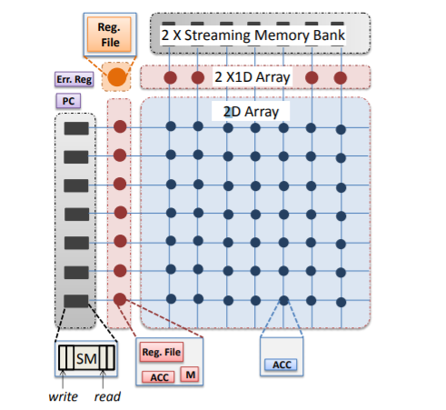
Software Visible Architecture
Main Sections of Architecture
Streaming memory bank
2D array accumulator registers
1D array accumulators
Error register
Notes:
2 Streaming memory banks are FIFO buffers. Can be individually addressed and data vectors can be read or written
2D array of processing elements, each containing an accumulator register. Data can be scanned in/out by row or column
1D arrays operate in a single-instruction-multiple-data fashion. Each element has an accumulator register, small register file, and a mask register
Error register holds estimate of actual error incurred during execution of the quality programmable instructions

Slide 12
Quality Programmable Instructions
Lots of different types of instructions for scalar operations, streaming memory instructions, 2D array instructions, etc.
A couple different error metrics can be specified at the instruction level
Maximum error magnitude, average error magnitude, error probability
Notes:
In the instructions, r_q_type is the type of error, and R_q_amt is the amount of acceptable error

Slide 13
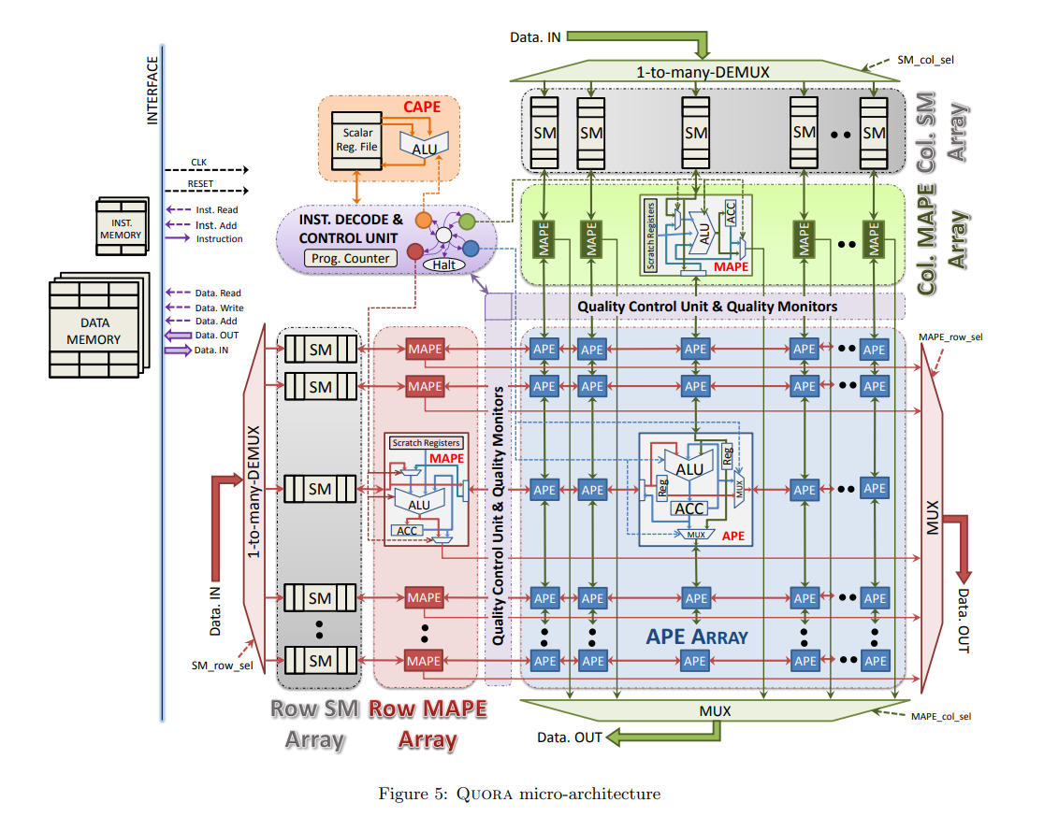
New ECE Faculty Orientation Aug 18, 2020
John Harris, Chair
Notes:
APE – Approximate processing elements. Connected in a systolic array fashion. Results stored in their own accumulator registers.
->in a typical instruction APE operates over multiple cycles with new input operands fed in every cycle from neighboring APEs to the left and top of it.
-> APE elements optimized to carry oout vector-vector reduction operations such as Dot product, Euclidean distance, etc.
MAPEs – Mixed Accuracy Processing elements. Mapes in each set (top or left) operate together in a Single-instruction-multiple-data fashion.
->operate in reduction mode, streaming mode, self-operand mode
->execute a mix of arithmetic and control instructions.
-> Mapes tailored to complex reductions performed on intermediate data such as min/max operations, kernel functions like tanh, exponentials etc.
Completely accurate processing elements – similar to conventional scalar microprocessor
Quality control units interprets quality fields in instructions and translates them into hardware accuracy knobs for the APE and MAPE processing elements
->doing approximation via precision scaling

Slide 14
How is Approximation Done?
Precision Scaling
Bit width(precision) of input operands used by processing elements are modulated during instruction execution
Up/down precision scaling
Similar to round-off in floating point notation. Truncation, however if the value is larger than 2^{psc-1}, input is rounded up by adding 2^{psc}
Precision scaling with error compensation
Dynamically vary threshold at which values are rounded up/down in precision scaling unit
Dynamic precision scaling
Previous mechanisms have set number of bits to precision scale at the start of instruction execution
Notes:
Up/down precision scaling – takes in number of bits to precision scale, truncates LSB. However if the value is larger than 2
Precision scaling with error compensation. If positive or negative error is greater than twice the other, comparator threshold is increased or decreased.
->hardware controls the threshold at which rounding occurs via a comparator
->trying to leverage the fact that some errors will be positive and some will be negative. So if more negative error, increase threshold such that
more values are rounded down (introducing more positive errors). Significantly improved energy-quality tradeoff
Dynamic precision scaling
->number of bits to precision scale is changed dynamically during instruction execution based on actual error value

Slide 15
Why Precision Scaling?
Reduction in switching activity
Clock gating of registers
Voltage scaling
Notes:
Reduction in switching activity – less 1s since LSB is truncated
Clock gating of registers – bit slices of registers can be clock gated to further enhance energy efficiency.
->basically when no activity at a register input, no need to clock the register. Enable signal from reg can be and’d with clock (and latched so doesn’t toggle)
Voltage scaling – precision scaling leads to reduction in circuit delay due to reduction in the critical path. Reduce supply voltage to APE and MAPE elements.
->only to exploit timing slack created by precision scaling

Slide 16
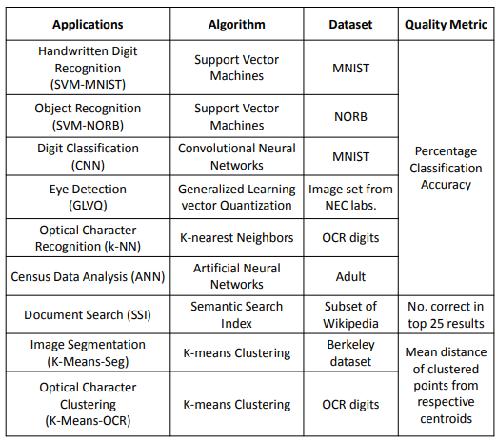
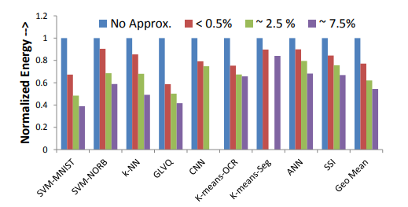
Results
Notes:
Used Modelsim to simulate complete applications at RTL level.
Quality fields of quality programmable instructions were set empirically using greedy auto-tuning procedure
->Similar algorithm as first paper, except they first set all quality programmable instructions to fully accurate.
Then, the program is energy profiled to identify the most energy consuming instructions and relaxed their accuracy of instructions in steps 2.5%
This is repeated until the application level quality constraint is violated.
Figure on the right shows normalized energy consumption at different output quality targets for all applications. Energy is normalized to base case where all quality
Programmable instructions are executed in a fully accurate manner.
->can see that energy benefits can be large for virtually no loss
->on average, quality programmability results in 1.3x, 1.6x, and 1.85x energy savings at the different quality levels
->however the fully accurate execution doesn’t take parallelism into account

Slide 17
Questions?

Slide 18
Multiple Choice Questions
Just on first paper (required paper)
Axe is built on top of which framework?
Expax
Pandora
ACCEPT
React
How did Axe implement approximations?
Through precision scaling
Loop perforation
Approximate adders
Synchronization relaxing

Slide 19
Multiple Choice Questions
Just on first paper (required paper)
Approximate static count refers to:
The amount of instructions executed at run time
Amount of static (noise) measured in approximate hardware
Guarantee of user-provided quality constraints
The number of static instructions that are safe-to-approximate

