Slide 1
Parallel Synchronization-Free Approximate
Data Structure Construction
Martin Rinard, MIT CSAIL

Slide 2
Overview of Concepts
Synchronization/Parallelism: Process to ensure that concurrent processes do not simultaneous execute or access critical sections of code
Approximate Data Structures: Composed of basic tree and array building blocks with associated synchronization-free construction algorithms
Barnes-Hut Simulation: An approximation algorithm for performing an n-body simulation

Slide 3
Synchronization/Parallelism
Parallel vs. Sequential Algorithms
Sequential algorithms execute from start to finish without stopping for other processing executions
Parallel algorithms can do multiple operations at a time
Synchronization
Process to ensure that concurrent processes do not simultaneously execute or access critical sections of code
Non-blocking synchronization
Failure or suspension of any thread cannot cause failure or suspension of another thread

Slide 4
Approximate Data Structures
Eliminate synchronization by leveraging the end-to-end ability of the client to tolerate some imprecision in the approximate data structure that the algorithm produces
Data structures created using standard sequential algorithms that successfully execute without synchronization in parallel
“Researchers advocate for the development of reusable data structure building blocks with associated approximate construction algorithms”

Slide 5
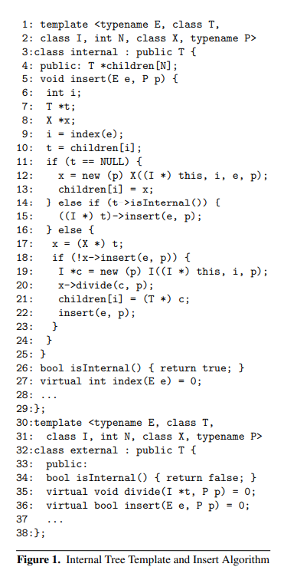
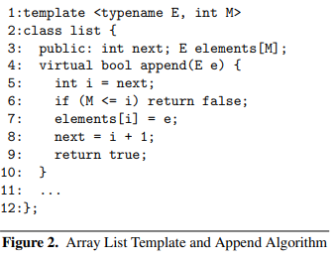
Reusable Data Structure Building Blocks

Slide 6
Approximate Data Structures (cont.)
Researchers used basic tree and array building blocks with synchronization-free construction algorithms to compose the approximate data structure
Algorithm inserts elements as leaves to trees or appends elements at the end of arrays.
Algorithms use different techniques such as the use of the data structure building blocks, atomic read and write operations or pthreads to avoid deadlock, data racing crashes, etc
Data structures accurate enough for clients to use successfully

Slide 7
Barnes-Hut Simulation
An approximation algorithm for performing an n-body simulation.
At each step of the simulation, the computation computes the forces acting on each body, then uses these forces to update the positions, velocities, and accelerations of the bodies.
Barnes-Hut inserts the n-bodies into a space-subdivision tree, computes the center of mass at each node of the tree, then uses the tree to compute the force acting on each body
Approximates the combined forces from multiple distant bodies
Approximation reduces the complexity of the force computation algorithm from N^2 to (N log N)

Slide 8
Barnes-Hut Simulation Versions
Tree Locking
Locks each node in the tree before it accesses the node)
Compare and Swap
Uses compare and swap instructions to make individual data structure updates execute atomically
Update Locking
Fine-grained locks to make updates execute atomically
Hyper Accurate Update Locking
Update Locking version running with a smaller tol parameter
First Parallel
Synchronization-free approximate versions in Figures 1 and 2
Final Check
Synchronization-free approximate versions augmented to use final checks

Slide 9
Results
Performance and accuracy tested using Barnes-Hut n-body computation
At each step each thread inserts a block of N/T bodies into the tree, where N is the number of bodies and T is the number of parallel threads.
0.0003% of the inserted bodies are dropped.
On 16 cores (the unsynced algorithm), runs over 14 times faster than the sequential tree construction algorithm
runs over an order of magnitude faster than a version that uses standard tree locking
Runs 5% and 10% faster than sophisticated parallel implementations that use either fine-grained mutual exclusion locks or compare and swap operations.

Slide 10
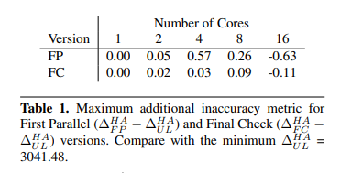
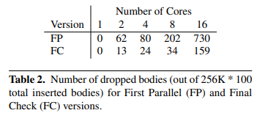
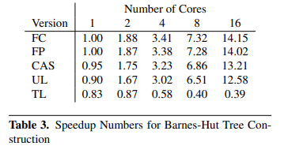
Results

Slide 11
Questions
?

Slide 12
What is a parallel algorithm?
Same as an approximation algorithm
An algorithm were failure or suspension of any thread cannot cause failure or suspension of another thread
An algorithm that can do single operations in a given time.
An algorithm that can do multiple operations in a given time.

Slide 13
What is the Barnes-Hut simulation?
Simulation of atomic operations
Graphics simulation
Approximate data structure
N-body simulation

Slide 14
What were the data structures composed of?
Linked List
Array and Tree
Array and Linked List
Tree

