Slide 1
An Approximate Communication Framework for Network-on-Chips
By: Yuechen Chen & Ahmed Louri
Presented By: Alexis Rodriguez

Slide 2
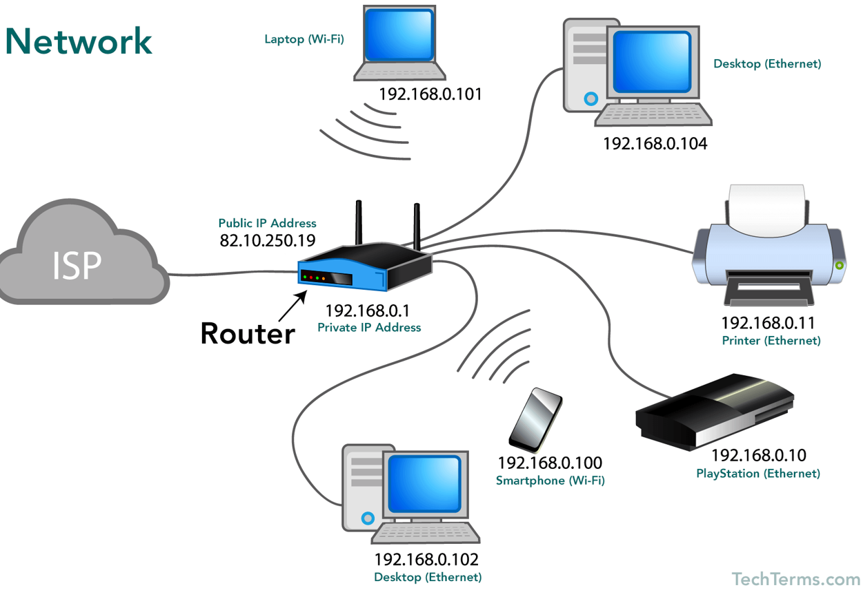
Background Information
Source: https://techterms.com/definition/network
Notes:
Scalability of the design improves since IP can be replaced easily

Slide 3
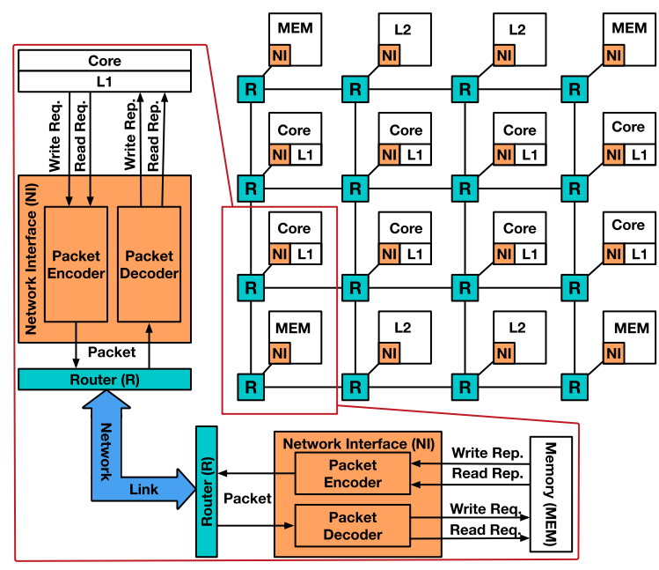
Network-on-Chip?
Bus is replaced with a computer network style transmission involving routers, switches, and network interfaces.
Can improve the scalability of a design
Can improve the power efficiency of a design
A different type of interconnect
“…are becoming standard communication solution for connecting cores, caches and memory controllers on chips.” - Paper
Notes:
Scalability of the design improves since IP can be replaced easily

Slide 4
OSI (Open Systems Interconnect) Model
Application
Presentation
Session
Transport
Network
Data link
Physical

Slide 5
OSI (Open Systems Interconnect) Model
Application
Presentation
Session
Transport
Network
Data link – Flits of data
Examples: Ethernet, i2c, physical addressing (e.g. MAC address), error control
Physical
Notes:
Packets, frames, flits, etc

Slide 6
Answers To What We Are Looking For
Type of approximation? Hardware, software, communication, algorithmic [Framework]
Approximation strategy? Truncation and compression
How is it done? Automatically
What is being approximated? Float & int
How to determine what to approximate? Code analysis
How much approximation is acceptable? User set
What applications are being targeted? Data being transmitted over the network
Notes:
Packets, frames, flits, etc

Slide 7
What is Being Solved?
Communication takes more time than the computation itself
Communication consumes more energy than the computation itself
Notes:
Packets, frames, flits, etc

Slide 8
How is it Solved?
Approximate Communication Framework
Software
Automatically identify parts of code that can be approximated (ints/floats)
User provides error tolerance then truncate the data, compress it, send it
Hardware
Compression/Decompression, Quality Control Table
Notes:
Packets, frames, flits, etc

Slide 9
Software – Error Tolerance
Int
Float
Ex (int):
32 bit number
5% Error Tolerance
100 dec = 0000 0000 0000 0000 0000 0000 0110 0100 bin
Keep 29 MSB (n = 29)
96 dec = 0…1100000 bin
Error = (1-(96/100))100 =4%
Notes:
Packets, frames, flits, etc

Slide 10
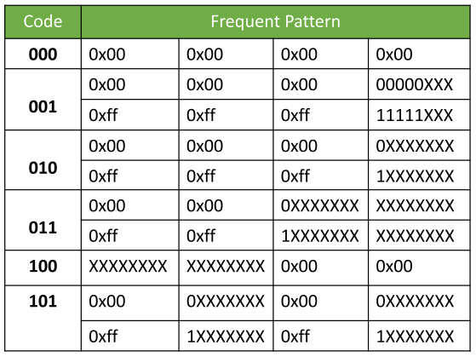
Software – Compression
Frequent Data Pattern Compression
MSB is replaced by the Code
Assume 32-bit flit (payload)
Notes:
Assume 32 bits, MS

Slide 11
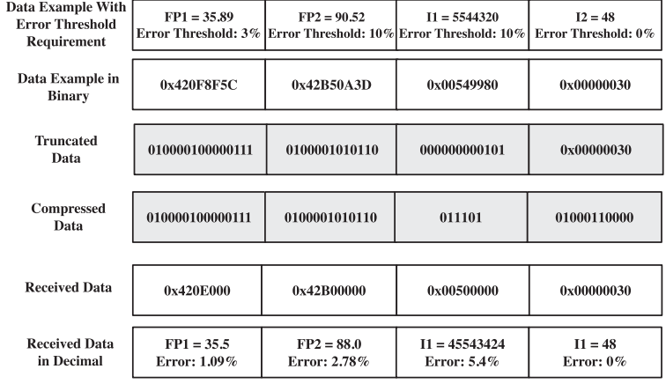
Software – Truncation/Compression Example
Notes:
Error in paper: I1, truncated data would be 0x00500000 therefore it should be code 100, not 011

Slide 12
Software – Code Analysis
Automatically find error resilient values in code sections and calculate error tolerances based on user input.
Break down operations into basic operations (Control Flow Graph [CFG])

Slide 13
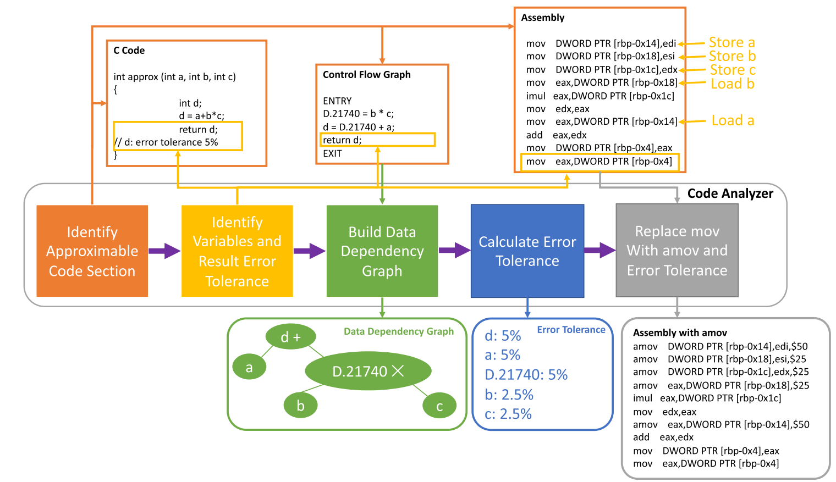
Software – Code Analysis

Slide 14
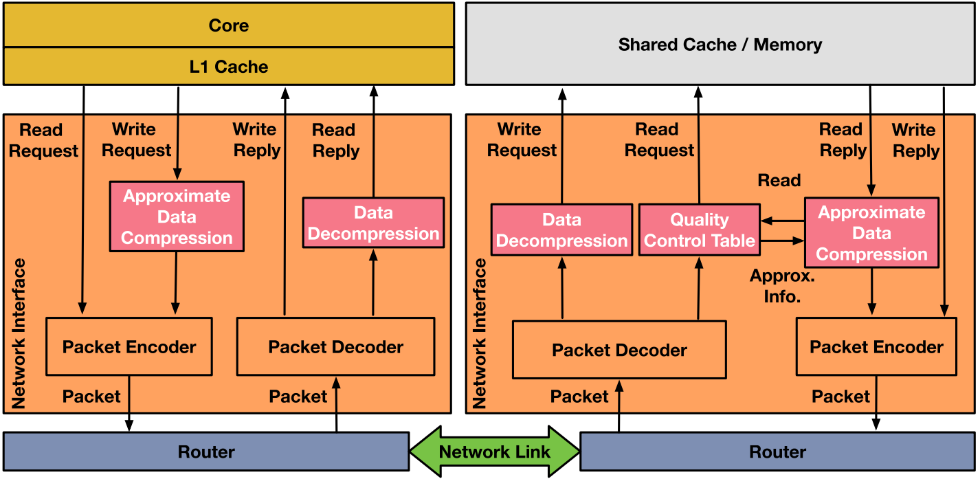
Hardware

Slide 15
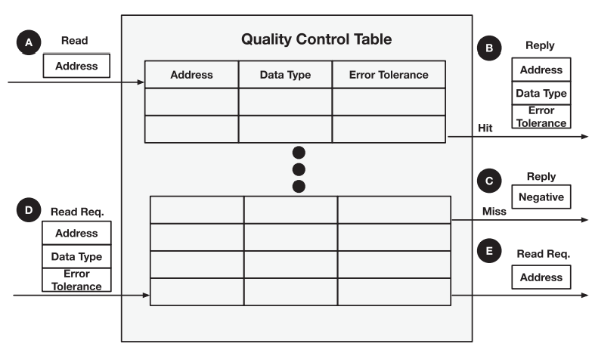
Hardware
Notes:
QCT receives a Read packet with an address.
If Hit, reply back with approximation info: address, datatype, and err tol
If Miss, reply back with “negative”
QCT receives a Read Request packet with an address, data type, and error tol
If it has approx. data, table extracts it. If table has multiple entries then it fills the table. Then it forwards only the address to shared cache/memory

Slide 16
Results
Setup
Ran framework in GEM5 simulator
AxBench Benchmark Suite
Used to benchmark approximate computing
Target: 95% Quality
Compared against other frameworks:
AxBA
Quality Control Framework

Slide 17
Results
Experiments
1) Compression Rate vs Error Threshold
2) # of Approx. Packets vs Allowable Error (5%)
Auto vs Manual
3) Compression Rate vs Allowable Error (5%)
4) Network Latency
5) Dynamic Power & Overhead

Slide 18
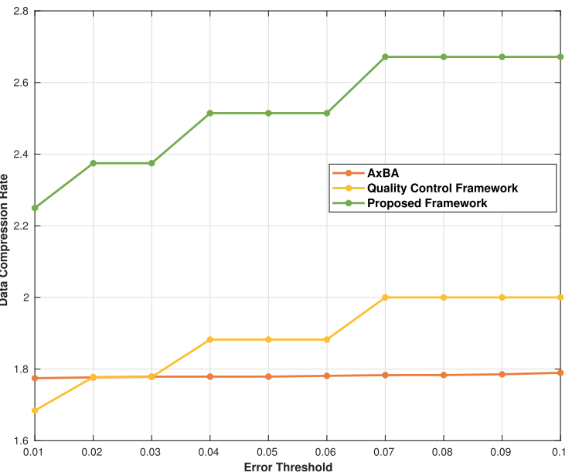
Results - Experiment 1

Slide 19
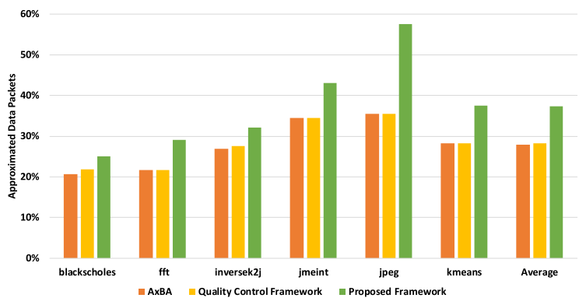
Results - Experiment 2

Slide 20
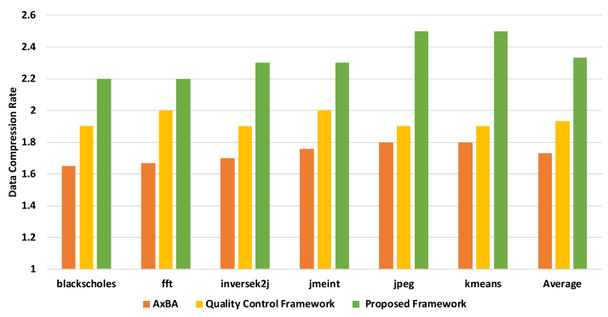
Results - Experiment 3

Slide 21
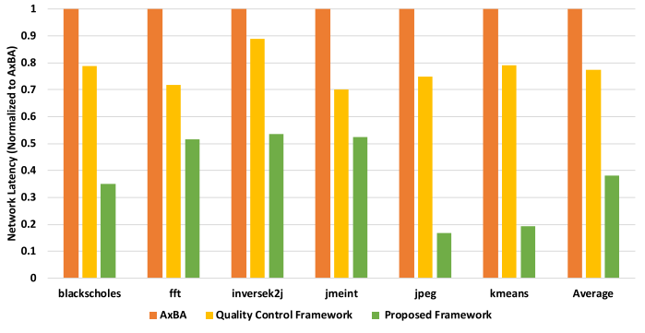
Results - Experiment 4

Slide 22
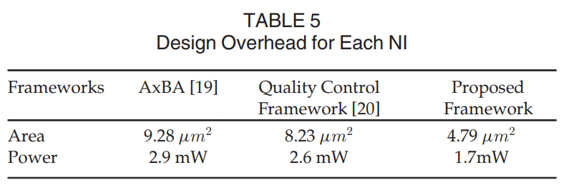
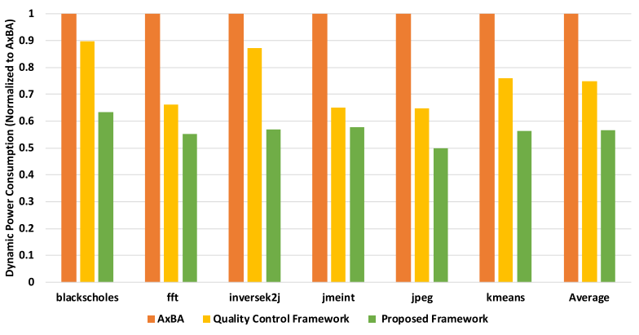
Results - Experiment 5
4.79 um² is less than 1% of total NoC area but this is per NI
“When the supply voltage is 1.0 Volt, the framework incurs a power overhead of 1.7 mW for each NI, which is only 0.025 percent of the NoC static power consumption. Compared to quality control framework [20] and AxBA [19], the proposed framework reduces static power overhead by 35 and 41 percent, respectively.”
Notes:
Each NI

Slide 23
Questions
Question 1
As approximated packets go up relative to total packets…
A) Power should go down
B) Power should go up
C) Latency should go down
D) Latency should go up
Answer: A and C

Slide 24
Questions
Question 2
Why did the Approx. Comm. Framework for NoC work so well?
A) Truncated int and float
B) Compression
C) Automatic determination of approximate data
D) Manual determination of approximate data
E) Truncated float
Answer: A, B, C

Slide 25
Questions
Question 3
What part of the OSI model does the Approx Framework for NoC focus on?
A) Physical Layer
B) Data Link Layer
C) Network Layer
D) Application Layer
Answer: B

