Slide 1
Efficiency Limits for Value-Deviation-Bounded Approximate Communication
Phillip Stanley-Marbell and Martin Rinard
Presentation by Arvind Shankar

Slide 2
Overview
Problem: Power dissipation overhead from sensor activation and serial data transfers in wearable and health-tracking devices
Objective: Reduce the dynamic power dissipation in these devices
Solution: Reduce number of transitions in serial signal transmissions by introducing some error to reduce power overhead
Approximation Type: Data encoding in relation to tradeoff between power and error

Slide 3
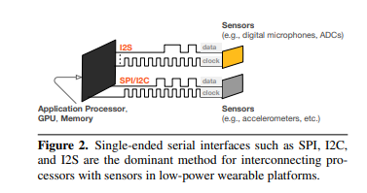
Data Transfer and System Power
Processors in wearable, embedded, and mobile platforms transfer data between many sensor ICs
IC data transfer hasn’t scaled with semiconductor process technology advances – relative proportion of system power attributed to data transfer will only grow
Can improve efficiency of data transfer through intelligent data encoding

Slide 4
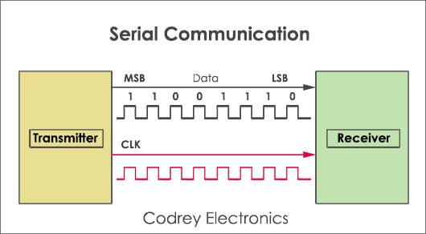
Serial Communication
Transmitting data one bit at a time from a source to a destination
Most cases: a “high” value on the data bus represents a ‘1’ while a “low” value represents a ‘0’
This paper focuses on improving efficiency of serial-only transmissions, not on parallel buses

Slide 5
VDBS Data Encoders
Value-Deviation-Bounded Data Encoders are a possible way to address the challenge of reducing power dissipation in serial transmission
VDBS data encoders change the value being transmitted such that the new value has fewer transitions between low and high, thus reducing the dynamic power in the transmission

Slide 6
Objectives of this Paper
Analyze the theoretical efficiency of VDBS data encoders and construct proofs regarding the properties of these encoders
Determine limits on VDBS efficiency and provide insights into best possible tradeoffs between dynamic power reduction and approximation error

Slide 7
Definitions
1. Serial Transition Count (STC) Function: The number of serial transitions that occur when a single value s is transmitted over a serial link. Can mathematically define the number of signal transitions as:
2. Serial Transition Count Difference: The absolute value of the difference in STCs between two l-bit words s and t. Mathematically, this is:

Slide 8
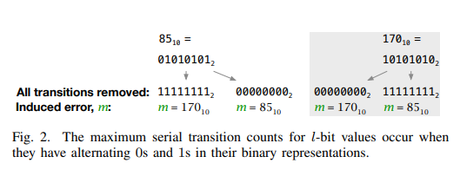
Properties of STC Function
Analysis of the properties of the STC function give bounds for the maximum increases in efficiency from VDBS data encoders.
Proposition 1: If l is even, max STC occurs when the word has (l/2) 0’s and 1’s in an alternating pattern
Lemma 1: The max STC is bounded by (l – 1)
Therefore the maximum reduction in dynamic power from VDBS data encoders is a function of the length of the word being transmitted

Slide 9
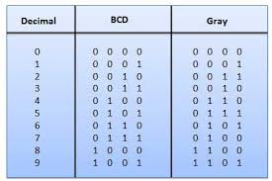
Gray Code
Invented by Frank Gray in 1953, Gray code is “a binary numeral system where two successive values differ in only one bit
https://cp-algorithms.com/algebra/gray-code.html#:~:text=Gray%20code%20is%20a%20binary,by%20Frank%20Gray%20in%201953.

Slide 10
Serial Transitions and Gray Code
Using Gray code allows us to reduce the number of transitions between consecutive words in serial transmission
Theorem 1: “Let s be an l-bit integer, let GrayCode(s) denote the sth value in Gray code order for l-bit values, and let $\#_{1}\left(n\right)$ denote the count of 1s in an l-bit integer n. Then, $\#_{1}\left(s\right)= \#_{1}\left(GrayCode\left(s\right)\right).$
This theorem give us a method to determine the count of 1s in a Gray code representation of a number
Using this theorem, we can derive the formula from before for the count of the number of signal transitions in a serialized l-bit word.

Slide 11
Bounds on STC Reduction
By introducing some error into the values being transmitted, we can reduce the number of serial transitions
This decreases dynamic power usage
Max number of serial transitions we can remove is limited:
Property 1: For any 2 l-bit words s and t, the serial transition count difference, $∆_{s,t}$ is less than or equal to (l – 1)
But what happens to the actual values when we reduce the number of serial transitions?

Slide 12
Bounds on STC Reduction
Property 2: Let s and t be 2 l-bit words with l even. If s and t differ in serial transition count by the maximum possible amount (l-1), then their difference in numeric value is bounded by:
These bounds are only specified for the case of maximal changes in STC, but not in the general case
Next logical step is to determine how much can STCs differ for a given value deviation

Slide 13
Bounds on STC Reduction
How to relate transition reduction and value deviation?
Definition 3: Given an l-bit integer m, left f(m) be a function yielding the amount by which the STCs of 2 unsigned l-bit words s and t can differ if $\left|s −t\right|=m$
Mathematically, this is represented as:
This function is important because if given exact values or tight bounds for f(m), an algorithm that searched for the serial-transition-reducing encoding value for s could terminate as soon as it found t such that $∆_{s,t}$ = f(m)
This gives us the bounds on the difference between STCs of 2 different words

Slide 14
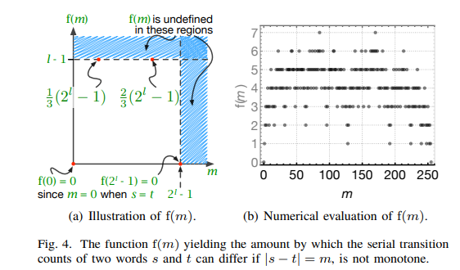
Bounds on f(m)
Defining the bounds on transition reduction that can be achieved is necessary for evaluating VDBS data encoders

Slide 15
Bounds on Value Deviation
Next we need to define bounds on minimum and maximum numeric value deviation that any VDBS data encoder will induce
Definition 4 gives us these 2 functions:
Where $g(d)$ is the min amount by which s and t differ, and $\hat{g}(d)$ is the max amount

Slide 16
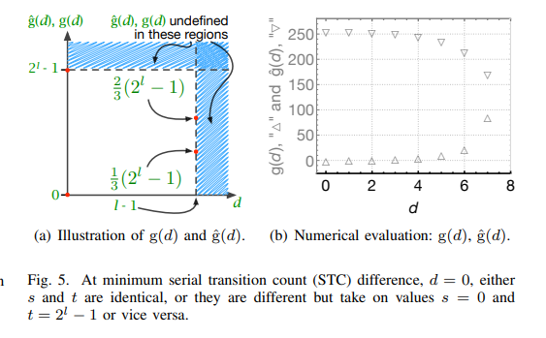
Bounds on Value Deviation
No difference in STC (d = 0) => original and encoded values may be identical or may be 0 and $2^{l}−1$
At max STC difference, incurred deviation is also bounded as shown

Slide 17
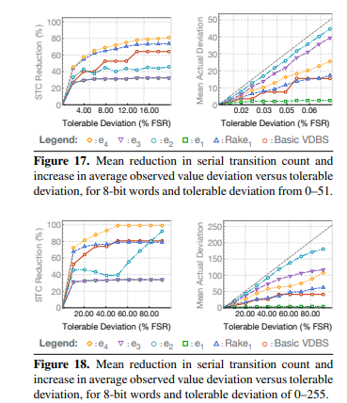
Results
As proven, both STC reduction and value deviation are bounded
Bounds are determined by the length of the word being transmitted – in this case, l = 8

Slide 18
Conclusions
Reducing the number of serial transitions reduces dynamic power usage
1. We can reduce serial transitions at the cost of inducing some amount of error
2. Gray code can be used to reduce number of transitions across consecutive words
3. Defining bounds for transition reductions in relation to value deviations helps us evaluate the efficiency and usability of VDBS encoders

Slide 19
Sample Questions
1. What is the goal of VDBS encoding?
A. Reduce dynamic power dissipation of serial data transfers
B. Improve efficiency of sensors by allowing error into sensor data
C. Accelerate data transfer speed through parallelization
D. Accelerate neural network training time
2. Which of the following is true regarding VDBS encoding?
A. It is useful in all applications and use-cases
B. It works by reducing the number of serial signal transitions
C. Gray code encoding is of use in VDBS encoders
D. Both B and C
3. Which binary number has the most serial transitions?
A. 00000000
B. 00100001
C. 01010101

Slide 20
Sample Questions
1. What is the goal of VDBS encoding?
A. Reduce dynamic power dissipation of serial data transfers [Correct]
B. Improve sensor data throughput
C. Accelerate data transfer speed through parallelization
D. Accelerate neural network training time
2. Which of the following is true regarding VDBS encoding?
A. It is useful in all applications and use-cases
B. It works by reducing the number of serial signal transitions
C. Gray code encoding is of use in VDBS encoders
D. Both B and C [Correct]
3. Which binary number has the most serial transitions?
A. 00000000
B. 00100001
C. 01010101 [Correct]

Slide 21
Questions/Discussion?

