Slide 1
IMPACT: IMPrecise adders for low-power Approximate CompuTing
Authored by: Vaibhav Gupta, Debabrata Mohapatra, Sang Phill Park, Anand Raghunathan and Kaushik Roy
Presented by: Trung Tran

Slide 2
Background/Context
Low-power for portable multimedia devices
Final output is imperfectly interpreted by humans
Previous research to exploit error-resiliency:
Voltage overscaling
Utilizing algorithmics & architectural techniques
Algorithmic Noise Tolerance
Significance Driven Scaling
Notes:
Commonly used multimedia applications have Digital Signal Processing (DSP) blocks as their backbone.
Most of these DSP blocks implement image and video processing algorithms, where the ultimate output is either an image or a video for human consumption.
The limited perception of human vision allows the outputs of these algorithms to be numerically approximate rather than accurate.
Fast but “inaccurate” adder has been proposed, and an error-tolerant adder where they split the input operand into accurate and inaccurate parts, and there has been work that considers logic complexity reduction but only for a 2x2 multiplier

Slide 3
Approach
Logic complexity reduction to take advantage of the relaxed numerical accuracy for signal processing applications
Imprecise Full Adder (FA) cells
Simplify Mirror Adder (MA) circuit
Reduced complexity at transistor level
Reduction in switched capacitance
Shorter critical paths
Enabling voltage scaling
Only Least Sig Bits (LSB)
Notes:
develop imprecise but simplified arithmetic units, which provide an extra layer of power savings over conventional low-power design techniques.
the approximate arithmetic units not only have reduced number of transistors, but the internal node capacitances are reduced.
Complexity reduction leads to power reduction in two different ways. First, an inherent reduction in switched capacitance and leakage results from having smaller hardware. Second, complexity reduction frequently leads to shorter critical paths, facilitating voltage reduction without any timing-induced errors.

Slide 4
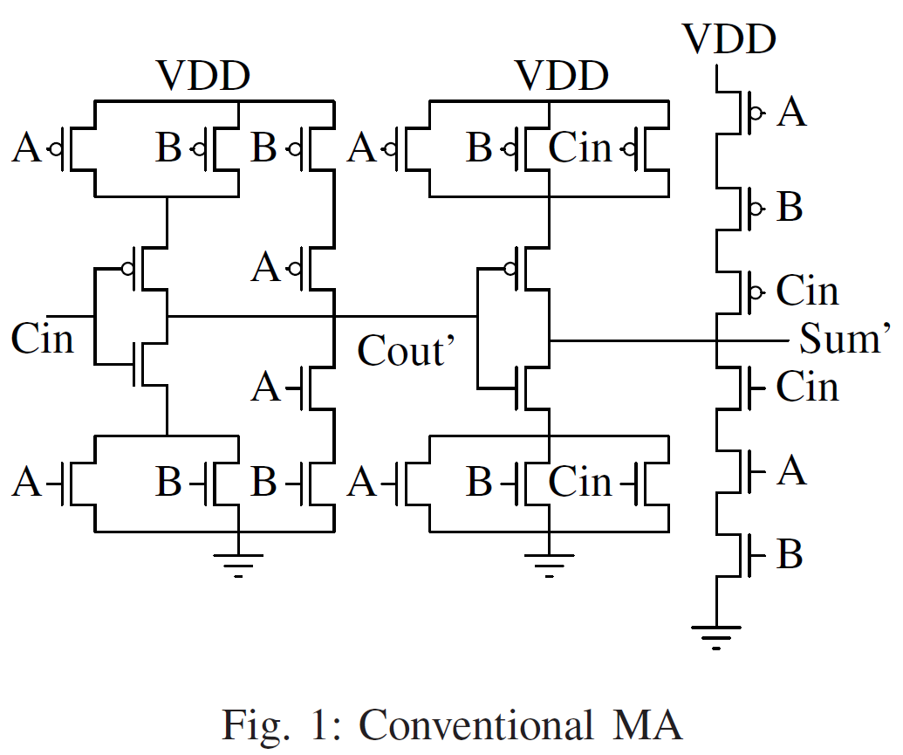
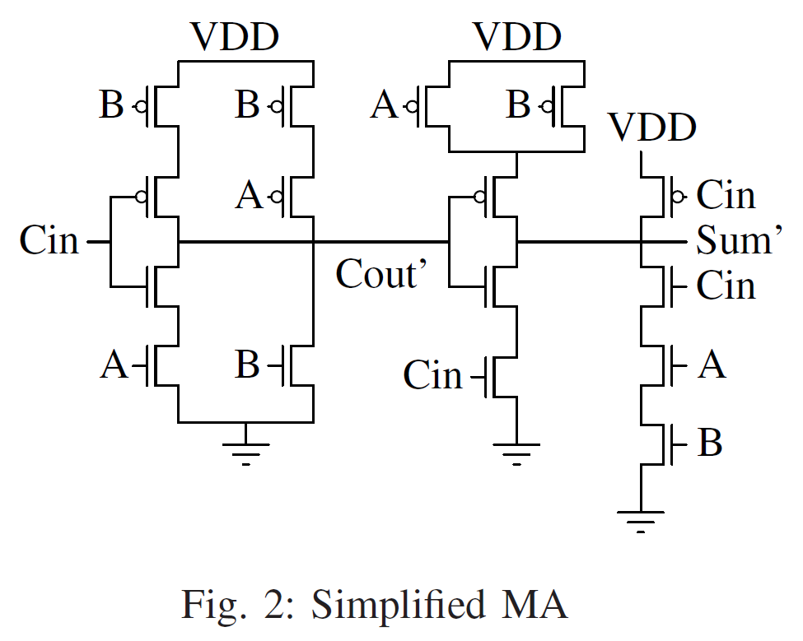
Conventional Mirror Adder VS Approx. 1
Notes:
Different approximate versions of the MA with lesser number of transistors.
Since series connected transistors contribute to larger delay, removal of some of them will facilitate faster charging/discharging of node capacitances.
Removal of transistors will reducing the switched capacitance which will lower power dissipation and reduce the area used.
Remove transistors once by one while ensuring there are no shirt or open circuits in the simplified schematic
They also wanted to have minimal errors in the truth table
This led to the figure on the right where there are 8 less transistors

Slide 5
Approx. 1 Truth Table

Slide 6
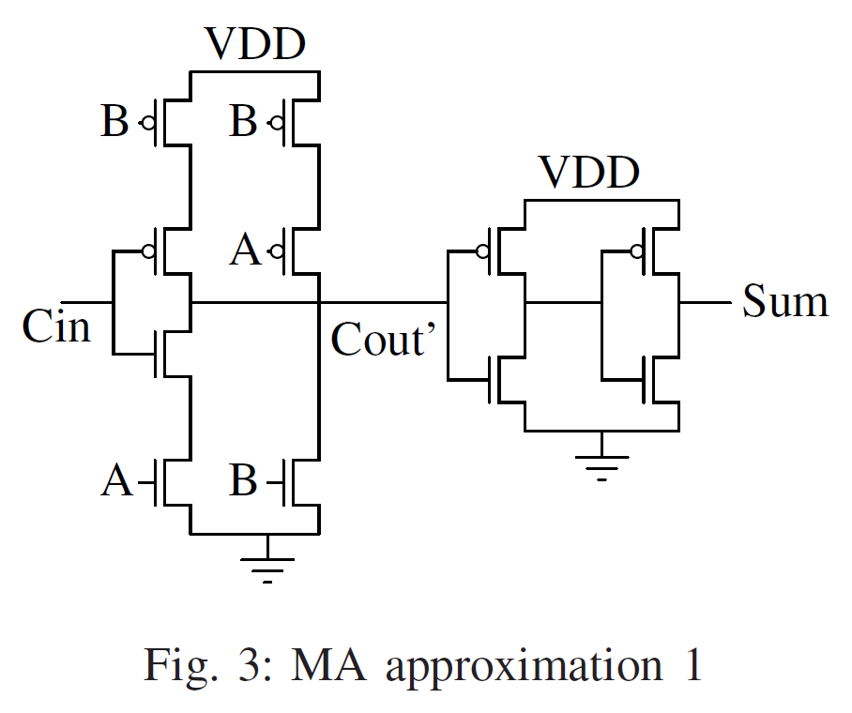
OG Mirror Adder VS Approx. 2
Notes:
In the second approximation, they examined the previous simplified mirror adder’s truth table and found that A and B are interchangeable, so they used an inverter with input A to calculate C out while the Sum is still calculated like the simplified mirror adder.

Slide 7
Approx. 2 Truth Table

Slide 8
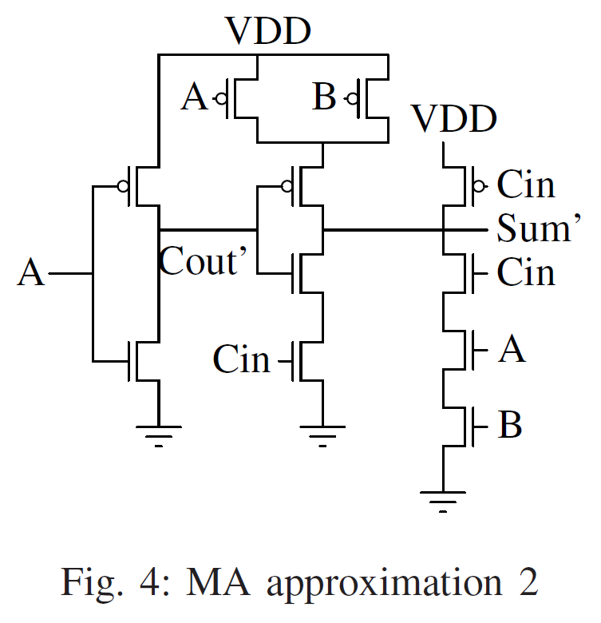
OG Mirror Adder VS Approx. 3
Notes:
They take the previous iteration and allow for one more error, specifically, in the sum because they wanted to reduce the dependency of sum of C in to save area.
This led to them setting the Sum equal to B and C Out to A, which gave accurate outputs in 4 out of 8 cases. They wanted to ensure that for a particular input combination of A, B, and C in, that ensuring the correctness of the sum will also make C out correct.

Slide 9
Approx. 3 Truth Table

Slide 10
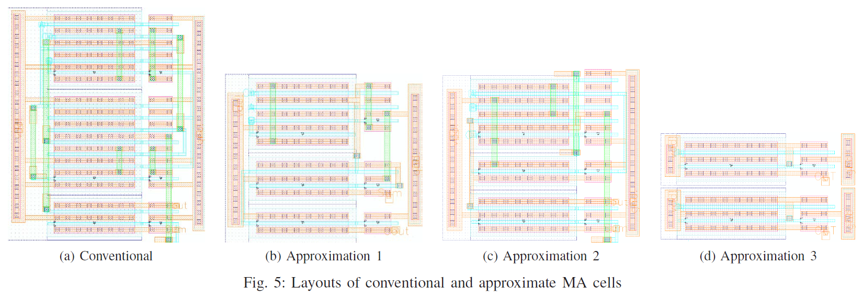
Area of Approximate MA Cells
Notes:
A reduction in load capacitances is the crux of the proposed approximations, offering an appreciable reduction in propagation delay and providing an opportunity for operating at a lower supply voltage than the conventional case.

Slide 11
Application to DSP Systems: Image Compression
Discrete Cosine Transform (DCT) & Inverse Discrete Cosine Transform (IDCT) are integral components of JPEG image compression
Experiments:
Using approximate FA cells beyond the 9th LSB results in an appreciable quality loss
Approximate FA cells for 7, 8, and 9 LSB
FA cells corresponding to other bits in each case are accurate
Used truncation as another case
Design used accurate adders as the base case
Notes:
most DSP algorithms used in multimedia systems have inherent error-resiliency, these occasional errors might not manifest as an appreciable reduction in the final output quality. Multimedia DSP algorithms mostly consist of additions and multiplications, which use adders as basic building blocks. We focus on two algorithms, viz. image and video compression, and present the results of using our approximate FA cells in these algorithms

Slide 12
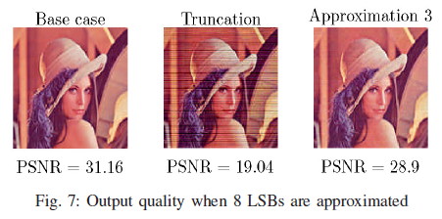
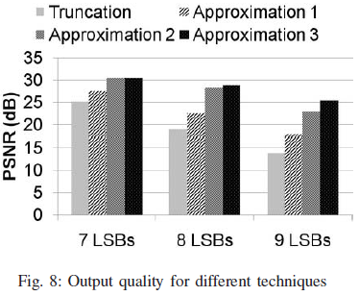
Application to DSP Systems: Image Compression Results
Peak Signal to Noise Ratio (PSNR)
Output Quality
Notes:
Error in truncating has blockiness
Using approximation FAs in the LSBs can make up for lost quality

Slide 13
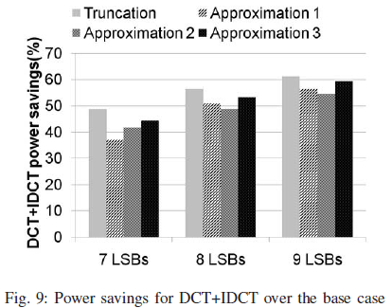
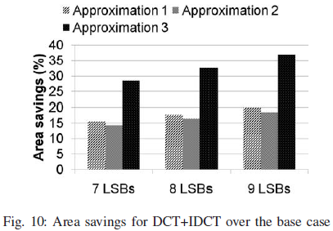
Application to DSP Systems: Image Compression Results
Power Consumption
Area Savings
Notes:
-

Slide 14
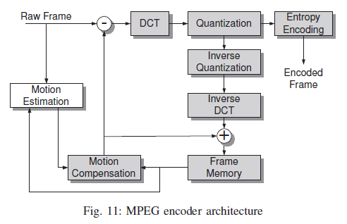
Application to DSP Systems: Video Compression
Motion Estimation (ME) hardware accounts for ~70% of total power consumption
Implemented using Sum of Absolute Difference (SAD)
MPEG
International standard for encoding
and compressing video images

Slide 15
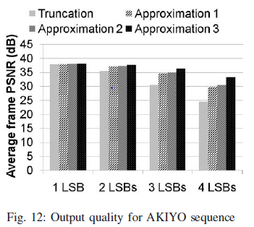
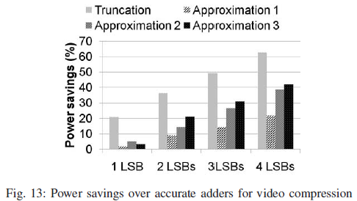
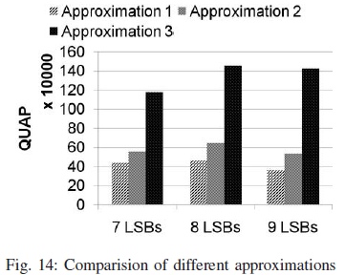
Application to DSP Systems: Video Compression Results
Output Quality
Power Saving
QUAP
Note: QUAP (Quality X Area savings (%) X Power savings (%))
Notes:
Figure 12 shows the average frame PSNR for 50 frames of the AKIYO benchmark CIF [17] video sequence.

Slide 16
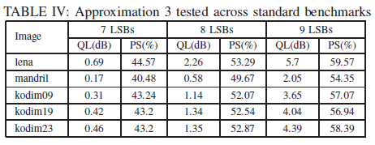
Conclusion
Proposed approximate FA cells can be utilized to build multi-bit arithmetic units and trade off power, area, and quality for error-resilient DSP systems
Reduced complexity of MA cell by reducing transistor & load capacitance
Impact on quality is negliable

Slide 17
Questions
What does are the trade-offs of truncation?
Low output quality, low power (Ans)
High output quality, low power
Low output quality, high power
High output quality, high power
Select the techniques that are based on Voltage Over-Scaling (VOS)?
Algorithmic Noise Tolerance (ANT) (Ans)
Significance Driven Computation (SDC) (Ans)
Discrete Cosine Transform (DCT)
Inverse Discrete Cosine Transform (IDCT)
Simplified Mirror Adder (SMA)

Slide 18
Questions
In the paper, “IMPACT: IMPrecise adders for low-power Approximate CompuTing,” why were bits past the 9th LSB not approximated?
Using approximate FA cells beyond the 9th LSB resulted in appreciable quality loss
Approximate FA cells could not support beyond the 9th LSB
DSP applications do not need to consider beyond the 9th LSB
Using accurate FA cells for the MSB was already enough

