Slide 1
Probabilistic Accuracy Bounds for Fault­-Tolerant Computations that Discard Tasks
Authored by: Martin Rinard
Presented by: Nick Poindexter & Trung Tran

Slide 2
Context/Background
Standard program execution platforms would deny uses access to outputs if an error propagated and caused the whole computation to fail
New approach to handle errors:
Developer starts with standard programming language such as C or Java
Use metalanguage (Jade metalanguage) to partition the computation into tasks
Discard task when it encounters a software or hardware fault
Completes computation by running remaining tasks
New technique for enabling computations to survive errors and faults while providing bounds on resulting output distortion

Slide 3
Approach
1. Task Decomposition:
Use metalanguage to identify task blocks
2. Baseline:
Obtain inputs for program to generate correct results
3. Critical Testing
Configure execution to randomly fail execution of selected task block at target failure rates
Mark task blocks as critical or failable
4. Distortion Model
Record observed failure rates and the resulting output distortion
5. Timing Model
Each trial records the execution time of program

Slide 4
Potential Uses
Hardware Faults
Tolerating partial failures within a distributed computing platform hosting a distributed (and potentially parallel) execution of the program
Software Errors
consciously exploit the technique by purposefully omitting complex code otherwise required to handle rare special cases
Reducing Computation Time and Resources
Optimally fail tasks to obtain maximum execution time while minimizing resulting output distortion output
Assumptions and Fault Model

Slide 5
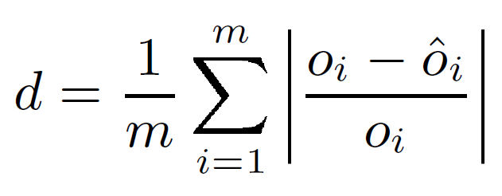
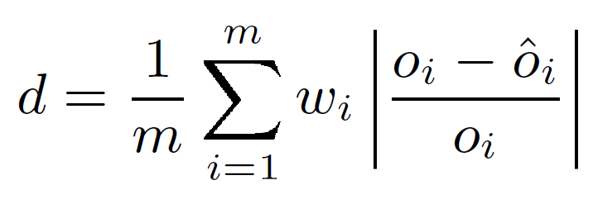
Methodology
Only programs that produce output of the form O₁,…, O_{i} where O_{i} is a number
d is the distortion, measures accuracy of observed result
closer the d is to zero, the less the failures distorts the output
w_{i} is set of weights to generalize distortion whose outputs are not equally important

Slide 6
Methodology Cont.
Experimental testing to differentiate between critical and failable task blocks
Some blocks must always execute without failures to produce acceptable results
Characterize effect that failable blocks have on the acceptability of outputs
Script to run execution of program with test input and pseudo-random number generator to select target failure rates
Collected data and computed the distortion and timing models

Slide 7
Methodology Cont.
Distortion Model
Timing Model
Used multiple linear regression to compute a linear least-squared distortion model
Produces F value that assesses how well the model predicts the data
R² value that indicates how much variation in the data the model accounts for
Produce confidence interval for specific failure rate space
95% confidence interval
Observed running times of execution to capture effect of failures on running time
Useful for calculating time/accuracy trade-offs
Obtains scaled time observation (s = t²/t) for each execution to compare
Purposefully fails task to move the execution towards a more desirable point in trade-off space

Slide 8
Using the Distortion Model
Allow user to obtain estimate of how failures affected the accuracy of the results
Take observed failure rates and apply distortion model to obtain an estimated distortion along with its associated confidence interval
Distortion:
Examine model coefficients, the smaller the coefficients, the less the results are affected by failures of the corresponding task block
Bounds:
Both the distortion estimate and the upper confidence interval must be small enough to make the likelihood that an unacceptably large actual distortion has occurred remote enough for the user to accept
Predictive Power:
Separated learning inputs and unseen inputs to train and test derived models
Notes:
Distortion: How quickly does the distortion grow as a function
of the task block failure rates?
Bounds: How small are the confidence intervals?

Slide 9
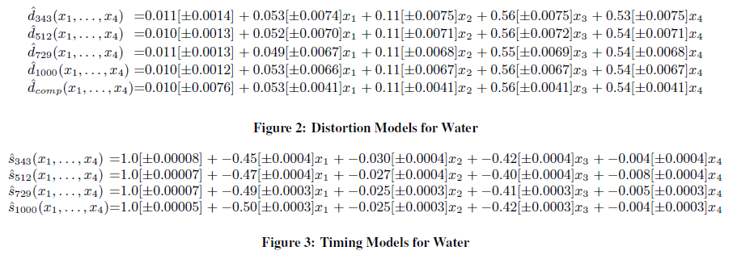
Experimental Results: Water
Water evaluates forces and potentials in a system of water molecules in the liquid state
Notes:
Note that the models are close to identical for all of the different
inputs, which (because the models are linear) indicates that the
models do not depend on the input to the program. It should therefore
be feasible to use models developed from one set of inputs to
predict distortions for other inputs.
The coefcients are relatively large, which indicates that the distortion
increases relatively quickly in the face of failures.
At a high level, Water essentially computes sums of positive
numbers. The net effect of failing tasks is to remove some of the
positive numbers from the sums.

Slide 10
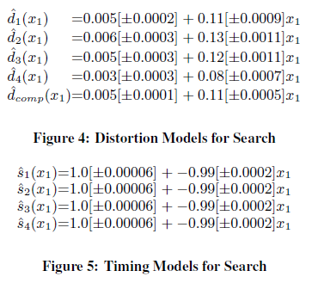
Experimental Results: Search
Search is a program from the Stanford Electrical Engineering department that uses Monte-Carlo technique to simulate the elastic scattering of each electron from electron beam into solid
Notes:
The coefcient c1 is relatively small, which indicates that the distortion increases relatively slowly as that task fails.
The program is therefore relatively resilient to failures.
Note that the models are close for all of the different inputs, which (because the models are linear) indicates that the models are largely independent of the input to the program. It should therefore be feasible to use models developed from one set of inputs to predict distortions for other inputs.
At a high level, the tasks in Search essentially sample a population
of electron paths. The net effect of failing a task is to discard
the samples that the task would have performed. The net effect
of performing fewer samples is that the resulting estimate of the
property of interest in the population may be somewhat less accurate.

Slide 11
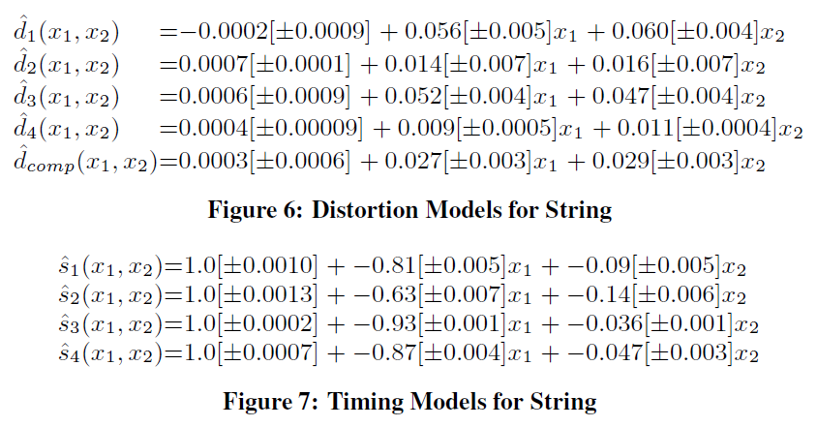
Experimental Results: String
String uses seismic travel-time inversion to construct a two-dimensional discrete velocity model of the geological medium between two oil wells
Notes:
At a high level, the failable tasks in String either sample a population
of rays projected through the velocity model of the geology
between two oil wells or combine the results of this sampling process.
Task failures therefore have the effect of discarding projected
rays. Because the combination operator averages the contributions,
there is no bias and failures have little effect on the accuracy of the
nal computation.

Slide 12
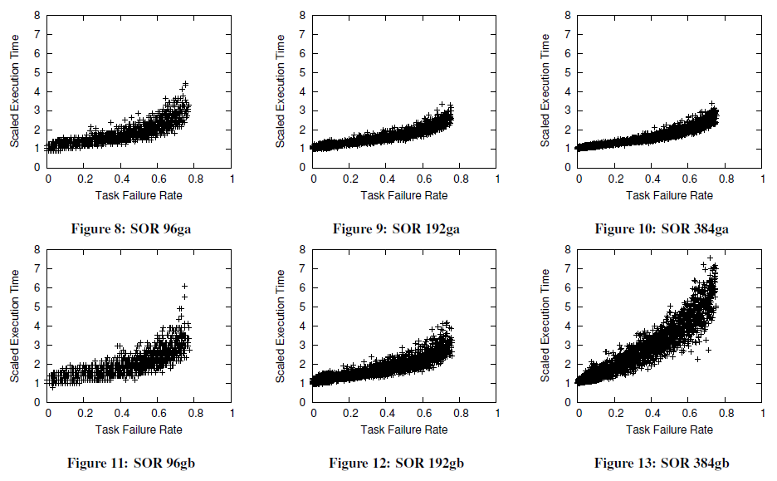
Experimental Results: SOR
SOR uses iterative method to solve a set of spatial partial differential equations
Inputs are taken from SPLASH benchmark Ocean, simulates role of boundary currents’ influence on large-scale ocean movement
Notes:
One of the benefits of our approach is that it can identify critical
parts of the computation whose failures have a large effect on
the accuracy of the result. The clear pattern that emerges is that
tasks that move or copy data are critical . if they fail, the downstream computation that reads the data is usually unable to generate an acceptable output because its input diverges significantly from the correct input.
Tasks that create data structures are even more
critical a program that attempts to access an incompletely constructed data structure usually fails because of an addressing exception and is unable to produce any result at all. We expect this
pattern to also hold for different programs.

Slide 13
Conclusion
Alternative approach to terminating error or failure computation
Tasks with fault containment mechanism
Execution platform discards faulty task and continues with remaining tasks
Probabilistic distortion model
Bounds the resulting distortion in the output
Probabilistic timing model
Enables user to predict the effect on the overall execution time of the computation
Allows user to quantitatively evaluate the effect of any failures on the accuracy of the output
Give users confidence in their results
Make techniques that discard tasks when encountering faults more acceptable
Will increase reliability and robustness of corresponding computations

