Slide 1
REACT:
A Framework for Rapid Exploration of Approximate Computing Techniques
By: Mark Wyse, Andre Baixo, Thierry Moreau, Bill Zorn, James Bornholt, Adrian Sampson,
Luis Ceze, Mark Oskin
Presented By: Tim Dwyer

Slide 2
Motivation/What is Being Solved?
“… but accurately estimating these quality-efficiency trade-offs requires significant effort for both researchers and practitioners.”
Time/cost constraints on validating approximate computing techniques in developmental stage:
Approx. hardware often modeled with power modeling tools
Approx. software often rewritten or manually error injected

Slide 3
Framework/How is it Being Solved?
“We propose REACT, a modeling framework allowing quick and accurate exploration of the efficiency–accuracy trade-off created by approximate computing.”
Consists of:
Custom application profiler
Linear energy model
User-directed error injection quality model

Slide 4
What Are We Looking For?
Type of approximation? Multiple, room for non-conceived methods
Approximation strategy? Rapid evaluation of multiple approximation strategies
How is it done? Application profiling, energy modeling, error injection
What is being approximated? Instructions and Functions*
How to determine what to approximate? User defined
How much approximation is acceptable? User defined
What applications are being targeted? User defined

Slide 5
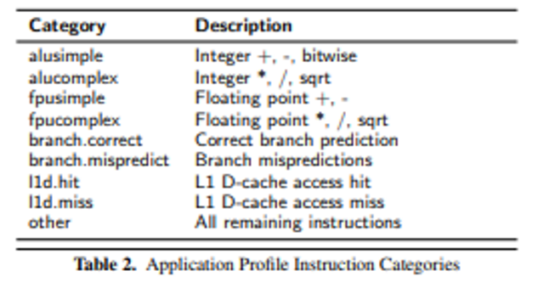
Application Profiling
“…the profiler simulates a tournament-style branch predictor and multi-level data cache hierarchy.”
Implemented within Intel’s Pin [7] framework
Groups instructions into categories for energy model
Profiling data aggregated at function level

Slide 6
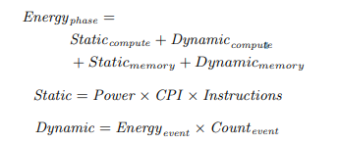
Energy Modeling
“REACT uses a simplified linear energy model to estimate the total energy consumption of an application’s execution”
Captures dynamic cost of architectural & micro-architectural events
Captures static cost of architectural structures
Inputs: application profile, energy models, and architectural parameters
Outputs: precise and approximate energy totals

Slide 7
Fine-Grained Approximations
“Fine-grained approximation techniques operate at the event level, replacing individual operations with approximate versions.”
Modifies one or more architectural parameter of baseline system.
Ex: model reduces the energy consumption of integer arithmetic operations to model approximate arithmetic instructions
Energy cost is computed in the same way as baseline cost, but using appropriately modified architectural parameters
Multiple orthogonal fine-grain approximations can be collected into a set of modified parameters

Slide 8
Coarse-Grained Approximations
“Coarse-grained approximation techniques replace entire application phases with approximate implementations.”
Phases restricted to functions
1. Compute precise baseline, then scale each term affected by coarse approximation by user-specified factor.
2. Prorates static cost according to speed variations introduced by the approximation technique
3. Technique specific dynamic invocation and static costs introduced:
Dynamic invocation: (number of invocations) x (per-invocation cost)
Static cost: (power) x (C.P.I) x (Instructions)

Slide 9
Energy Model Validation
“REACT employs a custom linear energy model to estimate the energy savings available through approximation.”
REACT trades-off the accuracy of existing energy and power modeling tools for the rapid exploration of techniques by focusing on first-order concerns
Average energy error of 0.87% (0.31% – 1.38%) when compared to McPAT power modeling framework

Slide 10
Quality Modeling
“REACT performs quality modeling via user-directed error injection.”
Extends ACCEPT compiler framework
Errors injected at two granularities: Fine and Coarse
Fine: error injected after each instruction
Values are marked as approximate or precise
When compiled w/ ACCECPT, instructions marked as approximate & intercepted with a hook to a user-defined error injection routine
Error routine invoked at runtime

Slide 11
Quality Modeling
Coarse: error injected on output of functions
Injection routine modifies the outputs of a function
Should be representative of the respective approximation technique used
ACCEPT imposes no restrictions on type of error introduced
Ex: when evaluating neural acceleration, user may decide to evaluate a neural network or instead sample a probability distribution that produces a similar quality degradation

Slide 12
Taxonomy of Approximations
“… we select only a few techniques found in literature, although our current taxonomy is much larger and continues to grow.”
Taxonomies may be examined from other dimensions including determinism, hardware versus software, computational resources affected, and granularity

Slide 13
Questions?

Slide 14
Exam Questions
What is one major problem for engineers/developers when exploring multiple approximation techniques?
A. Abundance of positive experimental results to draw conclusions from
B. Cost/time constraints to explore each technique
C. Incompatible hardware/software
D. Destroying hardware

