Slide 1
Quality of Service Profiling
By: Sasa Misailovic, Stelios Sidiroglou, Henry Hoffmann, Martin Rinard
Presented By: Marco A. Kalnay

Slide 2
Definitions
Loop Perforation: Transforming loops to only execute a subset of their iterations.
Quality of Service: the description or measurement of the overall performance of a service.

Slide 3
Paper Summary
Problem: Performance optimization is important in software engineering. Profilers are generally used to assist in the optimization of computations and sub-computations. However, existing profilers address the only the performance side of the trade off.
Solution: to present “a new quality of service profiler that is designed to help developers identify promising optimization opportunities in such computations.” This profiler considers sub-computations that:
1) increase performance,
2) may produce a different result , but
3) still maintain acceptable quality of service.

Slide 4
How the Profiler deals with Loop Perforations
The goals is to reduce the number of loop iterations, so to perform less computational work, which may improve performance of the computation. However, a different result may be produced.
The profiler first goes though each individual loop (that takes up a significant amount of time), determines which ones can be perforated and perforates the loop and records the results of the perforation individually.
Critical Loops are ignored.
The profiler then “explores potential interactions between perforated loops” and based off a quality of service requirement and goes through the possible solution space.
Current algorithm uses cost/benefit analysis of performance and quality of service.

Slide 5
Quality of Service in the Profiler
To measure the results of the loop perforations, an output of the original application is compared to the output of the perforated loop application and the difference is measured by a non-negative number. Zero means no difference, while a large number means a large difference.
Closer d is to zero the less the perforations distorts the output. d measure the absolute error that loop perforation induces.
By default, the equation weighs each component equally, but it is possible to modify the weight.
d = distortion
o = unmodified execution
o(hat) = perforated
execution

Slide 6
Loop Perforation
Implemented as an LLVM compiler pass and written in C/C++ code.
However, can be written is an language for which an LLVM front end exists.
The perforation rate (r) determines the percentage of iterations that the perforated loop skips.
Modulo perforation transforms the loop to perform every nth iteration.
All of the experimental results in this paper use modulo perforation with an n of 2 and a perforation rate of ½.
Original loop
Perforated loop

Slide 7
General Results
The author’s results show that by using loop perforations a benchmark (PARSEC benchmarks) performance can be increased by a factor of two or three, while only incurring a lose of less than 10%.
Loops that saw the most improvement were loops that “performed redundant sub-computations in heuristic searches over a complicated search space.”
The authors do note that not all loop perforation will produce positive results sometime it can cause a degradation of results or fail to make any improvements.
Computations with “hard logical correctness and long dependence chains” are not optimal for loop perforations.

Slide 8
Benchmarks used (PARSEC)
X264: performs Media application performs H.264 encoding on a video stream
Streamcluster: Data mining application that solves the online clustering problem
Perforated loop version can potential perform better than the unmodified version.
Swaptions: Financial analysis application using Monte-Carlo
Cannel: Engineering application using simulated annealing
Blackscholes: Financial analysis application
Bodytracking: Computer vision application to track the movement of a human
Ferret: Search application performs content-based similarity search on an image database.

Slide 9
How to read the tables
First Column (Function): Name of the function
Second Column (Instruction %): the percentage of the (dynamically executed) instructions in the loop for the profiling run. Percentages can go over 100% because of both interprocedural and intraprocedural loop nesting.
Third Column(Quality of Service): Ex 0.5 = 50% difference between perforated and original output. “-” means crash or unacceptable output.
Fourth Column(Speedup): Greater than 1 = speedup compared to the original application. Less than 1 slower than original application.

Slide 10
Results
For Quality of Service, smaller is better
For Speedup, larger is better
Multiple loop profiling results using 0.1 quality of service bound.

Slide 11
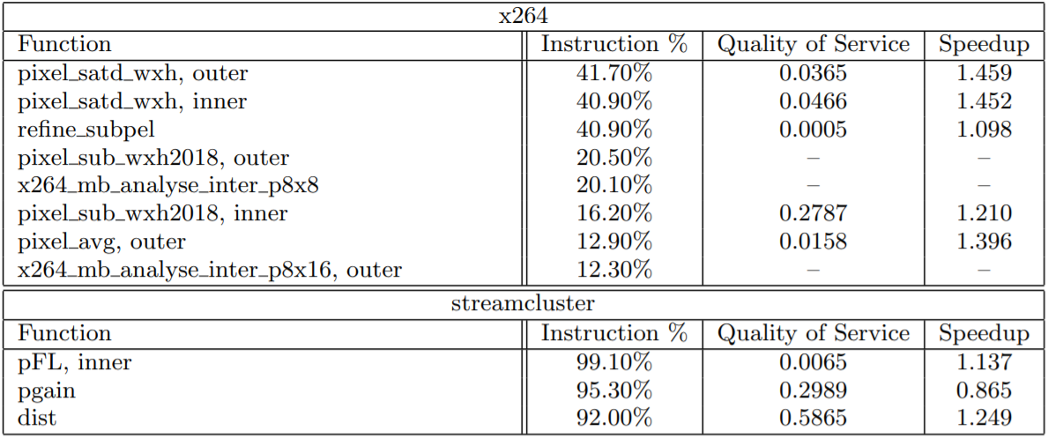
Results: Single loop profiling results

Slide 12
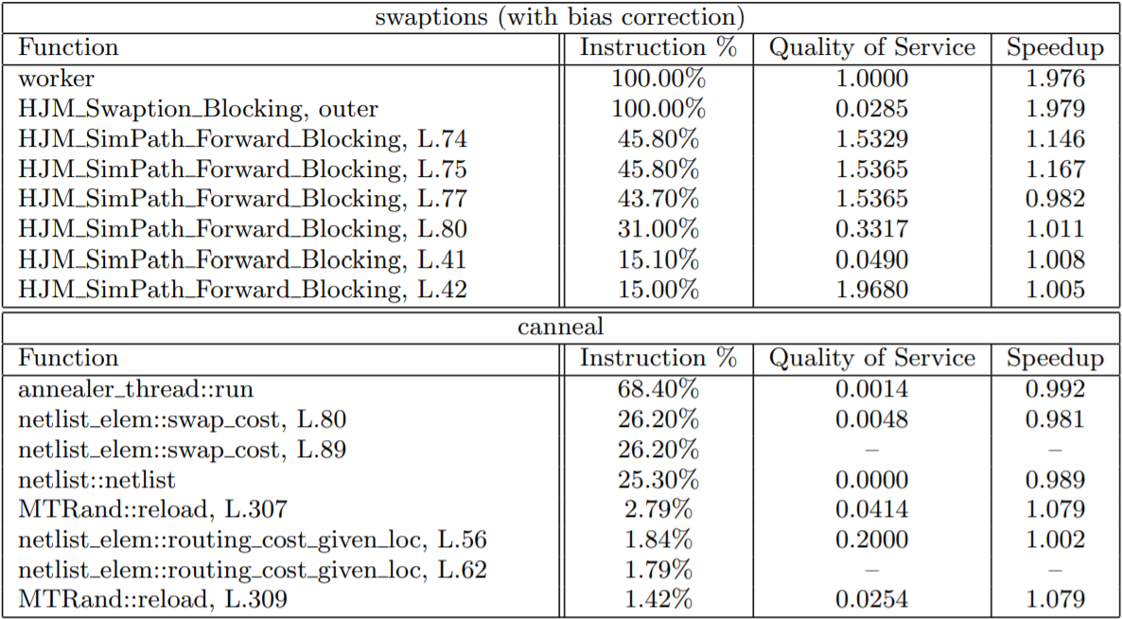
Results: Single loop profiling results

Slide 13
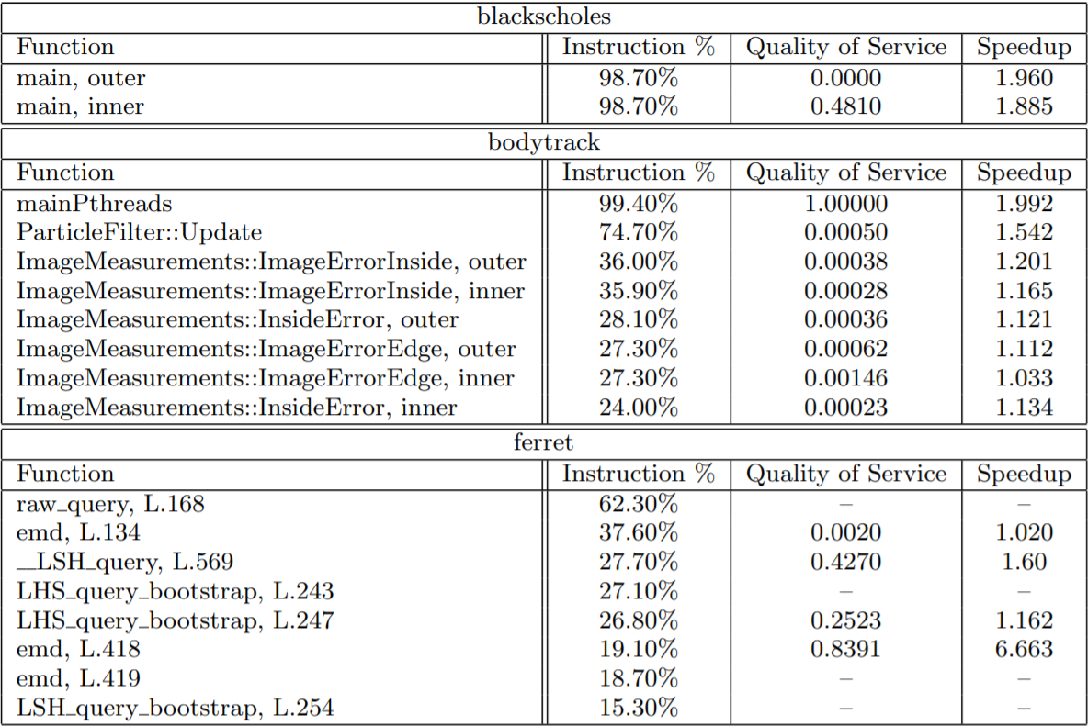
Results: Single loop profiling results

Slide 14
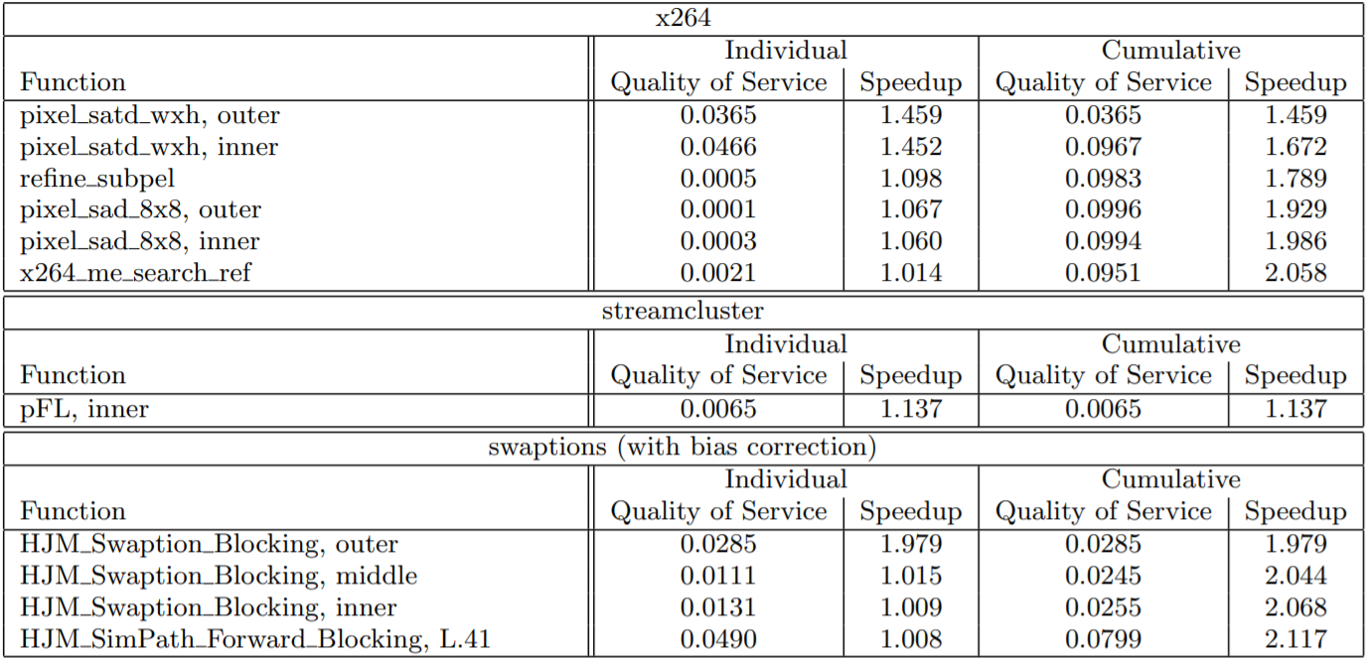
Results: Multiple loop profiling results

Slide 15
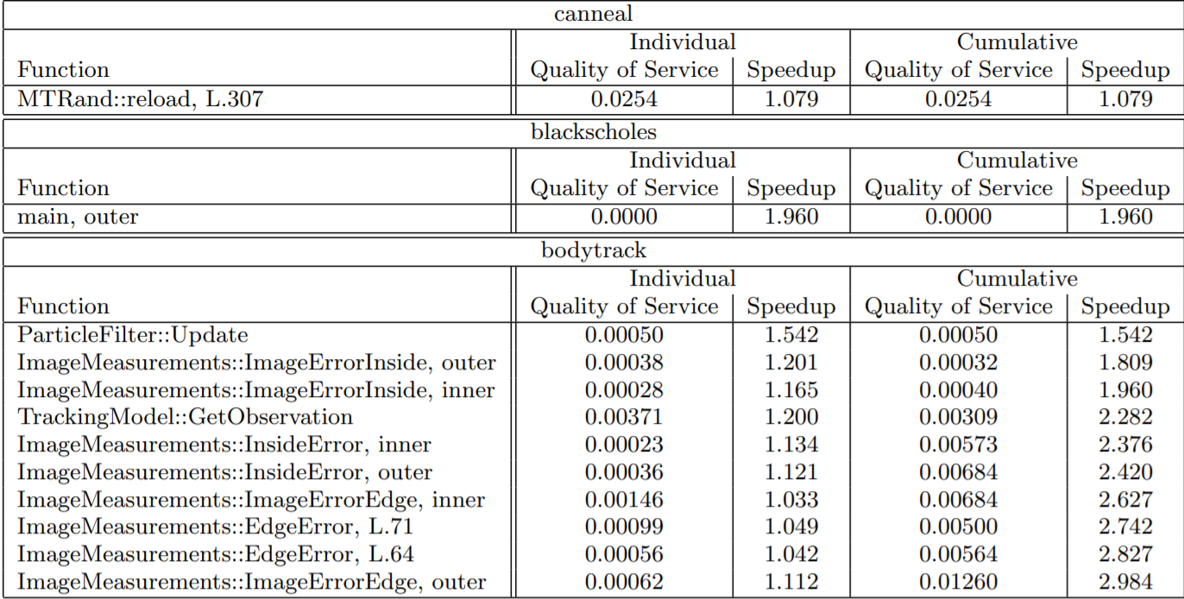
Results: Multiple loop profiling results

Slide 16
Results: Multiple loop profiling results

Slide 17
Questions

Slide 18
Question 1
What loops gain the most benefits from perfortation?
A) All loops
B) Loops that performed redundant sub-computations in heuristic searches over a complicated search space.
C) Loops with little computations inside of them.
D) loops with hard logical correctness and long dependence chains

Slide 19
Question 2
What is an issue with current profiler used by programers?
A) They only focus on performance end.
B) They only focus on quality of service end.
C) They are no issues with current profilers
D) They focus both on performance and quality of service.

Slide 20
Question 3
Perforated loops will always gain these benefits?
A) Quality of Service
B) Speedup
C) Both A) and B)
D) None of the above

