Slide 1
Neural Acceleration for General-Purpose Approximate Programs
Hadi Esmaeilzadeh, Adrian Sampson, Luis Ceze, Doug Burger
Powerpoint by John Morin

Slide 2
Overview
Objective: Decrease time and power consumption of code using neural net processors while preserving acceptable accuracy
Approximation type: Neural Acceleration
Parties involved: Programmer, Compiler, NPUs
Strategy: Programmer marks code for approximation, compiler converts it into NPU friendly code, then NPU trains and performs calculations

Slide 3
Refresher on neural nets

Slide 4
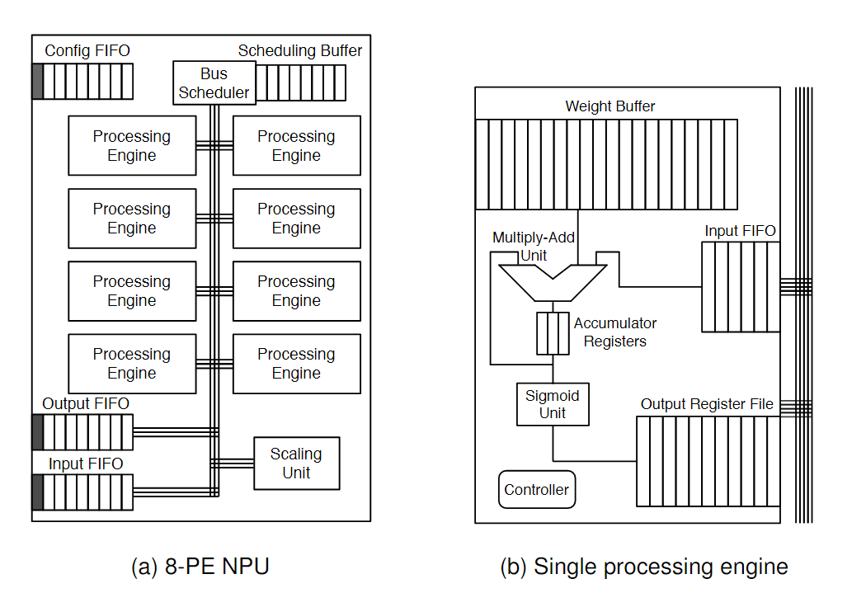
Elaboration on NPUs
Designed specifically to deal with neural nets
Neurons are assigned individually to a PE
Each PE is used to evaluate individual multiply accumulate operations

Slide 5
3 phases
Programming
Compiling
Execution

Slide 6
Programming – Code Criteria
“Hot” Code
Used frequently
Approximation friendly
No memory management
Well-defined inputs and outputs
No dynamic structures

Slide 7
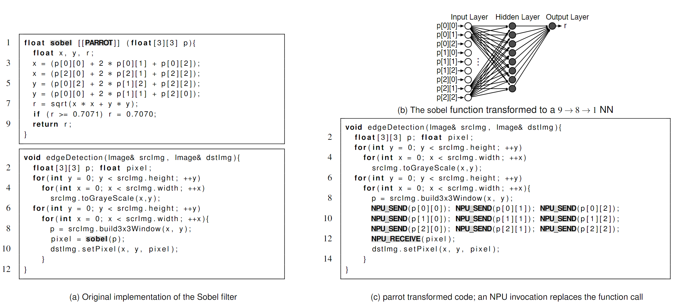
Programming – Annotation
Up to Programmer’s discretion
Place [[PARROT]] on desired function
Compiler then replaces function with NPU specific code

Slide 8
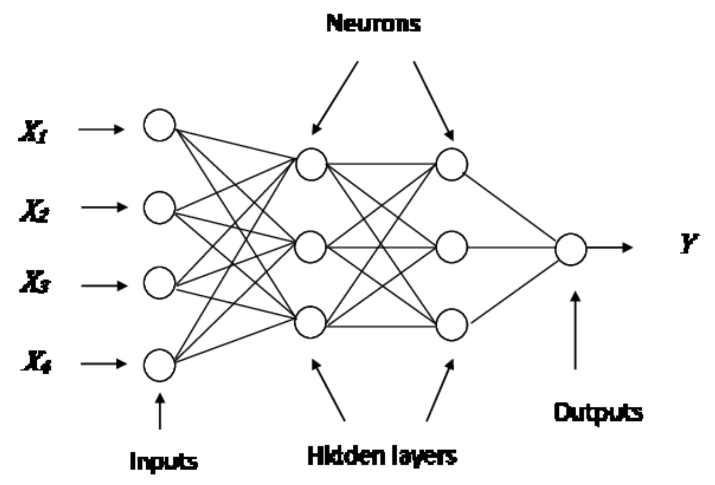
Compiling – Training (Weights/Biases)
Performed on traditional Multi-Layered Perceptron (MLP)
Generally requires 5000 epochs (complete pass over data) to achieve sufficient accuracy and generalization
Weights and biases determined in the training phase

Slide 9
Compiling – Topology selection
Hidden layer structure of the MLP must be determined
Larger networks typically provide higher accuracy but worse speed and energy consumption
Tests performance of various combinations for optimal compromise
Number of neurons per layer increase in powers of two
Max limit of 32 neurons per layer and 2 hidden layers – 30 total combinations

Slide 10
Execution – Architecture
Three FIFOs: Input, Output, Config
Configuration FIFO determines the neuron assignments to PEs
Scheduling buffer either sends Input data to PE or PE data to Output

Slide 11
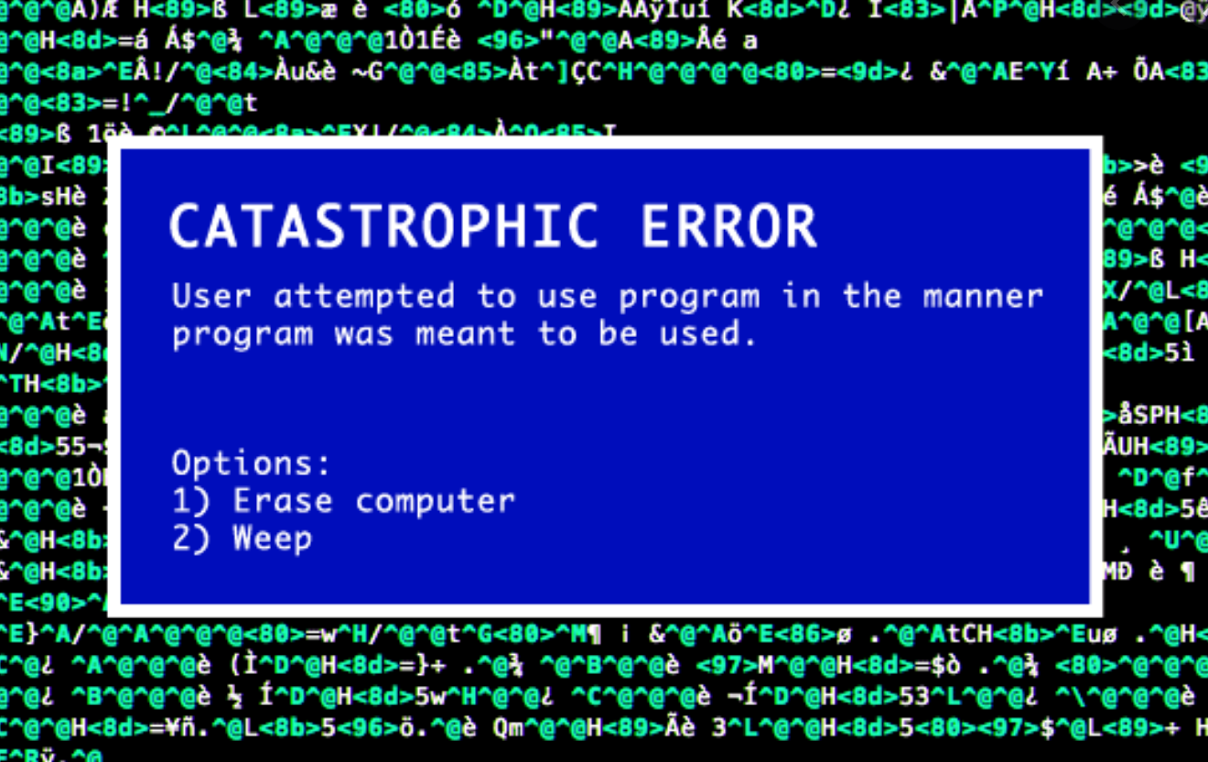
Execution – Interruptions
Calling of NPU can not be interrupted, otherwise NPU will be flushed / reset
Interrupts and Context Switches should be disabled during this period

Slide 12
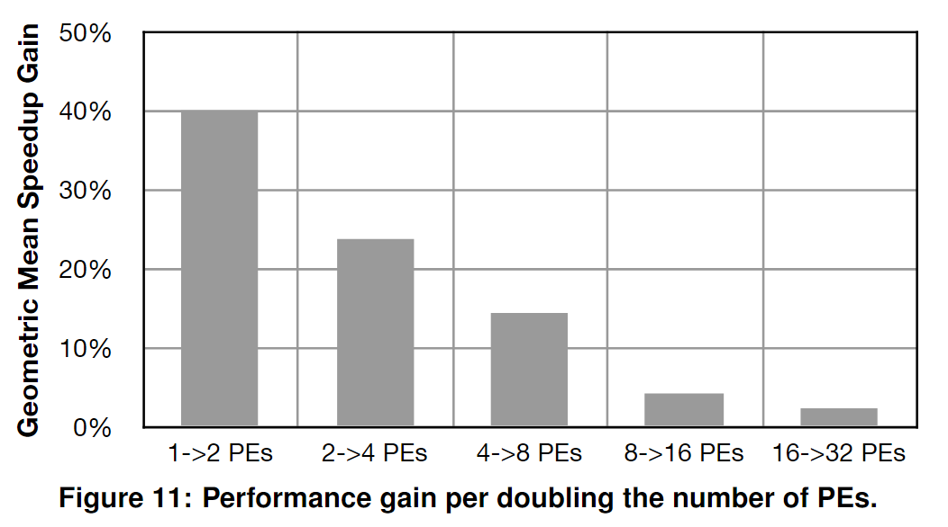
Deciding Number of processing engines
Multiple is better but have diminishing returns
Not worth increased complexity after 8

Slide 13
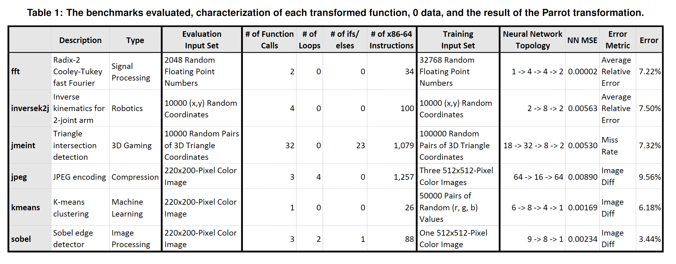
Evaluation
Tested on wide variety of applications
Average error <10% but sometimes as individually high as 80%

Slide 14
Possible Issue
Only trained on a single image – Possible Overfitting

Slide 15
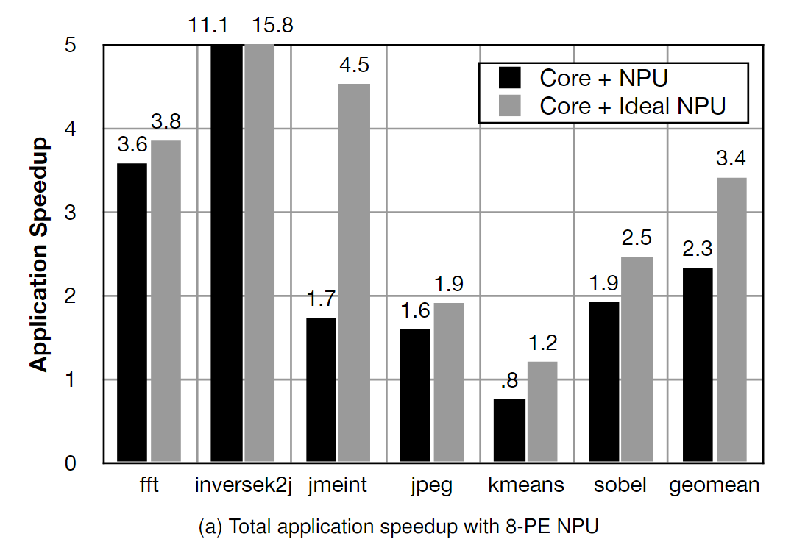
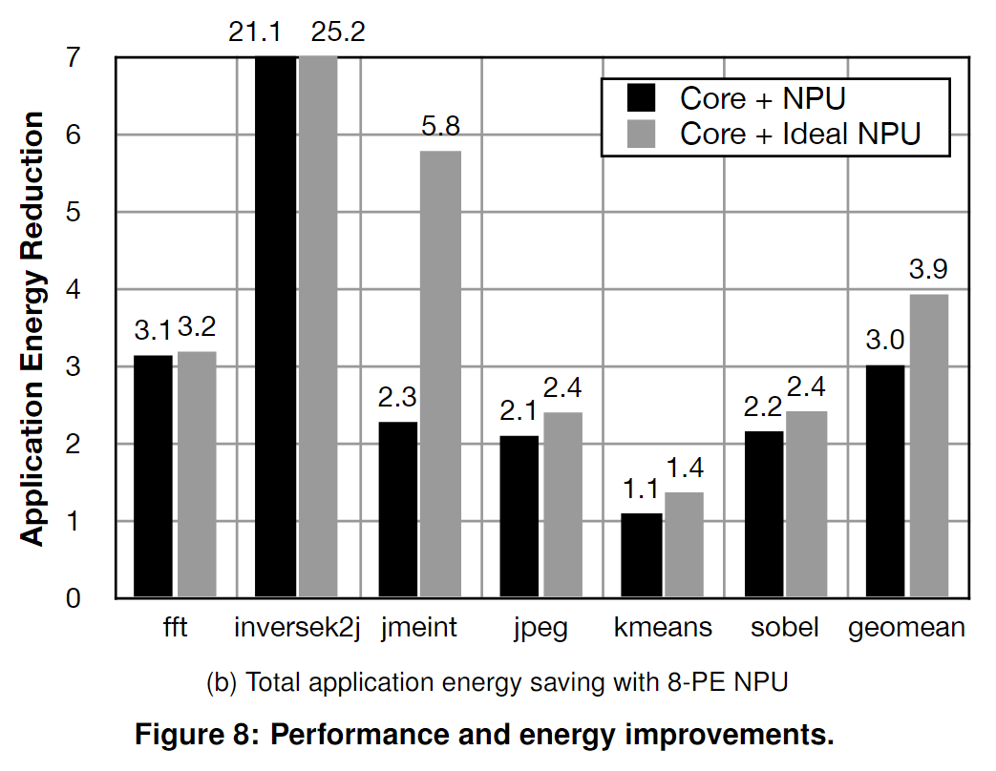
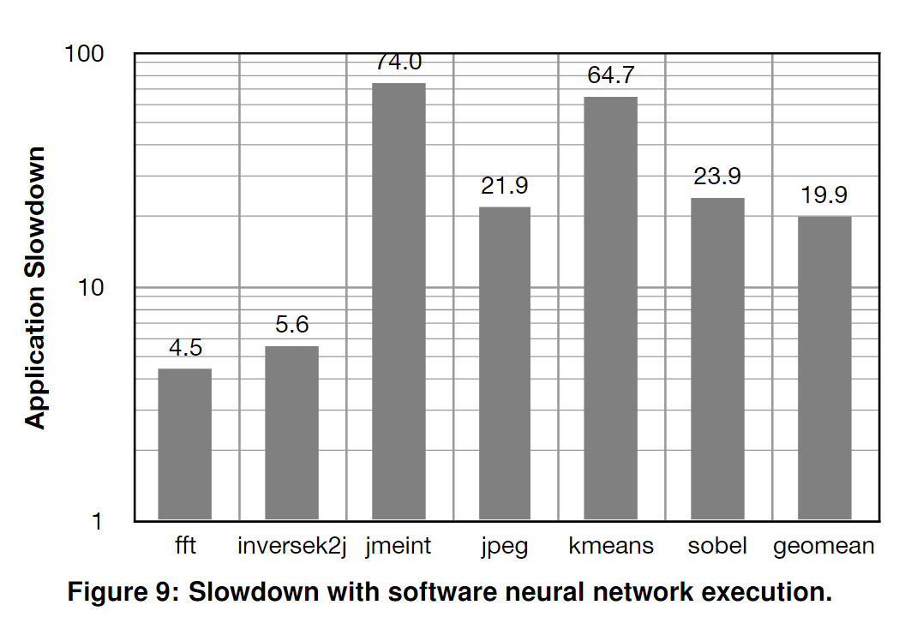
Results
Ideal NPU represents an NPU simulators prediction of outcome
Average speedup was 2.3x baseline
Average energy saved was 3x baseline
Slowed down significantly compared to baseline when using a regular CPU-NN

Slide 16
Limitations / Possible Improvements
Applicability
Not all code can be approximate
Programmer Effort
Could be inconveniently large programs
Quality and Error Control
Possible worst-case scenarios of >80% error

Slide 17
Sample Questions
What is the core processing unit used to compute neural nets?
GPU
NPU
CPU
What two aspects of the NPU is the compiler in charge of configuring to maximize performance?
Weights/Biases and Node Topology
Clock latency and Neural Net Area
Set-up times and Hold times
Code Selection and Number of PEs used
Which is NOT a criteria for selecting a function to be approximated?
“Hot” code
Complex functionality
Well-defined inputs and outputs
Error Tolerant

Slide 18
Sample Questions
What is the core processing unit used to compute neural nets?
GPU
NPU
CPU
What two aspects of the NPU is the compiler in charge of configuring to maximize performance?
Weights/Biases and Node Topology
Clock latency and Neural Net Area
Set-up times and Hold times
Code Selection and Number of PEs used
Which is NOT a criteria for selecting a function to be approximated?
“Hot” code
Complex functionality
Well-defined inputs and outputs
Error Tolerant

Slide 19
Questions?

