Slide 1
IncApprox: A Data Analytics System for Incremental Approximate Computing
By: Dhanya R Krishnan, Do Le Quoc, Pramod Bhatotia, Christof Fetzer, Rodrigo Rodrigues, TU DRESDEN, GERMANY
Presented by: Rabin Acharya, TOmasz Wiercioch
Notes:
Rabin: Intro, Design, Implementation, Discussion
Tomasz: Overview, Evaluation, Conclusion

Slide 2
Introduction
Incremental and approximate computations used increasingly for data analytics systems such as Twitter Analytics, and Network Traffic Monitoring to achieve:
low-latency execution
efficient resource utilization.

Slide 3
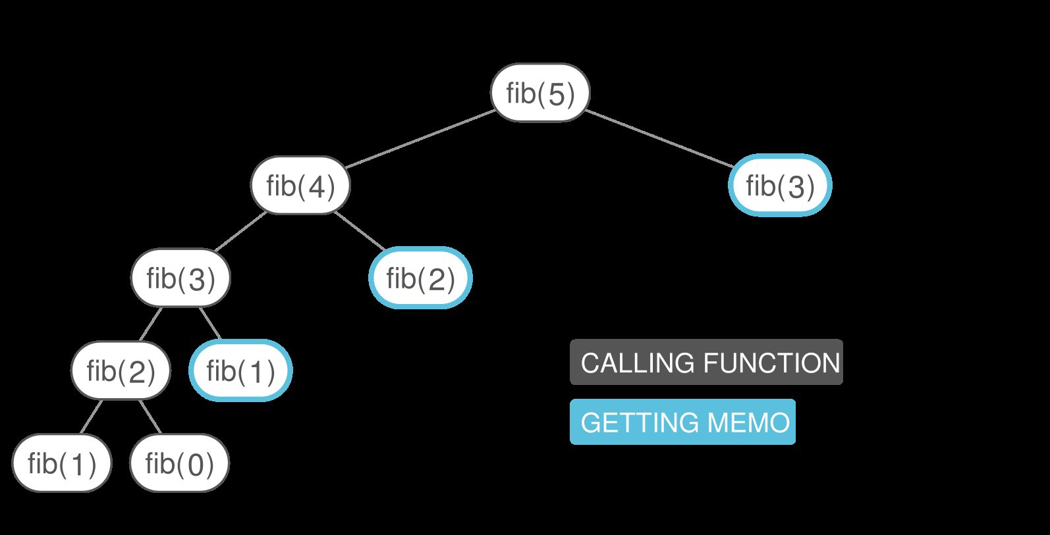
Introduction - IncApprox
IncApprox = Incremental + Approximate Computing
Incremental computing:
Updates the output incrementally when new input data streams in.
Memoization of intermediate results of sub-computations
Ensures that a method doesn't run the same inputs more than once by storing the intermediate results

Slide 4
Introduction - IncApprox
Approximate computing:
Returns an approximate output instead of an exact output
Relies on representative sampling and computation over a subset of the data
IncApprox: an algorithm that biases the sample selection to the memoized items

Slide 5
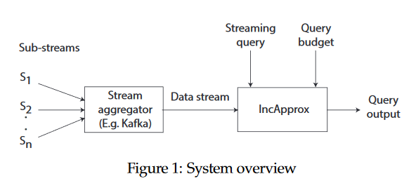
Overview
Designed for real-time data analytics of online data streams
Goals:
Application transparency (universality)
Guarantee query budget
Improve efficiency
Guarantee confidence level

Slide 6
Overview – System Model
Batched streaming processing
Sliding window computations
Overlap provides speedup opportunity
Assumptions:
1. Input streams are stratified based on source of event
i.e. follow same distribution, are mutually independent
2. Virtual cost/budget function exists
3. Memoized results storage is fault-tolerant

Slide 7
Overview – Building Blocks
Stratified sampling
Ensures selection from every strata/substream
Self-adjusting computation
Reuse of memoized results in computation window
Error estimation
Output ± error margin

Slide 8
Implementation of IncApprox
Implemented using the Spark Streaming Framework.
Spark is a scalable distributed data-parallel job processing framework that offers batched streaming processing APIs.
Input stream is split into batches (or RDD – Resilient Distributed Dataset) based on a pre-defined interval.

Slide 9
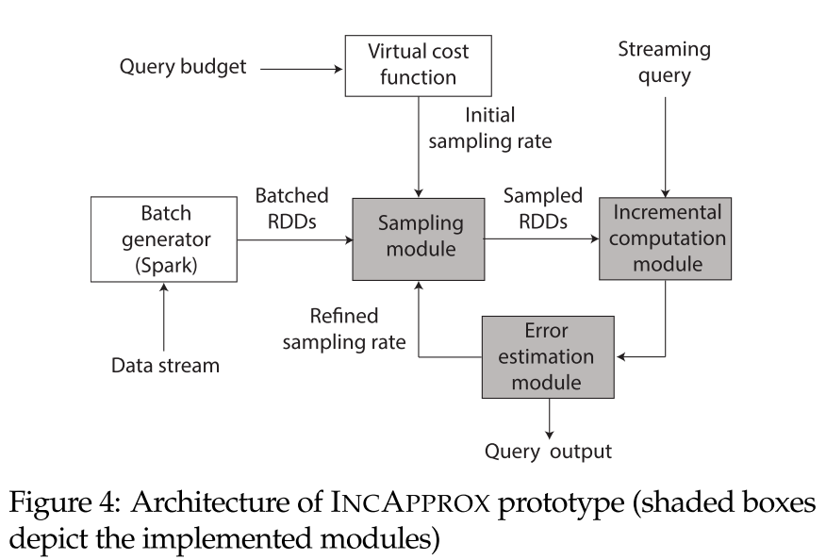
Implementation of IncApprox
Each RDD is then sampled at a rate computed from the query budget.
Computation is then done, and an error value is estimated.
If the error is higher than the target, a feedback mechanism is activated to tune the sampling rate.

Slide 10
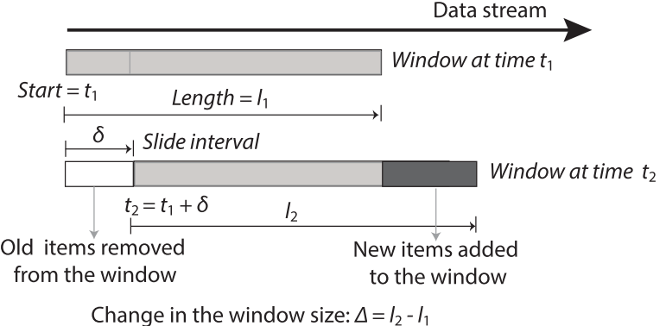
Design of IncApprox - Algorithm
Algorithm computes the streaming query as a sliding window over the input data stream
The user-specified query budget is used to derive the sample size using a cost function.
First, the computation window is adjusted to t₁ and the old data items are removed.

Slide 11
Design of IncApprox - Sampling
Next, the new incoming data is read in the window after which stratified reservoir sampling is performed to select a sample
Uses a reservoir of size equal to the sample size
Space in reservoir allocated proportional to each stratum
Allocation updated based on arrival rate of items
This sample is then biased to include items from the memoized sample to enable reuse

Slide 12
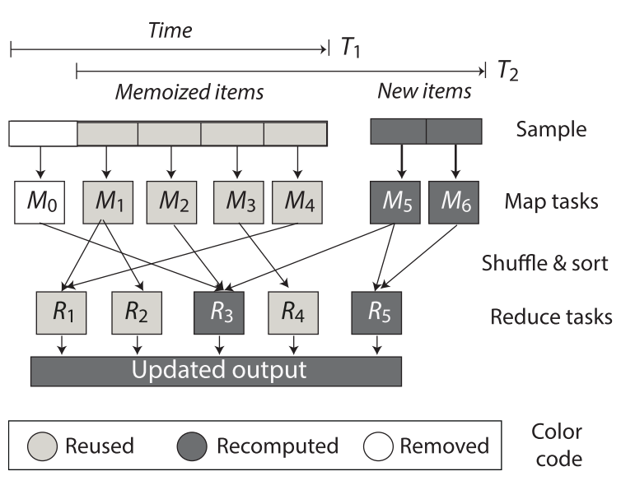
Design of IncApprox – Running the job
The user specified query is then run on this biased data as a data-parallel job incrementally
The job is divided into sub-computations and a dynamic dependence graph is constructed
The memoized results for unchanged data items are reused
Output is updated based on the changed data items

Slide 13
Design of IncApprox – Error Estimation
After the job finishes, all the items and computations in the sample is memorized for reuse
An error estimation as well as the confidence interval (output ± error) is then provided for this approximate output.
Margin of error is computed using the t-score and variance of the sample.
The entire process is then repeated for the next window.

Slide 14
Evaluation – Microbenchmark Setup
Tested 4 parameters across simulated data stream setup (3 sub-streams)
Sample size
Slide interval
Window size
Arrival rate for sub-streams
Sub-stream setup
Groups 1-3: Poisson distribution with 3:4:5 data items per unit time
Group 4: 2 sub-streams with fluctuating arrival rates, 1 with constant

Slide 15
Sample Size
Parameters:
Window size = 10,000 items
Slide interval = 4% of window size (i.e. 400 items)
Sample size = varying, % of the window size
Average # items memoized is directly proportional to:
Sample size
More items from previous window are available for memoization
Arrival rate
Proportional allocation of sub-sample sizes

Slide 16
Slide Interval
Parameters:
Window size = 10,000 items
Sample size = 10% window size (1000 items)
Slide intervals = varying % of window size
Slide interval is inveresly proportional to memoized data
When slide interval = 1%, algorithm memoizes an avg of 99.5%
Greatly improves the reuse rate => Higher efficiency
Larger slides allow fewer sample reuse from previous window
Repeated with different window sizes, observed very similar results

Slide 17
Window Size
Parameters:
Slide interval = 2%
Sample size = 10%
Window size = varying (10200, 10100, 10400, 10250, 10450)
Window size decreases (-∆): # memoized > # needed in window
Decreasing window can allow 100% reuse rate, (if low slide interval)
Window size increases (+∆): # memoized < # needed in window
∆window size is proportional to ∆samples and memoized

Slide 18
Arrival Rate
Parameters:
Window size = 10,000 items
Sample size = 10% (1000 items)
Memoization is inversely proportional to the arrival rate
IncApprox has a memoization rate > 97%.

Slide 19
Evaluation – Case Studies
Throughput
# processed records per second
Accuracy loss
(approx – exact) / exact
Also tested Inc and Approx separately
Inc: Window size = 10s, Slide interval = 2s (20%)
Approx: Sampling fraction = 60%

Slide 20
Test Case - Network Traffic Monitoring
Network traffic traces from CAIDA captured on high-speed Internet backbone links in Chicago (around 670 GB in 2015)
Developed a tool that allows tuning of throughput of NetFlow stream
Number of messages sent per second
Number of NetFlow records per message.
Experiment conducted for 30 minutes.
Stream starts with 1000messages/s, throughput increased to system exhaustion
Each message contains 200 NetFlow records.

Slide 21
Test Case - Network Traffic Monitoring
Speedups:
Approx = 1.41x
Inc = 1.43x
IncApprox = 2.1x
Higher sampling fraction = quick decrease of throughput
Higher sampling = Lower accuracy loss

Slide 22
Test Case - Twitter
Developed crawler using Twitter API to collect publicly available tweets
9/17/2015 - 9/19/2015
Dumped the crawled tweets dataset to CSV file, developed tool to replay tweets as Twitter stream
Twitter API limits the number of returned tweets per request
Tool allows control of throughput of the tweet stream.
Started at 1000messages/s, increased until the system exhaustion

Slide 23
Test Case - Network Traffic Monitoring
Speedups:
Approx = 1.49x
Inc = 1.51x
IncApprox = 2x
Higher sampling fraction = quick decrease of throughput
Higher sampling = Lower accuracy loss
Similar results to Network monitoring

Slide 24
Test Cases - Graphs

Slide 25
Discussion of Assumptions
1. Stratified sub-streams
Bootstrap
Semi-supervised algorithm for stratification
2. Cost function
Pulsar (optimizes resource allocation)
Resource prediction model (optimizes the latency budget)
3. Fault tolerance
Continue processing without using memoized items (lower efficiency)
Use lineage of memoized RDDs to recompute the lost RDD partitions
Use underlying fault tolerant file-systems to asynchronously replicate memoized results

Slide 26
Conclusion
Inc and Approx both function on subsets of the data stream
Combination of the two methods nets better performance overall
Proven quantitatively (though exact computation remains unclear)

Slide 27
Memoization is:
Committing information to memory via flashcards
Recomputing all sub-values from scratch
Reusing previously computed values to accelerate computation
The automatic generation of a memo signifying the end of a test

Slide 28
Incremental and Approximate computing may be combined because:
The combination of the two methods ensures 100% accuracy
They both operate on subsets of data instead of the entire dataset
The combined name sounds cool
Incremental results are inherently approximate

Slide 29
In Stratified Sampling, data items within each stratum: (select all that apply)
Follow the same distribution
Require pseudorandom generation
Are mutually independent

