Slide 1
A Hybrid Approximate Computing Approach for Associative In-Memory Processors
Hasan Erdem Yantır , Ahmed M. Eltawil, and Fadi J. Kurdahi,
UC Irvine, CA
Presented by: Rabin Yu Acharya

Slide 2
Motivation
Problem
High demand for high-speed low power consumption cores.
Memory bottleneck problem: If processing elements cannot be fed by the memory at the desired processing rate.
Solution
Approximate computing: A hybrid approach combining both voltage and precision scaling is proposed for efficient approximate in-memory computing.
Associative Processors (APs): Architectures to accelerate operations directly in-memory to eliminate the data movement cost.
CPUs/ GPUs
Input
Output
Memory unit

Slide 3
Contributions
The “hybrid” approach is applied to SRAM-based APs (SAP) and memristor/Resistive RAM (ReRAM) based APs (RAP).
A design-time simulator is proposed to find the optimal approximation degree in APs even dynamically.
For the evaluation of the proposed methodology, benchmarks related to image processing, machine learning, machine vision, and digital signal processing are used.
When compared to full-precision, unscaled implementations:
Average energy savings of 5.17× and 59.11×
Speedups of 2.1× in SAP and 3.24× in RAP

Slide 4
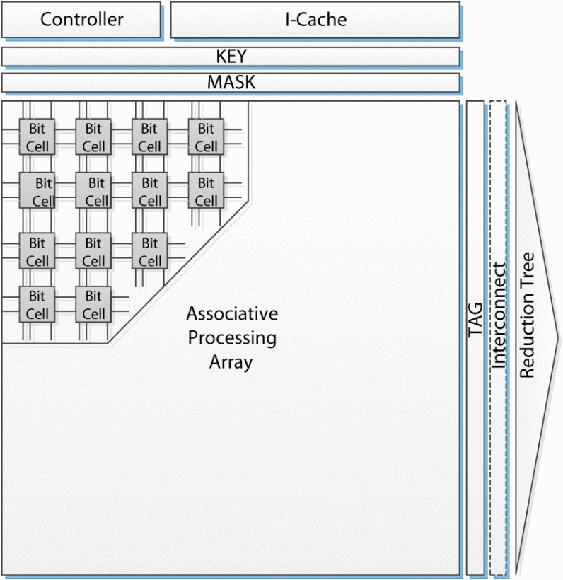
Associative processors (AP)
In-memory data storage and processing units.
Compare-and-write processors.
Consists of:
CAM (Content Addressable Memory) holds the data on which the instruction is performed.
Controller: fetches Instruction (I) and decodes them into:
KEY: Contains the data to be written/ compared.
MASK: Selects the column of bit(s) for write/ comparison.
TAG: marks the rows that are matched by the compare operation and are to be affected by consecutive parallel write.
The Interconnect allows parallel communication between rows of an AP or between different APs.
CAM
Notes:
which functions as a massively parallel processor and a memory at the same time.
Therefore, the execution time of an operation on the AP does not depend on the vector size they fit into the memory.

Slide 5
Associative processors (AP)
Compare and write phases are referenced from a lookup table (LUT).
In each step, one input entry of the truth table (or LUT) is compared against one row of the CAM, and the matching rows are tagged.
Each row of the AP behaves as a simple processor and an operation (or consecutive compare-and-write) is done on Bit-serial, word-parallel manner.
CAM
SRAM based CAM cell
ReRAM based CAM cell
Notes:
which functions as a massively parallel processor and a memory at the same time.
Therefore, the execution time of an operation on the AP does not depend on the vector size they fit into the memory.

Slide 6
Hybrid approach – to save energy
Bit Trimming (BT) and Cell Scaling (CS)
In BT, one or more LSBs are disregarded from the computation.
CS corresponds to voltage scaling in this paper.
In SAP: By lowering the supply voltage from V_{CF} to V_{CS}.
Decreases the write energy and static energy.
In RAP: By narrowing the R_{on} and R_{off} range.
Decreases the write voltage of scaled cells from V_{WF} to V_{WS}.
Lowers the write time and saves energy.
Notes:
Since operations on AP are done bit-by-bit from LSB through MSB.

Slide 7
Effect of bit trimming and cell scaling
Effect of BT and CS in a 16-bit FFT algorithm.
Scaling is better for approximation (lower error).
Bit Trimming is better for energy reduction and speedup.

Slide 8
Design flow for Approximate AP systems
Find optimum degree of approximation with respect to a given quality of metric.
Dynamic approximation using the controller
The starting point of the bit-trimming operation can be modified dynamically.
Degree of scaling can be controlled dynamically by using adaptive supply voltage.
Using “short-stop” technique to quickly change voltage between full-voltage(V_{F}) and scaled-voltage (V_{S}).

Slide 9
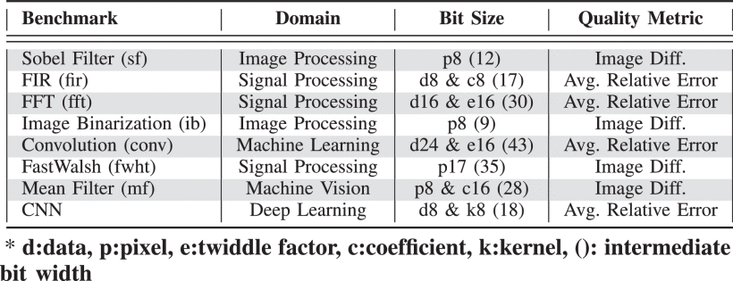
Evaluation benchmark
Seven benchmarks from AX-BENCH (approximate computing benchmark) tool.
The bit size represents the number of input bits of the benchmarks.

Slide 10
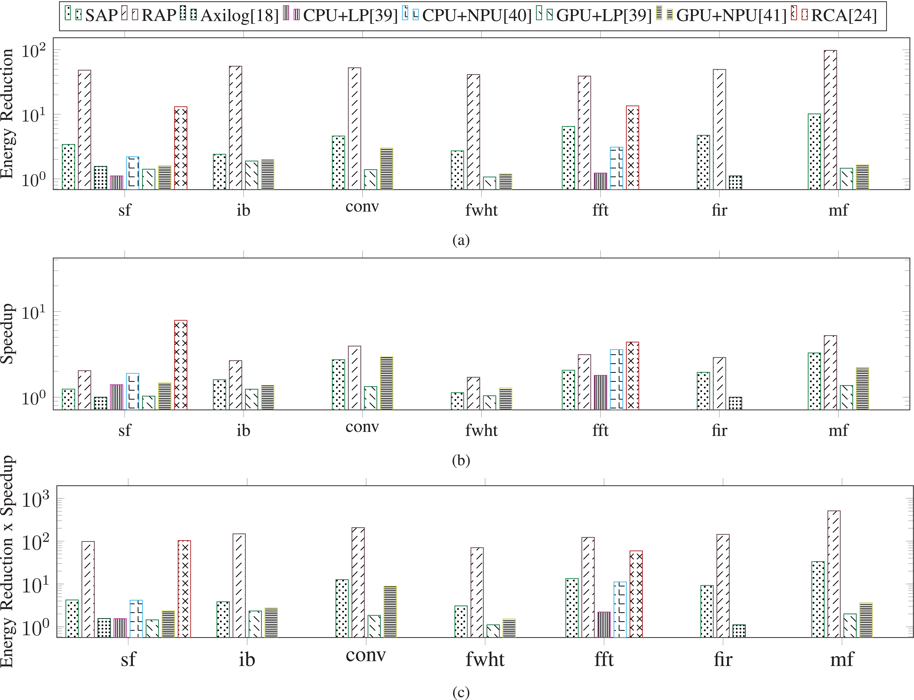
Comparison of different approximation methods
Maximum allowable quality degradation of 10%
Index:
SAP
RAP
Axilog HDL (design tool for approximate ASIC designs)
CPU+LP (Loop-Perforation)
CPU+NPU (Neural-Processing-Unit)
GPU+LP
GPU+NPU
RCA (Resistive CAM accelerator)

Slide 11
Conclusion
﻿Combined the two approximate computing approaches: bit-trimming and cell scaling.
Implemented this hybrid approach in APs to form a hybrid approximate in-memory computing architecture.
The proposed architecture design is tunable even dynamically.
This method was compared against other approximation methods and was able to provide relatively better Energy reductions and higher speedups.

Slide 13
Multiple choice Questions
Compared to scaling n bits, what does trimming n bits result in?
(a) Lower Energy reduction.
(b) Higher speedups.
(c) Lower error rate.
(d) a & b.
2. Compared to trimming n bits, what does scaling n bits result in?
(a) Lower Energy reduction.
(b) Higher speedups.
(c) Lower error rate.
(d) a & b.
3. What makes Associate Processor faster than traditional CPU?
(a) Lowers/ removes the memory bottleneck problem.
(b) Consumes more power.
(c) Has larger cache memory.
(d) Processes less amount of data at a time.

Slide 14
Multiple choice Questions
Compared to scaling n bits, what does trimming n bits result in?
(a) Lower Energy reduction.
Correct answer: (b) Higher speedups.
(c) Lower error rate.
(d) a & b.
2. Compared to trimming n bits, what does scaling n bits result in?
(a) Lower Energy reduction.
(b) Higher speedups
Correct answer: (c) Lower error rate.
(d) a & b.
3. What makes Associate Processor faster than traditional CPU?
Correct answer: (a) Lowers/ removes the memory bottleneck problem.
(b) Consumes more power.
(c) Has larger cache memory.
(d) Processes less amount of data at a time.

