Slide 1
EEL4930 Approximate Computing
Literature Presentation
Armando Robles & Corey Kochman

Slide 2
Overview
Managing Performance vs. Accuracy Trade-offs With Loop Perforation
AXNet: ApproXimate computing using an end-to-end trainable neural network
Loop Perforation: Transforming loops to only execute a subset of their iteration
Criticality Testing: Filtering out loops with unacceptable behavior (critical loops)
Perforation Space Exploration: Combining our leftover loops (tunable loops) and their perforations to find the optimal strategy
Approximation type: Neural acceleration
Strategy: train a single holistic approximator & predictor neural network
Framework deployment: NPU in hardware
Approximation delivery: automatic in architecture
Notes:
Unacceptable Behavior: produce unacceptable results, crash, increase its execution time, or execute with a memory error.

Slide 3
Managing Performance and Accuracy Trade-offs with Loop Perforation
Stelios Sidiroglou-Douskos, Sasa Misailovic, Henry Hoffmann, and Martin Rinard

Slide 4
Loop Perforation?
An approximated computing technique where a set of iterations of a loop are skipped
Normal Loop:
for (int i = 0; i < N; i++) {
// do things
}
Perforatated Loop:
for (int i = 0; i < N; i++) {
// do things
i = i + skip_factor;
}
Notes:
The goal is to reduce the amount of computational work (and therefore the amount of time and/or other resources such as power) that the computation requires to produce its result. Of course, perforation may (and in our experience, almost always does) cause the computation to produce a different result. But approximate computations can often tolerate such changes as long as they do not unacceptably reduce the accuracy.

Slide 5
How are we altering programs/applications?
In any particular application, a set of candidate loops (L) are selected by profiling and account for at least 1% of executed commands (cut-off after the top 25 loops).
A set of perforation rates (r) (0.25, 0.50, 0.75, and 1 for this research) are selected to be used.
for (int i = 0; i < n; i += n) {
// do things
}
Where our perforation and increments:
$$r=1+ \frac{1}{n}$$

Slide 6
Criticality Testing: Tossing out those pesky bad results.
When an application has its loops perforated, not all perforations will allow that application to still function.
These perforated loops whose perforations causes the application to produce unacceptable results are known as critical loops.
Unacceptable results come from perforated loops that produce unacceptable results, crash, increase execution time, or execute with a memory error.

Slide 7
Perforation Space Exploration Algorithms
Exhaustive Exploration Algorithm
Greedy exploration algorithm
Starts with the set of loops leftover from criticality testing, the tunable loops.
The algorithm exhaustively explores every combination of tunable loops l, and perforation rates r.
The resulting accuracy and speedup are the recorded.
Starts with the set of tunable loops, but also requires a given accuracy bound b.
A greedy strategy is then used to produce a set of loops and perforation rates to maximize performance based on b.

Slide 8
Inputs and Applications
For our Criticality Testing and Perforation Space Exploration Algorithms, the “applications were chosen to be representative of modern and emerging workloads for the next generation of processor architectures.”
For the Perforation Space Exploration Algorithms, a set of inputs are pseudo-randomly partitioned into production inputs and training inputs.
The training inputs drive the algorithms while the production inputs test how well these algorithms respond to generalized input.

Slide 9
Results
The following tables represent the resulting speedups and accuracies for the various applications chosen for this research. The values shown are the Pareto-optimal values.
Each group of columns shows the results for four accuracy bounds b: 2.5%, 5%, 7.5%, and 10%.
The format of the results are X (Y%), where X is the mean speedup and Y is the mean accuracy.

Slide 10
Training Results
Application | 2.5% | 5% | 7.5% | 10%
x264 | 2.38 (2.5%) | 2.66 (5%) | 3.17 (6.53%) | 3.25 (9.31%)
bodytrack | 3.44 (2.23%) | 6.32 (4.36%) | 6.89 (6.19%) | 6.89 (6.19%)
swaptions | 5.08 (1%) | 5.08 (1%) | 5.08 (1%) | 5.08 (1%)
ferret | 1.02 (0.2%) | 1.03 (4%) | 1.03 (4%) | 1.16 (10%)
canneal | 1.14 (4.38%) | 1.18 (4.43%) | 1.913 (7.14%) | 1.913 (7.14%)
blackscholes | 33 (0.0%) | 33 (0.0%) | 33 (0.0%) | 33 (0.0%)
streamcluster | 5.51 (0.54%) | 5.51 (0.54%) | 5.51 (0.54%) | 5.51 (0.54%)

Slide 11
Production Results
Application | 2.5% | 5% | 7.5% | 10%
x264 | 2.34 (5.15%) | 2.53 (6.08%) | 3.12 (8.72%) | 3.19 (10.3%)
bodytrack | 2.70 (4.00%) | 4.93 (6.12%) | 4.811 (6.58%) | 4.811 (6.58%)
swaptions | 5.05 (0.2%) | 5.05 (0.2%) | 5.05 (0.2%) | 5.05 (0.2%)
ferret | 1.002 (0.15%) | 1.02 (0.23%) | 1.02 (0.23%) | 1.07 (7.90%)
canneal | 1.14 (4.38%) | 1.14 (4.38%) | 1.46 (7.88%) | 1.46 (7.88%)
blackscholes | 28.9 (0.0%) | 28.9 (0.0%) | 28.9 (0.0%) | 28.9 (0.0%)
streamcluster | 4.87 (1.71%) | 4.87 (1.71%) | 4.87 (1.71%) | 4.87 (1.71%)
Notes:
Blackscholes is the odd one out because there exists a loop specifically to increase the workload in the application.

Slide 12
Conclusions
Loop perforation has the potential to augment a wide array of applications, providing some applications with significant performance improvement and others with not as much.
Loop perforation is not for all applications, but its use in target applications dramatically increases the ability to trade-off accuracy for increased performance (and therefore decreased energy consumption as well).
For this set of experiments, we saw performance improvement close to a factor of 2 with accuracy trade-offs 5% or less.

Slide 13
Questions?
I highly encourage, if you are interested, to give this paper a quick read.
The techniques used require only basic knowledge of computer science and a rudimentary version of this same experiment can be easily designed by anyone!

Slide 14
What is Loop Perforation?
Approximate computing technique that turns for-loops into while-loops.
Approximate computing technique that skips a set of iterations in one or more loops.
When your loop starts sweating profusely.
Approximate computing technique that uses neural nets to completely remove loops from a program.

Slide 15
Answer: B

Slide 16
What is considered a critical loop?
Loops that crash.
Loops that increase execution time.
Loops that cause a memory error.
Loops that produce unacceptable results.
All of the above.

Slide 17
Answer: E

Slide 18
What is the purpose of training and production inputs?
To check if techniques used with one set of inputs can be generalized to other sets of inputs.
To see if different types of inputs with different perforation techniques break the program/application.
To make your life more confusing by doubling the amount of inputs for this experiment.
None of the above.

Slide 19
Answer: A

Slide 20
AXNet:
Approximate Computing Using
An End-To-End Trainable
Neural Network
Z. Peng, X. Chen, C. Xu, N. Jing, X. Liang, C. Lu, L. Jiang

Slide 21
In context of approximation research
What type of approximation?
Neural acceleration
What is the approximation strategy?
Train a single holistic predictor & approximator neural network
How is the approximation done?
NPU in hardware automatically approximates instruction results when possible
What is being approximated?
How to determine what to approximate?
How much approximation is acceptable?
What applications are being targeted?

Slide 22
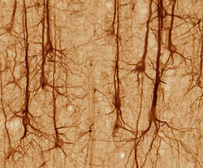
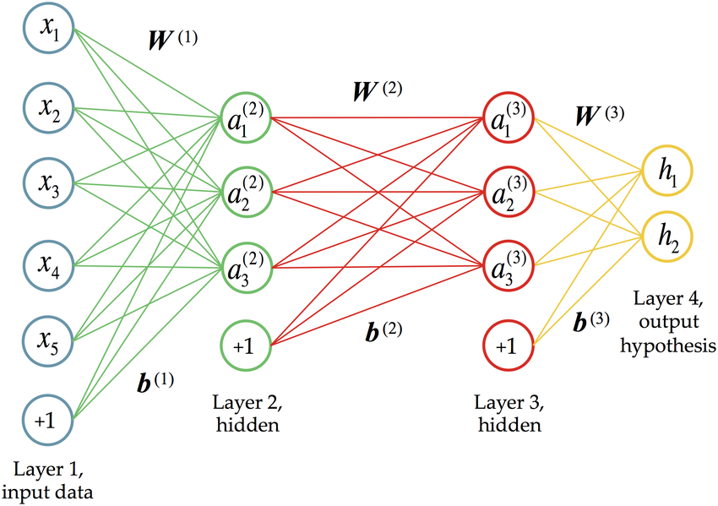
Neural Networks: how do they work?
Neurons:
"Several stimuli can activate a neuron leading to electrical activity, including pressure, stretch, chemical transmitters, and changes of the electric potential across the cell membrane. Stimuli cause specific ion-channels within the cell membrane to open, leading to a flow of ions through the cell membrane, changing the membrane potential." -Wiki
Neural Networks:
Linear combination—inputs are modified by a weight and bias, then summed
First layer receives a linear combination of the input data
The layer acts as an input layer for the next layer, and so on...

Slide 23
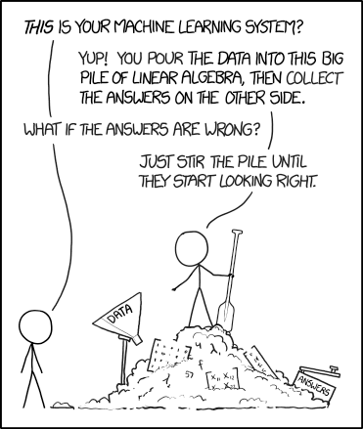
https://xkcd.com/

Slide 24
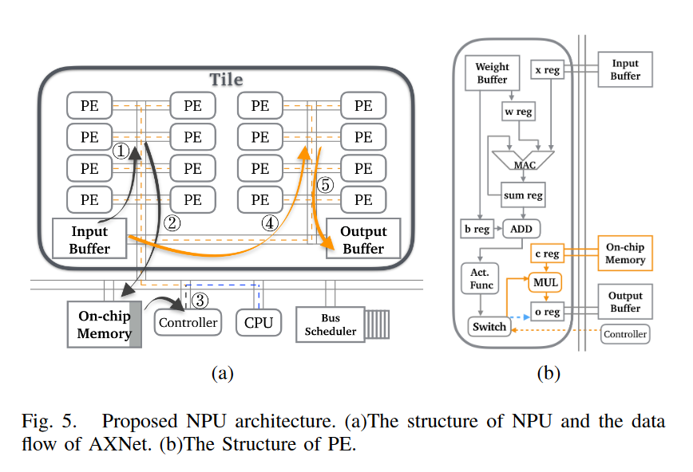
NPU Deployment
How is the approximation done?
Automatic in NPU architecture
Neural Processing Unit (NPU)
AI acceleration in hardware
Highly parallelized and pipelined
Well known examples
NVidia RTX platform
Tensor cores (TPU)

Slide 25
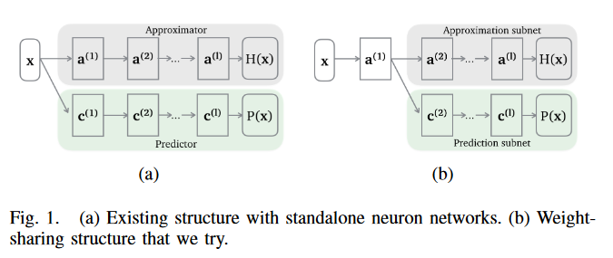
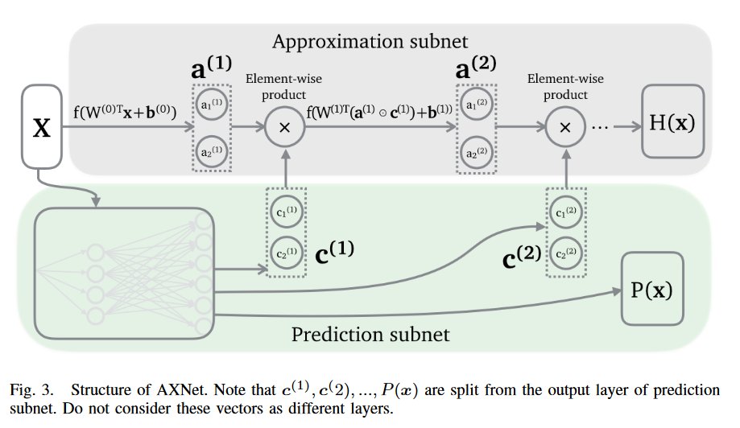
Approximation strategy
How to determine what to approximate?
Approximator network generates labels
Input data labeled as "safe-to-approximate"
Learned by checking error rate
How much approximation is acceptable?
Predictor network sorts inputs
Learned from approximator performance
As much as is "safe"
What is the approximation strategy?
"…[the predictor is] proactively used to predict whether the approximator can safely approximate the output given the input data. Those unsafe input data are sent to CPU for exact computation."

Slide 26
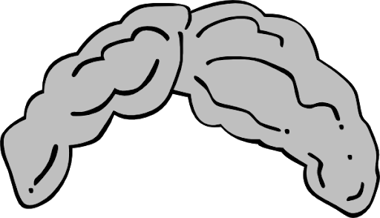
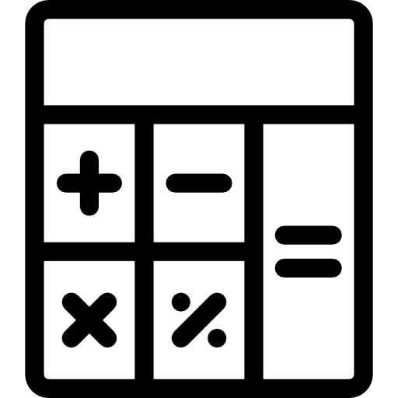
in layman's terms
The Approximator ➡ A good guesser
The Predictor ➡ A wise judge
How to avoid ~local~ optimums?
Novelty in this approach ➡ the Puppeteer

Slide 27
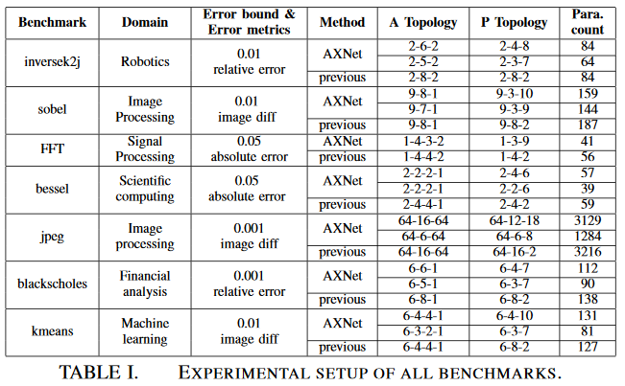
Target application
AXNet generated on a per-application basis
Experiment pits AXNet against independently trained neural networks
Test applications include image processing, financial analysis, robotics, etc.
Generalized, ideally
Remains to be implemented

Slide 28
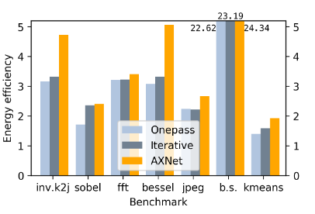
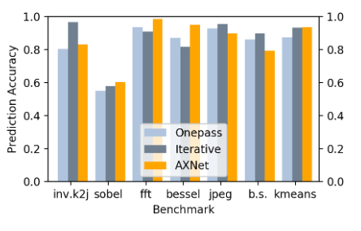
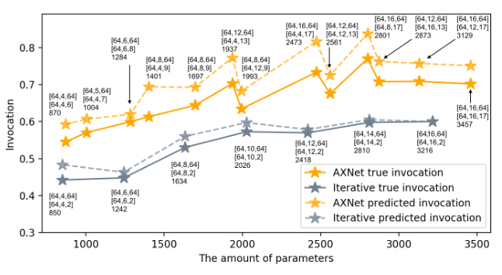
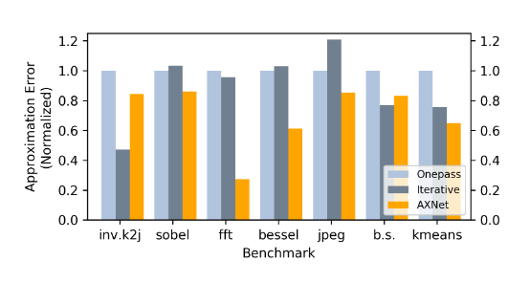
Results
Energy Efficiency fig. 10(b)
Prediction Accuracy fig. 7
"Due to the space limit, we theoretically estimate the performance of AXNet according to the performance of NPU in [6]"
Low training time, yet competitive
Invocations vs parameters fig. 9
Approximation Error fig. 8

Slide 29
Questions?

Slide 30
Sample questions
1. Neural networks model which of the following natural phenomenon?
Neuron cell activation in the brain
Star constellations
Ant colonies at work
2. Neural networks transform a set of inputs to outputs, generally, by applying transformations known as _____
transmodification.
magic.
weights and biases.
3. The AXNet Neural Network approximation technique delivers approximations ____
predetermined at compile time.
automatically from the NPU during runtime.
generated in software at development time.

Slide 31
Sample question Answers
1. Neural networks model which of the following natural phenomenon?
Neuron cell activation in the brain
Star constellations
Ant colonies at work
2. Neural networks transform a set of inputs to outputs, generally, by applying transformations known as _____
transmodification.
magic.
weights and biases.
3. The AXNet Neural Network approximation technique delivers approximations ____
predetermined at compile time.
automatically from the NPU during runtime.
generated in software at development time.
O
O
O

