Slide 1
Crayon
Saving Power through Shape and Color Approximation on Next-Generation Displays
Phillip Stanley-Marbell
Virginia Estellers
Martin Rinard

Slide 2
What is Crayon?
Crayon is a graphics library/runtime that utilizes approximation in order to reduce the power usage of a display in a system.
Crayon exploits the fact that the power dissipation of OLED displays and DLP pico-projectors is different for different colors.

Slide 3
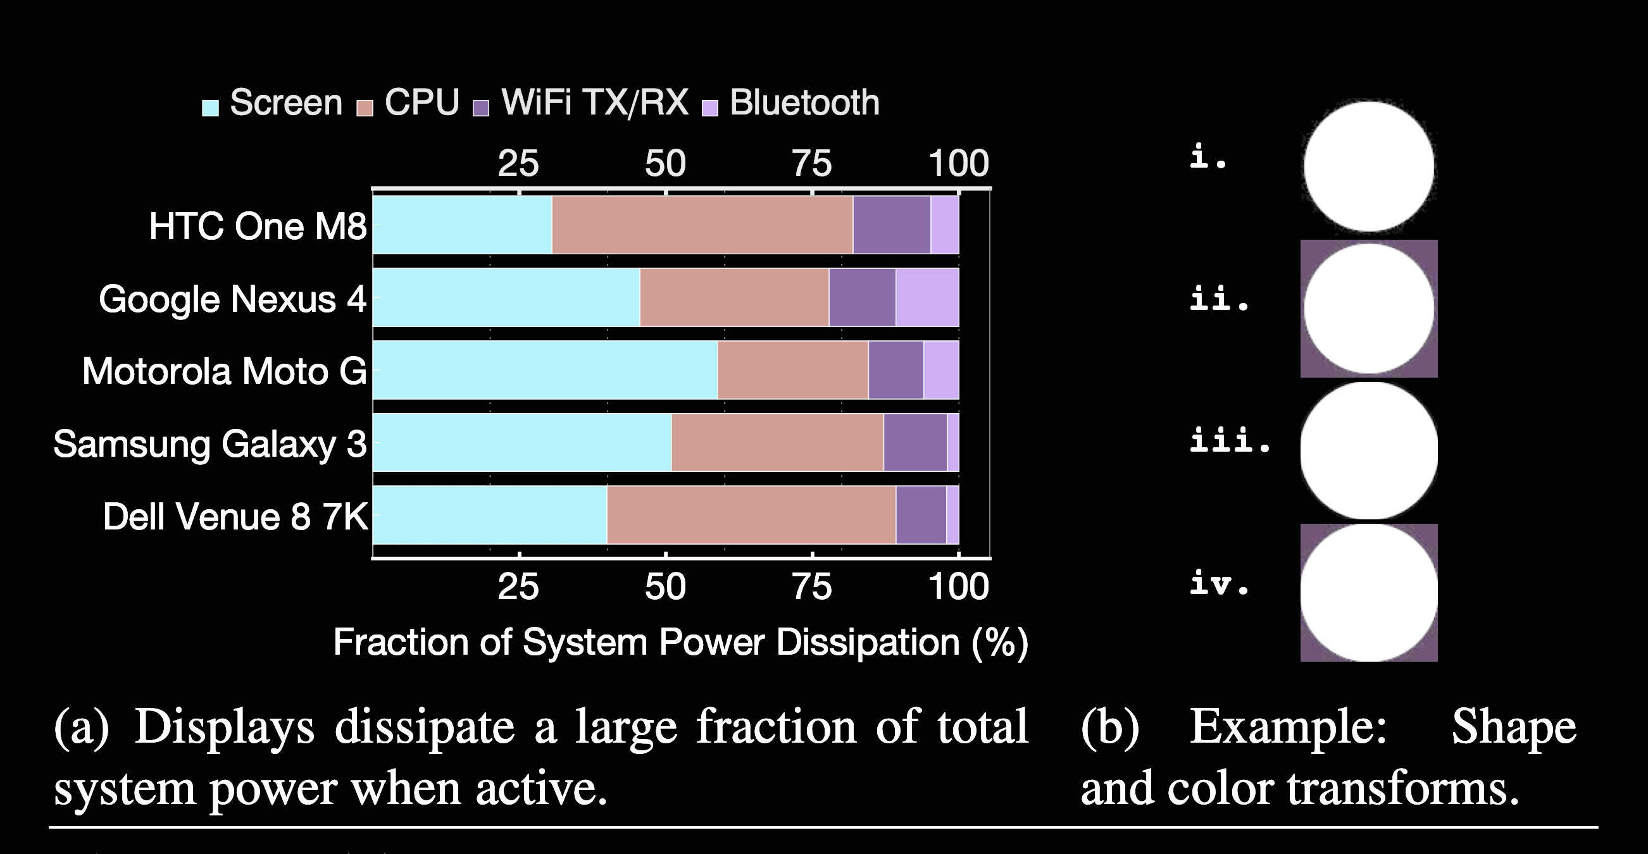
Why use Crayon?
Displays account for a significant amount of total system power dissipation in mobile platforms.
Display power usage is dominated by analog electronics which do not scale with improvements in semiconductors, the power consumed by displays is likely to remain constant or increase.

Slide 4
How does Crayon work?
Power dissipation of OLED and DLP pico-projectors depends on the displayed colors.
Blue pixels in OLED displays typically dissipate twice as much power as green, with red in between.
Darker pixels emit less light and consume less energy

Slide 5
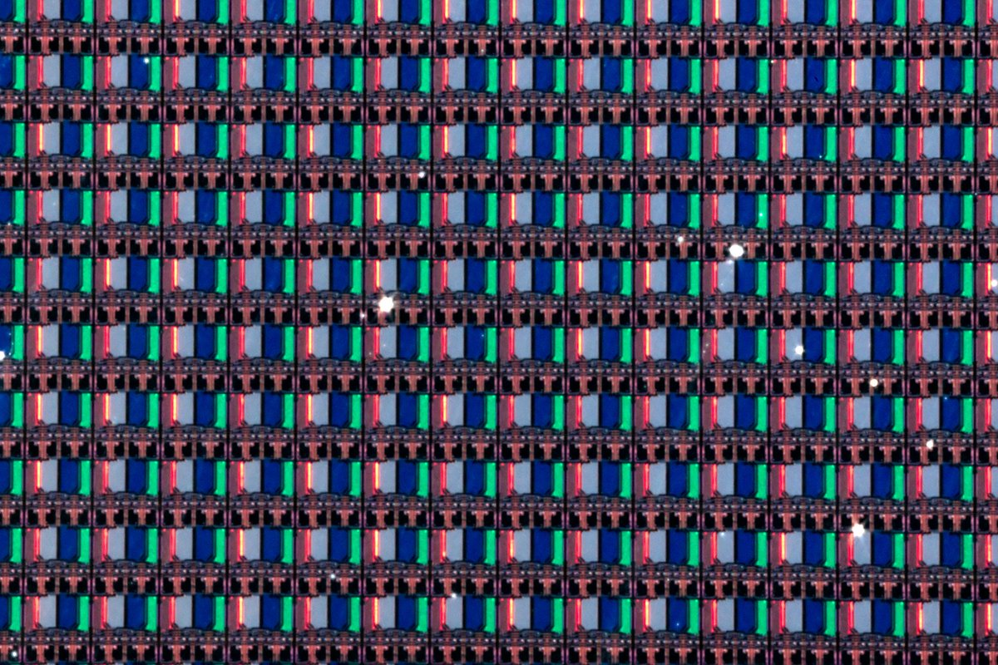
How does Crayon work?
Crayon approximates images and shapes in a way to reduce power dissipation, for instance, reducing the amount of pixels that need to be blue.
Crayon does not work with traditional LCD displays, as their power consumption is largely due to the backlight and not what is being displayed.

Slide 6
How does Crayon work?
Crayon also exploits humans, in that the human visual system exhibits great tolerance for certain kinds of shape and color changes.
Research has established that most people do not notice limited levels of hue and of brightness changes, and easily tolerate changes in the area of graphical objects.

Slide 7
How does Crayon approximate color?

Slide 8
Least-squares color approximation
Distance between the two images measured with squared Euclidean norm
Closed Form Solution
This transform results in many small number of color approximations

Slide 9
Euclidean-distance color approximation
Distance between the two images measured with Euclidean norm
Closed Form Solution
This transform results in many small number of color approximations that might be large

Slide 10
Tradeoff Parameter
Each transform includes a tradeoff parameter
The higher the tradeoff parameter, the closer the image
The lower, the more approximated.

Slide 11
How does Crayon approximate shapes?
Crayon’s shape approximation works by intercepting the API calls of a drawing framework.
The shape approximation either grows or shrinks a shape along the perimeter by a number of pixels.
The number of pixels is dependent on that shapes impact on power dissipation, taking into account the background as well.
The color of the shape and background determine the impact on power dissipation, and whether or not Crayon shrinks or grows the shape.

Slide 12
How is Crayon used?
Crayon can be used both as an offline tool or during runtime.
Offline, Crayon can take an image file as an input and output transformed image file that is optimized for reduced power dissipation.
Comparable to previous methods

Slide 13
How is Crayon used?
During runtime Crayon can be used to actively approximate images and drawn graphics.
In this paper, Firefox is compiled where Crayon is being used as a shim for Cairo API calls, which is Firefox’s graphics framework.
Maintains conventional GPU acceleration

Slide 14
How well does Crayon perform?
Image approximations were graded by 440 people, using Amazon Mechanical Turk.
Participants rated groups of ten matched pair images.
Crayon’s color approximations were evaluated in both the RGB and CIE LAB color spaces, the latter specifically designed to reflect the way humans perceive color differences.

Slide 15
How well does Crayon perform?
Mechanical Turk Grading Scale:
3, Identical
2, Minor Difference
1, Significant Difference
0, Completely Different

Slide 16
How well does Crayon perform?
Approximations were also evaluated quantitative.
This was done with three image quality assessment metrics: mean squared error (MSE), peak signal-to-noise ratio (PSNR), and structural similarity (SSIM).
The qualitative results correlate with the quantitative results, however images with a score of 0 may have good MSE, PSNR, or SSIM values.

Slide 17
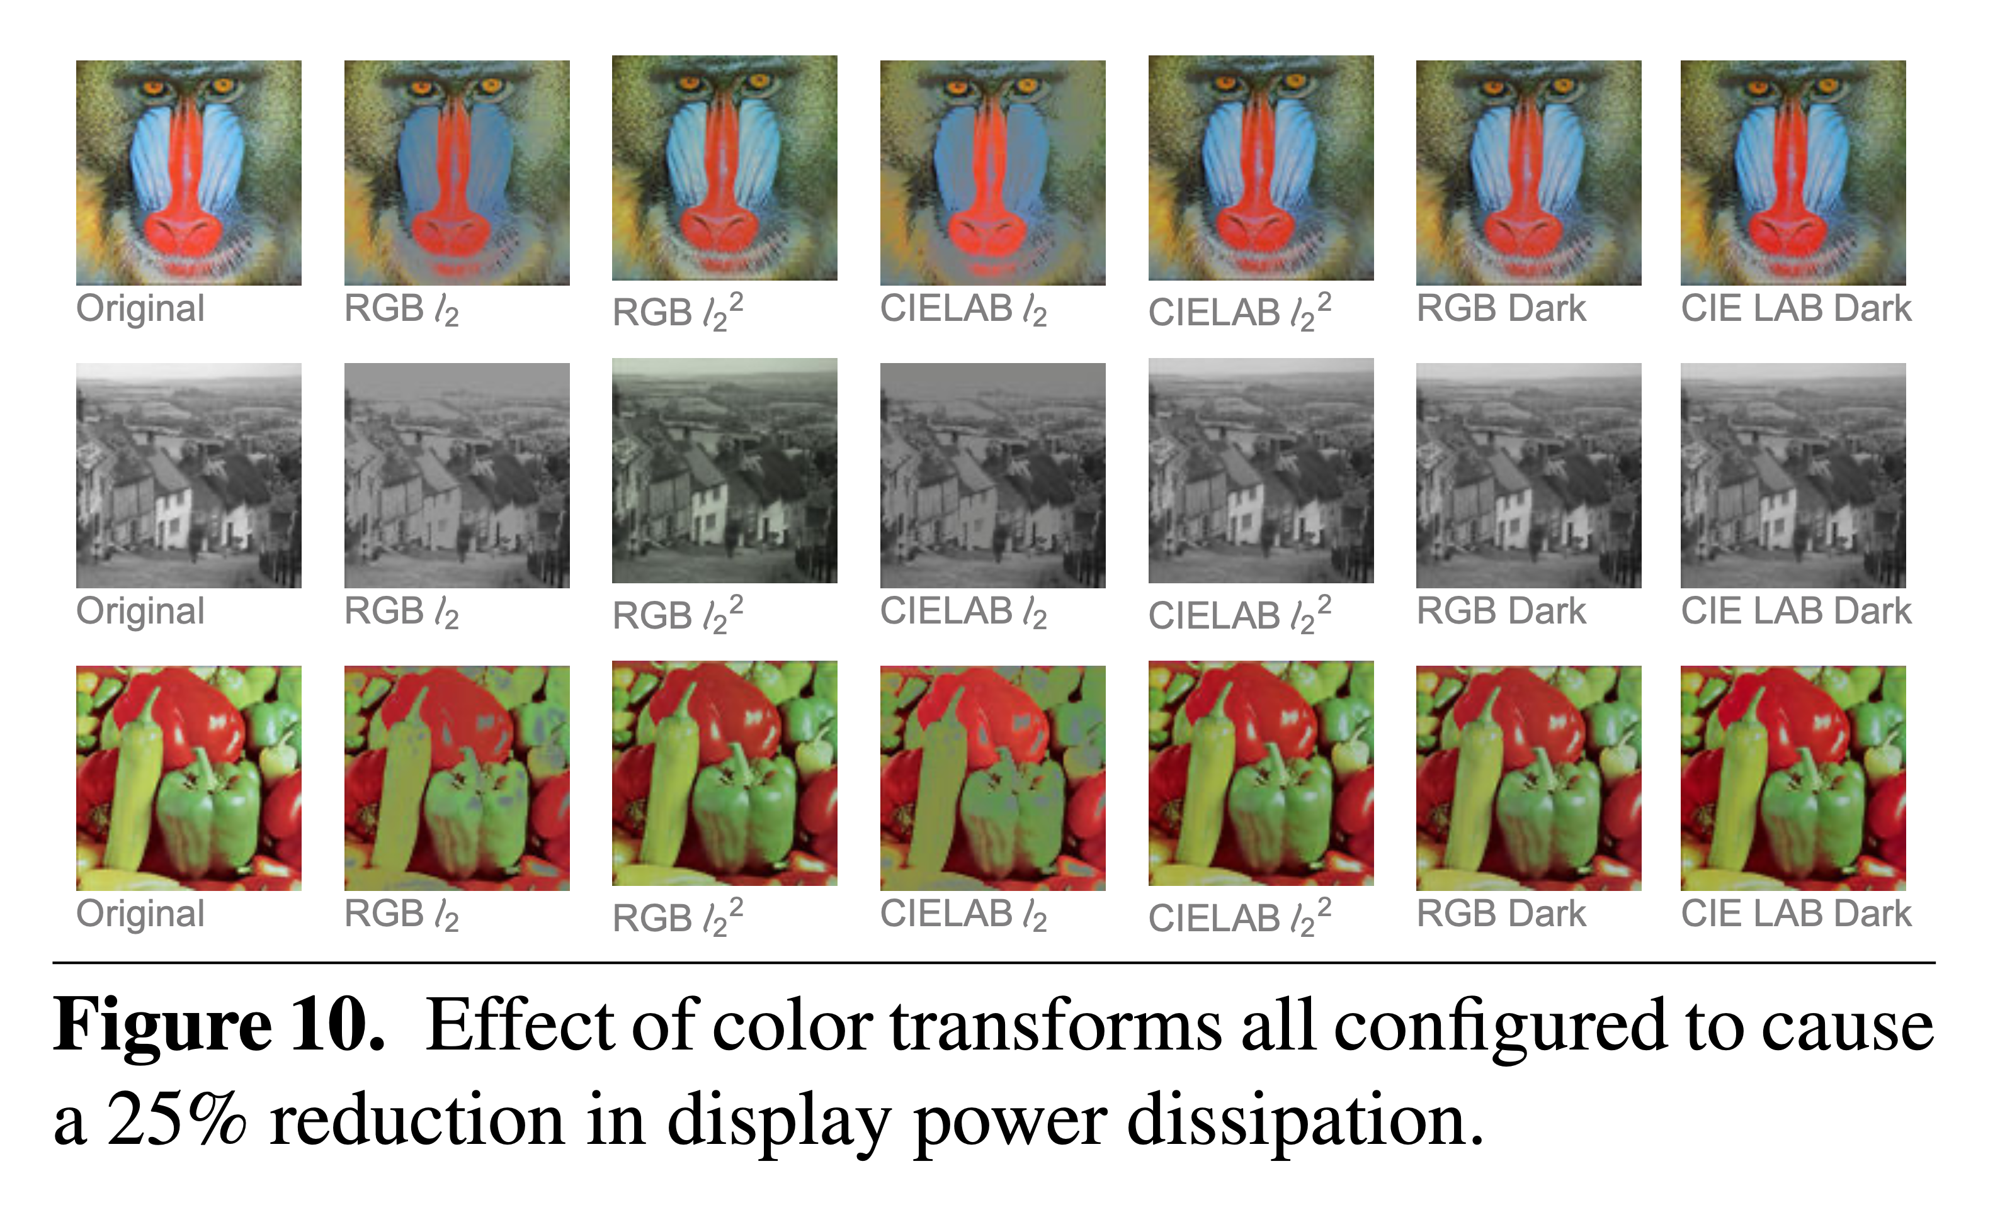
How well does Crayon perform?
A specialized hardware evaluation board was used to precisely measure the power dissipation of an OLED display as it displayed the approximations.

Slide 18
How well does Crayon perform?

