Slide 1
AXILOG: ABSTRACTIONS FOR APPROXIMATE HARDWARE DESIGN AND REUSE

Slide 2
Axilog
A set of concise, high-level annotations that provide the necessary syntax and semantics for approximate hardware design and reuse in Verilog
Key idea is the abstract away the details of approximation and leave the choice to designers which elements are synthesized approximately, and which are critical
Allows for design reuse in structural design flows
Backward Compatible extension of Verilog

Slide 3
Objectives of Axilog
craft a small number of Verilog annotations that provide designers with complete oversight over the approximation process;
minimize the number of manual annotations while relying on SIA to automatically infer the designer’s intent for approximation, thereby relieving the designer of the details of the approximate synthesis process
support the reuse of Axilog modules across different designs without the need for reimplementation.

Slide 4
Evaluation Axilog with Two Synthesis Flows
First focuses on current technology and synthesis tools
Approximates by relaxing timing constraints of safe to approximate sub circuits
Provides 1.54x energy savings and a 1.82x area reduction by allowing a 10 percent quality loss
Second focuses on a probabilistic gate model for future technologies
Provides on average 2.5x energy saving and a 2.2x probabilistic area reduction

Slide 5
Axilog Keywords

Slide 6
Simple Example

Slide 7
Scope of Approximation
Top nand implementation shows that the relax keyword marking approximation on the output. This crosses the module boundary to the design.
The relax local at the bottom keeps the approximation scoped to only inside the module definition it self.

Slide 8
Restrictions
The restrict keyword makes the argument precise unless a relax keyword has made the driving elements safe to approximate
Restrict-global works the same way but overwrites the preceding relax keywords.

Slide 9
Critical and Bridge
Critical is for when a designer does not want approximation to affect certain inputs
Wires that carry approximate outputs cannot drive a critical input
The bridge keyword is for when the designer wants an approximate output to drive a critical input

Slide 10
Safety inference Approximation
Static Analysis of safe to approximate design elements
SIA is applied after the design is translated into primitive gates and circuit structure is applied
Backwards slicing algorithm that subtracts all the precise wires to find safe to approximate wires

Slide 11
Approximate Synthesis
Annotated Verilog gets converted into a precise gate level netlist while preserving the approximate annotations
SIA then runs procedure to find safe to approximate subset of the annotations
Second stage is synthesis tool applying approximate synthesis and optimization to the subset of safe annotations
gate substitution, gate elimination, logic restructuring, voltage over-scaling, and timing speculation

Slide 12
Approximate Synthesis through relaxing timing constraints

Slide 13
Approximate synthesis through gate resizing
Assume the probability of error for a gate is an inverse function of the size of the gate
ASG and synthesis applies approximation by selectively downsizing gates
Smaller gates dissipate less energy and have smaller area

Slide 14
Evaluation

Slide 15
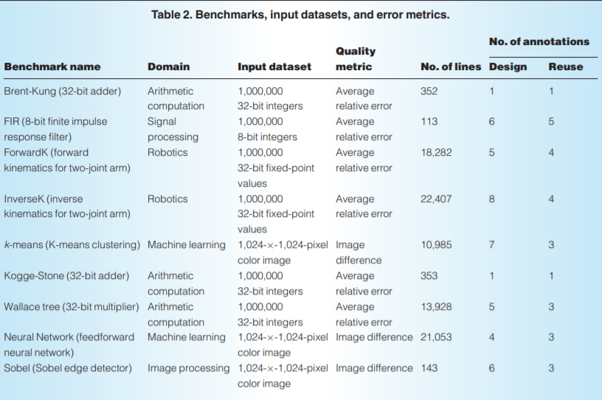

Slide 16
AST Results

Slide 17
ASG Results

