Slide 1
Architecture Support for Disciplined Approximate Programming
Hadi Esmaeilzadeh, Adrian Simpson, Luis CEZE – University of Washington
Doug Burger – Microsoft REsearch

Slide 2
Overview
”Dark Silicon” is a large modern issue in VLSI and chip design
Create “soft slices” of the program that can be computed on approximate hardware
Separate architectures that produce approximate results – run on low VDD and precise architectures – on high VDD
Propose an ISA extension to accommodate approximate operations

Slide 3
Approximate ISA
Two guiding principles when designing the ISA:
Abstract notion of approximation – replace guaranteed outcomes with reasonable expectations of behavior
ISA Safety is not guaranteed – shifts blame away from hardware and trusts that the programming language and compiler will implement safety code
Assumes a language like EnerJ is used to provide safety guarantees statically to the programmer
ISA only provides approximation to the compiler - not dynamic invariant checking, error recovery, or other support mechanisms

Slide 4
Approximate ISA Properties
Approximation at an instruction granularity
Must support approximate storage
Must be able to convert between approximate and precise storage
Approximation fallout must be able to be isolated and controlled by the compiler
Approximate Registers
Each register has an approximate and a precise mode – approximate mode does not promise the last value written
Mode is implicitly defined by last operation that used it
Precision of operands of instructions must be set explicitly

Slide 5
Approximate ISA Properties (Continued)
Memory & Memory Accesses
Cache line precision is determined by consistent memory accesses – a line’s precision is determined by cache misses and cache writes
Address calculation and indexing are never approximated
Main memory approximations can be done by varying DRAM refresh rate, or varying DRAM line size
Explicit control over main memory approximations through system calls or special system instructions that manipulate precision of regions of memory – precision level can be stored in the page table

Slide 6
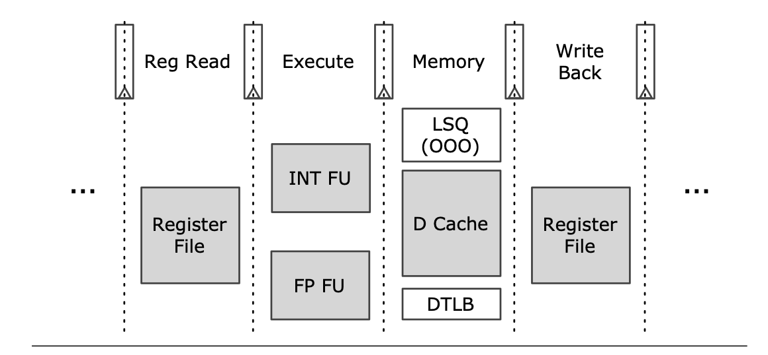
Design Space
Two regions of the design space:
Instruction control plane (precise) – fetch, decode, and bookkeeping
Data movement/processing plane (approximate) – register file, data caches, load store queue, functional units, and bypass network
Two consequential voltage lines, one for each region of the design space
Voltage Levels:
Vdd H – nominal, reliable level
Vdd L – lower voltage level that could cause timing errors
Vdd L High – Between Vdd H and Vdd L used with a design that has error correction mechanism

Slide 7
TRUFFLE: A Dual Voltage Microarchitecture for Disciplined Approximation
Dual Voltage SRAM – hold approximate and precise data together
Indexing logic is always precise, while data retrieval and storage must alternate between rails
Dual Voltage Multiplexers and Voltage Level Shifters
Precision input pin which determines the voltage level of output
Control Plane Units:
Fetch – branch predictor, instruction cache, TLB,
Decode - logic determines between approximate and precise instructions, identifies with 1 extra bit and precision bits for registers
Rename – physical register indices/tags
Issue – needs to store register index bits and physical register indices. Precision bit is coupled with address
Schedule – Approximate and Precise units appear to scheduler as one unit
Commit – commits in order and will update registers using precision bit

Slide 8
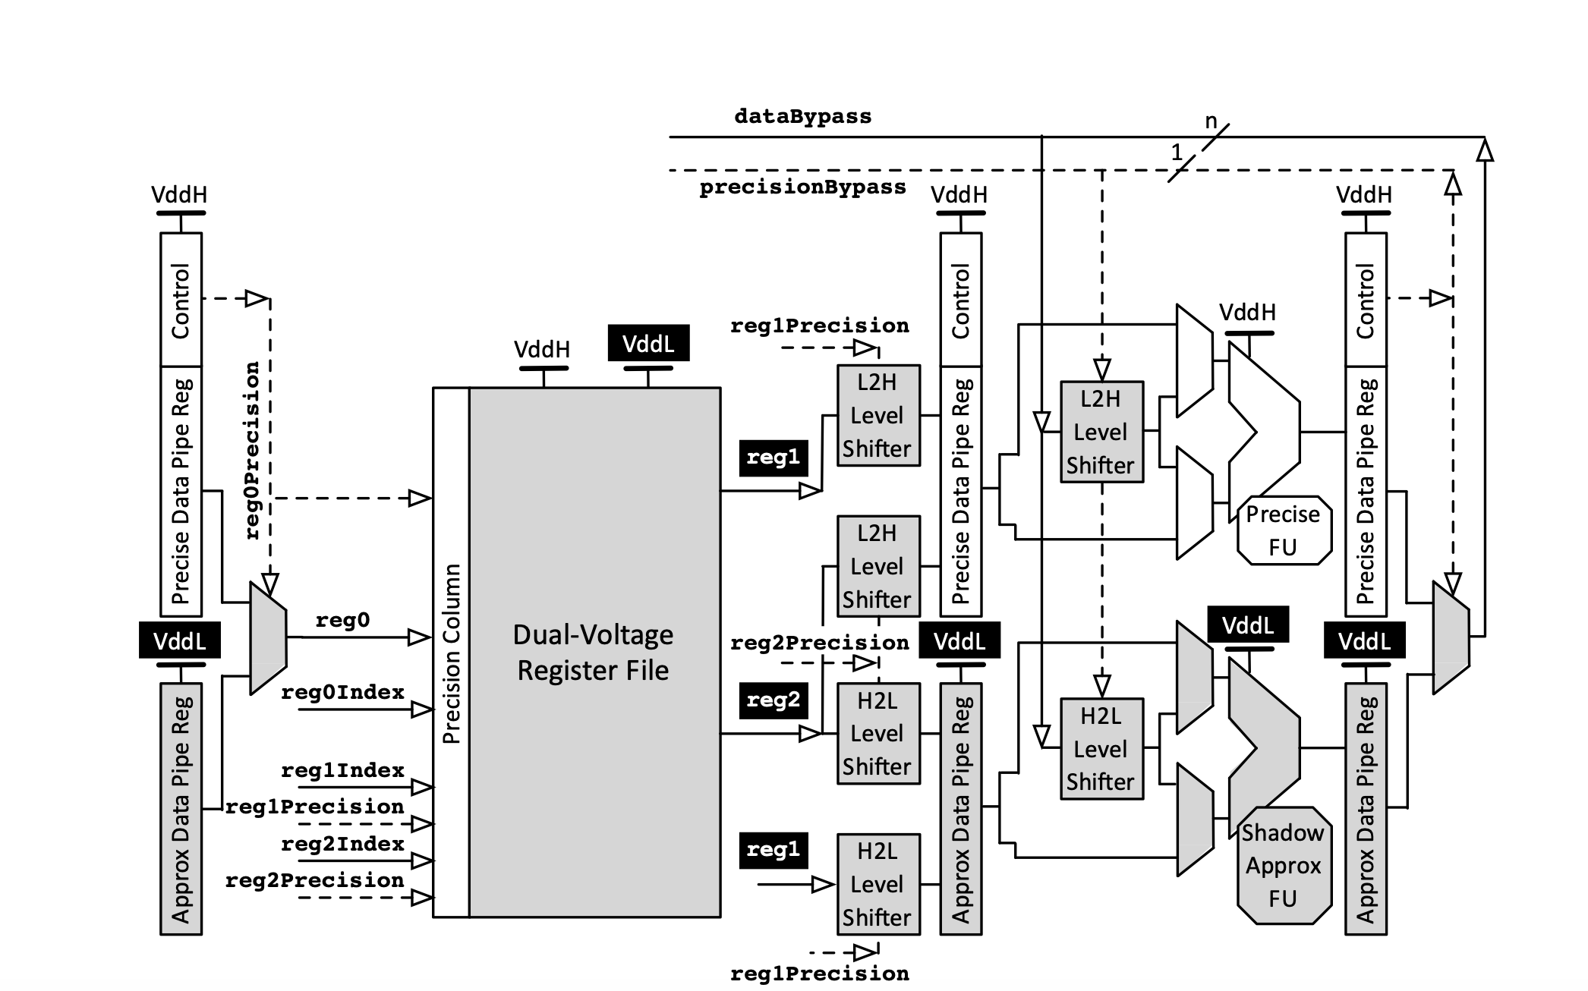
Data Movement/Processing Plane
Register Read
Dual Voltage Register File – Precise for Program and Control Data, Approximate for Imprecise Data
Level Shifters are adjusted in order to fulfill ISA requirements of converting between approximate and precise data
Execute
Functional Units are duplicated and precision bit determines which functional unit to use
Inputs of unused functional units are kept constant to reduce DV
Memory
Precision of memory determined by load or store it depends on

Slide 9
Microarchitectural Overhead
Duplicated pipelined registers
Extra level of dual-voltage multiplexing on output of pipelined registers
Extra bit on every DV-SRAM storage along with each port
Extra Level Shifters for the ports of all read/write entities
Extension of 1 bit to bypass network, issue slot, load/store queue, and pipelined registers

Slide 10
Experimental REsults
Used CACTI and McPAT to model architectures – 65 nm node technology
2 Metrics of Evaluation
Energy Savings – Using McPAT power model
Sensitivity to Error – Error Injections and Output Quality
Benchmarks:
EnerJ Benchmarks seen in October 7th Paper
ZXing (barcode scanning), jMonkeyEngine (Game Development)
Frequency is set to a constant 1666 MHz
Vdd L is varied between 50%, 62.5%, 75%, and 87.5% Vdd H

Slide 11
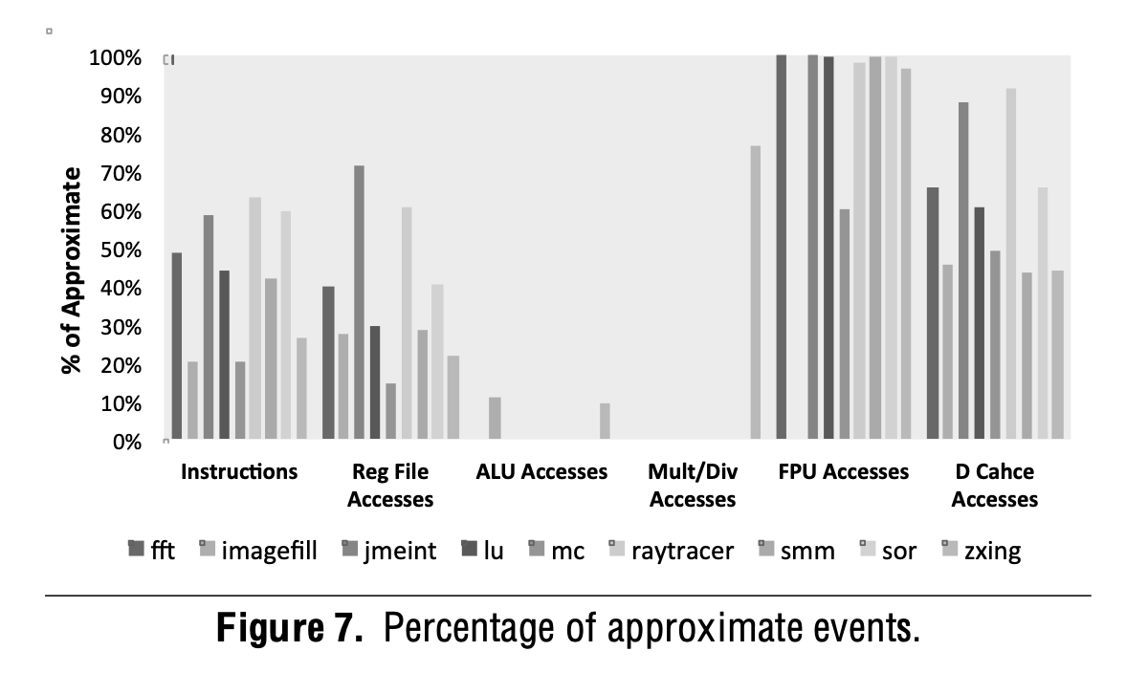
Experimental Results (Continued)

Slide 13
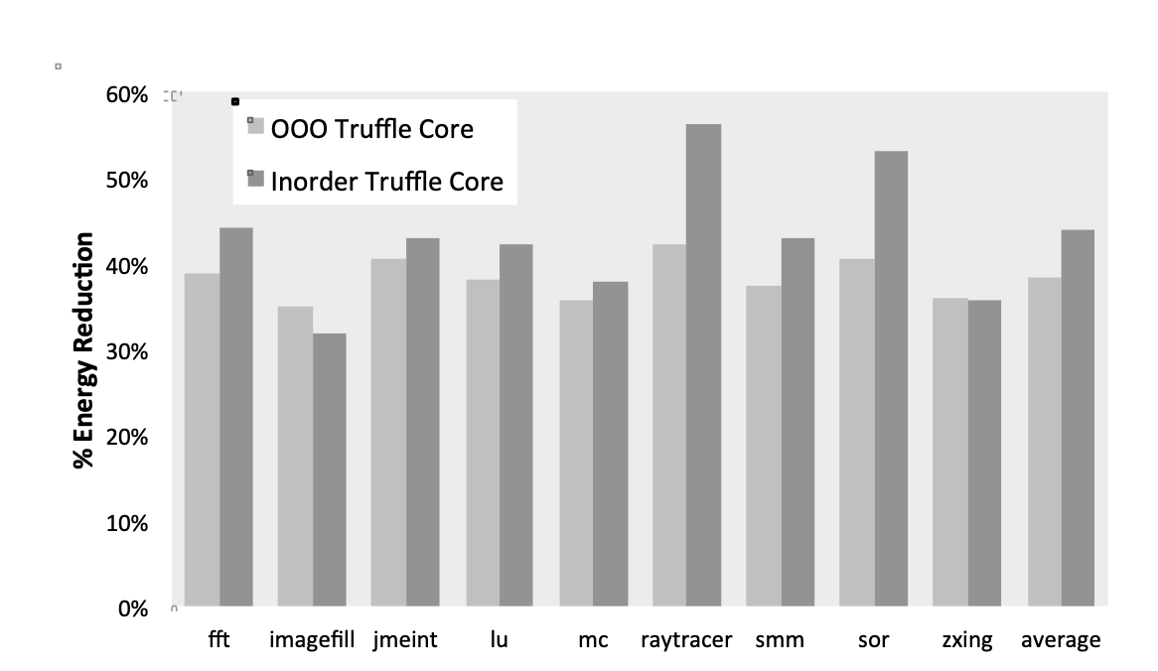
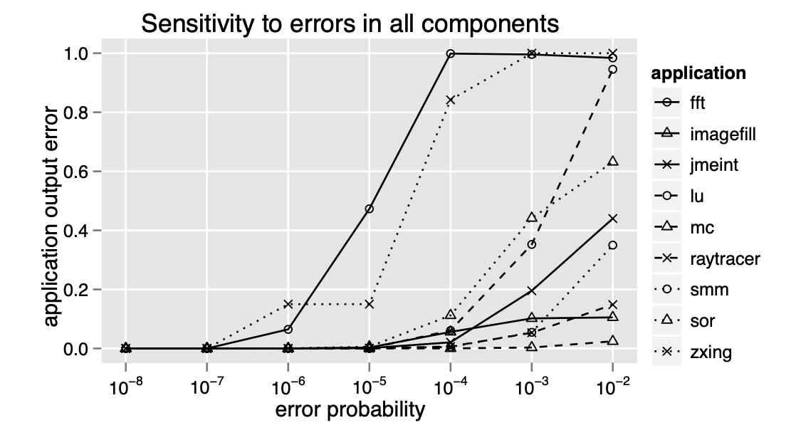
Experimental Results (Continued)

Slide 14
Conculsion
Energy savings up to 43% in best cases with low or negligible output error rate
Created an Architecture that allows for interleaved precise and approximate accesses
Dual-voltage SRAM array that implements approximation-aware caches and registers
ISA relies on the heavy lifting from the compiler and and programming language

Slide 15
Multiple Choice Question 1& 2
What were the two main regions of the TRUFFLE Design Space?
Instruction Control Plane & Memory Control Plane
In-Order Processing Plane & OOO Processing Plane
Approximate Plane & Precise Plane
Instruction Control Plane & Data Processing Plane
What voltage level corresponded to units executing approximate instructions and why?
Vdd H, because higher voltage allows for better timing closure for approximate instructions
Vdd L, because lower voltage saves more energy but is less reliable
Vdd H, because higher voltage will more likely cause metastability
Vdd L, because lower voltage saves more energy and is more reliable

Slide 16
Multiple Choice Question 3
Which is NOT a property of the ISA outlined in Architecture Support for Disciplined Approximate Programming?
Approximate computation must be controllable at instruction level granularity
ISA must support Approximate storage
Approximation can be used in unpredictable contexts
Transition between approximate and precise storage must be possible

Slide 17
Questions?

