Slide 1
SNNAP: Approximate Computing on SoCs via Neural Acceleration
Thierry Moreau, Mark Wyse, Jacob Nelson, Adrian Sampson - University of Washington
Hadi Esmaeilzadeh - Georgia Institute of Technology
Luis Ceze, Mark Oskin - University of Washington
Presented by Jaxon Brown

Slide 2
Zynq SoC
Places an ARM microcontroller and FPGA on a single TSMC 28nm die
Allows designs to communicate between CPU interfaces and programmable logic
Easily reprogrammed

Slide 3
Hardware Acceleration with Programmable Logic
Hardware acceleration is hard to do
Requires an experienced engineer
Each section of accelerated code requires the creation of an accelerator
Programmable logic reconfiguration is costly
Takes a lot of time to reprogram logic
Alternative strategy: High Level Synthesis (HLS)
In theory, infers hardware pipelines from C code, promising little developer effort
In practice, significant engineering time by an engineer familiar with HLS tools is required to get the tools to produce a meaningful benefit
HLS also requires programmable logic reconfiguration

Slide 4
Neural Network Acceleration
Using neural networks, portions of code can be approximated
Network can be trained ahead of time and loaded into a neural accelerator
Most existing research focuses on the inclusion of neural acceleration in CPU designs
This is something that would require new hardware that doesn’t really exist in widespread form yet
Some modern CPUs and other hardware (such as Zynq) have programmable logic attached to the CPU already

Slide 5
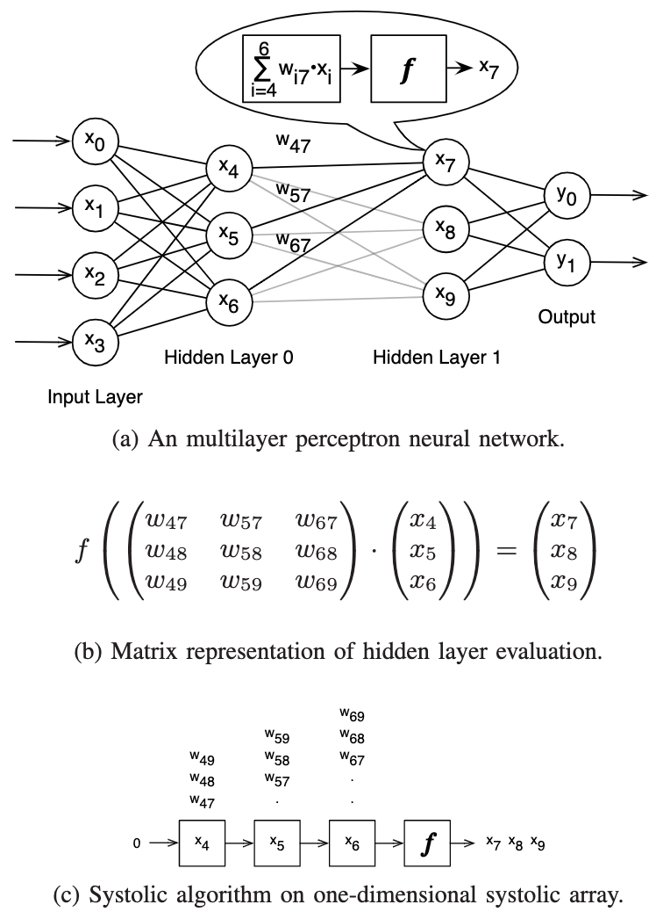
Multilayer Perceptron as Systolic Array
Each layer of weights can be represented as a matrix of weights
Weights from each input node are inputted one by one to the chain of Pes
The activation function is performed as the output comes out the end

Slide 6
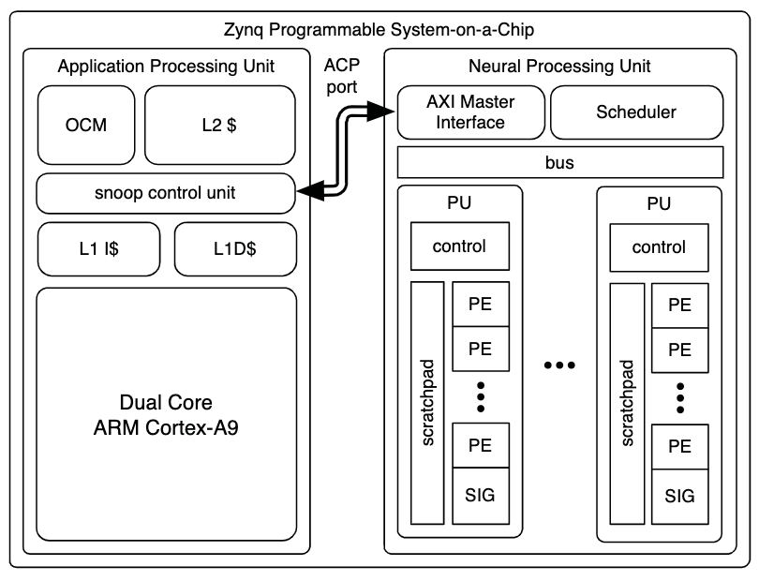
SNNAP: Systolic Neural Network Accelerator in Programmable logic
SNNAP uses the programmable logic to implement a neural accelerator
Defines an efficient interface between the CPU and neural accelerator
Permits scheduling of multiple neural network evaluations in order to eliminate pipeline stalls for data dependencies in the network

Slide 7
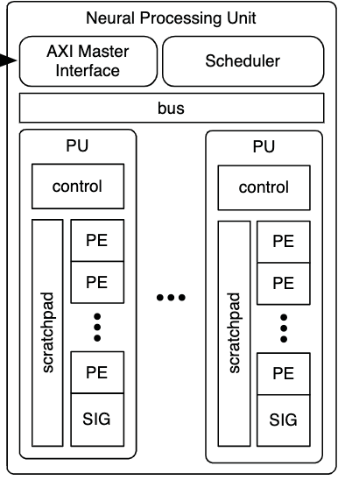
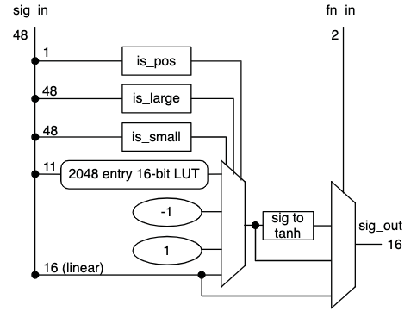
SNNAP Neural Accelerator
The Neural Processing Unit (NPU) for SNAP consists of an interface, a scheduler, and one or more processing units (PU).
Each PU consists of a controller, a scratchpad for IO and temporary storage, and a sigmoid unit
The PEs are used to evaluate each multiply accumulate operation
Finally, the sigmoid unit evaluates the activation function for each node

Slide 8
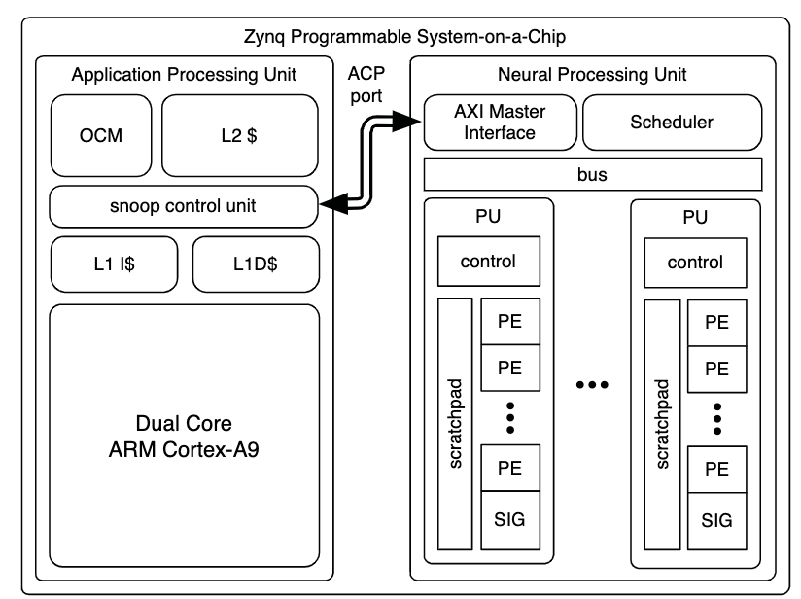
SNNAP Interface
Doesn’t use DMA
Snoop Control Unit
Provides access to cache memory
Allows programs to avoid flushing the cache every time the program is to be run
AXI for control signals

Slide 9
SNNAP Usage
SNNAP can be used with an approximation aware programming language and a compiler performing neural algorithmic transformation
This way the transformation is completely transparent to the developer
SNNAP can also be used with a low level C library that directly manages the NPU core

Slide 10
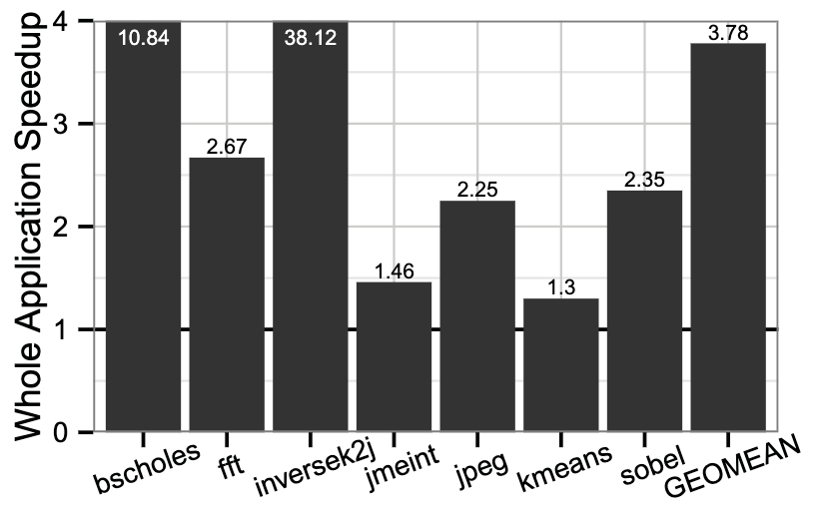
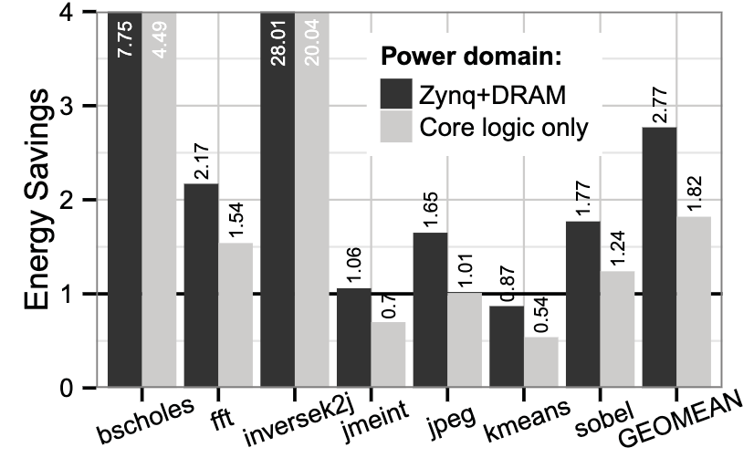
Evaluation of SNNAP
SNNAP generally results in faster execution time and reduced power consumption in most cases for the testing programs
SNNAP is configured in an 8x8 PUxPE setup at 167MHz, and the ARM CPU runs at 666MHz
Notes:
Amdahl Speedup is the theoretical speedup available from approximating the program
Inversek2j sees highest speedup of 38.12x because it is almost entirely offloaded to SNNAP
Kmeans sees the lowest speedup because only a small portion is offloaded to SNNAP
As for power, for small sections being offloaded, transferring the NN config and data takes up many CPU clock cycles and so the CPU sleeps less time, resulting in higher power use

Slide 11
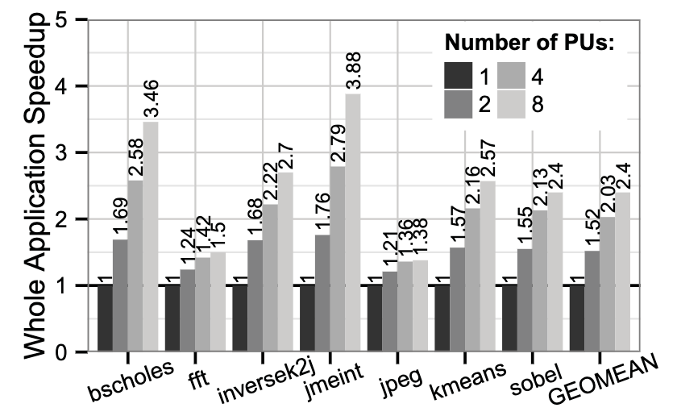
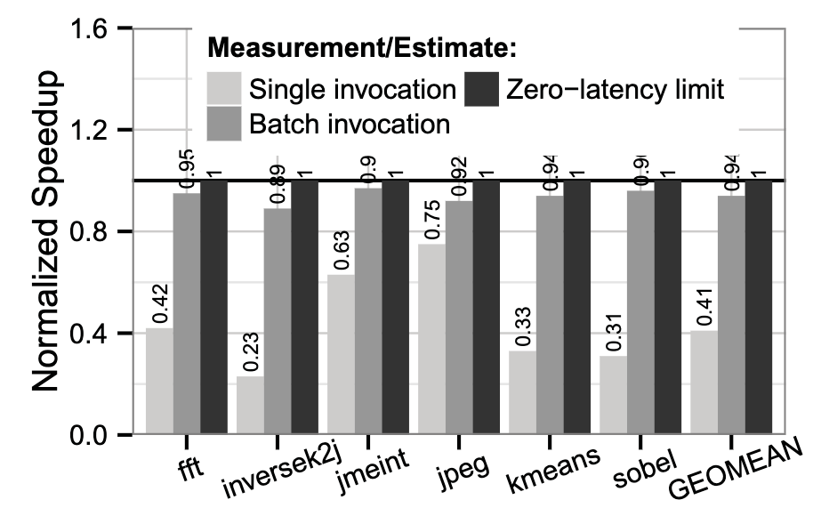
Characterization of SNNAP
SNNAP was also tested in a number of different configurations to determine the effects of growing the design
Batch invocations reduce necessary SNNAP configuration

Slide 12
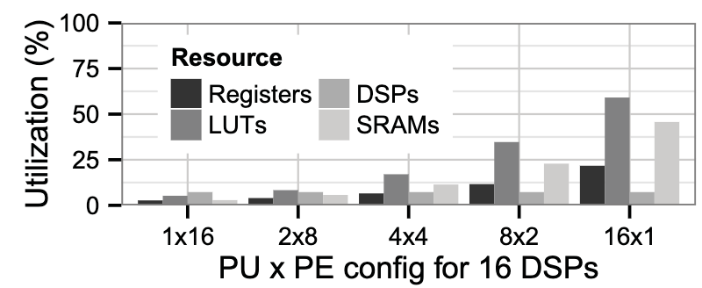
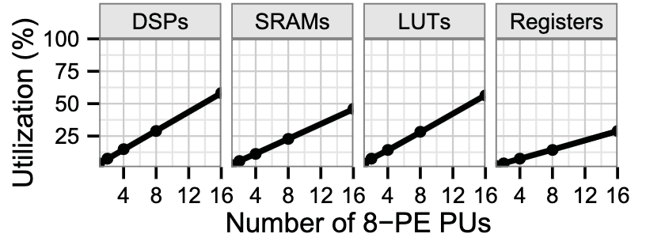
Resource Utilization of SNNAP
Takeaways: Each PU uses a significant quantity of LUTs and SRAMs
Adding PEs mostly uses more DSPs, since PEs are basically just multiply add units

Slide 13
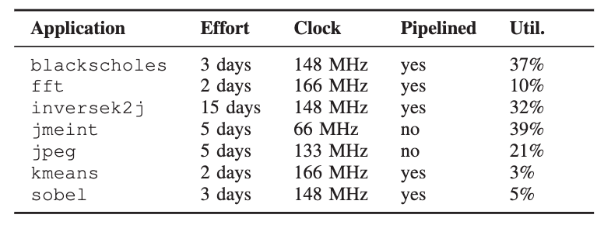
HLS Experiment
A Master’s student with some verilog experience spent 2 months familiarizing themselves with Xilinx HLS tools
They then implemented each of the programs with HLS

Slide 14
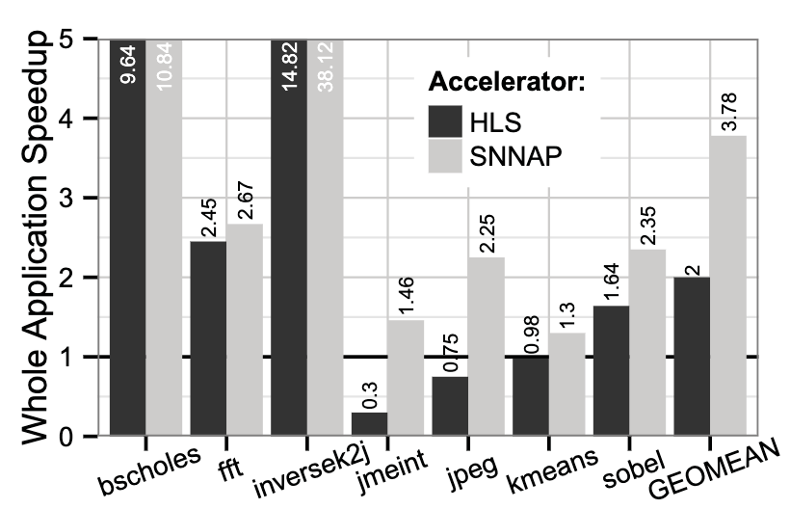
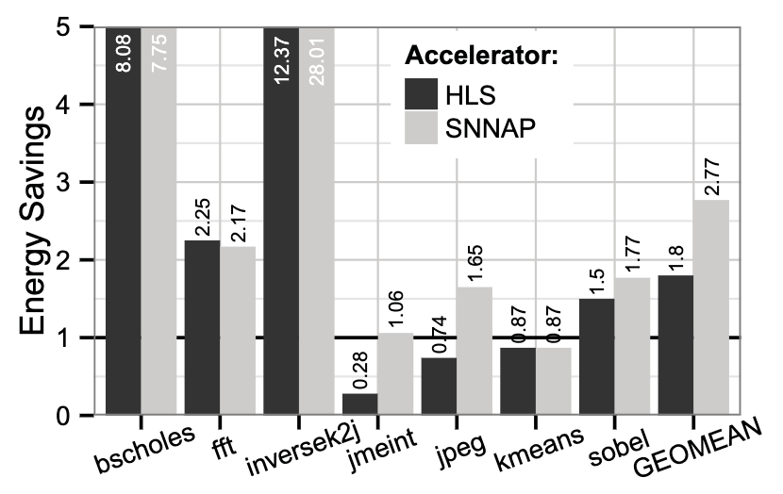
HLS Results
We can see that despite HLS taking much effort to configure to produce usable kernels, SNNAP often exceeds its performance

Slide 15
Questions?

Slide 16
Multiple Choice Questions
Which is not a difference between neural acceleration and HLS approaches to programmable logic uses?
Neural Acceleration is approximate, HLS is not
Neural Acceleration does not need to reprogram the FPGA, HLS does
Neural Acceleration does not require the designer to write HDL, HLS does
Neural Acceleration does not involve RTL, HLS does
In a Multilayer Perceptron, a hidden layer is
Code that is not executed
A layer of nodes that is not the input or output layer
A layer of nodes that is skipped in the network
Why can neural acceleration result in power savings?
The CPU can go to sleep while the NPU works
Neural networks are less computationally complex than other programs
The Zynq may not have measured the power correctly

