Slide 1
ApproxHadoop: Bringing Approximations to MapReduce Frameworks
Inigo Goiri, Ricardo Bianchini, Santosh Nagarakatte, Thu D. Nguyen
Presented by: Dunyea Grant, Bryce Herrera, and Natalie Franklin

Slide 2
Introduction
Overview
MapReduce is a popular model for large-scale applications
-Data analytics and compute-intensive applications on server clusters
ApproxHadoop is the framework for approximating MapReduce programs
-Evaluated on different domains including machine learning and video encoding
Evaluate statistical theories to compute error bounds
Notes:
The technique for approximating is built on the program MapReduce. MapReduce is a popular model for large scale applications such as data analytics and compute-intensive applications on server clusters. ApproxHadoop is the framework for approximating MapReduce programs. In the experiments they evaluate several domains including machine learning, video encoding, and scientific computing.

Slide 3
MapReduce and approximation mechanisms
Three mechanisms that are used as an approach to approximating MapReduce
-Input data sampling, task dropping, user-defined approximation
All three are applicable to a large range of MapReduce applications
Notes:
MapReduce works by performing a set of tasks called jobs. A job is made up of code given by the user that execute these map tasks. Three mechanisms are used to approximate MapReduce. Input data sampling where only a subset of the input data is processed. Task dropping where only a percentage of the tasks are executed. And also user defined approximation where the user gives a precise and approximate version of the task code.

Slide 4
Computing error bounds for approximations
Error bounds are computed with multi-stage sampling theory and extreme value theory
The approach for input data sampling and task dropping are the same
These error bounds allow the user to choose their tradeoffs between accuracy, energy consumption, and performance
Notes:
Error bounds are computed with multi-stage sampling and extreme value theory. This is used to consolidate the approaches to input data sampling and task dropping. The error bounds calculated allow flexibility between accuracy, energy consumption, and performance.

Slide 5
ApproxHadoop
Only input data sampling and task dropping are discussed because of space constraints
User specifies the desired error bounds at a particular confidence level
There is also an option to specify what percentage of tasks can be dropped or the data sampling ratio
Notes:
The user specifies the error bounds at a particular confidence level. Then while the job is executed ApproxHadoop uses the data obtained from the statistics mentioned earlier and decides a mix of input data sampling and task dropping to achieve the desired error bound.The user can also tell the program specific parameters for the approximation, for example 15% of the tasks in a job can be dropped or 20% of the data input can be sampled.

Slide 6
Background
MapReduce
A computing model designed for processing large data sets on server clusters
Defines two functions map() and reduce()
-map() takes one value pair and creates a set of intermediate value pairs
-reduce() computes final value pairs from intermediate pairs
Notes:
As stated before MapReduce is a computing model designed for processing large data sets on server clusters. Every MapReduce program defines two functions which are like two phases of execution. In the map phase the input data is split into a set of blocks in which the map function is used. In the reduce phase the framework gathers all the intermediate values from the first phase and puts them through reduce tasks to produce the output.

Slide 7
Hadoop
Hadoop is the implementation of MapReduce
-Hadoop Distributed File System(HDFS)
-Hadoop MapReduce framework
HDFS organizes files across several local disks of servers
Four processes that make up the framework
-NameNode, DataNode, JobTracker, and TaskTracker
Notes:
Hadoop is one of the more popular implementations of MapReduce. It has two main parts: Hadoop Distributed File System or HDFS and Hadoop MapReduce Framework. HDFS organizes files across several local disks of servers. There are four processes that make up the framework, NameNode, DataNode, JobTracker, and TaskTracker. NameNode keeps the location of each data block. DataNode provides access to each data block through the server. JobTracker manages job execution by communicating to the first process. It will then decide which server to execute the job on, usually the server with the data locally on it if there are slots available. TaskTracker starts the tasks assigned to it and monitors their execution time. That is a basic overview of how the whole system works. I’ll hand it off to Bryce to get more into the specifics of the error bounds.

Slide 8
Approximation with Error Bounds (MapReduce)
Multi-stage sampling was used to compute the error bounds for approximate MapReduce applications
This was tested against 4 math functions:
Sum
Count
Average
Ratio
Depending on the algorithm, it may be necessary to add additional sampling stages
Notes:
Before we look at any results of this method, we first have to understand how the authors tested this method of approximation, and their methodology of using MapReduce.
The authors determined their best method of approximation would be multi-stage sampling, and to test the sampling itself, they used 4 common math functions. These functions were used to rigorously estimate the error bounds for incoming input data.
The authors wanted to make this easy to understand, so for all of their examples in this paper, and the ones I will show you, the maximum stages for a sample will be 2. In reality, the authors mentioned that there could be many sampling stages.

Slide 9
Example of Sampling Calculations
Example of two-stage sampling
The inner term represents the first stage
The outer term represents the second stage
Using a random number of clusters, ‘n,’ and a random number of ‘m’ units from each chosen cluster ‘i’, we can estimate the sum of the sample.
Notes:
While the math in this paper is relatively difficult, this is the one part that is the most important. I promise, I tried to limit the math as much as possible to not bore you.
The math equation shown on this page is a two-stage sampling of approximate sum equation. The term v-i-j represents the individual unit inside of a cluster, and that term is summed with others in that selected cluster. And then all of the clusters are summed together afterwards. The approximation comes from the fact that we are not summing ALL of the units in the clusters, nor are we summing ALL of the clusters in the population. It’s pretty much just a samples of samples added together.

Slide 10
MapReduce with Two Stage Sampling
To use two stage sampling with MapReduce, the authors matched each value of the two stage sampling function to a respective component in MapReduce.
An approximate computation would be able to be performed by executing a smaller set of randomly chosen inputs as well as group assignments (‘Map tasks’ in the MapReduce lingo).
Using the two-stage sampling equations below, we would be able to break down the Reduce phase of MapReduce into mathematical processes.
Notes:
You may have noticed that I did not mention one term on the previous page - C. This is the error bound that is allowed to be added into the approximation, and it has its own complex equation that I don’t want to bore you with.
What I do want to mention is that because we are using MapReduce processes, the authors need to match the corresponding terms of the stages for each equation to the components of MapReduce. Instead of having “samples n” of “samples m,” we would not have map tasks of input blocks. This makes this process much simpler to think about in technical terms instead of mathematical terms.

Slide 11
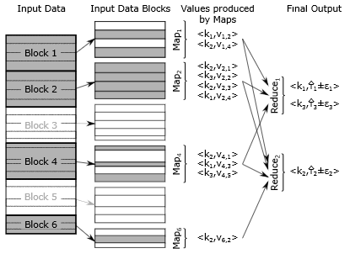
Overall Structure
Notes:
This page is really just to demonstrate what the two stage sampling is, if the previous slides didn’t explain it well enough. As we can see here, we have multiple input data blocks. Of those data blocks, onle 1,2,4, and 6 are chosen to be sampled. And of those input data blocks, only a few terms are chosen. Each term has a specific key corresponding to each block/unit of data they were as well, which is represented by the values produced by Maps. And finally, our result is shown on the right hand side, after the Reduce aspect of MapReduce comes in.

Slide 12
Potential Issues with Two-Stage Sampling
Input data could not have associated values for intermediate terms
Could be two separate issues:
Missing values could be 0
There is no longer a defined set for this value (the data items were filtered out)
Solution:
Only consider the first issue as a possibility, and consider these missing values as 0
Potentially create “Three-Stage Sampling”
Three-Stage Sampling creates an intermediate grouping to relate these data items to. Comes with its own issues if we miss the generation of intermediate keys.
Notes:
While the authors are using two stage sampling as a large example in this paper, it is not completely sound for approximations. The issues faced by the authors were twofold - some units do not have associated values for their intermediate keys, and there could be no defined values for that key (an example of this is that it was part of our map computation to filter out a data item that another item depended on).
The fix the authors proposes was to ignore the second case - this is because the second case can’t be accurately computed without the intermediate value, which also cannot be computed without the unit count for the total number of keys.
In addition, the authors did propose a “Three stage sample” in which they generated a midpoint between two values to satisfy the intermediate value and approximate further. Overall, this came with it’s own drawbacks, such as the possibility that we could miss a generation of an intermediate key, which would cause a spiraling error.
Long story short, authors just said it was easier to say if there is this issue, the missing value is just 0.

Slide 13
ApproxHadoop
ApproxHadoop provides a set of pre-defined functions that can be used by programmers, as well as pre-defined map templates and reduce functions via classes
These classes perform the approximate algorithm by:
Collecting the Data
Perform the reduction
Estimate the final values and confidence intervals
Output approximated results
Notes:
Some info about how the actual approximation works now: ApproxHadoop works by using pre-defined functions from Java classes, as well as pre-defined Reduce functions via classes as well.
Each of these classes implement the approximation in the same way, collect data, perform the reduction, estimate the final values and confidence intervals, and output the results. In addition to these, ApproxHadoop has its own pre-defined classes to perform approximations with dropping and sampling.

Slide 14
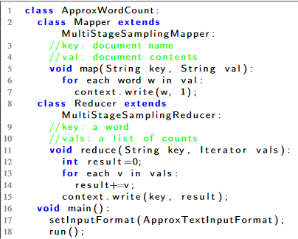
ApproxHadoop (cont)
User must specify either:
Percentage of Tasks that can be dropped
Target Error Bound
Example:
Notes:
To use ApproxHadoop, the user must specify either a % of tasks to be dropped, a target error bound, or both. Just to show what the program would look like, the authors provided an example which we can see on the right.
This example is used to approximate a word count MapReduce program using ApproxHadoop. We can see that many classes are used in this program, as previously mentioned.

Slide 15
Framework for ApproxHadoop
Input data sampling
Produces a random sample from a data block
Task Dropping
Execute tasks in a random order
Kill running maps that are taking too long without waiting for results
Error Estimation
Computes the data bounds across entire job
Incremental Reduce Tasks
Processes intermediate outputs at runtime to reduce tasks and process data
Notes:
This slide I included mostly for clarity sake. The information will be more clearly repeated on the following slide, but I wanted to explain it before I confused everyone.
So far we’ve talked about input data sampling, which produces a random sample from an input data block, but this program is most efficient altogether due to the following factors on this page, such as task dropping, error estimation, and incremental reduce tasks. *Describe the slide*

Slide 16
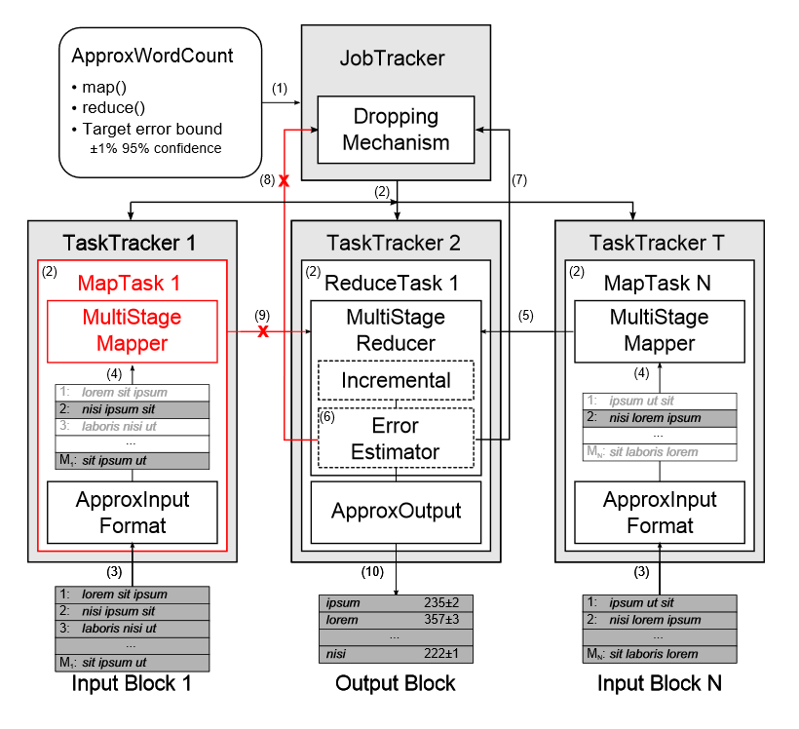
Framework for ApproxHadoop (example)
Notes:
possible approximate execution of a program called ApproxWordCount
Submits a job
JobTracker starts N map tasks and reduces tasks
Map Tasks sample their data blocks
5) Map task N finishes first and reports its statistics to the Reduce task
6) Task estimates error bounds
7) Jobtracker terminates other tasks
8) Kills map task 1, and will not complete its execution and Reduce outputs the results

Slide 17
User Specifications
The user specifies:
The ratio of dropped/sampled map tasks
The appropriate error bound
If they would like the program to run smaller numbers of samples in their first iteration
The Reducer:
Transforms the data into a maxima/minima for extreme values
Estimates the error bounds as each map completes
Notes:
This functionality is pretty easy to use too, and does not require much from the user. All this program really requires from the user is the ratio of dropped map tasks to sampled map tasks and the approximate error bound. If the user cares more about speed than accuracy, the user could configure the approximation to run the first iteration of the program (or first wave, as it is referred to in the paper) partially, instead of incorporating all values initially and then doing the approximation.
The approximation itself uses the Reducer to do everything else. The reducer transforms the data into maxima and minima for the extreme values, so it is able to guards itself against potential outliers. And the Reducer will also estimate the error bounds as each map individually completes.

Slide 18
Evaluation
Many different approximation applications with varying characteristics were used to evaluate the ApproxHadoop.
Three different evaluation methods we are looking at today
1.) Approximation mechanisms taking user input on dropping/sampling ratios
2.) ApproxHadoop’s ability to adjust its approximation to get user error bounds
3.) ApproxHadoop’s responsiveness to distribution of important values like job sizes and input data sizes
Notes:
Discuss the applications used and the different characteristic that are mentioned in the table S = sample input data, D = drop computation, U = user defined approximation

Slide 19
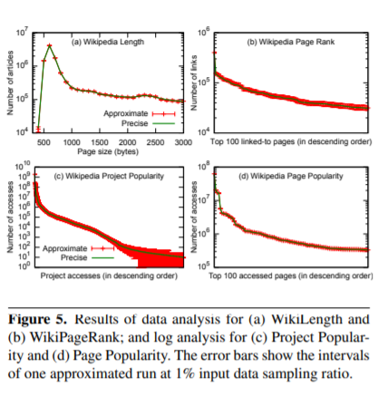
Results of user input of dropping/sampling ratios
Data analysis
WikiLength and WikiPageRank both focus on analyzing English Wikipedia articles
It is seen that dropping tasks reduces execution times more than input data sampling, but with wider confidence intervals.
Log processing
Data analysis done using MapReduce
Datacenter Placement
the application uses simulated annealing to find the lowest costing placement of a set of datacenters in a geographic area constrained by a maximum latency to clients
Notes:
WikiLength produces a histogram of lengths of the articles [45], with the Map phase producing a key-value pair and . WikiPageRank counts the number of articles that point to each article. The Map produces a pair for each link it finds to article a and Reduce phase sums the count for each key. Task dropping has a stronger impact on execution times because it eliminates all processing for each dropped block. In this case, each unit is an access log entry containing information like access date, access page, and request size. In the MapReduce program, each map executes an independent search through the solution space, outputting the minimum cost placement that it finds. The single reduce task outputs the overall minimum cost placement.

Slide 20
ApproxHadoop’s ability to adjust its user error bounds
We consider two applications, log processing and optimization, which use multi-stage sampling and extreme value theory for approximation.
Log Processing
DC Placement
Notes:
This section discusses ApproxHadoop’s ability to achieve a given target error bound by dynamically adjusting the dropping/sampling ratio
When you increase the error percentage ApproxHadoop can use input sampling ratios to reduce runtimes by more than 37%
DC Placement only uses task dropping and the errors introduced by dropping maps are relatively large, ApproxHadoop cannot improve execution time until the target bound is larger than 2%.

Slide 21
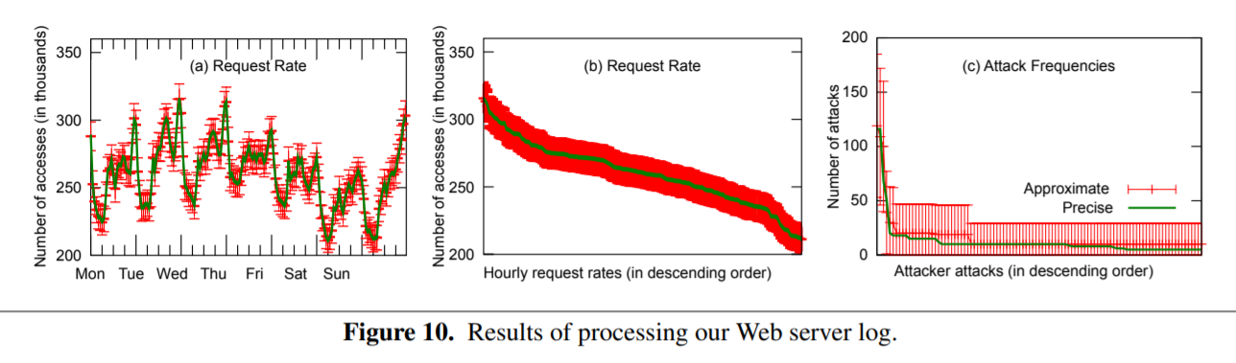
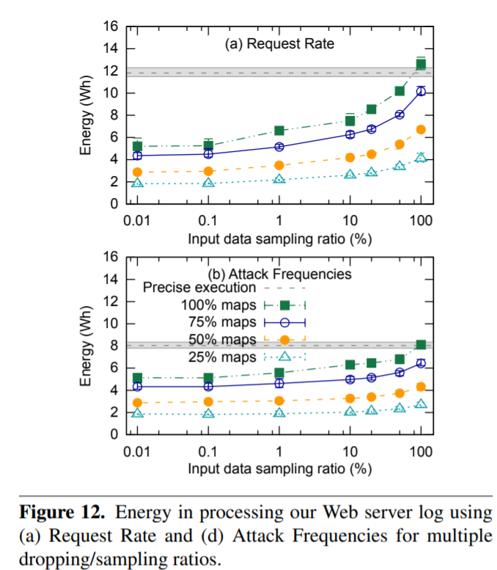
Impact of sensitivity to key values
An important factor when estimating errors is distribution of program outputs (key values).
This application emphasizes that approximation is most effective for estimating values computed from a large number of input data items, rather than those from only a few.
Reduces execution time by not increasing power consumption therefore saving energy.
Approximating results shortens runtimes significantly, especially for the larger input sizes.
Notes:
Those key values are found through two applications that analyze: (1) Request Rate: computes the average number of requests per time unit and (2) Attack Frequencies: computes the number of attacks on the Web server per client. Figure 10a shows the a precise and an approximate execution of Request Rate with an input data sampling ratio of 1%. We dont increase power bc certain dropping maps are not used.
Figure 12 is basically showing energy consumption from dropping maps and input data sampling decreasing the input data reduces energy consumption and execution time.
Last bullet point talks about data size and the imact on that

Slide 22
Related Works and Conclusion
Rinard previous works also studied task dropping but with the approach based off of known out outs and computation for estimating errors
Sampling dropping mechanism is even similar to loop/code peroration techniques
We saw similarities in other papers using the approximation mechanisms, the approximation in query processing and MapReduce and Hadoop
In conclusion these statistical theories presented can accurately and efficiently compute error bounds for MapReduce programs.
Notes:
These papers have not been discussed in our class yet it would be interesting to see how we can take the approach from these different papers and apply them to these techniques directly or apply in another method.
RINARD our favorite author is back again with the paper from Monday being cited in there. Main takeaway was that ApproxHadoop can significantly reduce execution time and/or energy consumption when tolerating a little bit of error, especially for MapReduce programms!

Slide 23
Questions??

