Slide 1
ACCEPT: A Programmer-Guided Compiler Framework for Practical Approximate Computing

Slide 2
What is ACCEPT?
Approximate C Compiler for Energy and Performance Trade-offs
ACCEPT is a framework for approximation that is built on top of the LLVM compiler for C/C++ code.

Slide 3
What is ACCEPT?
Allows programmers to designate what can be approximated.
Automatically determines the best approximation parameters.
Identifies where safe approximation can be performed.
Can utilize an FPGA for hardware acceleration.

Slide 4
How is ACCEPT used?
Programmers can mark data types as approximate or precise using keywords in code.
Suggestions output to the log identify approximations to the programmer.
Identifies regions of code that cannot be safely approximated in the log.

Slide 5
How is ACCEPT used?
Can be approximated:
loop at streamcluster.cpp:651
can perforate loop
Cannot be approximated:
loop at streamcluster.cpp:651
blockers: 1
* streamcluster.cpp:652: store to myhiz
650 double myhiz = 0;
651 for (long kk=k1; kk<k2; kk++) {
652 myhiz += dist(points->p[kk], points->p[0],
653 ptDimension) * points->p[kk].weight;
654 }

Slide 6
How is ACCEPT used?
Identified regions of code that are safe to approximate are tested with 3 approximation methods, and automatically generated configurations of those methods.
Candidate approximations are tested and measured against programmer provided inputs and tolerances.

Slide 7
ACCEPT’s Language
Information flow and endorsement:
ACCEPT prevents approximate data from interfering with precise data by default, by using the APPROX and ENDORSE keywords a programmer can explicitly override this behavior.
Implicit flow
ACCEPT prohibits approximate variables from being used in conditions (if, for, do, while, and switch). A programmer can override this with the ENDORSE keyword.
Escape hatches
A programmer can have manual control of ACCEPT using the ACCEPT_PERMIT and ACCEPT_FORBID keywords to force approximation on code, or to forbid approximation.

Slide 8
ACCEPT’s Language
The APPROX keyword is used to indicate that a variable can be approximated:
APPROX int a = expensiveCall();
The ENDORSE keyword is used to cast from an approximate type to a precise:
cheapChecksumPrecise(ENDORSE(a));

Slide 9
ACCEPT’s Approximation Methods
Loop Perforation
Skipping of loop iterations as per a perforation factor.
ACCEPT considers loop perforation given a loop is precise-pure and free of break statements.
Synchronization Elision
Bypassing locks (mutexes), semaphores, and barriers in parallel processes.
ACCEPT requires a thread’s code to be precise-pure.
Neural Acceleration
Approximating the behavior of a program using a neural network.
ACCEPT approximates identified regions of code to offload to an FPGA and automatically offloads executions of that code to the FPGA.

Slide 10
ACCEPT’s Safety Analysis
Precise-pure regions of code:
Contains no stores to precise variables that may be read outside the region.
Does not call any functions that are not precise pure.
Does not include an unbalanced synchronization statement (locking without unlocking or vice versa).
Proves that chunks of code are cleanly separable from the rest of the program

Slide 11
ACCEPT’s Autotuning Search
ACCEPT automatically searches for and uses the best configuration of an approximation.
Relies on programmer defined quality metrics to determine the best configuration.
The autotuning search does not enumerate all possible configurations, instead it vets each approximation and then determines a composites of vetted approximations.

Slide 12
ACCEPT’s Autotuning Search
During the search only the approximation being tested is used in the program.
If the error is above a threshold, the running time averaged over several executions is slower than the baseline, or the program crashes, the approximation is discarded.
If an approximation survives, the autotuner increases the aggressiveness of the approximation.

Slide 13
ACCEPT’s Autotuning Search
After determining an approximation for each area of approximated code, the autotuner then determines combinations of those approximations to produce the program.
ACCEPT assumes that error from each approximation added is linear.
ACCEPT tests and selects the fastest configuration up to a specified error ceiling.

Slide 14
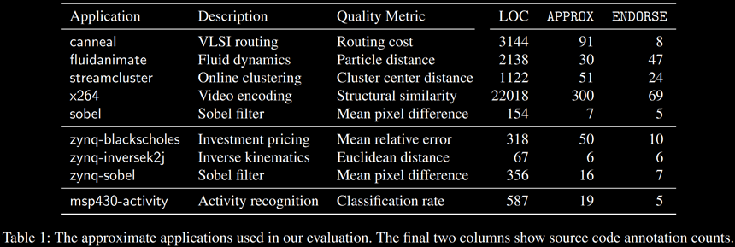
Evaluation
ACCEPT was tested on three platforms: x86, ARM with integrated FPGA, and an embedded system (MSP430).

Slide 15
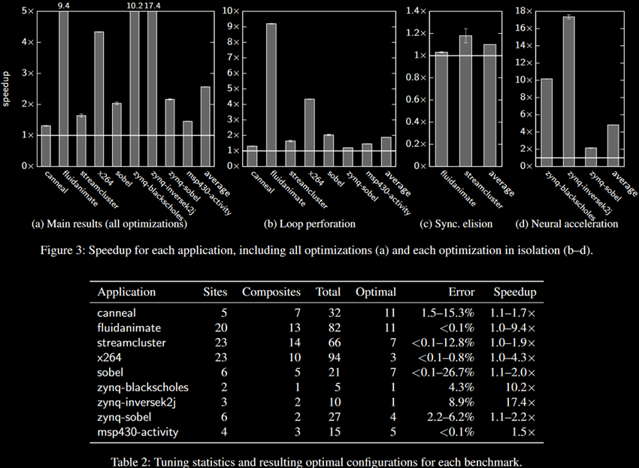
Results

