Slide 1
Understanding Register Retiming: The key to Intel’s HyperFlex Architecture
Presenter: Madison N. Emas
November 22, 2019

Slide 2
Intel’s 2019 FPGA Announcements: New Devices

Slide 3
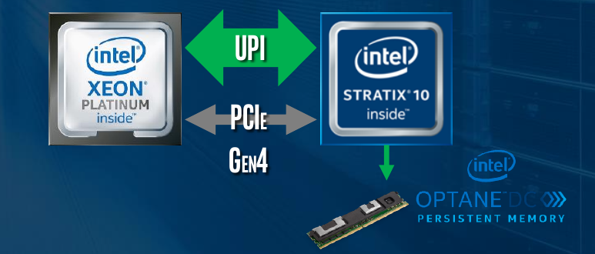
Intel’s 2019 FPGAs
Intel Stratix 10 DX FPGA (announced in September)
  Supports Ultra Path Interconnect (UPI)
    Intel’s proprietary point-to-point
    cache-coherent interconnect
    Intended to allow FPGA to connect with
    Intel Xeon processors with lower latency
  Supports PCIe Gen 4
  New Memory controller
    Supports director connections to
    select Optane DC persistent memory
  Includes Intel’s HyperFlex FPGA Architecture

Slide 4
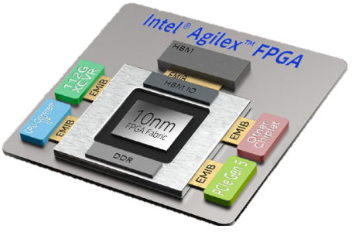
Intel’s 2019 FPGAs
Intel Agilex FPGA (introduced early April)
  Supports new Computer Express Link (CXL) interconnect
    Cache and memory coherent interconnect to Intel Xeon processor
    Claims will provide low latency and performance gains for memory intensive applications
  Support for Intel Octane DC persistent memory
  Includes Intel’s HyperFlex FPGA Architecture
    2nd generation Hyperflex Architecture
    Claims up to 40% faster performance
    Claims up to 40% lower total power

Slide 5
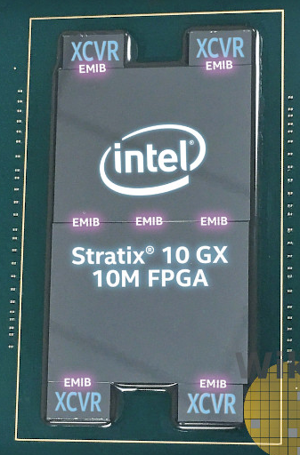
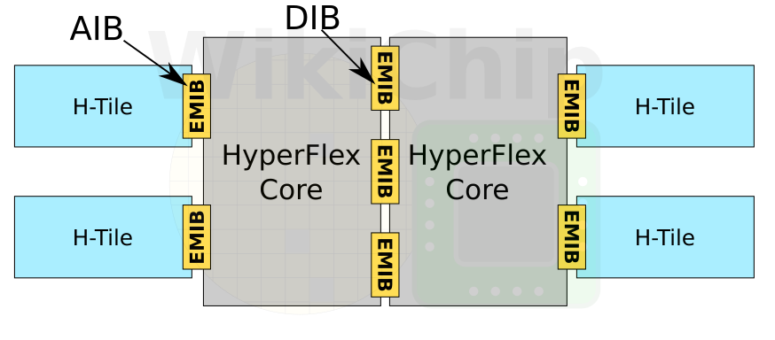
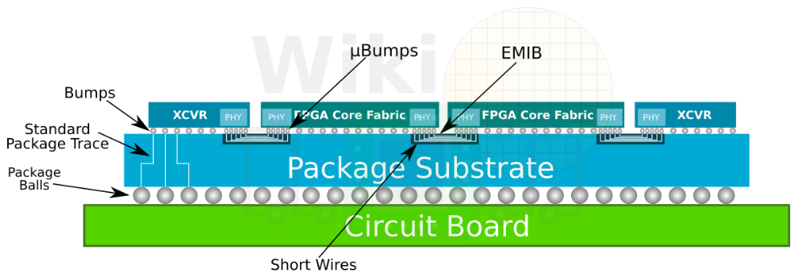
Intel’s 2019 FPGAs
Intel Stratix 10 GX 10M FPGA (introduced early November)
  2 FPGA fabric dies interconnected using three
  embedded bridges
    Uses new DIB interconnect (more information promised in
    later announcements)
    25,920 parallel connections between
    two dies
  Largest Intel FPGA
    10.2 million logic elements
    43.3 Billion Transistors
  Includes Intel’s HyperFlex FPGA Architecture

Slide 6
Retiming in Traditional FPGAs

Slide 7
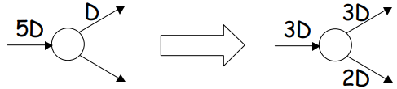
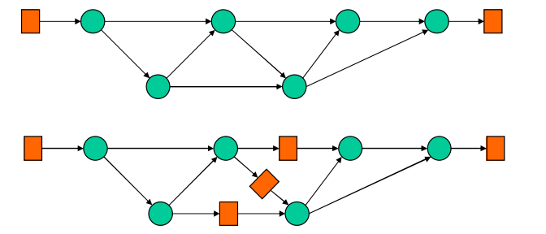


Retiming Definition
Moving around existing delays
  Example shows basic Node Retiming
Pipelining is equivalent to
introducing many delays at input followed by retiming
Logic
Register

Slide 8
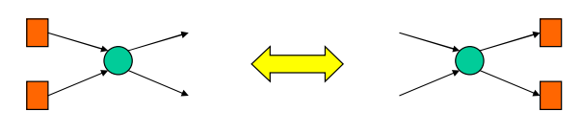
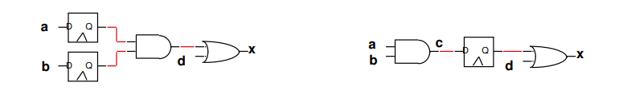
Register Retiming
2 ways to retiming registers
  Remove one register from each input and add one to each output
  Remove one register from each output and add one to each input
  Note takes same amount of cycles from input to output
Logic
Register
Notes:
Conceptually, in order to achieve balanced path delays, you could try to shuffle around the logic and routing so that an equal amount exists between registers. Or you could approach it backwards and leave the logic and routing in place and just move the registers around to achieve balanced delays, which is what the Hyper-Retimer does.

Slide 9
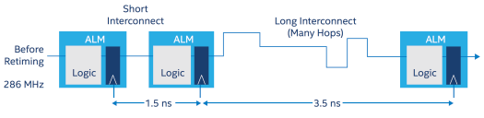
Fmax limit
Critical Path: The path in the design with the maximum delay
  Fmax is limited by the traversal time of critical path
Optimal Fmax achieved when all path delays are equal
???
???

Slide 10
Critical Path
Circuit Example:
  Total Path has total delay of 5 ns
  Critical Path has long interconnect path with delay of 3.5 ns
    Fmax limit = 286 MHz

Slide 11
Balance Paths with Retiming
2 ways to balance path delays to try to minimize or eliminate critical paths
  Shuffle around the logic and routing so that an equal amount exists between registers
    Logic can be manipulated using logic techniques like Shannon’s decomposision
  Or you could approach it backwards
    Leave the logic and routing in place and just move the registers around
      Intel retimes after place and route for HyperFlex Architectures
      Intel preforms some retiming before place and route and most after fully performing place and route

Slide 12
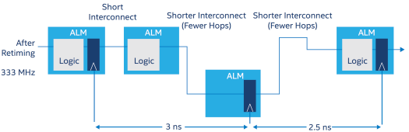
Retime
Traditional retimer reroutes interconnect path through unused ALMs
Circuit Example:
  New Critical Path has
  delay of 3 ns
    Fmax limit = 333 MHz
  Total Path Delay has
  total delay of 5.5 ns
    Increase of .5 ns

Slide 13
Retiming limitations
There exists a delay cost of routing in and out of ALM
  Can limit retiming
    Delay cost could be more than
    possible benefits
Needs to use more
ALMs to achieve better
timing
  Need more unused ALMs
  for retiming
Compile time to retime
high
~ 300 ps
~ 200 ps

Slide 14



Pipeling
Traditional Pipelining can improve timing
  Critical Path still has
  delay of 2.5 ns
    Fmax limit = 400 MHz
  Total Path Delay has
  total delay of 5.5 ns
    Increase of .5ns from
    original path
  Requires additional ALM
  Requires additional cycle

Slide 15
Retiming in FPGA’s with HyperFlex Architecture

Slide 16
HyperFlex Architecture
HyperFlex Architecture = Registers Everywhere
  Registers in routing paths
  allow for
    Easier elimination of critical paths
    through retiming
    Free registers for pipelining
      ALMs will only be used for logic
      functions
  Intel claims max clock
  frequency of 1 GHz for
  Stratix 10

Slide 17
Hyper Registers
Routing path and Inputs to LUTs, FFs, DSPs, etc has bypassible registers that can be easily utilized
Registers have only clock and data signals
  No Async/Sync resets
  No clock enables

Slide 18
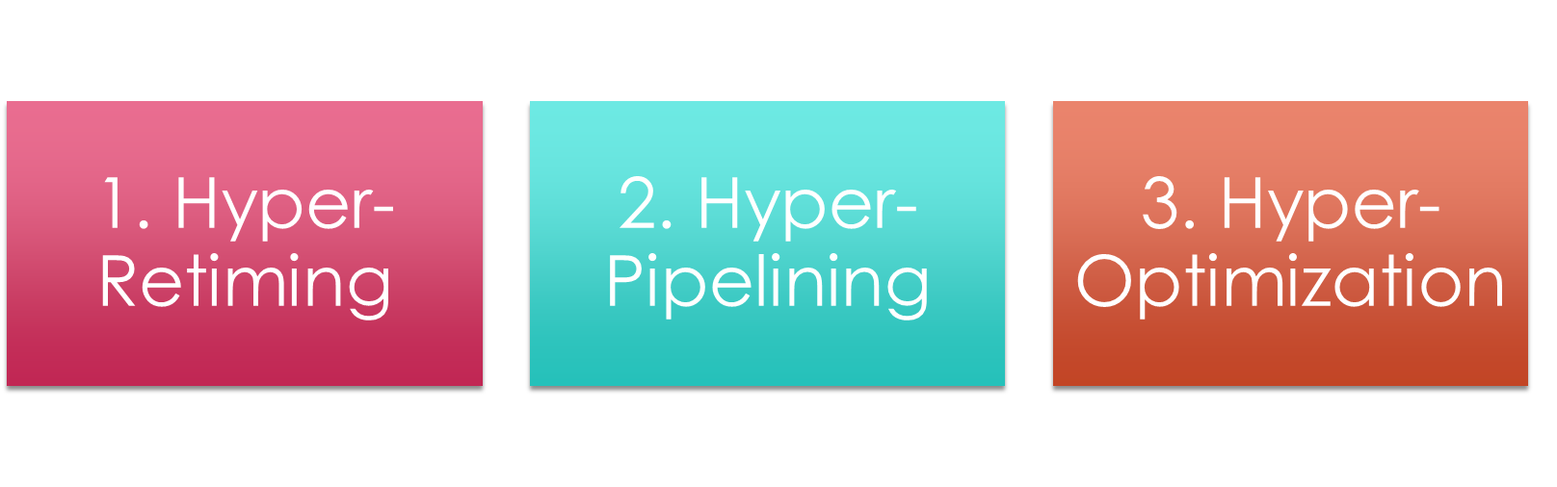
3 Hyper Techniques to approve retiming

Slide 19

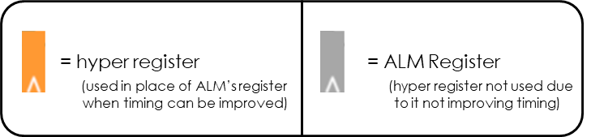
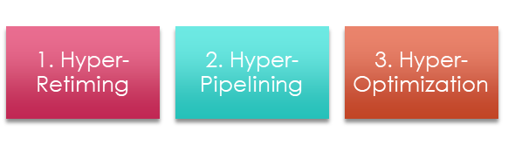
Hyper Retiming
Circuit Example:
  Total Path still has total
  delay of 5 ns
    Previous retiming and pipelining
    had total delay of 5.5 ns
  Critical Path has delay
  of 2.5 ns
    Fmax limit = 400 MHz
  No additional ALMs needed
  Compile time faster due to retiming
  occurring after place and route fully
  finalized

Slide 20


Hyper Pipelining
Circuit Example:
  Total Path still has total
  delay of 5ns
    Previous retiming and pipelining
    had total delay of 5.5 ns
  Critical Path has delay
  of 1.75 ns
    Fmax limit = 572 MHz
  No additional ALMs needed
  Requires additional cycle
  Compile time faster due to retiming
  occurring after place and route finalized

Slide 21
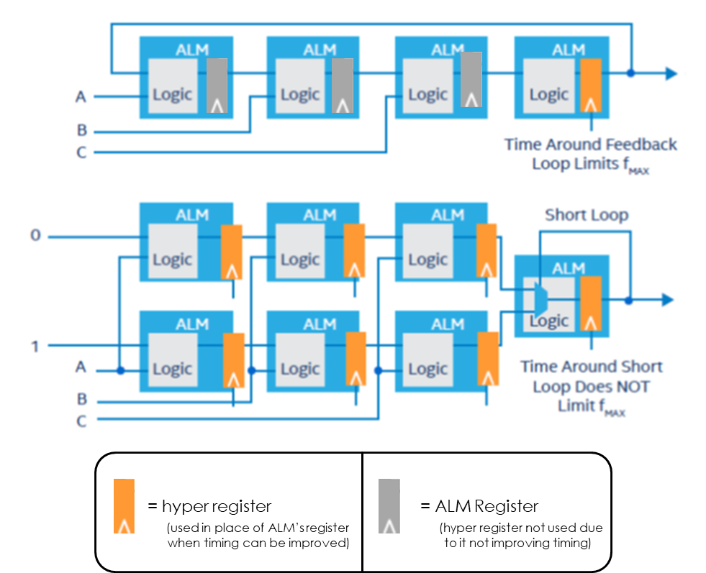
Hyper Optimization
Bottlenecks remain after hyper-retiming and hyper-pipelining
  Optimizations can be made to
  improve timing and utilize more
  hyper registers
    Remove Async resets/clock enables/pipeline stalls
    Remove RTL loops
    Pipeline control signals when possible

Slide 22
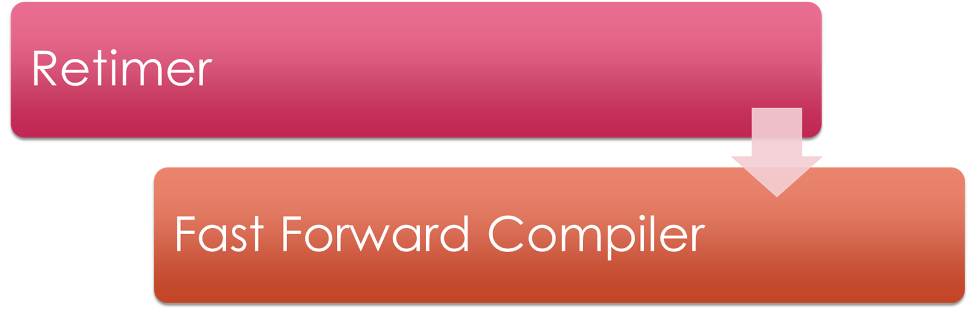
New Tools for Hyper Technique implementation

Slide 23
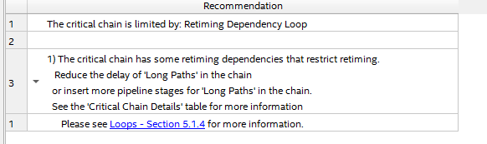
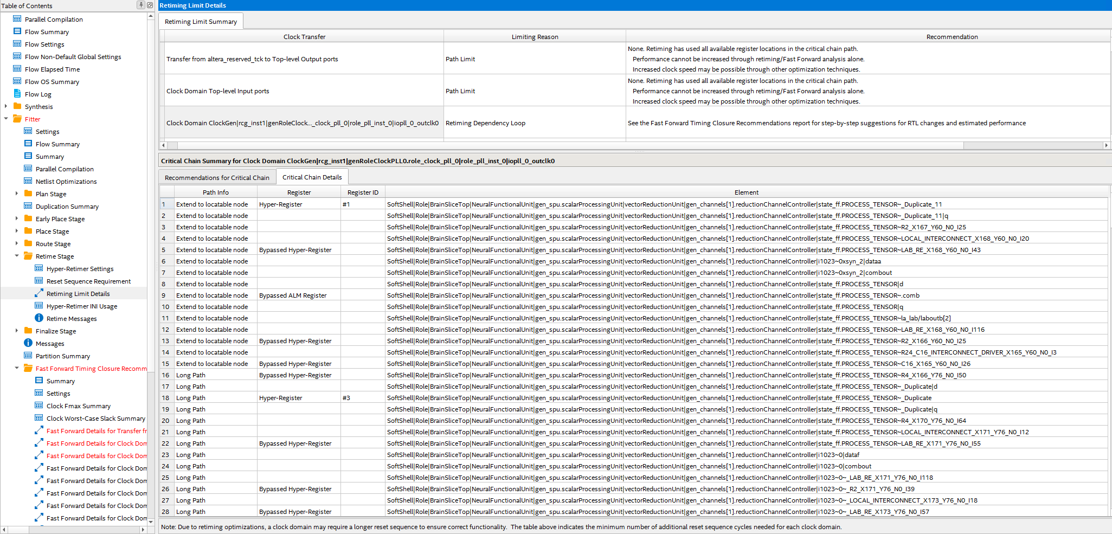
Hyper Technique Tools
Hyper Retiming and Fast Forward Compile
  Retimer applies hyper retiming
    Retimer report outputs current bottleneck that prevents further retiming
  Fast Forward reveals series of steps to take (such as removing async resets or removing user restrictions)

Slide 24
Hyper Technique Tools
Hyper Retiming and Fast Forward Compile
  Fast Forward reveals series of steps to take
    Hyper Retiming – reveals current
    restrictions preventing retiming such
    as using async reset or user restriction
    attribute
    Hyper Pipelining – reveals where adding
    pipelining states can improve timing
    Hyper Optimization – reveals logic
    bottleneck that prevents further hyper
    retiming

Slide 25
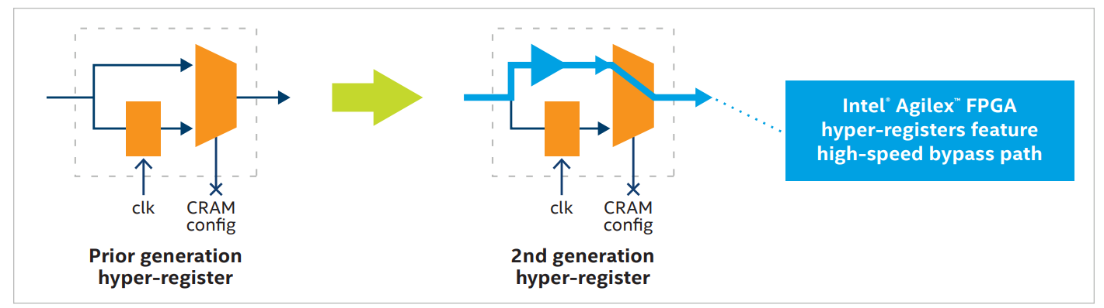
2nd generation HyperFlex Architecture
Coming in Intel Agilex FPGA as early as 2021
  Claims up to 40% faster performance
  Claims up to 40% lower total power
Includes high-speed bypass to Hyper-Registers
  Performance Improvements for both Intel HyperFlex Architecture optimized designs
  and designs
  not optimized
  for Intel
  HyperFlex
  Architecture

Slide 26
Tips for HyperArchitecture Designs
Limit Async Resets and Clock Enables in design
  Prevents mapping onto Hyper-Registers
Run multiple seeds to identify top critical chains
  Different random seeds can result in different critical chains
Retimer does NOT optimize the second-place critical chain
  No point in retiming if no more Fmax gain
  Likely that multiple paths that are almost as critical as ultimiate critical path
    Focus retiming on paths identified by retimer/fast forward compiler instead of looking at TimeQuests top failing paths

Slide 27
Sources
White Papers
  Using Intel Quartus Prime Software to Maximize Performance in the Intel HyperFlex FPGA Architecture
  Understanding How the New Intel HyperFlex FPGA Architecture Enables Next Generation High-Performance Systems
  Intel Agilex FPGAs Deliver a Game-Changing Combination of Flexibility and Agility for the Data-Centric World
News articles
  Intel Introduces World’s Largest FPGA With 43.3 Billion Transistors
  Intel Launches Stratix 10 GX 10M; 10M LEs, Two Massive Interconnected Dies
  Intel Stratix 10 DX Adds PCIe Gen 4.0, Cache Coherency: UPI As Stopgap
  Intel Stratix 10 DX Introduces PCIe 4.0, Cache-Coherency via UPI

Slide 28
Sources
Intel Documentation
  Intel Stratix 10 High Performance Design Handbook
  Intel Quartus Prime Pro Edition User Guide – Design Compilation
  Intel Quartus Prime Pro Edition User Guide – Design Recommendations
  Intel Quartus Prime Pro Edition User Guide – Design Optimizations
Books
  Synthesis and Optimization of Digital Circuits
Additional Sources for Images
  PowerPoint presentation from TAU 2016
  Chapter 4: Retiming

Slide 29
Understanding Register Retiming: The key to Intel’s HyperFlex Architecture
Presenter: Madison N. Emas
November 22, 2019

